Slide 1
The Lighting Workshop

Slide 2
Light/colour setting
Hue
The shade of colour
Saturation
The intensity of colour
Luminance
The brightness of colour

Slide 3
What is kelvin?
Kelvin is the unit of measurement,used to describe the colour temperature of a specific light source.

Slide 4
The sound Workshop

Slide 5
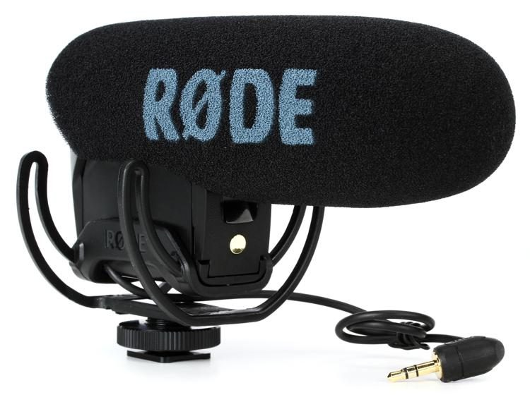
Video mic (5)
Shotgun Mic
Directional recording from a camera

Slide 6
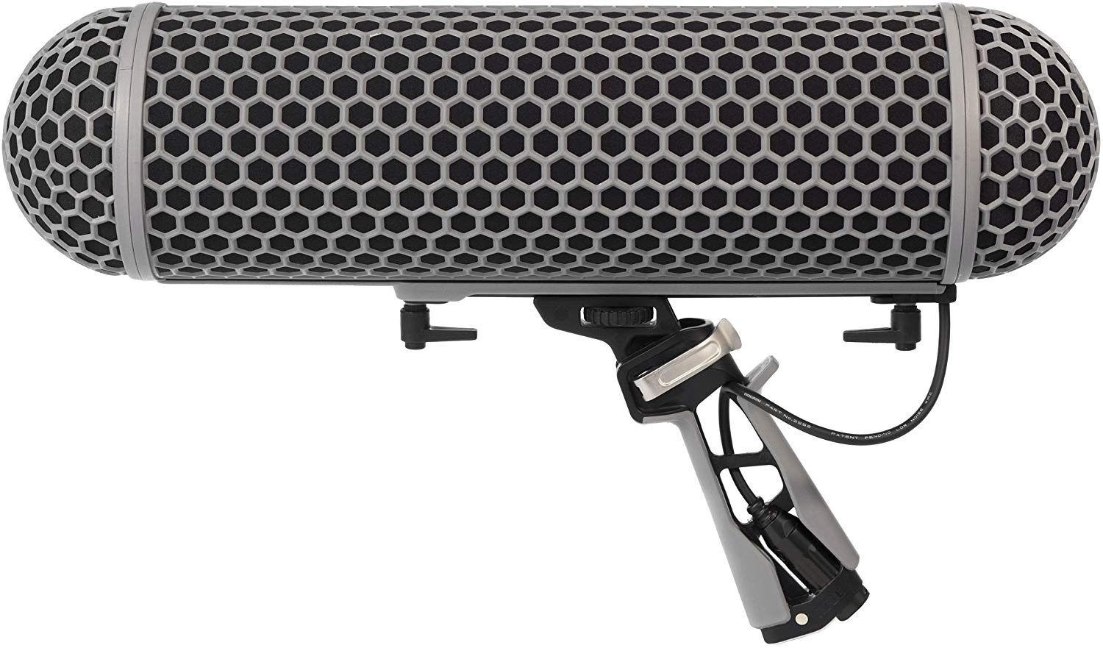
Blimp (1)
Shotgun Mic
Directional recording from a distance

Slide 7
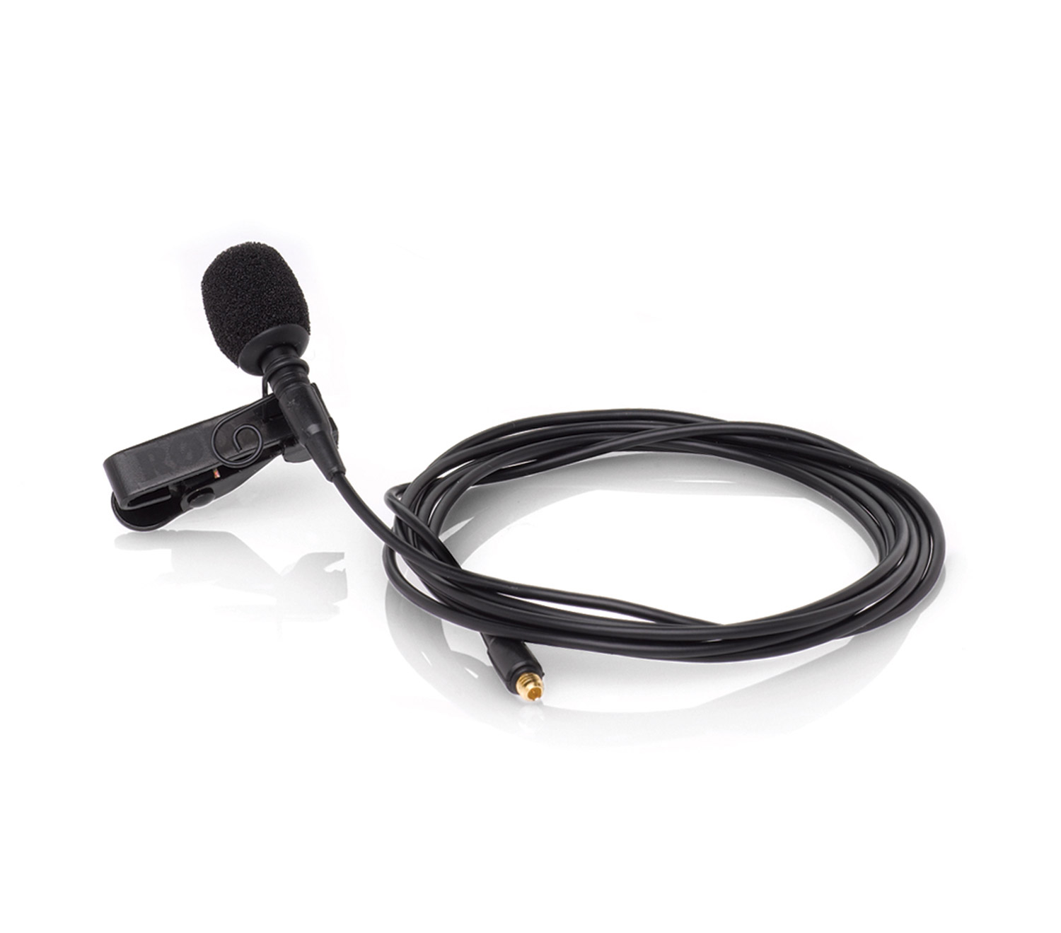
Lapel (4)
Rode Lapel
Discreetly records one dialogue track

Slide 8
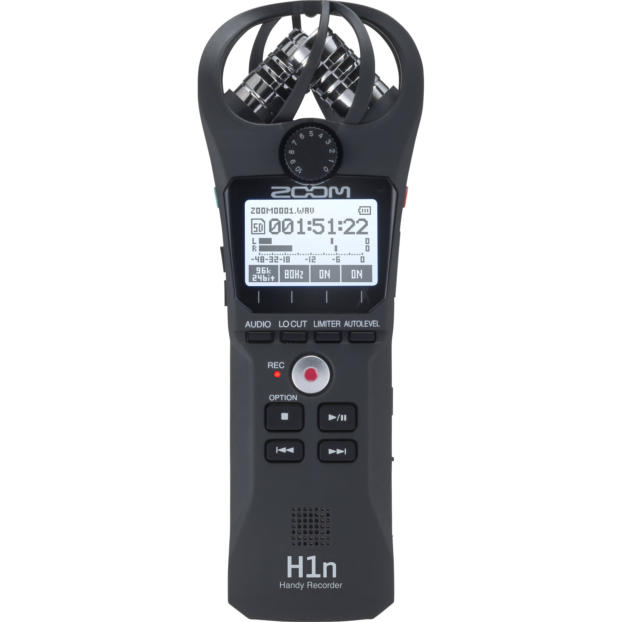
Zoom/audio recorder (6)
Zoom H1n
Records audio directly or through a connectable mic

