Slide 2
The Diving Bell and The Butterfly (Schnabel. 2007 France)
FILM FORM

Slide 3
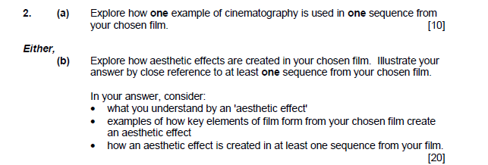
Aims
To have three key scenes you can draw on for the exam with detailed film form and building on previous representation analysis.
WHY?

Slide 4
Scene analysis must cover:

Slide 5
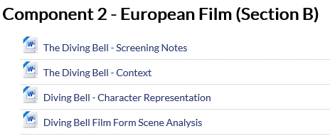
Scene Analysis :
Download from GoL or Dropbox
Download the scene analysis sheet
Choose at least 3 scenes, I would recommend:
The Fantasy Scene
Fathers Day
Opening Scene
The scenes are all chaptered on estream
I have written prompts to help in this PowerPoint
Please use the downloaded sheet and write up full, detailed responses to all questions and include scene grabs
Label the word document with your name and film form
Upload this to the right folder in dropbox

Slide 6
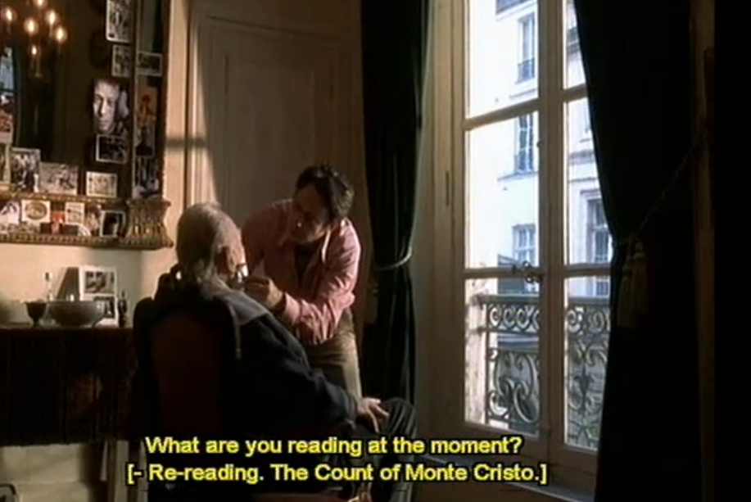
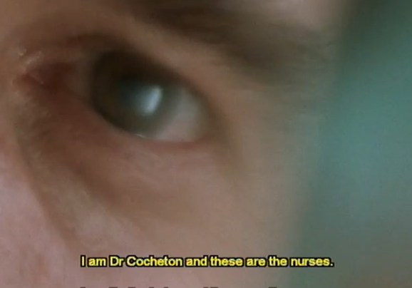
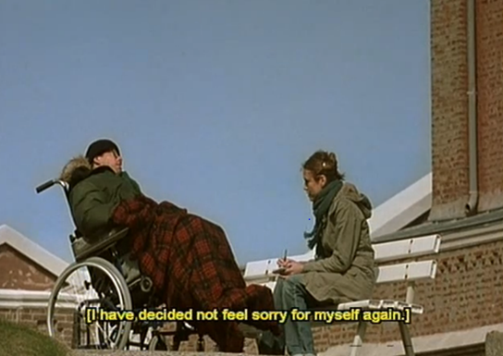
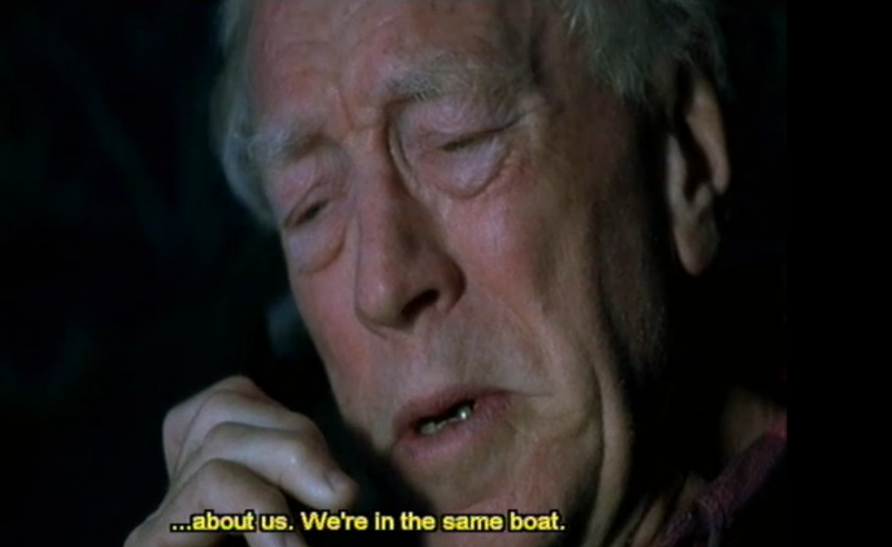
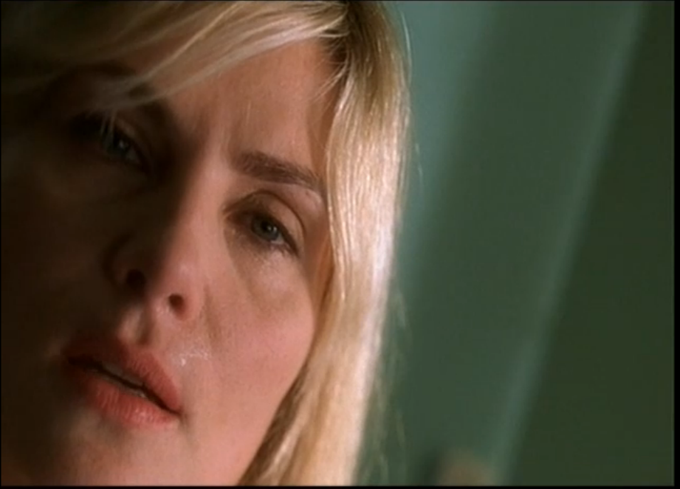
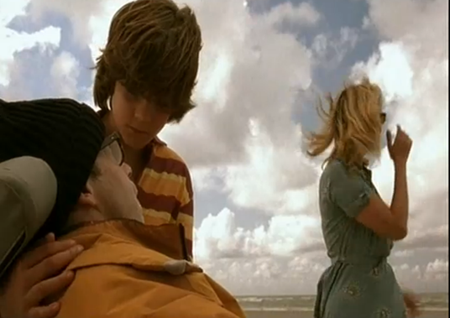
Scenes you may wish to choose from…
The Shave
Opening Sequence
The Fantasy
Father and Son
Celine and Innes
Father’s Day

Slide 7
1: The Fantasy Scene .
Film Form: What do the following areas suggest about Jean-Do, who he is and his state of mind?
Cinematography: The use of long and extreme long shots as we see Jean-Do and his nurse. The use of extreme close up of the butterfly and later wide epic action shots.
Mise-en-scene: Jean-Do’s stillness in the wheelchair compared with later montage shots, the locations of the montage and the lifestyle they express, use of different images and meaning within.
Editing: Discussion of his eye, imagination and memory being the only things not paralysed - edited along with a superimposed montage. Choice of images, pace of editing and accompanying sound choice. How does the final cut differ from the smooth montage . . .
Sound: Use of dialogue and tone of voice to add to the mood and narrative, use of music and rhythm and how it works alongside the images.
Representation: Of Jean-Do, his lifestyle choices, his state of mind, the people around him, his life now.

Slide 8
2: Father’s Day .
Film Form: What do the following areas suggest about Jean-Do, who he is and his state of mind?
Cinematography: The use of long and extreme long shots as we see the windy beach setting. The use of extreme close up reaction shots of the children. Fluid camera movement with a variety of angles. POV shots and lens flares. Panning across the isolate beach and static shot of Jean-Do out at sea.
Mise-en-scene: Jean-Do’s stillness in the wheelchair compared with the freedom of movement of the children. Actors performance and facial expressions. Windy beach location and platform out at sea. Costume – Jean-Do compared to his family members.
Editing: Pace of cuts along side wide flowing shots and POV shots. Editing pace tied into sound choices. Visuals interrupted by lens flares of blurred images.
Sound: Use of dialogue and tone of voice to add to the mood and explain Jean-Do’s emotional state, use of music and rhythm and how it works alongside the different camera movement.
Representation: Of Jean-Do, his lifestyle choices, his state of mind, the people around him, his life now. What can we say about his relationship with his family?
In response to this scene you may want to briefly mention the previous scene The Shave as they are so closely linked in the theme of fatherhood.

Slide 9
3: Opening Sequence .
Film Form: What do the following areas suggest about Jean-Do, who he is and his state of mind?
Cinematography: The POV shots coming in and out of focus. Extreme close ups. Cut away shots to roses and window. Change in depth of field and comments on composition. Emotional impact on the audience.
Mise-en-scene: Setting of the hospital and the generic conventions of costume and props setting the location. Use of blue green and cuts to black. Props – flowers, photos and art on the walls. Performance and heightened breathing.
Editing: Mostly on camera effect, but these can still be discussed. Cuts to flash back memories and to Ines. Use of black and extreme bright sunlight. Disorientating cuts from person to person.
Sound: Use of dialogue and tone of voice to add to the mood and explain Jean-Do’s emotional state, images of son crying (flashback) without diegetic sound, heightened sound of breathing, at times muffled dialogue.
Representation: Of Jean-Do, his lifestyle choices, his state of mind, the people around him, his life now. What can we say about his relationship with his family?

Slide 10
AS Exam Question
Explore how one example of cinematography is used in one sequence from your chosen film. [10]
Explore how mise-en-scène in your chosen film can be interpreted in different ways. Illustrate your answer by close reference to at least one sequence from your chosen film. In your answer, consider:
What you understand by mise-en-scène
Examples of how mise-en-scène can be interpreted in different ways
How at least one sequence from your film demonstrates the different ways mise-en-scène can be interpreted. [20]

