Slide 1
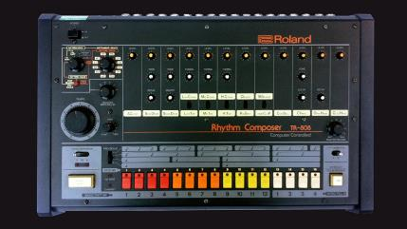
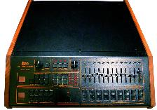
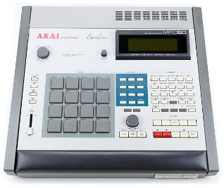
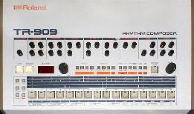
What is a drum machine?
An electronic device that allows the user to playback and sequence drum sounds

Slide 2
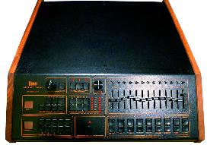
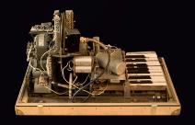
Development of drum machines
1931 -Rhythmicon
Invented by Leo Theremin was the first machine that could be called a drum machine but was limited in its capacity and preset patterns.
Name another Leo invention.
1979 – Linn LM-1.
The first digital drum machine which used drum samples from live drums. The samples were short in length which meant that they didn’t take up much memory which helped keep the cost down of producing these units, as memory at the time was very expensive. The Linn LM-1 produced realistic drum sounds (featured on Prince’s ‘When Doves Cry’ and many other 80s pop songs)
https://www.youtube.com/watch?v=i0sWBa8wKKk

Slide 3
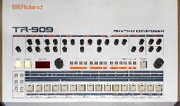
1980 – Roland TR-808
Popular in the hip-hop scene and is still in huge demand today. Uses analogue synthesis so lacked the realism of competing digital units of the time (featured on Marvin Gaye’s ‘Sexual Healing’, The Beastie Boys ‘Licensed to ill’ , ABC’s ”The Look of Love’)
https://www.youtube.com/watch?v=yJiJSGsJH4U
1984 – Roland TR-909.
Successor to the TR-808, uses analogue synthesis combines with digital cymbals to produce its drum sounds
https://www.youtube.com/watch?v=ydCDro4YerY

Slide 4
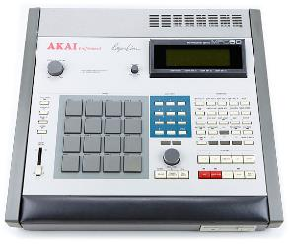
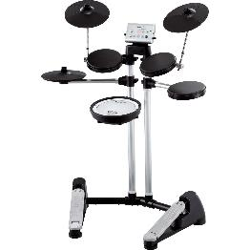
1988 – Akai MPC60
A collaboration with Roger Linn which saw in a successful era of the ever popular series of drum machines (MPC series). The MPC60 was a fully programmable digital drum machine that included pads to help with programming. This series is popular with electronic artists and hip hop producers
https://www.youtube.com/watch?v=fC1BQNz0Aj8
Akai today… https://www.youtube.com/watch?v=AHdouFZ6FCs
Early 1990s – Roland V-Drums.
Pioneered the electric drum kits using midi to triggers drum and percussion samples.
https://www.youtube.com/watch?v=cC3u2WVnGtM

Slide 5
Aims and objectives
STARTER
Today’s lesson
Get out your C2 composition planning document And listening
Collect your written work on my desk
The picture is a device that has been used on many Pop music records of 80s. Explain the functionality of this device.
Review the sampling requirements for C2
Understand the assessment grid
Explore sampling techniques
Build a sample instrument using the EXS24
Assign pitch mapping and tuning zones

Slide 6
What is a sampler?
A sampler plays back audio files, called samples
The samples are combined into tuned, organised collections called sample instruments
Samplers have similar parameters to synthesizers, however, the sound generator plays back audio files( not an oscillator), which makes it suitable for emulating real instruments such as strings(violins, cellos etc), piano, drums etc.
There are hardware and software versions of samplers e.g AKAI MPC range are popular hardware samplers and NI Kontakt is a third party software sampler used in DAW
A sampler is limited by the amount of storage( hard drive space)a device has. Early models of hardware( and software) samplers relied on RAM. However, new tech can access content directly from the HD
There are companies that just manufacture sample libraries to load in a dedicated sampler e.g EastWest Hollywood Orchestra 680GB of samples
Hardware
Software

Slide 7
Component 2
Identify 3 ways to manipulate audio in Logic Pro X without using a sampler
Non-destructive editing
Using audio editing tools
-Cut
-Delete
-Move
-Fade in/out(Speed up/Slow down
Destructive editing
-Reverse
-Normalise
-Gain
-Time Stretch/Pitch Shift
Flex
-Flex Pitch
-Flex Time

Slide 8
Introducing logic’s sampler exs24 mkii

Slide 9
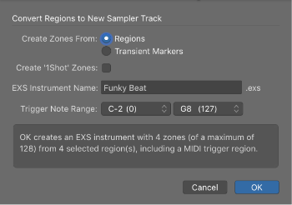
Creating a sample instrument
Control Click( or right click) on the audio region/s you want to add to your sampler
Select Convert Regions to New Sampler Track
2 choices- Regions or Transient Markers( Region will assign the entire region to 1 note trigger. Transient will split the region across several notes by detecting the transients of the audio( good for drum sampling)
Select the trigger note( C-2 is low change to C3 or C4)
A new track is created with a midi region and the trigger note
Your instrument is created but there’s nothing amazing yet and no sampling marks will be awarded. Time to set zones and pitch map

Slide 10
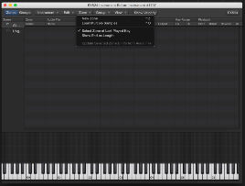
Exploring your newly created instrument
Double click on the EXS24 on your channel strip
On the Parameter window click the Edit button-The EXS24 instrument editor opens.
Set the zone range by click and dragging the sample across an octave of the keyboard. This maps the sample across multiple pitches( i.e. pitch mapping)
Trigger your sample and hear the difference. The sample changes in pitch and speed.
You can tune your sample with the Coarse( semitones) and Fine(cents) tuning parameters

Slide 11
Creating a sample instrument using audio regions component 2 sample number 1-Vocal sample
Task 1-Single Zone
Task 2-Multiple Zone
Import 8MT0 01 sample into by dragging the file into Logic-this is your first sample for Component 2
Add a new software instrument and open a EXS24 sampler
On the EXS24 front panel click the EDIT button
A EDIT window pops up, drag the audio region from your arrange window into the EXS24 EDIT window. This creates a single zone sample instrument mapped across the keyboard
Play your new sampler instrument and listen to the results.
Press T(for tools) and select the Scissor tool
Alt-click on the region, this should cut the region up in ¼ note(crotchet) lengths
Select all the new regions and right click(control-click) and choose Convert>Convert to New Sampler Track in the pop up menu
Change the trigger note range to C3 and OK
Each region is now assigned to a specific note starting at C3

Slide 12
Creating Loop Points
THE SAMPLER CHALLENGE
Looping in samplers is a technique used to create a sustaining sound when you hold down a trigger
Click on the View Menu and select View All
Select the Loop on function
You can select the start and end time, however, it is easier and more precise using your sample editor using your
Click on your audio file in the sampler and choose open Sample Editor
Select the portion you want to loop and ensure Snap Edits to Zero Crossing is selected to avoid audio clicks
For a smoother edit make sure Xfades in ticked.

Slide 13
Creating a sample instrument using audio regions component 2 sample number 1-Vocal sample
Task 1-Single Zone
Task 2-Multiple Zone
Import 8MT0 01 sample into by dragging the file into Logic-this is your first sample for Component 2
Add a new software instrument and open a EXS24 sampler
On the EXS24 front panel click the EDIT button
A EDIT window pops up, drag the audio region from your arrange window into the EXS24 EDIT window. This creates a single zone sample instrument mapped across the keyboard
Play your new sampler instrument and listen to the results.
Press T(for tools) and select the Scissor tool
Alt-click on the region, this should cut the region up in ¼ note(crotchet) lengths
Select all the new regions and right click(control-click) and choose Convert>Convert to New Sampler Track in the pop up menu
Change the trigger note range to C3 and OK
Each region is now assigned to a specific note starting at C3

