Slide 1
Music technology numeracy
A LEVEL COMPONENT 4

Slide 2
Listening task-IDENTIFY THE FREQUENCY AND PITCH

Slide 3
The relationship between frequency and musical intervals
We observed in the listening task that an octave above a known frequency is twice the original frequency and an octave below is half the frequency.
We can therefore use the following calculations:
f=n x 2 octave higher e.g. original frequency 100Hz f=100x2, f=200Hz
f=n / 2 octave lower e.g. original frequency 100Hz f=100/2, f=50Hz
Calculating a perfect 5th ( 7 semitones):
f=n x 1.5 Perfect 5th higher e.g. original frequency 100Hz f=100x1.5, f=150Hz
The same note is a Perfect 4th (5 semitones) below:
f=n x 0.75 Perfect 4th lower e.g. original frequency 100Hz f=100x0.75, f=75Hz

Slide 4
Task-calculate the following frequencies
845Hz an octave higher
200Hz a Perfect 5th higher
262Hz an octave lower
400Hz a Perfect 4th lower
349Hz an octave higher
1690Hz
300Hz
131Hz
300Hz
698Hz
Listening:
The first note is 440Hz(A)
What is the frequency of the next note?
Challenge: What are the frequencies of a C major chord starting on Middle C( just the triad)
262Hz C
330Hz E
393Hz G

Slide 5
The relationship between frequency and Period
The period is the time it takes to complete one cycle
For example, 100Hz is a 100 cycles per second therefore it takes 100th of a second to complete 1 cycle( or 0.01s).
We therefore can calculate the frequency and period( and visa versa):
f= 1/T if the period is 0.1s f= 1/0.1 f= 10Hz
T= 1/f if the frequncy is 1Hz T= 1/f T= 1sec
T=period
f=frequency

Slide 6
Task-calculate the following frequencies
0.0001s
0.02s
0.5s
0.05s
1s
10kHz
50Hz
2Hz
20Hz
1Hz

Slide 7
Sound REcap
Label the waveform
Compression
Amplitude
time
Rarefraction
Wavelength

Slide 8
Harmonics and overtones
An overtone is any frequency greater than the fundamental frequency of a sound. The fundamental and the overtones together are called partials.
Harmonics, or more precisely, harmonic partials, are partials whose frequencies are numerical integer multiples of the fundamental.

Slide 9
Task-calculate the harmonic/overtone
The fundamental frequency is 200Hz
Calculate the 1st overtone
Calculate the 2nd harmonic
Calculate the 4th harmonic
Calculate the 3rd overtone
Calculate the 6th harmonic
The fundamental frequency is 200Hz
f= nx2 400Hz
f = nx2 400Hz
f = nx4 800Hz
f = nx4 800Hz
f = nx6 1200Hz

Slide 10
DIGITAL Numeracy
You will need to convert a binary into a decimal number
The conversion should be fairly simple as you cannot use a calculator
This will more than likely be a MIDI analysis question which requires you to use your list editor, followed by a conversion.
MIDI is 8 bit(1 byte) and you should draw a table to make the process easier
Bits | 8 | 7 | 6 | 5 | 4 | 3 | 2 | 1
Cal | 2⁷ | 2⁶ | 2⁵ | 2⁴ | 2³ | 2² | 2¹ | 2⁰
Value | 128 | 64 | 32 | 16 | 8 | 4 | 2 | 1
Example code | 1 | 0 | 0 | 0 | 0 | 0 | 0 | 1
Example binary code conversion: 128+1=129

Slide 11
Calculate the following
The note of a C Maj7 chord is played a different velocities. Complete the table below.
Note | Velocity | Binary Code
C | 73 | 1001001
E | 64 | 1000000
G | 48 | 110000
B | 9 | 1001
Note | Velocity | Binary Code
C |  | 1001001
E | 64
G | 48
B |  | 1001
Bits | 8 | 7 | 6 | 5 | 4 | 3 | 2 | 1
Cal | 2⁷ | 2⁶ | 2⁵ | 2⁴ | 2³ | 2² | 2¹ | 2⁰
Value | 128 | 64 | 32 | 16 | 8 | 4 | 2 | 1
Example code | 1 | 0 | 0 | 0 | 0 | 0 | 0 | 1

Slide 12
Task
Component 4 Numeracy
Using the delay time formula, calculate the quarter note(crotchet), eighth note(quaver) and 16th note(semiquaver) delay times for a song that’s in 4/4 time at 100bpm
60000ms in 1 minute
Delay
Formula
60000/BPM

Slide 13
Acoustics basics
Lesson 1

Slide 14
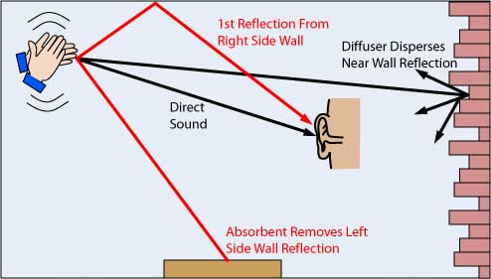
Acoustics Basics
When sound strikes a surface, some of it is absorbed, some of it is reflected and some of it is transmitted through the surface.
Dense surfaces, for the most part, will isolate sound well, but reflect sound back into the room. Porous surfaces, for the most part, will absorb sound well, but will not isolate.

Slide 15
isolation
The best way to stop sound transmission through a building structure is to isolate the sound source from the structure before the structure has a chance to vibrate.
Walls need to be isolated from ceilings and floors, usually by means of dense, pliable rubber.
The main ways to minimize sound transmission from one space to another are adding mass and decoupling.
Every object, every construction material has a resonant frequency at which it is virtually an open window to sound — kind of like a tuning fork that “sings” at its particular resonant frequency.
Different materials have different resonant frequencies.
Trapped air (a.k.a., air spaces and air gaps) is a very good decoupler.
Airtight construction is a key concept. Sound, like air and water, will get through any small gap.(Sound can leak through openings as small as 1/32” – in some cases even smaller.)
Sound bounces back and forth between hard, parallel surfaces. STANDING WAVE

Slide 16
Reflection
Sound hitting a dense surface is reflected
Laws of Reflection
The angle of incidence is equal to the angle of reflection
The incident ray, the reflected ray, and the 'normal' all lie in the same plane
Note: the 'normal' is a line drawn at 90 degrees to the surface of the reflector, at the point where the incident ray hits. Angles of incidence and reflection are normally (no pun intended!) measured between the ray and the 'normal', not between the ray and the surface of the reflector.

Slide 17
Absorption
One solution to reflections is to apply absorption to the wall, which turns acoustic energy into heat - this is a kind of damping. This absorption can be a specialist product such as those made of mineral wool, open cell foam, or recycled fibrous material like paper-waste, but absorption can also be provided by more commonplace object such as curtains, sofas or carpets. It can be a tricky balance for an acoustic designer - too much absorption, and the room will sound 'dead'. The sound quality would be like listening outdoors, where only the direct sound from a source is heard (assuming 'soft' ground and an absence of nearby buildings). While a few people favour such acoustic 'non-environments' for mixing music, for most people these are rather oppressive spaces too far removed from normal listening conditions.

Slide 18
diffusion
Acoustic Diffusers are used to disperse reflections spatially - to 'spread out' reflected sound energy over a wide range of angles - as shown in the diagram above. Some diffusion can be obtained by carefully placing book cases and other furniture in a room, but often specialist (=expensive!) diffusing surfaces can achieve greater diffusion in a more controlled manner. By using sound diffusers, first order reflections are dispersed to be heard later by the listener, and by removing and delaying early reflections, diffusion and absorption can make a small music studio sound like a larger room. Consequently, design is all about locating the reflection points for first order reflections, and applying appropriate treatment there.

Slide 19
Room modes
A room mode is a low frequency standing wave in a room.
Normally, this is a small room phenomenon, though large rooms have (very, very low) modes as well. A mode is basically a “bump” or “dip” in a room’s frequency response that is facilitated by the room’s dimensions and the way those dimensions cause sound waves to interact with each other. There are three types of room modes
• Axial modes: Standing waves between two parallel surfaces.
• Tangential modes: Standing waves between four surfaces.
• Oblique modes: Standing waves between six surfaces. (Oblique modes are more complex, higher in frequency and decay faster. Therefore, they are not typically a big problem.)

Slide 20
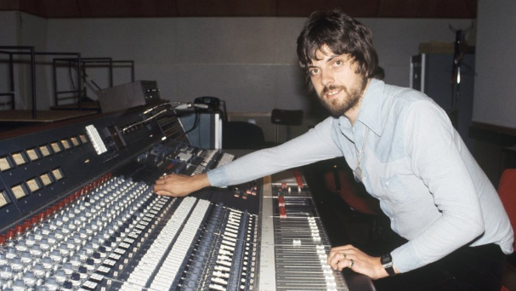
Don’t take my word for it…let’s ask alan
Grab your popcorn, sit back and let the learning happen

Slide 21
Writing Task
Write your opening paragraph
Scenario
You have a small room that you want to use as your control room for mixing and mastering. The room has parallel walls and a distinctive resonance at 70Hz.
Write a short paragraph outlining how would resolve the low frequency issue in the room and what other treatment would you use to ensure the room is ready for mixing audio.

