Slide 1
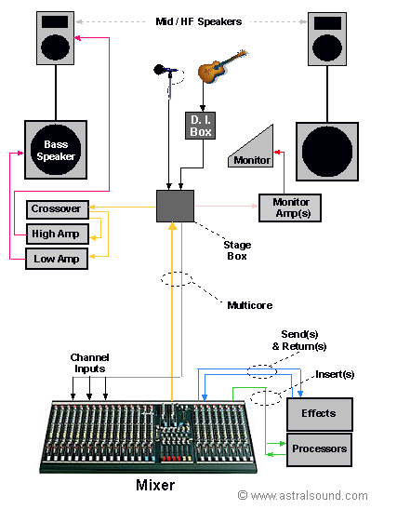
What does a mixer do?
https://www.youtube.com/watch?v=uq_Lvut9o0g
A mixer combines( blends) and processes multiple audio signals( INPUT) and sends( or diverts) the signal to a specific location(OUTPUT).
In Live Sound application, all the sound on stage( which is converted by a microphone or DI) is sent to an INPUT channel on the mixer. The mixer will increase the level( GAIN/PRE-AMP) and process it( EQ and/built-in FX). The combined signal is sent(via an OUTPUT BUS) to floor monitors for performers and loudspeakers for the audience.
In the Studio, the need for a mixer has diminished. Audio interfaces provide professional quality pre-amps to plug sound sources directly into your DAW without the need of a mixing desk. The advantage of this is that there is less cables and connectivity( which inevitably means less noise). However, having a routing matrix of a good quality mixer will allow you to link various pieces of equipment together(e.g. vintage processors). In addition to this, a digital mixer includes digital connectivity to your Mac/PC giving you added flexibility and convenience.
NB: A SOUND ENGINEER MUST HAVE EXPERT KNOWLEDGE OF MIXERS.
MINIMUM REQUIREMENT

Slide 2
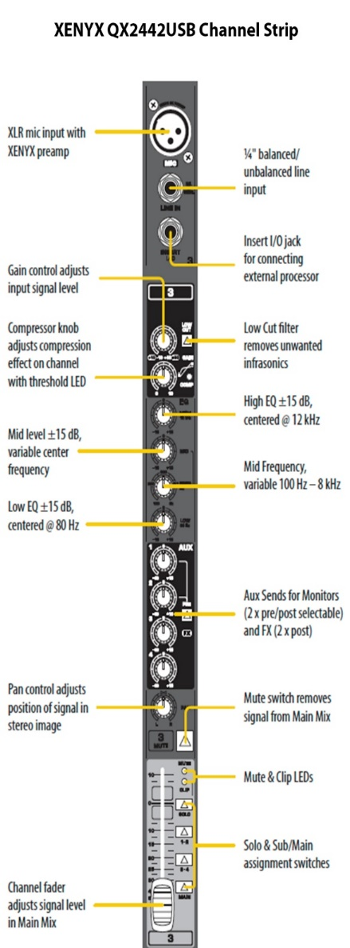
Channel Strip
Depending on the size on design of the mixer, generally a channel strip can be divided into the following sections:
Input-consist of the physical connectors( XLR and/or TRS Jack), Input Gain(pre-amp), Pad Switch
Equaliser-Shelving EQ, Semi-Parametric, Hi-Pass Filter
Aux Sends-Sends to Master Aux,Pre/Post fader button
Routing-Fader, Pan, Main Mix and Subgroup buses
Digital Mixers have one set of channel strip controls that is assigned to a selected channel. Analogue mixers have a channel strip for each input channel.
Digital
Channel Strip
Analogue Channel Strip

Slide 3
Task 1: The Channel Strip
https://www.youtube.com/watch?v=n_Ch_OmI1-M
Watch the video and complete the channel strip worksheet

Slide 4
MIC and LINE INPUTS
Channel Inserts-Unbalanced send and return Jack Socket( Input and Output on 1 connector). These are used to insert extra processor in the signal chain. E.g. compressor. More on that later….
These inputs operate and different levels
Microphone Inputs accept the low levels of a microphone( -70dBu to 50dBu) and sends it to the pre-amp(gain) which boosts the level(-20dBu to +4dBu). This is usually an XLR input
Line Inputs accept line level equipment(+4dBu). The level is high enough and does not require the extra gain to operate. The line level is a ¼” Jack input and usually bypasses the pre-amp.
Instrument/Guitar Level is lower than line level and higher than mic level, therefore, we use a DI( Direct Inject) to much the input impedances so that we operating at the correct level. Often Audio Interfaces have an INSTR or Hi-Z switch so that you can plug your guitar directly into the input without the need of a DI.
Microphones cannot operate on line inputs. The signal is too low. However, line level equipment can operate on a Mic Input if the mixer has a pad switch to reduce the level.

Slide 5
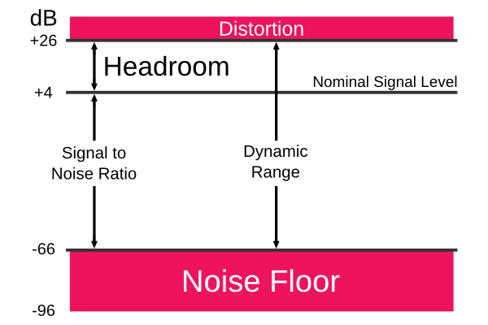
GAIN/ PRE-amp
The Gain increases the level(low-voltage) of the incoming signal and is usually the first pot(potentiometer) on the channel strip. Setting the gain is an integral part of getting a good overall sound. If the gain is too low, you won’t hear the signal and quality of the sound will be low as the signal-to-noise ratio is low i.e. less signal more noise. If it’s too high distortion occurs. You must get the balance absolutely spot-on. You must spend time in sound checks setting the correct gain level.
Top quality mixers have top quality(noise free) pre-amps.
Signal LED-Illuminates Green when there’s SIGNAL. RED when the channel is overloading i.e. DISTRORTION
HPF High Pass Filter-Reduces the level of low frequencies below a specific frequency( called the cut-off frequency
Pad Switch
Often mixers have a PAD switch in this section. It reduces the SENSITIVITY of the input channel by a specific level( usually -20dB)
All audio equipment has a noise floor, which means the moment you plug a microphone in the input noise is present in your signal path. The lower your signal when you set your gain, the closer it is to the noise floor(SNR-signal to noise ratio) therefore when you increase the signal level you increase the noise too. Hence you have to ensure a good strong signal so that there is more signal than noise present, in addition you have leave sufficient headroom to prevent distortion.

Slide 6
KEY WORD so far….Make sure you made a note of these
PRE-AMP/Gain
HPF(HIGH PASS FILTER) or LOW CUT
DISTORTION
HEADROOM
SNR(SIGNAL-TO-NOISE RATIO)
NOISE FLOOR
PAD SWITCH
Task:
Find the following POTS and SWITCHES on the mixer. What does this tell you about the functionality of the mixer.
GAIN
HPF
PAD

Slide 7
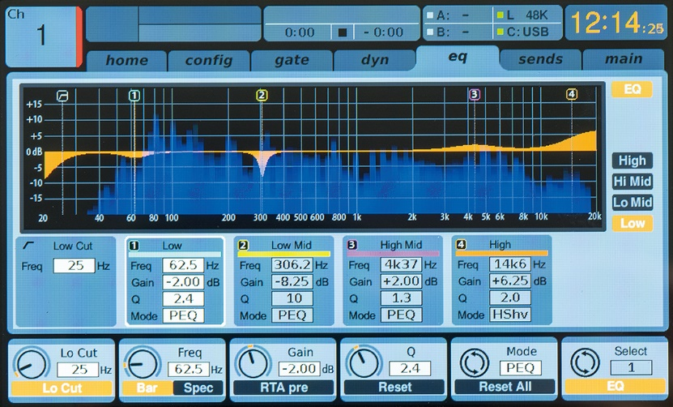
EQUALISER
EQ processes or shapes the sound of the incoming signal. There are 2 uses for EQ, creative or corrective. Use EQ only when your overall mix is deficient and sound sources require enhancement. Small format mixers have a basic shelf EQ, so use it only if it’s necessary.
RULE: CUT before your BOOST. Boosting adds more gain and generally more problems.
Channel EQ is usually shelving EQ with a set frequency, divided in high, mid and low. These frequencies( measured in Hz) can be cut(reduced) or boost( increased) by a specified level e.g. -15db cut and 15dB boost.
Bigger format mixers have sweepable mids, which allows you to select a specific mid-range frequency i.e more flexibility to shape sound.
Digital mixers( and music production software) have full parametric EQs which allows you to select any frequency to cut and boost i.e. SUPER flexible

Slide 8
AUX SENDs
AUX sends/diverts or duplicates the incoming signal to the Main Aux Sends Bus. An Aux send is effectively another output and has physical connectors(jack or XLR) attached to it.
In Live Sound application, we use an Aux bus to send the signal to the onstage floor monitors or to send the signal to outboard equipment for extra processing. In the Studio, we would use to send a headphone mix to the musicians.
When using outboard equipment the signal that is send to the processor needs to return to the mixer. The processed signal is connected therefore to the AUX RETURN. More about that later…
Small format mixers have 1 or 2 Aux sends. Bigger mixers have 6 or 8 Aux( hence more flexibility).
PRE/POST button
Some Aux sections have a PRE or POST button. PRE stands for PRE fader( or before fader). This means that the signal that is sent to the Main Aux send is not affected by the fader movement i.e your monitor mix is not affected by your FOH mix. POST stands for POST fader, if you turn down the fader, you turn down the send.

Slide 9
KEY WORD so far….Make sure you made a note of these
AUX SEND
EQ
PRE/POST
SWEEPABLE MIDS
SHELVING EQ
CUT/BOOST
Task:
Find the following POTS and SWITCHES on the mixer. What does this tell you about the functionality of the mixer.
AUX
PRE
EQ
HI
MID
LOW

Slide 10
Routing section
Once your signal has been processed, you will send the signal to a bus or busses. The controls for these buses are found in the Master Section
PFL-Pre Fade Listen
Often mixers have a SOLO/PFL button(or 2 separate buttons). This is useful to solo the track when setting your gains. The fader will not affect the level when it’s engaged
PAN POT-Sends the input channel to the left or right bus. It places the signal in the stereo field. C position sends the signal in equal amounts to both speakers
MUTE button-Cuts the signal. When the mute button is engaged you cannot hear the audio on that channel.
Linear Fader-Increases the overall level of the Input channel. Faders are used on mixers as it is easy to see the levels of your various sound sources in relation to each other. This is useful when mixing live.
SOLO button-isolates the channel. When the solo button is engaged only the solo’ed channel can be heard. You can solo several channels.
Routing buttons-sends the signal to an output bus. To send the signal to the FOH Speakers L R( also called STEREO or MAIN MIX) must be engaged. The numbers 1-2/3-4 are used to send the signal to sub-group busses. This is useful if you want to control multiple channels with 1 or 2 faders
Digital mixers have a huge amount of routing flexibility, it therefore can seem complicated. The rule generally is the your want to route(or send) a signal to a specific destination(or output) on your mixer.

Slide 11
Describe the functionality of this mixer by evaluating the channel strip
Task: IN PAIRS

Slide 12
Written TASK- 16 marks
Component 4-style essay question
Figure 1 shows a channel on an analogue mixing desk. Many of the controls are similar to those on a digital audio workstation track. Explain the function of the controls and specifications that can be seen in the picture. Give one practical use for each control.

Slide 13
Mixers Summary
All mixers have 4, 8, 16 Channels etc
Mixer Inputs – XLR/J2J inputs for microphones and DI boxes – controlled by input gain
Mixer Outputs – XLR/J2J/Speaker Cable outputs to connect mixer to speakers – controlled by output gain
Routing – process of moving a signal to another location
Busses – group one or more channels together to route to a particular destination i.e auxiliary send or FX
Auxiliary Sends – route a channel/output to a particluar destination i.e monitor or in/ear monitor
Group Tracks – grouping channels either onto a desk or in a logic project to attach identical FX, gains, levels etc – particularly useful on small desks to reduce number of channels needed – all drums to one channel to free space
Digital FX – built in FX i.e Reverb, Compression, Phasing, Delay
Talkback – microphone built in or attached to mixer to link producer to headphones/performer – in ear
Foldback – microphone built in or attached to mixer to link producer to monitors/performer – out loud

Slide 14
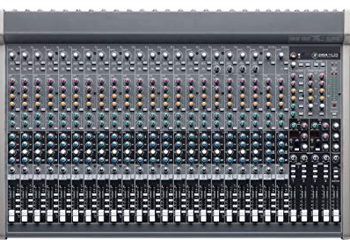
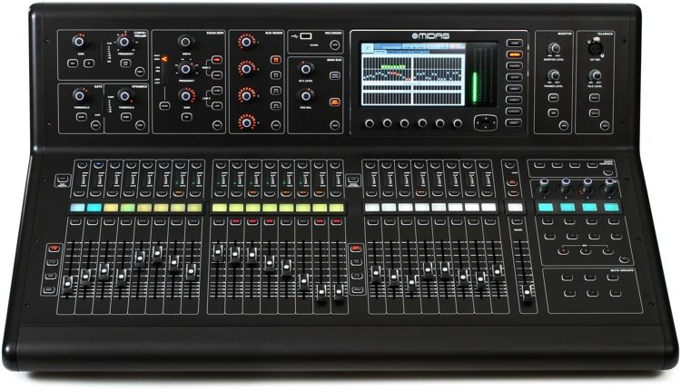
HOMEWORK Digital vs Analogue Mixers https://www.wirerealm.com/guides/top-10-best-audio-mixers
End of lesson Reminders
Snap it up
Research the spec of the following mixers. Draw up a comparative spec sheet and write a paragraph on the pros and cons of each mixer.
MACKIE SR24.4 VLZ Pro
MIDAS M32

