Slide 1
Recap: storm hydrograph practice question

Slide 2
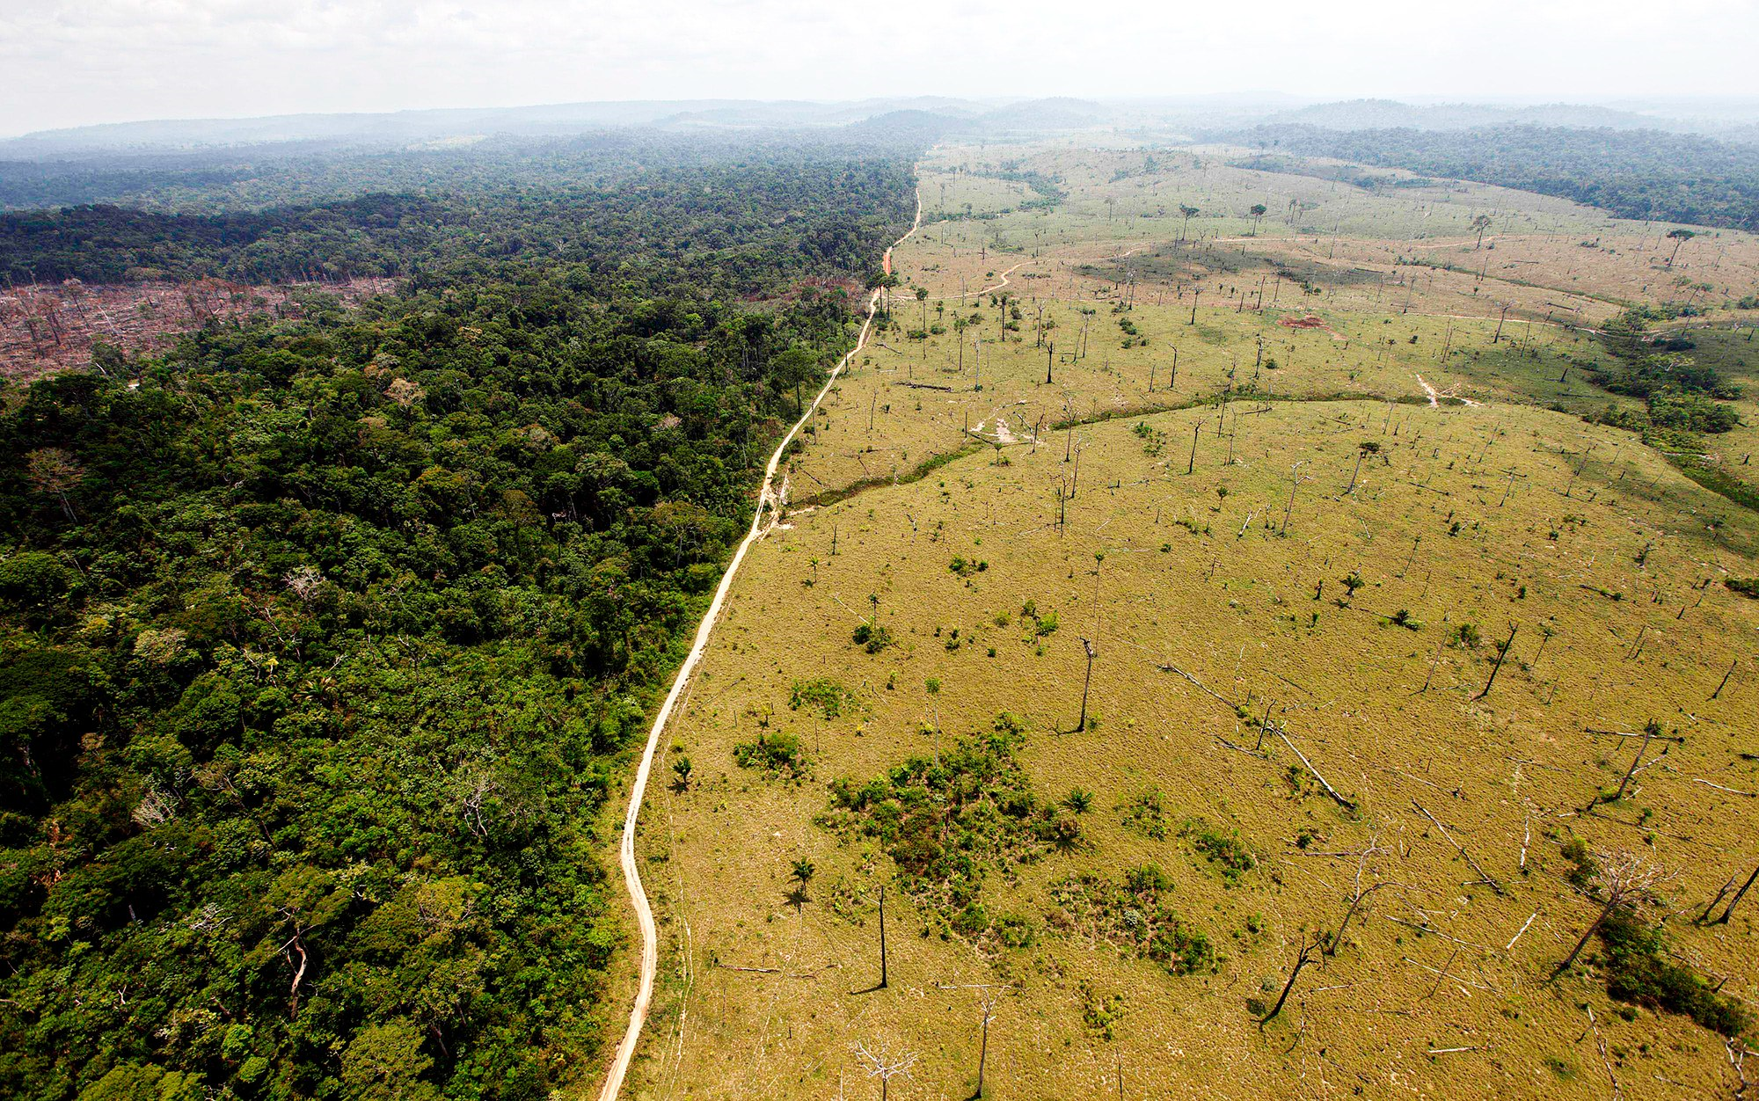
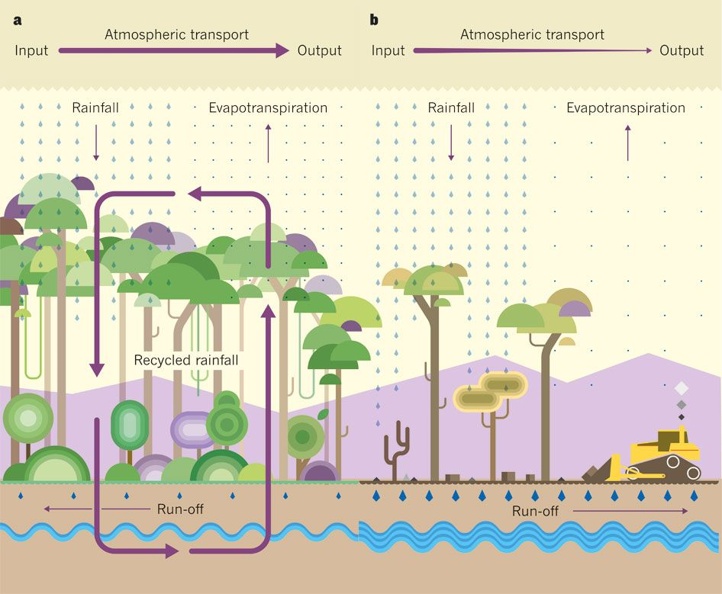
What is happening?
How could it affect the water cycle?

Slide 3
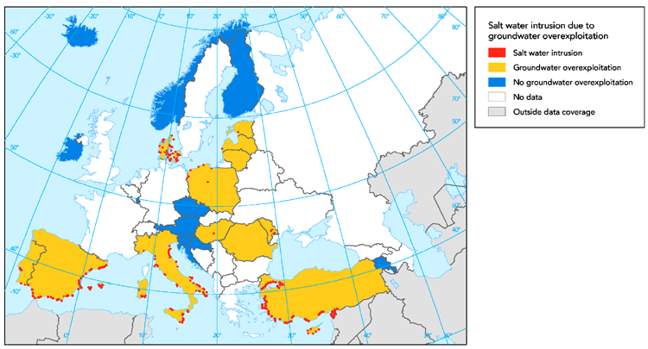
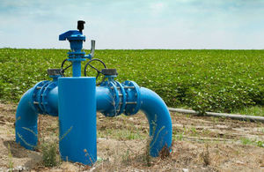
What is happening?
How could it affect the water cycle?

Slide 4
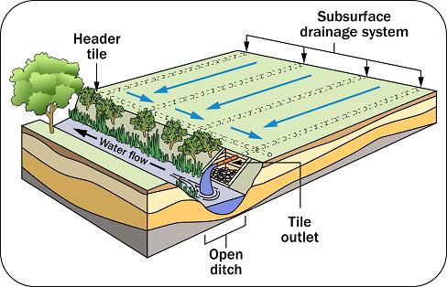
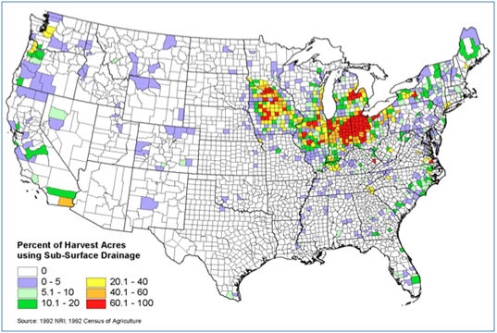
What is happening?
How could it affect the water cycle?

Slide 5
Changes in the Water Cycle over time.
All drainage basins undergo natural variations over time which influence the water cycle.
Typical Changes:
The removal of vegetation.
Creating impermeable surfaces
Changing land use by farmers such as drainage.
Water abstraction.
Seasonal changes/storm events
3.1.1.2 Changes in the water cycle over time to include natural variation including storm events, seasonal changes and human impact including farming practices, land use changes and water abstraction.

Slide 6
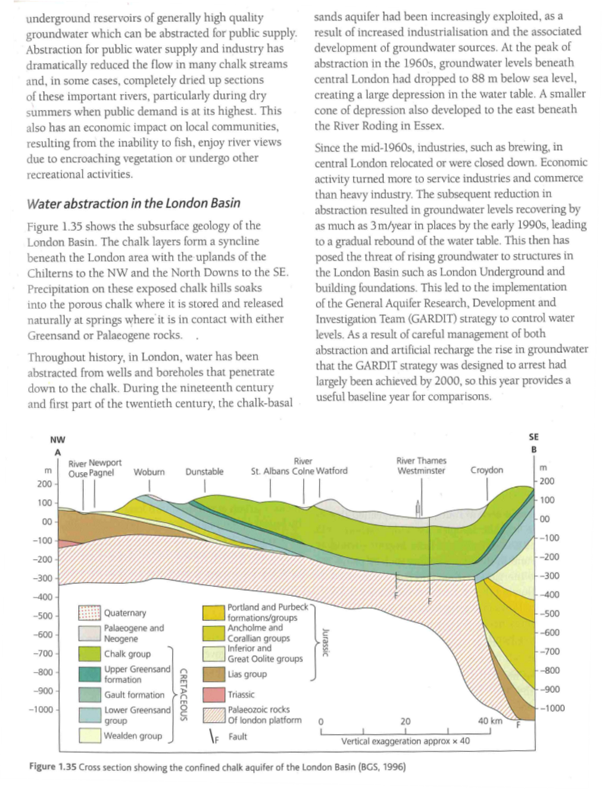
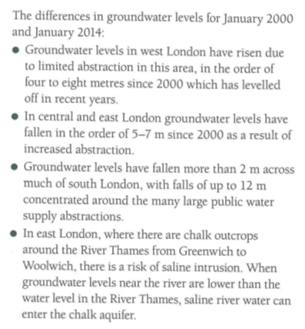

Slide 7
Task – You are going to create a detailed A3 revision sheet on the factors affecting the water cycle.
Use the Oxford and Hodder textbook scans to help you complete the sheet. Watch these clips:
Deforestation and the water cycle: https://www.youtube.com/watch?v=2_R4Sp_-Kfg
The dangers of over-abstraction: https://www.youtube.com/watch?v=HOtQ_iRq4Tk
You can use the handout sheet or you can choose your own style on a blank piece of A3.

Slide 8
Exam Practice: Outline the potential impacts of farming practices upon the water cycle (3 marks)
Handy Hint:
Worth 3 marks so: mention 3 farming practices and describe the effect (+/-) they have on the water cycle.
Or mention 1-2 farming practices and develop in more detail.

Slide 9
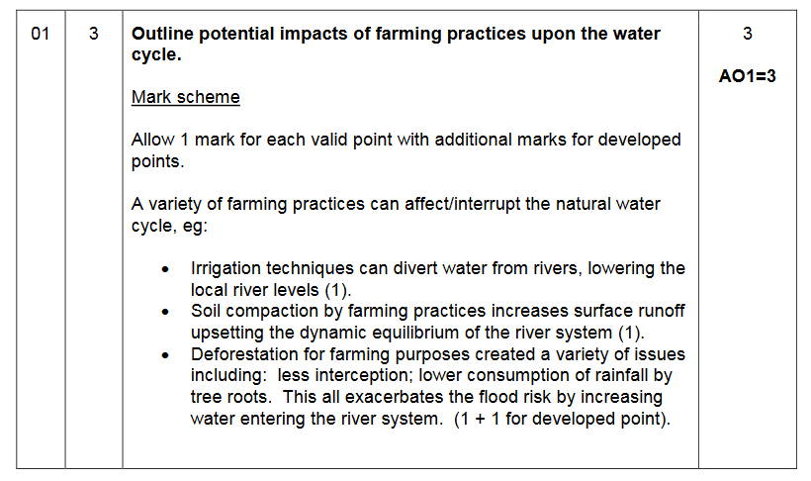

Slide 10
Exam Practice: Evaluate the view that human activity is having a greater impact than natural factors on the water cycle. (9 marks)
Things to think about:
Evaluate – make a judgement on the evidence;
What human activities can you discuss that impact the water cycle?
How do natural processes impact the water cycle?
Water Cycle – local or global scale?
Use of connectives/balanced argument.

Slide 11
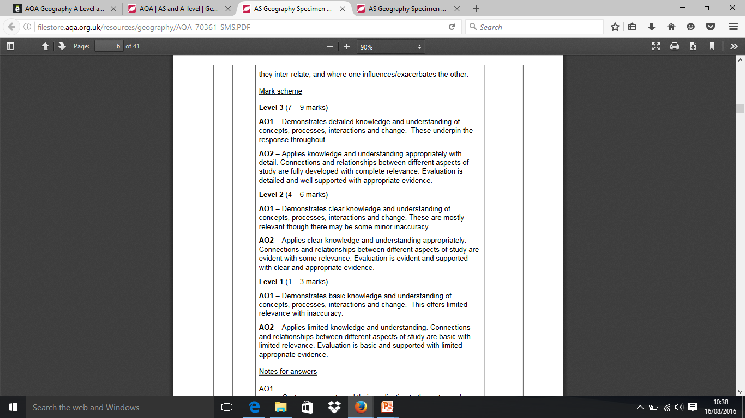
Evaluate the view that human activity is having a greater impact than natural factors on the water cycle.
AO1
– Knowledge and understanding of a range of human activities impacting upon the water cycle. Knowledge and understanding of natural factors which affect the dynamic equilibrium.
AO2
– Application of knowledge and understanding to evaluate the relative impact of both human factors and natural
variation, where

Slide 12
