Slide 1
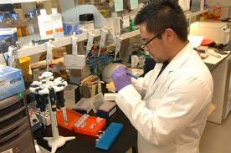
Operations Management:
Research and Development

Slide 2
R&D Key terms
Invention: the discovery of something new
Innovation: the commercial exploitation of invention
Research: an investigation (enquiry and discovery) used to generate new business ideas
Development: changing new ideas into commercial propositions

Slide 3
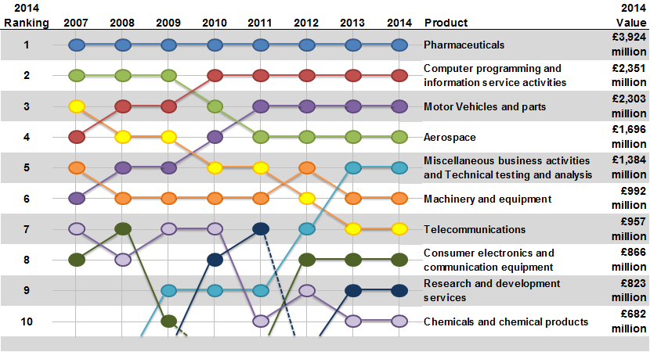
UK R&D expenditure

Slide 4
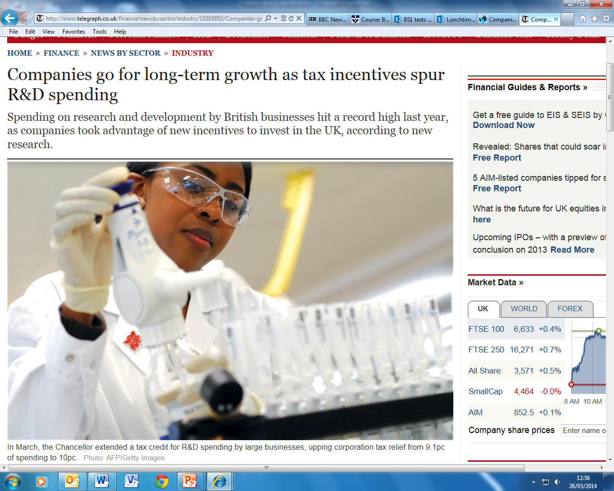

Slide 5

Purpose of R&D
Solving problems
Developing new products/materials
Improving quality
Reducing costs

Slide 6
The R&D process
Identification of problem
Research
Development of ideas and solutions
Development of prototypes
Final design
Testing
Manufacture and launch

Slide 7




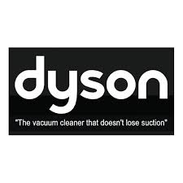
Benefits of R&D
Developing unique products (USP)
Provides competitive advantage
Provides long term income
Premium prices
Identifies new opportunities
Motivation for staff
Enhances reputation
Notes:
From Times case studies

Slide 8
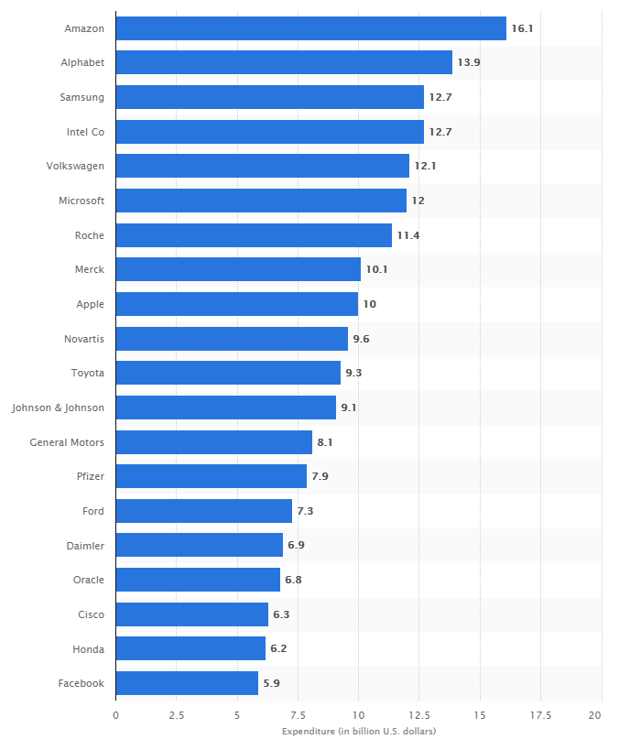
Ranking of the 20 companies with the highest spending on research and development in 2017 (in billion U.S. dollars)
3D printing

Slide 9
Challenges and costs of R&D
High financial costs, hard to estimate
Long timescales
Uncertain outcomes
Conditions may change during the R&D process
Reactions of rival companies
Possibility of failure and the associated impact on reputation
Notes:
From Times case studies

Slide 10
Activity: Wolfson case study
Turn to HJR Page 539 Question 1, and answer:
Questions a, b and c. (If you don’t have the book please see the next slide)
Outline two factors that might influence the amount a business spends on R&D
What risks might Wolfson face with their R&D spending

Slide 11
