Slide 1
Music Videos and the exam
Component 1 Section A: ANALYSING Media Language and Representation
This is Black: Dave

Slide 2
Music videos and the A Level Exam
Component 1 Section A: Analysing Media Language and Representation
This section assesses MEDIA LANGUAGE and REPRESENTATION in relation to TWO of the following media forms: Advertising (WaterAid and Tide) Marketing (Kiss of the Vampire) Music Video (Formation and Riptide) Newspapers (Daily Mirror, The Times) There are two questions in this section: One question assessing MEDIA LANGUAGE in relation to an UNSEEN, i.e. (NOT A SET TEXT) One extended response COMPARISON question assessing REPRESENTATION in ONE SET TEXT and an UNSEEN

Slide 3
Music videos and the A Level Exam
Component 1 Section A: Analysing Media Language and Representation
This section assesses MEDIA LANGUAGE and REPRESENTATION in relation to TWO of the following media forms: Advertising (WaterAid and Tide) Marketing (Kiss of the Vampire) Music Video (Formation and Riptide) Newspapers (Daily Mirror, The Times) There are two questions in this section: One question assessing MEDIA LANGUAGE in relation to an UNSEEN, i.e. (NOT A SET TEXT) One extended response COMPARISON question assessing REPRESENTATION in ONE SET TEXT and an UNSEEN

Slide 4
TASK – ANSWER THIS EXAM QUESTION
Q 1 is based on the audio-visual resource – Bad Blood by Taylor Swift, made in 2015.
https://www.youtube.com/watch?v=QcIy9NiNbmo

Slide 5
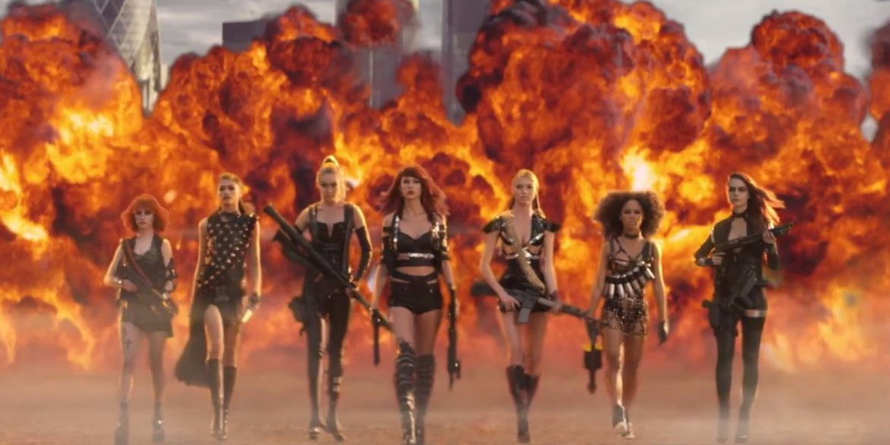
tips
THE QUESTION: Media Language is: the way in which meaning is created for the audience, including:
Genre
Narrative
Visual codes
Written codes
Technical codes including cinematography, mise-en-scene, lighting/colour, sound and editing
NOTE TAKING: Organise your notes, it is best to write your essay chronologically, so take your notes this way too
Denotation | Connotation
Camera movement | Thrilling, action adventure genre

Slide 6
Tips: use the mark scheme to structure your Essay
Question answered throughout | Use words from the question throughout the essay at the end of each point linking it back to the question. Key words include: media language and communicate meaning,
Appropriate terminology used | Start by choosing an element of the music video to analyse, when analysing your example you’ll use lots of terminology. This will include the more general; connotes, signifies etc... Along with specific e.g. tracking shot, desaturated colour, costume, make-up, low-key lighting etc…
Application of academic theories | Applying media language theorist (Choose from the following: Barthes, Levi-Strauss, Todorov, Neale) should fall naturally in to this paragraph somewhere, you need to apply and evaluate. “….would suggest that…” “…when considering…[theorist name]…”
Points illustrated with set text examples | Each point you make should start from an example, be specific, the more detail the better you demonstrate your knowledge of the set texts.
Analysis/Arguments/ Conclusions | This is crucial and is where you develop your arguments and points you want to make, in this case analysing media language
Writing style; including essay structure and SPAG | For Media Language questions you don’t need an introduction or conclusion, so it is important your essays is well structured and flows coherently from 1 point to the next. Analysing chronologically is important to this process.

Slide 7
Your turn…
Use the handout and write your own paragraphs, be sure to consider the areas of the mark scheme… You will need to type up you answer so that you can upload it to GOL.
Question answered throughout
Appropriate terminology used
Application of academic theories
Points illustrated with set text examples
Analysis/Arguments/ Conclusions
Writing style; including essay structure and SPAG

Slide 8
Once you have completed your analysis of the media language of bad blood please submit the work via gol – to the appropriate class
Please produce your work in a Word document and when you want to submit it:
Go to Formation/Riptide section on GOL
Go to the Remote Learning section of this. Find your class and then drag and drop your document.

