Slide 1
Framework | Theorist | Prompts | Marketing | Advertising | Music Video | Newspaper | Film | Magazine
 |  |  | Kiss of the Vampire | Tide | Formation | The Times | Black Panther | Vogue (1965)
 |  |  |  | WaterAid | Riptide | Daily Mirror | I, Daniel Blake | The Big Issue
Media Language | Roland Barthes | The 5 Codes (SEARS) | Y | Y | Y | Y |  | Y
 | Tzvetan Todorov | Equilibrium
 | Levi Strauss | Binary | Y | Y | Y | Y |  | Y
 | Steve Neale | Genre
 | Baudrillard | Post-Modernism
Representation | Stuart Hall | Stereotyping and inequality | Y | Y | Y | Y
 | David Gauntlett | Pick ‘n’ Mix | Y | Y | Y |  |  | Y
 | Judith Butler | Performance
 | Liesbet van Zoonen | Gender is constructed | Y | Y |  |  |  | Y
 | bell hooks | Patriarchal oppression |  |  | Y |  |  | Y
 | Paul Gilroy | Ethnicity | Y | Y | Y
Industries | Curran and Seaton | Power and Industries |  |  |  | Y | Y | Y
 | Livingstone and Lunt | UK regulation |  |  |  | Y | Y | Y
 | David Hesmondhalgh | Cultural industries |  |  |  | Y | Y
Audience | Albert Bandura | Media Effects |  | Y |  |  |  | Y
 | George Gerbner | Cultivation |  | Y |  | Y |  | Y
 | Stuart Hall | Reception x 3 |  | Y |  | Y |  | Y
 | Henry Jenkins | Fandom
 | Clay Shirky | End of Audience |  |  |  | Y

Slide 2
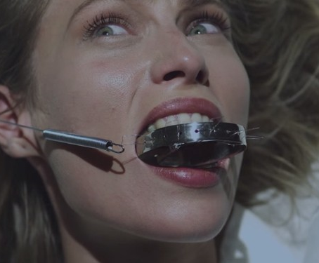
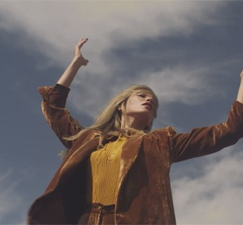
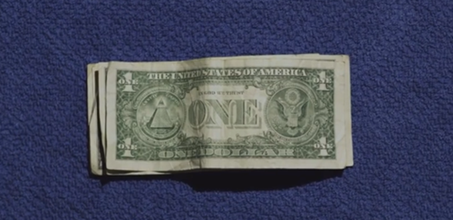
Theory task
You will need to develop on from the work you did on Formation and representation theorists…
You applied 4 theorists to Formation and you created ….
4 videos on your phone, or
4 Audio files on your phone, or
Poster on https://www.visme.co/ (Chrome) or a Word Document.
Add to these now with analysis of bell hooks and David Gauntlett for Riptide

Slide 3
Theory prompts
Theorists
bell hooks | Considering the contradictory messages about gender in the video, is it objectifying women in an ironic or knowing way or is it instead feeding into the oppression of women in a patriarchal society? bell hooks’ view is that feminism is a struggle to end sexist/patriarchal oppression. Is the video part of that struggle or part of the oppression?
Paul Gilroy | N/A
David Gauntlett | Exploring the complex and diverse representations in the music video, apply David Gauntlett’s concept of pick and mix. The style of the video constructs a range of different images/ideas that the audience are invited to interpret. The video rejects singular, straightforward messages and instead invites a variety of different responses and interpretations.
Stuart Hall | N/A

