Slide 1
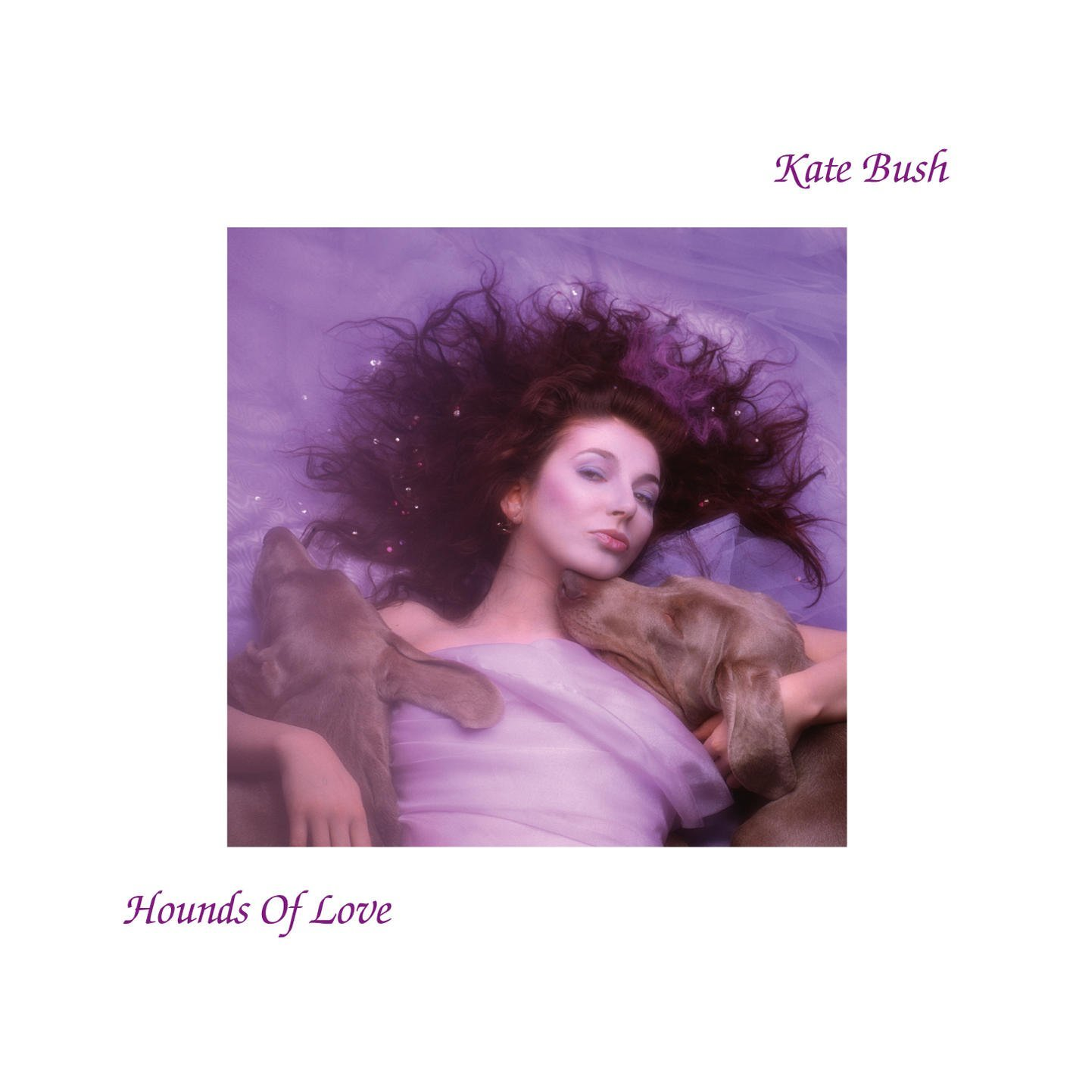
Kate bush: hounds of love

Slide 2
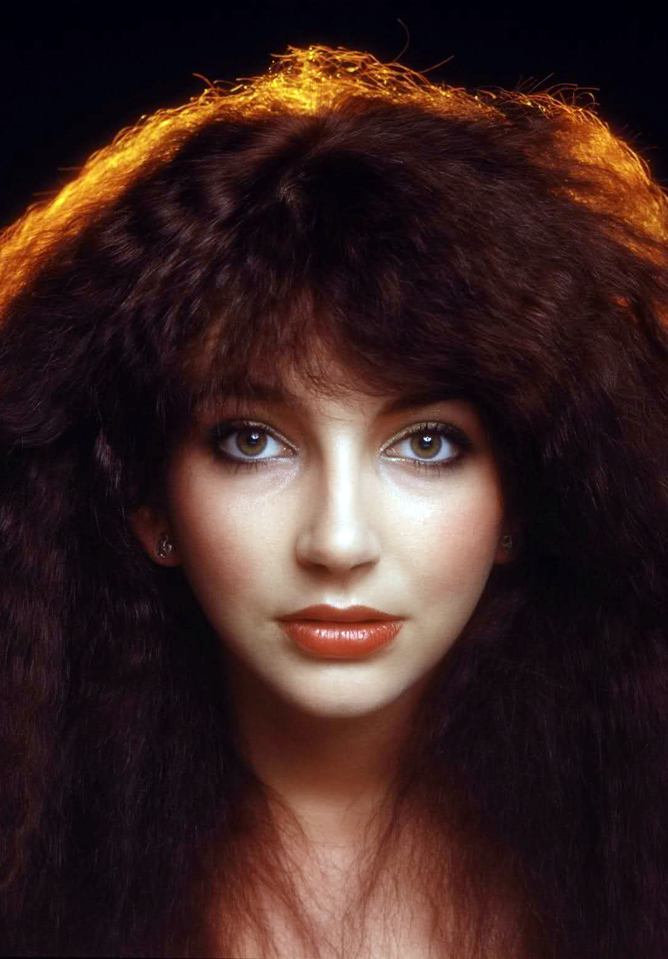
Kate bush
Born in 1958 in Kent
Performer and composer of progressive rock.
Wrote songs and performed as a teenager.
Pink Floyd guitarist Dave Gilmour heard her music on a demo tape and encouraged EMI to sign her at the age of 16!
First album Kick Inside released in 1978 had huge commercial success and included her most famous single Wuthering Heights.

Slide 3
Kate bush
As well as singing and playing keyboards, Bush is a trained dancer and mime artist.
She produces a unique sound, combining her distinctive voice with musical experimentation and interesting instrumentation.
Visual presentation is an important element of her live shows, which are notable for their use of dance, mime and elaborate stage sets.
Her songs often deal with unusual subjects, her complex imagery draws inspiration from writers including Emily Bronte, J.R.R. Tolkien and Stephen King.

Slide 4
Hounds of love
Released in 1985 to wide critical acclaim
It was recorded in her private studio where she had near control of the production process, acting as songwriter, performer and producer.
The first side of the vinyl ‘Hounds of Love’, consists of 5 progressive rock songs, whilst the music on second side ‘The Ninth Wave’, is loosely based on Tennyson’s poetic work Idylls of the King.

Slide 5
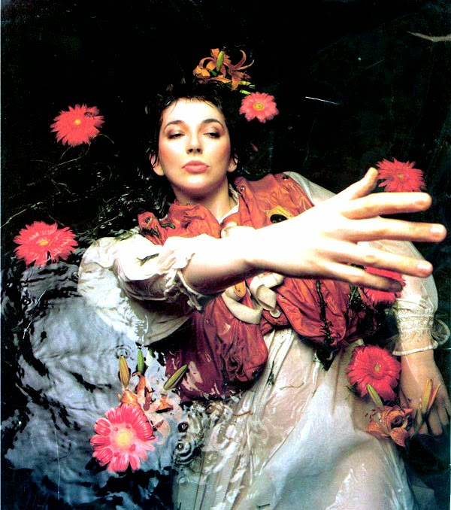
Hounds of love
‘The Ninth Wave’ could be described as a mini concept album, linking seven different tracks together through lyrical or musical ideas.
‘The Ninth Wave’ is about the thoughts of a person drifting alone in the sea at night, battling to stay awake and slipping in and out of consciousness.
It includes the songs ‘And Dream of Sheep’ and ‘Under Ice’.

Slide 6
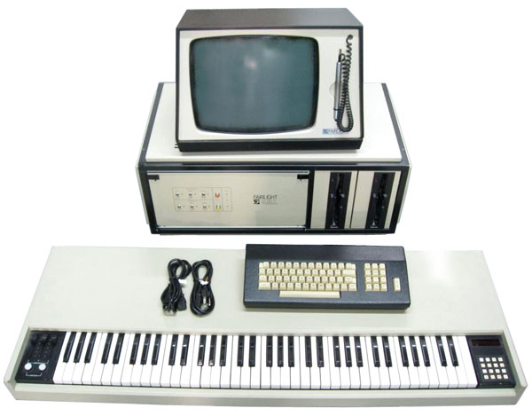
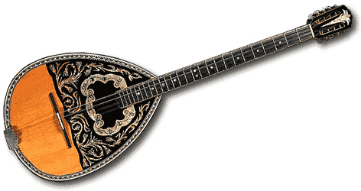
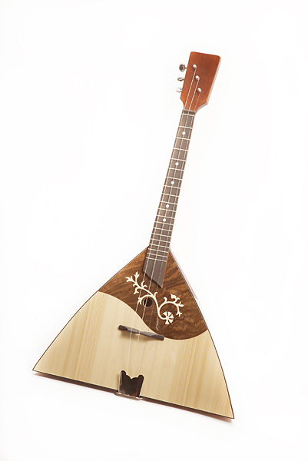
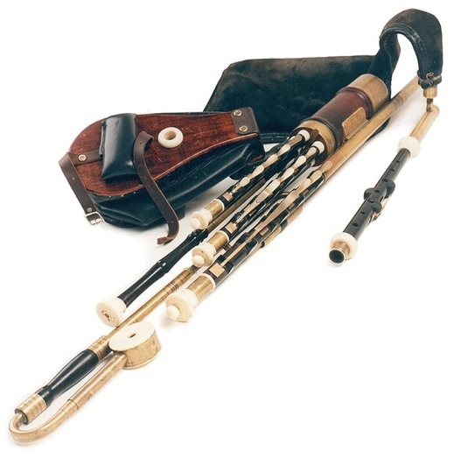
instrumentation
The central instrument on Hounds of Love is the Fairlight CMI (Computer Musical Instrument), which was then the latest in synthesizer technology.
It was the first commercially available sampler, also capable of sequencing and synthesising as well as sampling.
Hounds of Love combines folk instruments (bouzouki, balalaika & uilleann pipes) with the Fairlight.

Slide 7
KATE BUSH: What can I remember?
What is the name of the album the songs we are studying comes from?
When was it released?
What style of music is this album described as?
It had two sides – what was on each?
Which poems inspired the album?
Name two folk instruments included in the set work
Which synthesizer is heavily used in the set work?

