Slide 1
Courtney pine: back in the day

Slide 2
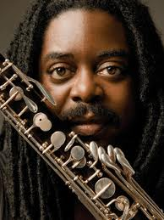
Courtney pine
A British-Jamaican, born in 1964
Leading British jazz saxophonist
Music combines jazz and contemporary pop music
Learned clarinet before taking up saxophone
Played in reggae and funk bands at early age
Member of the ‘Jazz Warriors’ which fused jazz with calypso, reggae and ska.
He found that electronic sounds and rhythms from pop music opened up new directions in his music and he mixed inspired sax playing with these influences.

Slide 3
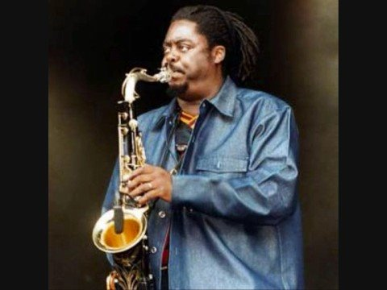
Courtney pine
Often credited as spearheading a jazz revival by broadening its appeal to younger audiences.
His album journey to the Urge Within was the first jazz album to enter the UK top 40.
Pine’s influences range from early jazz to bebop and experimental avant-garde; in particular the American saxophonists Sonny Rollins and John Coltrane.
He is a virtuoso musicians and often practises for 8 hours a days .
He has been awarded an OBE and a CBE for his contribution to the black community and jazz music.

Slide 4
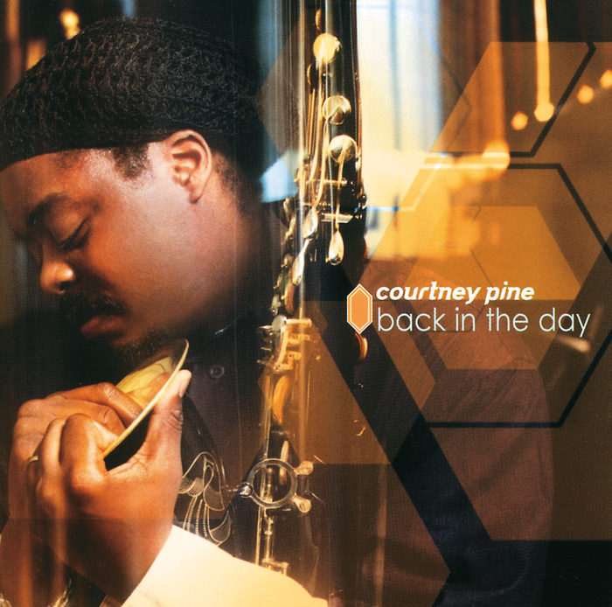
Back in the day
Released in 2000
Produced, engineered and mixed by Pine
Pine performs saxophone, bass clarinet and keyboard on the album

Slide 5
Lady day and (john coltrane)
Written by Gil Scott-Heron, an American poet/musician with a cult following. His lyrics are highly political.
The music pays homage to Billie Holiday and John Coltrane.
Billie Holiday (nicknamed Lady Day) was a singer in the big band swing jazz era. John Coltrane was a tenor saxophonist in the era of the modern jazz combo.
This music, on the other hand, is more closely connected with blues and soul.
Blues and soul singer Lynden David Hall is the vocalist on the track.

Slide 6
Inner state of mind
The music is an original composition by Courtney Pine, but it demonstrates an eclectic mix of influences including jazz and hip hop.
The music includes rap, sampling and turntable techniques (hip hop).
The vocal solo, sung by the jazz singer Eska Mtungwezi, pays tribute to the Gershwin classic ‘Summertime’. The original words ‘and the livin’ is easy’ are transformed into ‘and the living ain’t easy’. The initial minor third interval is the same as in the original song.
The pair of chords in the ‘horn’ (brass) section are taken from the Miles Davis piece ‘So What’.
Blue notes, as on the very first saxophone note, testify to the blues influence in this and almost any jazz piece.

Slide 7
Love and affection
This song was a hit single in the 1970s, composed and performed by the Caribbean‐born British singer Joan Armatrading.
This song is less jazz-influenced and more of a straight pop arrangement. The harmony is less adventurous and the vocals have elements of R&B.
The vocalist on this track is Kele Le Roc. The backing vocals are provided by the London Community Gospel Choir.

