Slide 1
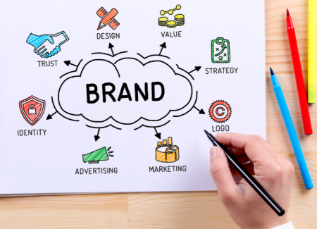
Essential information to answer Unit 4.2 Developing a Brand
You must use this together with the word document “Unit 4.2 P4 P5 M3 M4 D2 Spotify Model Answer” available on GOL in the Unit 4 folder

Slide 2
Unit 4 Promoting a Brand, 4.2 Developing a Brand
You have been employed as a marketing assistant at a marketing agency. You have been asked by your manager to produce a promotional campaign for a new client.
.
P4/P5
You must to produce a plan for a promotional campaign for a brand of your choice (this could be an existing brand you are familiar with or for your own start-up company that you’ve written about in Unit 3 – you may find it easier if you choose a famous brand you already know and plan a new brand for them under their original name).
The plan will include:
The promotional objectives for your brand
The brand’s target market
The brand personality
The elements of the promotional mix to be used
The promotional methods to be used
P5
You will include in the plan information on how branding methods and techniques could be used.
This section of the plan will include:
Information about the branded product, its features and benefits
Ideas for branding or a logo
The branding methods and techniques to be used

Slide 3
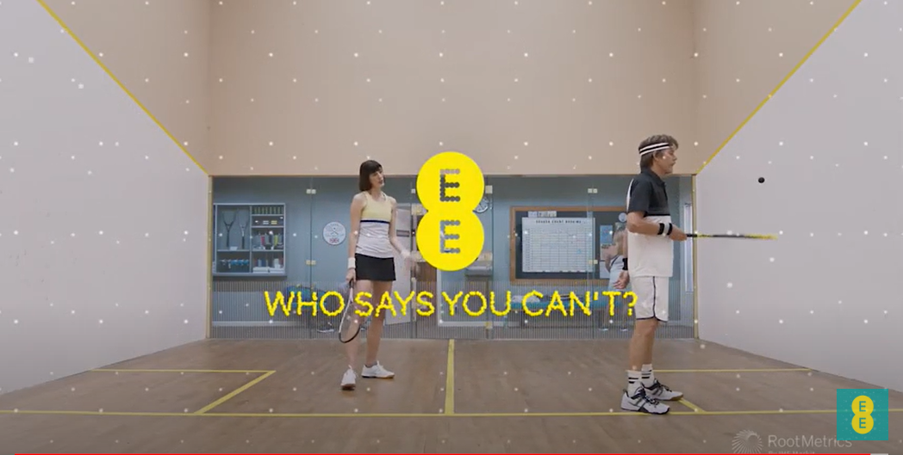
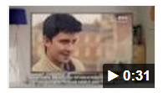
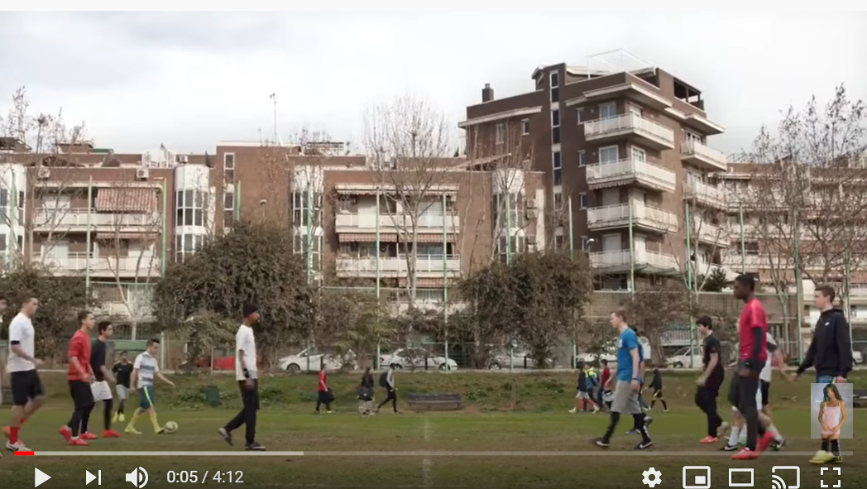
P4 PROMOTIONAL objectives
A business will need to be clear what the “promotional objectives” are for any campaign. These which must align with its overall business objectives (e.g. making a profit, expanding into new markets)
Examples of promotional objectives could be: - increase market share (taking customers from competitors or winning completely new customers who’ve never used a product or service before). For example EE’s campaign for 5G
https://www.youtube.com/watch?v=AHArSv5k3vU
- Increasing consumption, loyalty and enjoyment among existing users. See this example from Sky Q
https://www.youtube.com/watch?v=WyBpkPQUhcQ
- Raising awareness of a brand and communicating its values – for example Nike’s World Cup 2018 brand advert https://www.youtube.com/watch?v=eIpKzWU5Z2s

Slide 4
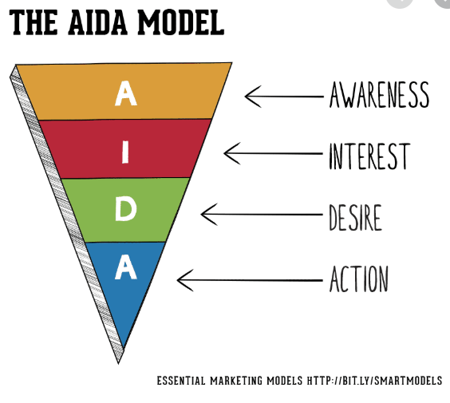
P4 Promotional objectives: include the “AIDA marketing funnel”
In your plan, be clear which of the “AIDA” marketing funnel objectives your campaign is aiming to hit. You must include this in your P4 answer.
For new products/brands, raising awareness is often the most important
For established products/brands, achieving action – the customer buying something or taking out a subscription – is more important.
Some campaigns are aiming for all four AIDA goals – but it’s much easier to raise awareness – and hit lots of people – than it is actually to prompt those people to take action and hand over their money. That’s why the AIDA model is often referred to as a funnel – the lower down the model you go, the fewer people you hit
https://www.youtube.com/watch?v=R5-LsY5dCSs – 2 min film about the AIDA model

Slide 5
P4 Other examples of promotional campaign objectives you could choose
Objective | Explanation
Raise awareness | Make public aware of product or service
Remind | Jog the publics memory about the product or service
Differentiate | Create a unique image so they stand out from competitors
Persuade or inform | To let people know about benefits & features of the product
Create market presence | Some brands benefit from being linked to environmental or ethical practices
Create market share | To increase market share by improving sales.

Slide 6
P4 Promotional objectives: think “SMART”
Promotional objectives, like any other objectives in business, need to be SMART. Make your P4 objectives SMART

Slide 7
P4 Promotional objectives: think “SMART”
Here’s an example of some SMART promotional objectives which Spotify might use if it were launching a new podcast brand
Promotional objectives:
Launch new Spotify sub-brand [S]podify to raise awareness and listening to the company’s podcasts to achieve increasing the percentage of users who pay to subscribe to Spotify.
Specifically, the campaign objectives will be to achieve:
20% uplift in awareness of [S]podify and a 5% uplift in consumption among existing customers 5% increase in new subscriptions during the second half of 2021
10% uplift in awareness of Spotify’s podcasts among people considering subscribing to Spotify

Slide 8
P4 Other things to cover in your promotional plan
What is the brand personality? (e.g. friendly, elegant, edgy, sophisticated)
How is it different from other brands? – what is your brand’s Unique Selling Point
Who is the target market? – e.g. Generation X, The Silent Generation, affluent mums, gardeners, skate boarders…
How will the brand be promoted? – by brand logo, slogan or advertisement
Which advertising medium will be best? – e.g. TV, radio, social media, podcast, in-store public address system

Slide 9
P4 Target market
A business must have a clear vision about who its target market will be and then select appropriate media through which to advertise and promote its brands.
E.g. young people might be the target market for hair gels & sprays and the company would choose advertising channels which young people will see – such as social media, ad breaks in TV’s Love Island or print ads on toilet doors in clubs
A brand targeting old people would choose totally different advertising channels – such as newspapers, magazines and in the ad breaks of TV programmes such as the local TV news

Slide 10
P4 Target market
A business must have a clear vision about who its target market will be and then select appropriate media through which to advertise and promote its brands.
E.g. young people might be the target market for hair gels & sprays and the company would choose advertising channels which young people will see – such as social media, ad breaks in TV’s Love Island or print ads on toilet doors in clubs
A brand targeting old people would choose totally different advertising channels – such as newspapers, magazines and in the ad breaks of TV programmes such as the local TV news

Slide 11
P4 – remember your learning about which generation your brand is targeting and what that means for how it promotes itself
Name | Born (approx. age) | Brand appealing to them?
Generation Z | 1996 – 2012 (18) | ??? Your view ???
Milennials | 1977 – 1995 (30) | Playstation, Amazon, Disney
Generation X | 1965 – 1976 (50) | Apple Amazon Netflix
Baby Boomers | 1946 – 1965 (70) | Amazon, Toyota, Apple
Silent Generation | Before 1945 (80) | Care Co, Radio Times, Tesco
For more info: https://www.visualcapitalist.com/the-most-loved-brands/

Slide 12
P4 The brand’s target market
A business must have a clear vision about who its target market will be and then select appropriate media through which to advertise and promote its brands.
Describe what demographic (e.g. age, gender, ethnicity, rich, poor etc) your brand is targeting
Perhaps it’s not just about demographic – maybe your target market is better summed up by attitude – e.g. early adopters of technology or music lovers
Explain what benefits your target market will see in your product/brand and how your brand will meet their needs

Slide 13
P4 What is brand PERSONALITY? When products are based upon human characteristics
For P4, describe your brand’s personality
Remember this from your work on Unit 4.1 with Anne/Ellen

Slide 14
P4 BRAND PERSONALITY
A brand personality is the things about the brand that will make customers want to be a part of the brand and ultimately to buy the product.
Customers will buy if they can relate to the brand image/personality & will look for brands they can trust & where information is honest.
A brand will communicate its personality in all its “consumer touchpoints” – that is the products the business makes or sells, its logo, packaging, service it provides & how it communicates with customers & media.

Slide 15
P5 The brand personality
If your brand were a person, how would you describe them? Are they outgoing, bold, energetic? Are they sophisticated and refined? Are they quiet and confident?
Are they fun loving? Are they edgy?
What colour would they be? Be imaginative in how you describe them?
When you’re thinking about your brand’s personality, keep in mind, how this appeals/relates to what the target market will value in the brand – the two must be aligned to each other.

Slide 16
P4 The promotional mix – what blend of these types of promotion will your campaign involve?
Paid-for advertising
(TV, posters, digital etc)
Social media feeds
(Snap, Insta, Twitter, Tick-tock, Youtube)
Type of Promotion
Public relations (PR)
Direct marketing/telesales
Price promotions
Branding – look/feel/sound
Notes:
https://www.business.qld.gov.au/business/running/marketing/advertising

Slide 17
P4 Elements of the “promotional mix” in a promotional campaign
Advertise in media with sales promotion such as a discounted starter price
Use Instagram influencers
Sponsorship of an event
Direct e-mail to existing customers
Do a door-drop with money-off coupons
Carry out in-store/shopping centre demonstrations with money-off coupons
Choose a relevant celebrity to advertise brand if business large enough

Slide 18
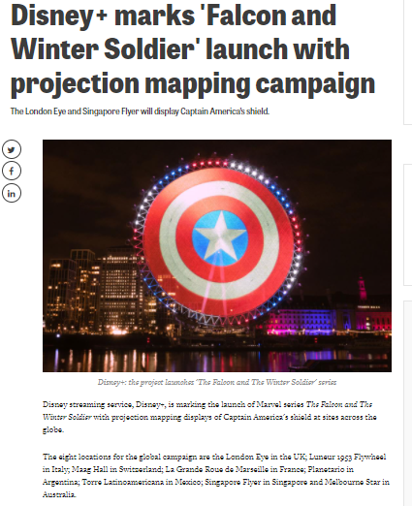
P4 Promotional Mix- example
Disney+ are using the promotional mix to the full – to accompany the launch of Falcon and the Winter Soldier, they’ve been taking over landmarks round the world – a great example of a PR (public relations) campaign that’ll get huge pick up on social media.
What could your brand do that’s like this?

Slide 19
P4 Effective Branding methods & techniques
Logos – a unique visual sign or symbol that is used on all products, company literature & advertisements
Strapline/slogan – a brief unique verbal phrase which a customer can memorise easily & link with a product e.g. Tesco “Every Little Helps”
Audio ident – for example Netflix’s drum-beat or Intel’s fanfare
Celebrity endorsements – well-known musicians, sports people or film stars are often used to advertise products in hope they will influence people to buy e.g. Gary Lineker & Walkers crisps.
Colour palette for all materials - packaging/ websites/ stores/ social media

Slide 20
Moving on to P5
For P5 You will include in the plan information on how branding methods and techniques could be used to recommend a brand personality and a target market for the brand. This section of the plan will include:
Information about the branded product, it’s features and benefits
Ideas for branding or a logo
The branding methods and techniques to be used P5
Use illustrations (snips of photos, designs, stills from adverts etc) to bring your work to life

Slide 21
P5 Give information about the branded product, its features and benefits
Describe your product/brand – what is it e.g. Spotify is a music and speech service available through connected devices
“Features” are things which exist or are true about a product/service – for example, Spotify is a music and speech service which uses algorithms and data about its customers to give them things to listen to.
“Benefits” are the things which result from the customer owning/using the product which they see as adding value to their lives – so, with Spotify, they can listen to the music they love that makes them happy – or they save storage space in their home because they don’t need to store CDs or records
When you develop a promotional plan, it’s essential to focus on the BENEFITS which customers value – these are not always the same as the product’s FEATURES. Sometimes features matter to the producer (maybe they relate to an aspect that makes the product cheaper to mass produce) but can be irrelevant to the customer. Sometimes customers see benefits in a product – it saves them time, makes their life simpler, helps them make friends faster – that the company doesn’t know about. The job of a great marketer is to discover and promote the benefits customers value most.

Slide 22
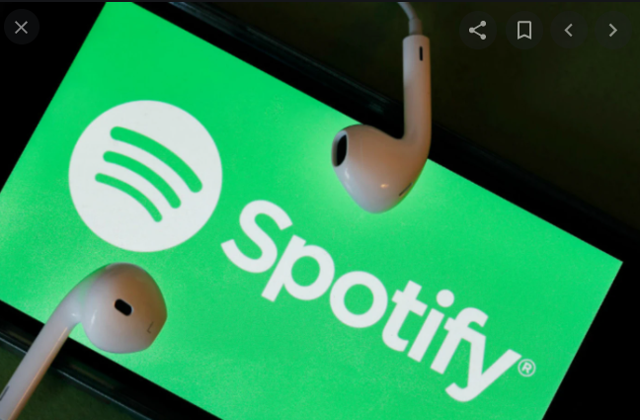
P5 example: how Spotify’s features become a benefit to its customers
From
Mess, hassle, endless time searching, taking up space, dust
To
Simplicity at your fingertips

Slide 23
P5 The brand’s objectives
Effective branding is important to the success of a business and deliver its business objectives
Businesses need to produce a brand that is easily recognisable & stands for quality in the minds of its target market and customers
Branding can relate to one product or a range of products
Branding will not only provide customers with information but also needs to make sure it stands out from competitors.

Slide 24
P5 Ideas for branding or a logo
Get creative in your answer – include your own artwork mock-ups:
Logo or symbol (or include “mood” images of photos/cartoons that communicate what the brand’s about)
Brand values/personality
Message in a slogan, jingle or strapline
Audio ident
How the brand features in advertising material
Sales promotional activities aligned to the brand values (e.g. competitions/social media stunts etc)

Slide 25
P5 Thoughts about straplines
What is a strapline?
What are the advantages and disadvantages of using celebrities to promote products?
What would be the impact for a business if customers become aware of unethical production processes?
Why is it important for a business to identify its target market?

Slide 26
P5 Branding methods and techniques to be used
For example
Brand name
Brand values/personality
Logo or symbol
Message in a slogan, jingle or strapline
Advertising material
Sales promotional activities
Public relations campaign/using celebrity ambassadors

Slide 27
M3 you’ll need to explain how and why you selected your target market and how your brand’s personality will appeal to them
A business must have a clear vision about who its target market will be and then select appropriate media through which to advertise and promote its brands.
E.g. young people might be the target market for hair gels & sprays and the company would choose advertising channels which young people will see – such as social media, ad breaks in TV’s Love Island or print ads on toilet doors in clubs
A brand targeting old people would choose totally different advertising channels – such as newspapers, magazines and in the ad breaks of TV programmes such as the local TV news

Slide 28
M3 Your target market – things to think about
Factor | Implications
Race/nationality | A business needs to make sure that their brands do not discriminate against or upset any nationality or social group.
Religion | It is also important not to offend any religious groups with a brand or advertising.
Children | If a brand is aimed at children their products should be suitable for them.
Disabilities | A brand should be sensitive to people with physical or mental disabilities e.g. use clear font for people with poor eyesight.
Environment | Some brands benefit from being linked to environmental or ethical practices.

Slide 29
M3 explain the branding methods and techniques to be used and why you’ve chosen your brand personality and target audience
Explain and justify your choices by linking what you’ve recommended to your understanding of who the customers will be for your brand and what you know about their likes and needs.

Slide 30
Unit 4 Promoting a Brand, 4.2 Developing a Brand
Here are questions M4 and D2 Use the suggested table in the Spotify Model Answer document on GOL
M4
Your client has also asked you to justify the choice of the promotional mix for the brand and to evaluate the campaign’s effectiveness, suggesting improvements. You will also need to include in your notes:
the reasons for selecting the elements of promotional mix you have recommended in your campaign plan, including the advantages and disadvantages of each one.
D2 – write a conclusion setting out:
the elements of your promotional campaign that you think will be effective and the reasons why
any elements of your promotional campaign that you think could be improved, and, if appropriate, provide recommendations for improvements to the campaign.
Use illustrations (snips of photos, designs, stills from adverts etc) to bring your work to life

Slide 31
M4 How will the business justify its choice of promotional mix?
A business will need to be able to explain why it has chosen the elements that make up its promotional mix & how they will appeal to the target market.
Business could explain how the advertisements it has chosen will attract target market & why this mode is most appropriate method.
The business will need to identify which sales promotional activities have been selected & why. In justifying the promotional mix, aim to link back to the overall campaign objectives and business objectives

Slide 32
M4 How will the business justify its choice of promotional mix?
A business will need to be able to explain why it has chosen the elements that make up its promotional mix & how they will appeal to the target market.
Business could explain how the advertisements it has chosen will attract target market & why this mode is most appropriate method.
The business will need to identify which sales promotional activities have been selected & why. In justifying the promotional mix, aim to link back to the overall campaign objectives and business objectives
Think about the advantages and disadvantages of the plan you’ve proposed – is it too expensive? Can the company afford it? Will it deliver its objectives – for example will it drive actual sales or just raise awareness?

