Slide 1
Make your life easy
Using Word to manage your sources

Slide 2
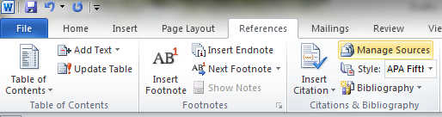
Click on References in the ribbon and then find Manage Sources

Slide 3
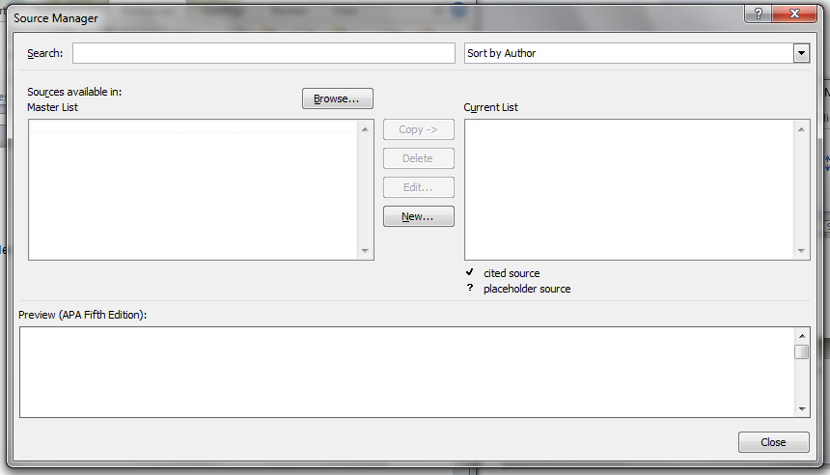
Click on it and the following box appears

Slide 4
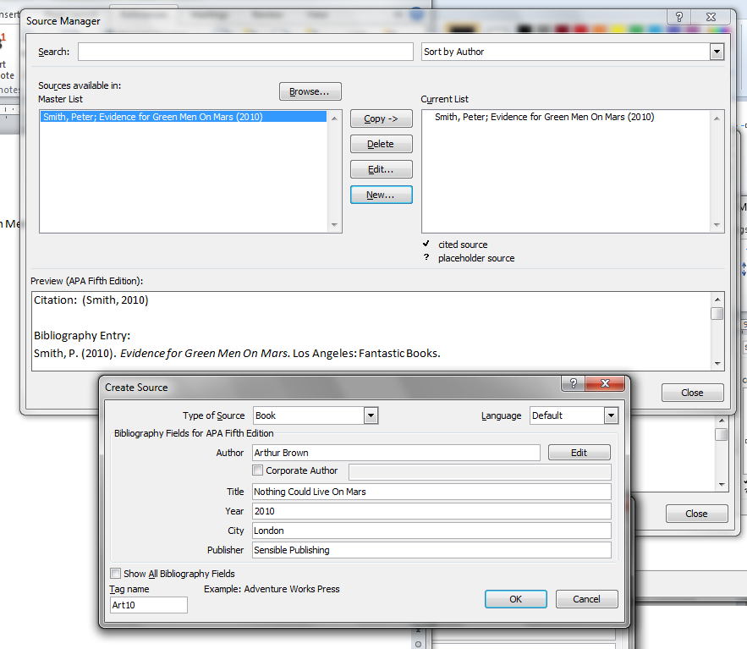
Click on New

Slide 5
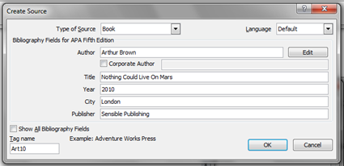
Choose your source type and fill in the details

Slide 6
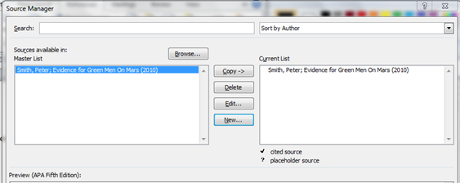
It will then appear on your master list and on the list for the current document
Close

Slide 7
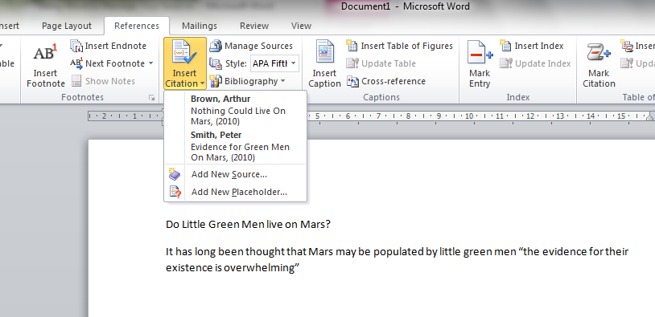
If you click on Insert Citation, then the list for the current document appears and you can select the source you are referencing the quote from.

Slide 8
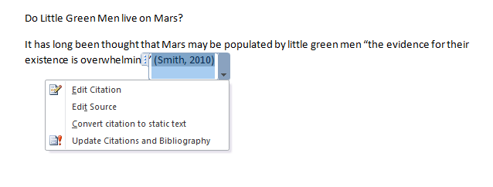
If you want to add anything to the citation e.g. a page number, use Edit Citation – click on the citation and then choose edit

Slide 9

Harvard Referenced Version

Slide 10

You can also insert footnotes,
Click on Insert Footnote followed by Insert Citation and a footnote will appear at the bottom of the page.
Footnotes are all automatically renumbered if you move the text around.

Slide 11


Footnote Referenced Version

Slide 12
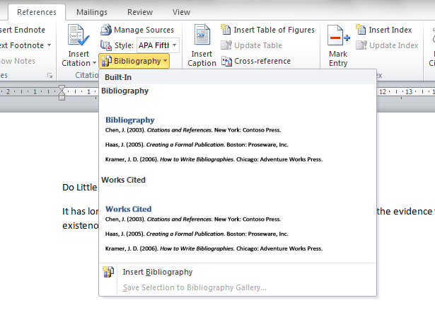
You can create a Bibliography too!
Click on Bibliography

Slide 13
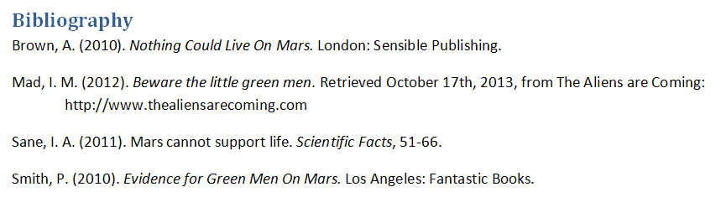
Choose Bibliography and it is created in an established format for you!

