Slide 1
A Level Paper June 2018

Slide 2
A Level Paper June 2018

Slide 3
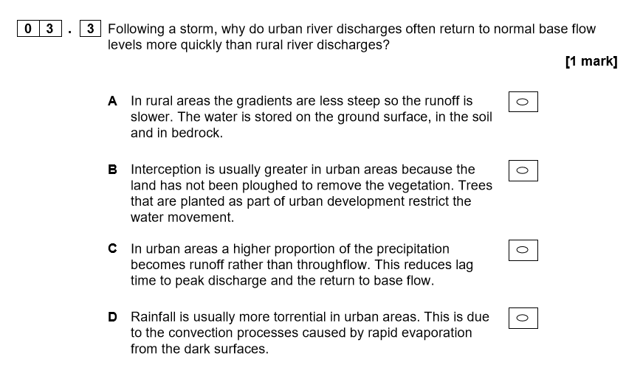
Exam question A Level Specimen Paper 2

Slide 4
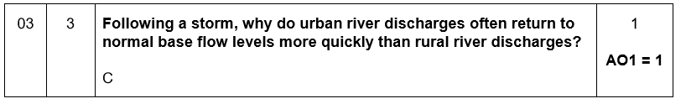
Exam question A Level Specimen Paper 2

Slide 5
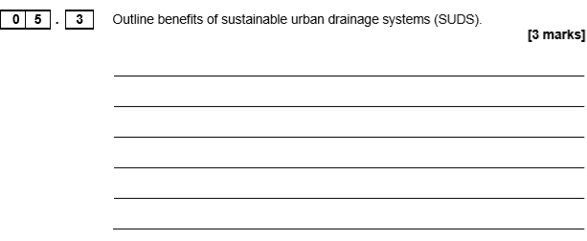
Exam question AS Paper 1 2017

Slide 6
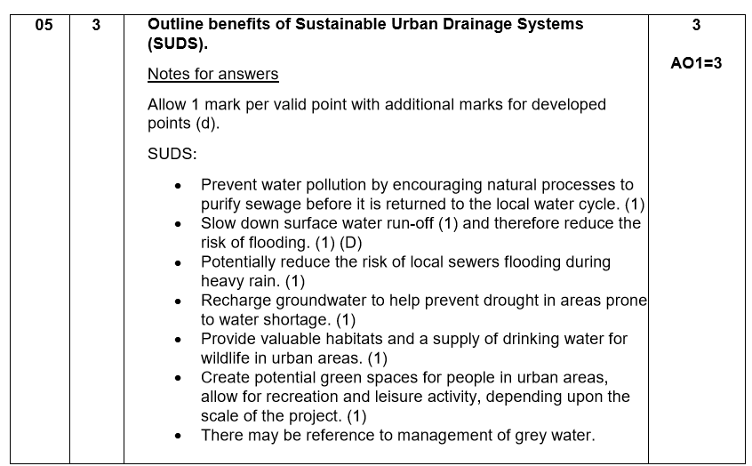
Exam question AS Paper 1 2017

Slide 7
AS Paper 1 June 2018

