Slide 1
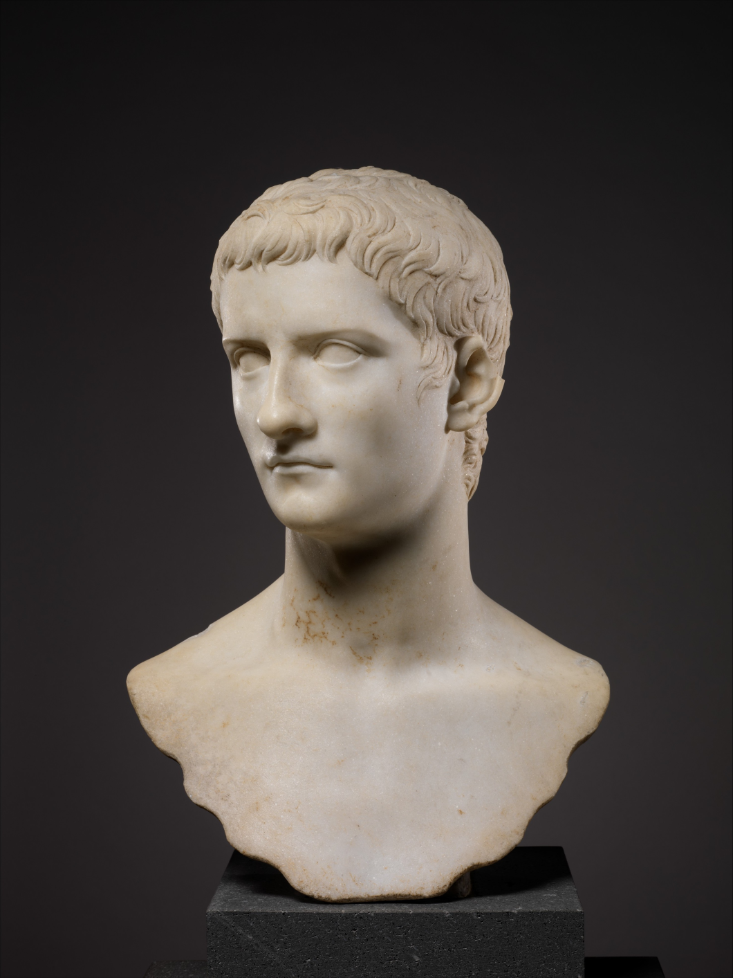
Ancient History Period Roman Study Revision
Session 3:
Gaius 37-41

Slide 2
Overview of the Period
12 – Gaius Caesar Germanicus was born in Atium 56 miles from Rome.
19 – His father, Germanicus died. Gaius was adopted by Tiberius.
23 – 33 His older brothers and mother, Agrippina died.
37 – Tiberius died and instead of his grandson Gemellus the Praetorian Guard supported Gaius’ claim. Shortly after his accession he becomes seriously ill.
38 – Tiberius Gemellus is executed as it the head of the Praetorian guard. Gaius’ sister, Drusilla dies and he is distraught and has her declared a god.
39 – Gaius made a surprise visit to the army on the Upper Rhine River. He begins capricious and extravagent projects. When he uses up the money he starts extorting funds from wealthy Roman citizens.
40 – Gaius takes the army into Gaul to seize wealth there. Then he goes north supposedly to carry out an invasion of Britain. Changes his mind and returns home.
41 – Gaius murdered along with his wife and daughter by the Praetorian guard.

Slide 3
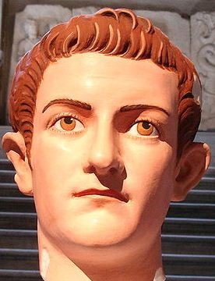
Background
Gaius became emperor at the age of 24
He had no experience governing and had received no official titles singling him out as the next emperor .
He had also lost his mother and two older brothers in peculiarly horrific circumstances. Surviving had been something of a challenge.
His parents had been the popular Roman general Germanicus and Augustus's granddaughter Agrippina the elder.
Although he was named Gaius he acquired the nickname "Caligula" (meaning "little boots", the diminutive form of caliga) from his father's soldiers during their campaign in Germania. When Germanicus died at Antioch in 19, Gaius was six. His mother, Agrippina returned with her six children to Rome, where she became entangled in a bitter feud with Tiberius.
The conflict eventually led to the destruction of her exile and starvation and the death of her two older sons. Untouched by the deadly intrigues, Caligula accepted an invitation in 31 when he was 19, to join the emperor on the island of Capri, where Tiberius had withdrawn five years earlier. He managed to survive in these peculiar circumstances for 6 years. Following the death of Tiberius, Caligula succeeded his adoptive grandfather as emperor in 37.

Slide 4
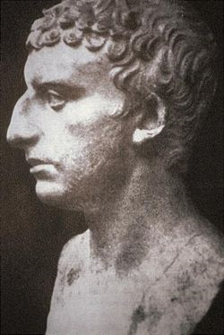
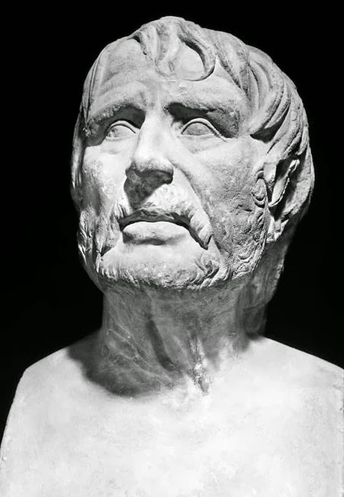
Contemporaries - Josephus and Seneca the elder
Josephus wrote the earliest account of Gaius’ reign. We have an account of him actually visiting the emperor (who was busily preoccupied with house improvements.)
Writing mainly under the next dynasty the Flavians he was encouraged to be critical of the Julio-Claudians to make the comparison favourable. Also hostile to Rome as a Jewish writer
Seneca the elder wrote about 55-59 in exile. Extremely critical of Gaius and his character possibly as a way to gain favour with the emperor Claudius and encourage him to end his exile

Slide 5
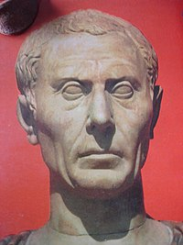
Suetonius
Suetonius loves gossip and scandal, so the decline of Gaius is a delight to him. This may not mean that it is untruthful, but he will certainly make the mistakes deeply colourful and it is probable that he would exaggerate for dramatic effect.
He is considered the main authorityon Gaius but was writing some 80 years after his death.
He had access to the imperial records which gave some of his information reliable suplementary information.

Slide 6
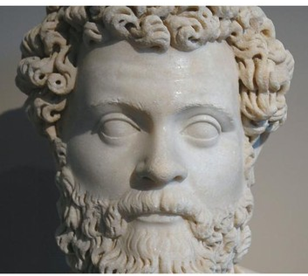
Cassius Dio
Dio was a senator writing a long time after this reign in the third-century who gave a his particular perspective on Gaius’ reign. Very critical of his absolute power and attacks on the senate and clearly contemptuous of the people who he distrusts. This means that he is unfair on what might seem to many people quite a democratic move on the part of Gaius.

Slide 7
Administration and reform
Evidence of positive changes to the government of Rome
Suetonius lists a range of reforms brought in by Gaius all of which appear sensible and seem to challenge the image of a ‘mad’ emperor:
• The imperial budget was published
• Censorship on a number of Augustan writers and historians was lifted
• Magistrates were given full authority over court cases
• A fifth judicial division was created to spread the workload of the courts
• The list of equites was revised
• The leadership and government of several ‘buffer regions’ to the Roman empire were reorganised.

Slide 8
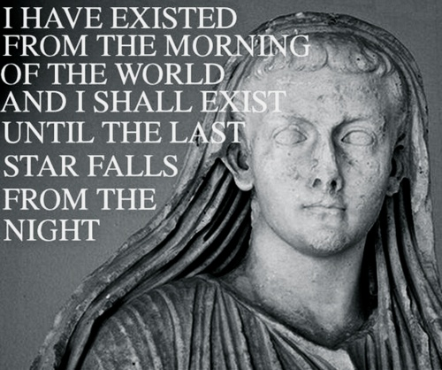
Gaius as a god
Brutal?
Divine?
Confused?

Slide 9
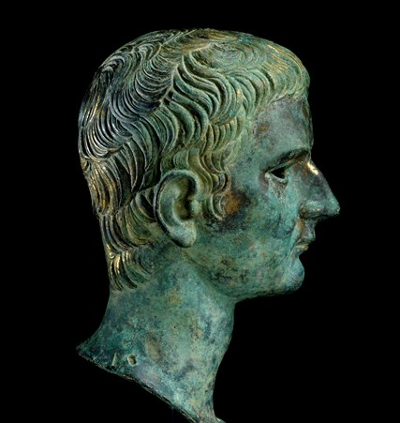
Divine Gaius
His opinion of his own divinity becomes the defining characteristic of his reign, again in complete contrast with Tiberius.
Gaius held no positions or powers before becoming emperor and therefore lacked auctoritas. Declaring himself a living god might have been a way to make up for this shortfall
Dio says that an ordinary cobbler from Gaul told Gaius that he was “a big joke” but got away with it because he was of such low rank. Those who were of higher rank had to pray to him and kiss his hand or foot. Most of the Senators seem ready to go down on their bellies to prostrate themselves before him. Suetonius tells us that all the richest citizens wanted to be priests in his temple.

Slide 10
Some key sources on signs of madness
Dio: says that Gaius tells the senators that he had been warned by Tiberius to show them neither affection or mercy…. “Because they are all praying for your death”. He then restored the Treason Trials and the Senate responded by making an annual sacrice to him, putting a golden image of him on the Capitoline hill and showing grovelling respect.
Suetonius
“The following instances will illustrate his cruelty. Having collected wild animals for one of his shows, he found butcher’s meat too expensive and decided to feed them with criminals instead. He paid no attention to the charge sheets, but simply stood in the middle of a colonnade, glanced at the prisoners lined up before him, and gave the order ‘Kill every man between that bald head and that one over there”
Younger Seneca on anger
This was the same man who used to wish that the whole Roman people had one single neck, so that he could have concentrated all his crimes, spread over so many times and places, into one single stroke on one single day.!:
Josephus
“Gaius' madness was now an offence to god and man…..Rome herself …became only too aware of the sheer horror of his actions, since he afforded her no special treatment.”

Slide 11
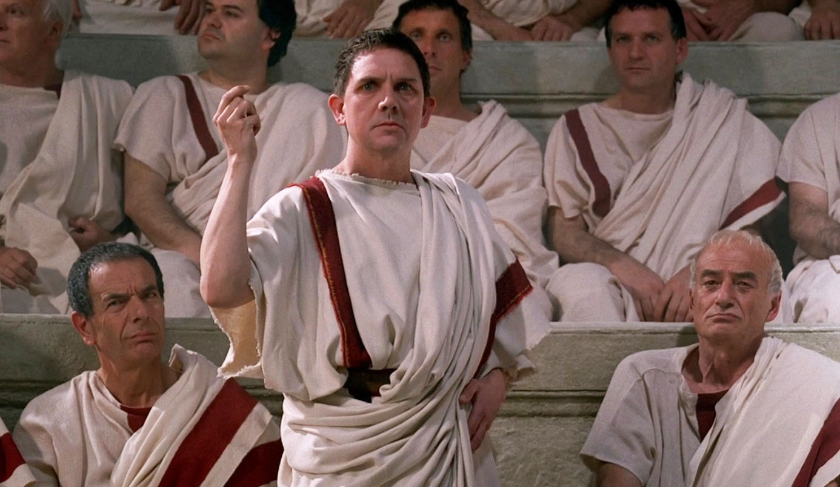
Senate
Dio and Suetonius both tell us when Gaius become Emperor he didn’t take full control of the senate and left the senate to run the empire which meant this rein started of with a healthy relationship between the senate and the emperor
According to Dio Tiberius told Gaius not to trust the senate and as time when on he began to distrust the senta as he saw them as corrupt and useless. This begins to cause a break down in relations between the two
He gave a speech to the senate where he reintroduce the treason trail so he could install an atmosphere of fear. The senate were a sycophantic body under Gaius and did not oppose the treason trial and instead began thanking him for not killing them.
The senate began rewarding Gaius for his clemency by offering annual scarifies, erecting statues of him on the Capitoline hill and awarding him triumphs which shows the fear had created a good relationship between the senate and Gaius

Slide 12
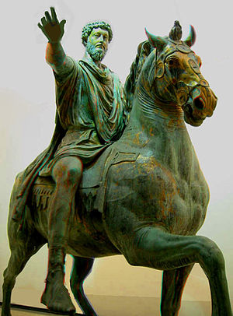
Equestrians
DIO account
Dio details that Gaius was very nice to the Equestrians as by the time of his accession the roll of equestrians were becoming depleted he stopped this by reveries the list of Equestrians and gave them permission to wear Senatorial dress before magistracies which gave them a huge states boost. Therefore Dio gives the view of a positive relationship between the Equestrians and Gauis
Suetonius
Suetonius and Josephus both give the view that Gaius was hostile towards the them. As he saw the Equestrians wasting his time but Suetonuis does acknowledge that the list of Equites was revised he still upholds the view of an unhealthy relation between the Equestrians and the emperor

Slide 13
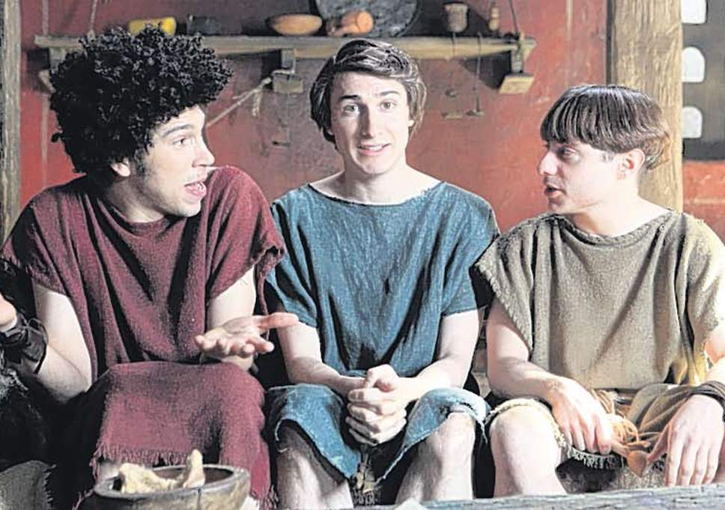
Gaius’s relationship with the Plebs.
Plebs
Abolished the 0.5% auction tax as he wanted to appeal to the masses of Rome
At a public game the plebs desperate requests to him to reduce taxes and grant relief but Gaius could accept this and sent officials into the crowd to arrest who was shouting the loudest and then to immediately kill them in front of the crowd ( from Josephus
Suetonius states “used to wish that the whole of Rome people had one single neck, so that he could concentrated all his crimes , spread over so many time and places , into one single stroke on one day
In summary it clear that Gaius clearly tried to appeal to the masses which is shown but the tax cut but after the riot at a public game he sees the plebs as pushing their luck and after this he is harsh to the plebs
He held a series of public games which were immensely popular (told to us by Josephus)
It’s clear at the beginning of his rein the plebs don’t mind him due to public games but after the treatment and the riot they seem to change their mind and the fact they don’t mourn his death shows the lack of support for him at the end of his rule

Slide 14
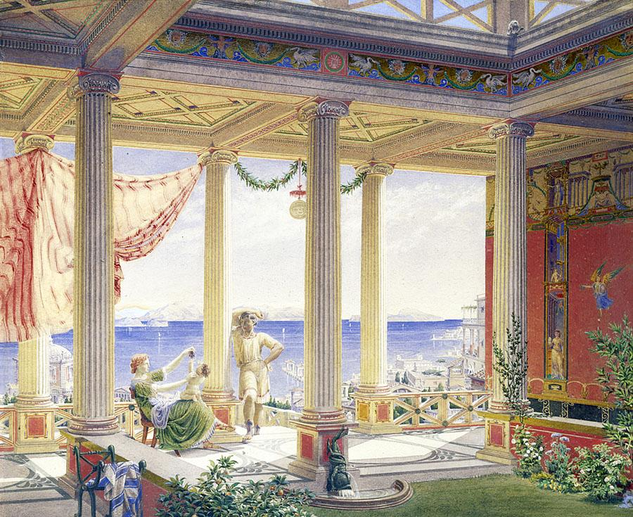
HOWEVER…..
Dio is quick to point out the recklessness of Gaius’ spending and the impact this had on taxation.
“He collected all the available merchant ships and anchored them in two lines, close together, the whole way from Baiae to the mole at Puteoli, a distance of some three miles and some 600 feet. Then he had the ships boarded over, with earth heaped on the planks and made a kind of Via Appia along which he trotted back and forth for two consecutive days. On the first day he wore a civic crown, a sword, a shield and a cloth-of-gold cloak, and rode a gaily caparisoned charger. On the second he appeared in charioteer’s costume driving a team of two famous horses”.

Slide 15
Assess how unpopular Gaius was

Slide 16
How far do the sources show that Gaius was universally unpopular during his reign?
He was Universally unpopular:
Josephus claims that ordinary Romans had a ‘deep hatred’ of Gaius that grew more intense during his reign. This was due to his ‘vicious’ and ‘savage’ behaviour
Josephus also claims (p.6) that Gaius mistreated the senate and equestrians, and inflicted on the entire empire “misfortunes to a degree unprecedented in recorded history”
Dio (p.7-8) says that Gaius was worse in “licentiousness and bloodthirstiness” than Tiberius and that Gaius made people think that Tiberius’ acts were “far superior to those of Gaius”
Suetonius says simply that Gaius turned into “Gaius the monster” (p. 3) suggesting he was not popular. He also claims that Gaius had supposedly wished that all of Rome “had one neck” so that he could execute them
There is also clear evidence from the sources of opposition from the Plebs: Josephus explains how the plebs protested over increases in tax, uttering a “storm of protest”
The sources present Gaius’ assassination as the inevitable consequence of his unpopularity. Dio (p.24): “Since Gaius continued to play the complete madman in every way, a conspiracy was formed against him.” In the same source Dio also presents the plot as broad suggesting all groups hated Gaius
He was not Universally unpopular:
Suetonius and Dio both agree that Gaius started his reign well and was greeted enthusiastically. Suetonius (p.4) claims that Romans shouted “Star, chick, baby and pet” as the crowds greeted him “ecstatically” in AD 37
Gaius was undoubtedly popular with the plebs – he held Games (Suetonius) and cancelled the 0.5% auction tax in AD 39 (see coin on p. 12)
The Plebs were also not offended by Gaius’ claims to be a living god. Dio (p.12) says that “The masses, however, were not even in the slightest disturbed by these events, but rather took pleasure together with him in his licentiousness.”
The sources also suggest that the senate supported Gaius. Suetonius (p.15) says that the Senate se ta side Tiberius’ will to make Gaius sole emperor. Dio (p.16-17) shows that even when Gaius threatened the Senate and restored maiestas, the Senate voted him a lesser triumph and paid for a golden statue of him to be placed on the Capitol because “they were most grateful to him for not having put them to death”
Gaius’ assassination was carried out by a small group of plotters and is not convincing evidence of mass opposition to Gaius

Slide 17
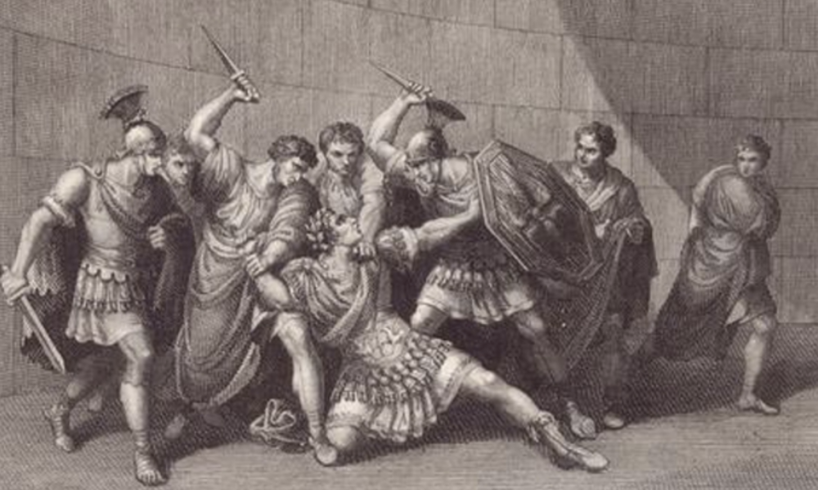
Assassination, 24th January 41
We have multiple accounts of Gaius’ assassination – Josephus, Suetonius and Dio
All present the assassination as natural justice for the brutality of Gaius’ reign
There is some disagreement about how many plots there were but all the sources want to create an image of mass opposition to Gaius
Dio tells us that the plot included Cornelius Sabinus (Praetorian Tribune) Callistus (imperial freedman) and Marcus Arrecinus Clemens (Praetorian Prefect). Josephus claims there were three separate plots

Slide 18
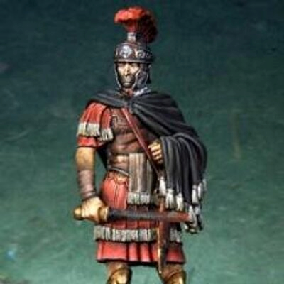
Assassination, 24th January 41
All the sources confirm that Gaius was killed during a festival on the Palatine Hill
The sources give slightly different account of the murder itself but all give a sense of its brutality – Dio claims that the assassins kept stabbing the dead body and even ‘tasted the flesh’
Seneca claims that Chaerea was motivated by the insults against his masculinity he received from Gaius
The assassins, however, came from a very limited group and there was not mass opposition to Gaius (Dio says that even as Gaius was leaving the theatre the consul was bending over to kiss his feet)
The assassins were most likely not trying to restore the republic but were motivated by personal revenge or self-interest

Slide 19
Final Points
Some overview questions to test yourself with:
What gave Gaius his claim to the throne?
Suetonius gave some examples of achievement in the initial period of his reign. What were these?
What examples of brutality did Gaius display?
Why did he flaunt his divinity?
What positive qualities did Gaius possess?
What (according to Dio) did Gaius do to help restore the equestrian order?
Who murdered Gaius and what motivated them?

