Slide 1
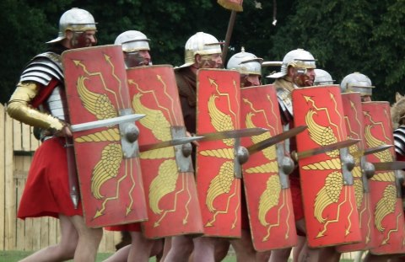
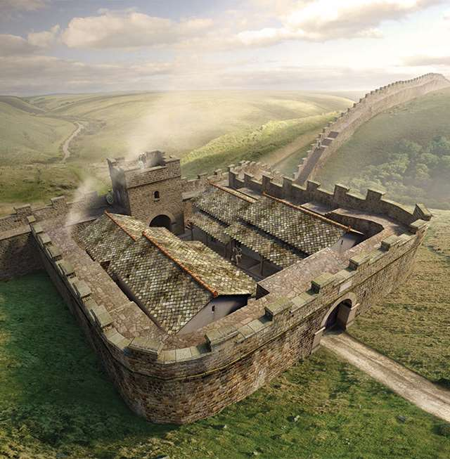
Roman Britain Topics 1&2
Topic 1:
Conquest and Expansion, AD 43-84
Topic 2: Consolidation and Retrenchment, AD 85-128

Slide 2
Conquest and Expansion, AD 43-84
55 & 54 BC – Julius Caesar's invasions of Britain
AD 41 – Claudius comes to power in Rome
43 – Claudius launches his invasion of Britain, led by Aulus Plautius
43 – Roman Victory at the Battle of River Medway and River Thames,
43 – Claudius arrives in Britain for 16 days – receives the surrender of Camulodunum

Slide 3
Conquest and Expansion, AD 43-84
44 – Vespasian expands Roman power in the South West
47 – Plautius extends Roman control up to the Fosse Way
47 – Revolt from the Iceni
49 – Revolt from the Brigantes
47-51 – Caratacus leads a guerrilla campaign against the Romans culminating in his defeat in Wales

Slide 4
Conquest and Expansion, AD 43-84
51-60 – Campaigns against the Silures and intervention in Brigantia (Cartimandua still a client ruler)
60-61 - Boudiccan Revolt – sack of Colchester, London and St Albans, Battle of ‘Watling Street’
67 – Fourteenth Legion removed from ‘Britanni’
69 – Year of the Four Emperors – Political instability in Rome

Slide 5
Conquest and Expansion, AD 43-84
71 – Expansion into Brigantia, Second Legion sent bringing the number up to four
74 – Further consolidation of control in Wales
81-84 – Agricola campaigned north of the Forth-Clyde line extending Roman Power into Caledonia
83 – Roman victory at Mons Graupius

Slide 6
Consolidation and Retrenchement, AD 85-c. 128
AD 82 – Construction of the fort at Inchtuthil
Mid 80s – Emperor Domitian experiencing financial problems in Rome and attacks in the east from Dacia – beginning of Roman withdrawal from Caledonia to the Forth-Clyne Line
87 – Second Legion withdrawn from Britain and sent East

Slide 7
Consolidation and Retrenchement, AD 85-c. 128
98 – Emperor Trajan built permanent stone fortresses at Caerleon, York and Chester signalling the limits of Roman power
C. 100 – Stangate system (Tyne-Solway Line) being used as a frontier, including forts such as Vindolanda
C.117-119 – Strong resistance to Roman power in the north shown by the arrival of fresh soldiers (Sixth Legion)

Slide 8
Consolidation and Retrenchement, AD 85-c. 128
AD 121-22 – Hadrian arrives in Britain and orders the construction of a Wall just north of the Stanegate System
125 – Forts were added to the wall e.g. Housesteads
C.125 – the vallum was added behind Hadrian’s Wall
125-128 – Wall extended in the East to Wallsend, Western end of wooden wall replaced by stone

Slide 9
Roman Military Policy in Britain after AD 43
Roman Governors of Britain during the Julio-Claudian Dynasty
Aulus Plautius | AD 43-47
Publius Ostorius Scapula | 47-52
Aulus Didius Gallus | 52-57
Quintus Veranius | 57-57
Gaius Suetonius Paulinus | 58-62
Publius Petronius Turpilianus | 62-63
Marcus Trebellius Maximus | 63-69
Marcus Vettius Bolanus | 69-71
Quintus Petillius Cerialis | 71-74
Sextus Julius Frontinus | 74-78
Gnaeus Julius Agricola | 78-84
The Big picture…
The rest of the topic 1 booklet looks at the different approach taken to strengthening Roman power in Britain by each Governor after the initial invasion
Some would follow a policy of expansion – fighting wars against British tribes to extend Roman territory and power in Britain
Others would follow a policy of consolidation – strengthening Roman control over existing or recently added areas

Slide 10
Key Questions
Why did Claudius invade Britain in AD 43?
Why were the Romans successful in the invasion of AD 43?
Why did the Romans alternate between periods of expansion and conisation?
To what extent was Agricola the most successful governor of Roman Britain?
Why did the Romans withdraw from northern Britain towards the end of the first-century AD?
How significant were the policies of emperors in shaping frontier policy in Britain?
What was the purpose of Hadrian’s Wall?
To what extent do the ancient sources allow us to understand Roman frontier policy between AD 85 and 128?

Slide 11
Essay Questions
‘The motives for Claudius’ invasion of Britain was personal rather than political.’ How far do the sources support this view?
How far should we accept Tacitus’ portrayal of Agricola’s military achievements as accurate and impartial?
How useful is the evidence for our understanding of Roman policy towards a permanent northern frontier in Britain?
How far would you agree that Hadrian’s Wall was built solely to keep the barbarians out?

