Slide 1
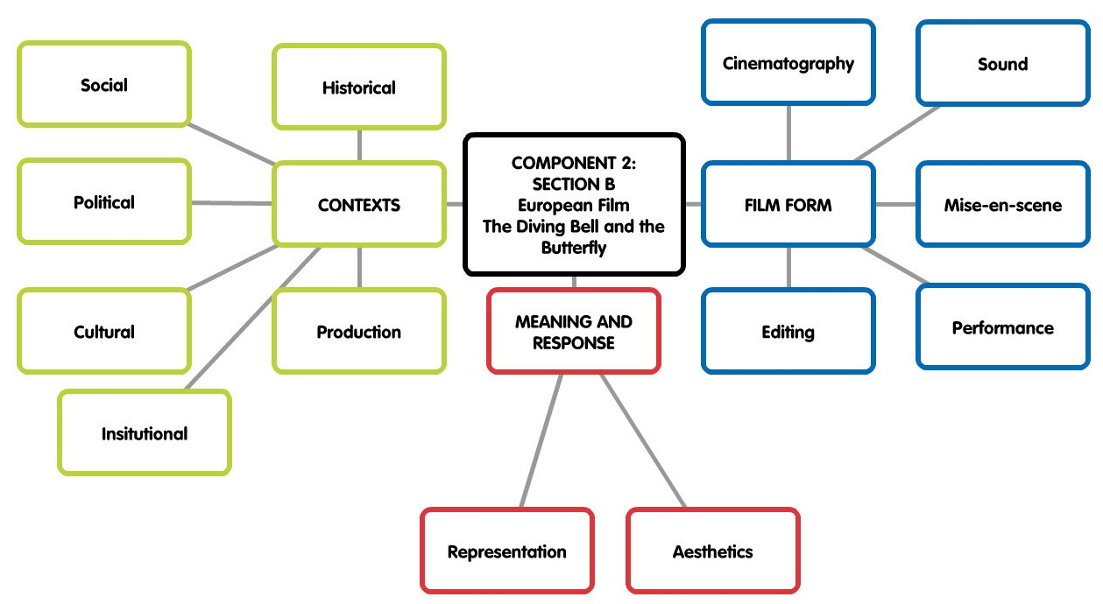

Slide 2
The Diving Bell and The Butterfly (Schnabel. 2007 France)
REPRESENTATION

Slide 3
1ST PERSON
RESTRICTED NARRATIVE
3RD PERSON
OMNISCIENT NARRATIVE
Audiences are not ‘aligned’ to any one character
The camera and sound filters the narrative only through 1 character
The viewer experiences what the character does
The viewer knows more than the characters as they are ‘all seeing’
The spectator is aligned to 1 character

Slide 4
Key areas to analyse
Representation | Focus | Scenes
Representation of Fathers | Relationship between Jean-Do and his father | The Shave Father and Son phone call
 | Jean-Do as a father | Father’s Day Jean-Do and Theo
Representation of Women | Jean-Do objectifying women | Meeting female therapists Lourdes Flashback
 | Relationships – Mother of his children and mistress | Celine and Ines Celine

Slide 5
representation
Download TDB Representation KLF from GoL
TASK 1 - THE RELATIONSHIP BETWEEN FATHERS AND SONS
Analyse the 4 scenes in terms of representation and how film form constructs them
TASK 2 - THE REPRESENTATION OF WOMEN
Analyse the 4 scenes in terms of representation and how film form constructs them
TASK 3 - CHARACTER PROFILES
We need to consider the characters and how they have been portrayed so complete the table, Finish for homework

Slide 6
homework
All of the 3 representation tasks on the handout

Slide 7
Exam question
How far do representations within your chosen film challenge stereotypes of either age or gender?
Illustrate your answer by close reference to at least one sequence from your chosen film.
In your answer, you may consider:
Stereotypical/Atypical traits & behaviours
How film form represents characters
Wider contexts surrounding the film [20]

