Slide 1
Holderness and Odisha Coastline Revision Notes
This is to supplement your notes that you have made and not to replace them!

Slide 2
Physical processes
Flamborough Head
Geology: relatively hard chalk formed 75 million years ago
Vertical cliffs 100m high with caves, arches, stacks and stumps, wave-cut notches and wave-cut platforms.
Landward dip
The chalk has been subjected to tectonic activity and so has many faults. These faults are areas of weakness for weathering and erosion to exploit.
Dominant processes of weathering – carbonation (chemical) and wetting and drying (mechanical) although other weathering processes will also occur e.g. biological, freeze-thaw etc
NE prevailing wind and large fetch create powerful waves, especially during the winter storms and so high energy. Wave refraction concentrates the waves energy on Flamborough Head.
Mass movement - rockfalls
Bridlington Bay to Spurn Head
Geology : weak, unconsolidated boulder clay deposited at the end of the last ice age approx. 10,000 years ago.
It has retreated by 5km since Roman times with rates of erosion in excess of 1m per year and 10m in some places. This rate of erosion has increased due to climate change and, in some places, coastal management schemes.
Dominant processes of weathering – wetting and drying leading to slumping (a type of mass movement)
Much of the sediment produced is carried offshore but some is transported south by LSD providing a supply of sediment for the narrow beaches and Spurn Head.

Slide 3
Spurn Head
Spurn Head is a zone of net deposition (sediment sink) and a temporary store of sediment. It is believed to have a life cycle of 350 years of growth, breach and being washed away.
The Humber Estuary stops it extending southwards and becoming a bar. Behind the spit is an a low energy environment with salt marshes formed. The river and sea currents meet and result in sediment being deposited.
The Holderness coastline can be used for examples of different landforms and processes.
The exam board specify that you need to know about temporal change on coastlines and so you can used the different timescales of formation and erosion for the Holderness Coast

Slide 4
Human impacts
How do councils decide whether to build coastal defences?
Why did they chose to protect Bridlington?
Why, despite having a small population have they protected Mappleton?
What hard engineering approaches did they use at Mappleton?
What additional benefits have there been as a result of the coastal defences having been built?
What has happened to the land south of the groynes at Mappleton?
Why is it important to protect Easington?
Bridlington
Easington

Slide 5
Why is Kilnsea village under threat from two directions?
Why have the Environment Agency refused to build coastal defences?
What have the locals done and why is this not a long term solution?
What is the roll back scheme that Sandy beaches caravan park qualify for?
Other than to protect the Humber estuary from increased erosion, why is Spurn Head valuable?
How is Spurn Head changing?
Bridlington
Easington

Slide 6
The Holderness coast is part of SMP 3 - Flamborough Head to Gibraltar Point.

Slide 7
The Holderness Coast is largely one where no intervention has been decided as a SMP. However, we also have areas of the coastline with hold the line and also a small area which is managed retreat

Slide 10
The Aims of the SMP along the Holderness Coast | Importance score /5
To balance flood and erosion risk management in a sustainable manner appropriate to the overall value of the features affected (Overall value – cost benefit analysis)
To ensure that shoreline management policies encompass longer term adaptation options, and give time for communities and individuals to adapt to changing climate conditions and levels of risk. (In the short term they may protect the coastline in order for people to adapt to changes but they may choose not to over the long term)
To develop policies for flood and erosion risk management that will inform spatial planning processes and provide a robust evidence base for Local Development Frameworks (spatial planning (e.g. whether to build new houses in a location)
To support sustainable patterns of development and consider possible effects on communities and their welfare. (Will whole communities be lost e.g. at Kilnsea?)
To support the nationally, regionally and locally important social and economic assets of the area in a sustainable manner. (Easington gas terminal, main roads and railway)
To consider the effects of coastal change on local industries, agriculture and employment and provide a secure environment for economic activity and development. (Protect jobs and the economy e.g. businesses at Bridlington)
To ensure that local decisions do not have a disproportionately adverse affect on the natural balance of the coastline and shoreline management elsewhere. (Protection at Mappleton has speeded up erosion further south)
To contribute to the positive management and enhancement of environmentally designated sites and protected species, subject to natural change. (e.g. Spurn Head nature reserve)
To support the conservation and enhancement of biodiversity in the wider coastal zone.
To support the preservation and enhancement of the historic environment (e.g. churches)
Pick 5 of these aims to memorise for the exam. Make sure that they are a range of ideas, with some more important than others so that you can assess.

Slide 11
What are the threats to the Holderness Coast?
Flooding due to sea level change and the increased frequency and intensity of storms. The North Sea is subject to storm surges – events caused by intense low pressure weather systems (associated with storms) and the funnelling of water.
Low lying areas of the Humber Estuary and Spurn Head are particularly at threat with communities such as at Kilnsea.
Increased rates of erosion due to greater wave energy. The whole coastline is at threat but particularly vulnerable is the land underlain by soft and unconsolidated boulder clay.
Disruption to transport – roads and railways and gas supplies
Loss of businesses and jobs

Slide 12
Sustainable coastal management
SMPs (Shoreline Management Plans)
Deal with the shoreline
ICZMs (Inter Coastal Zone Management)
Deals with the management of the whole coastal zone including off shore water and inland
e.g.
Shipping
Fisheries
Agriculture
Tourism
Development of infrastructure
Adaptation to climate change

Slide 13
The ICZM states that it is important to involve all stakeholders across the different sectors to ensure broad support for the implementation of management strategies.
Key stakeholders for Holderness involved in developing the SMP:-
The East Riding of Yorkshire Council
National government agencies – Environment Agency, Natural England
Local government – Lincolnshire County Council, North East Lincolnshire Council, East Lindsey District Council
Stakeholders in the economy – The National Farmers Union
Environment stakeholders – English Heritage

Slide 14
ICZM aims to contribute to sustainable development by employing an ‘ecosystem-based approach’ that operates within the limits of natural resources and ecosystems.
Planning
Decision-making
Managing and monitoring of implementation
Information collection
It should operate in a cycle with each stage generating feedback to be addressed by the following stage
The ICZM was used to develop the Flamborough Point to Gibraltar Point Shoreline Management Plan (SMP) in 2011

Slide 15
Odisha – NE India
Contains 3 important habitats – 6 major deltas (areas of net deposition formed by sediment from rivers), Chilika Lake and mangroves
The majority of the population live on the coastal plains

Slide 16
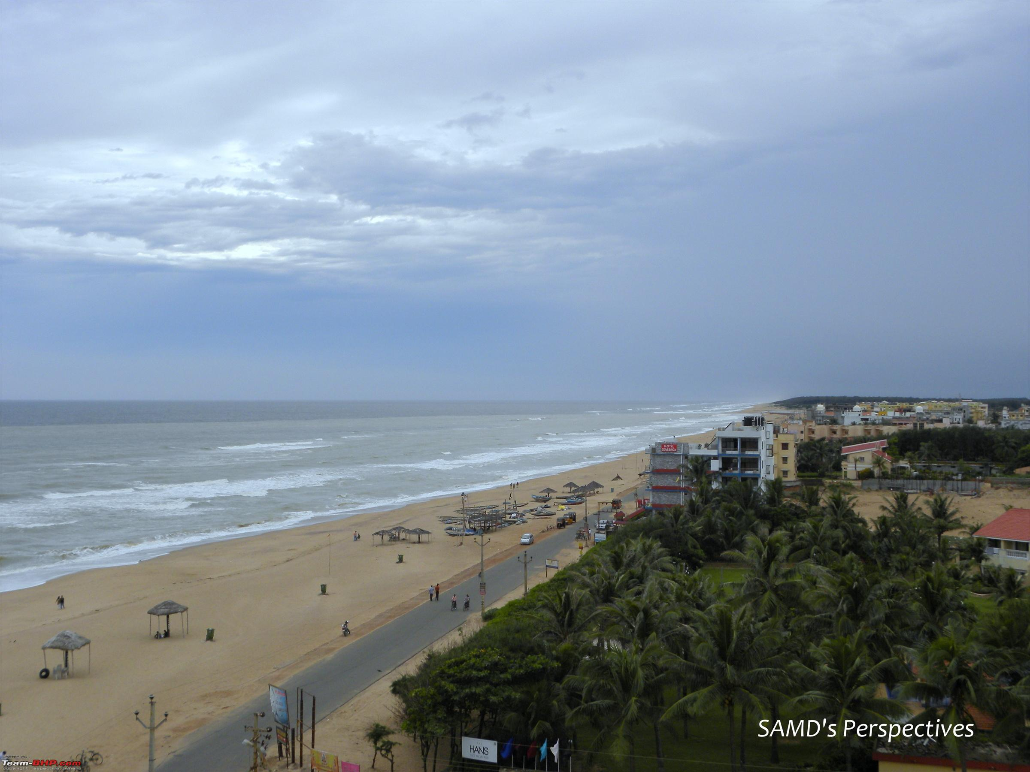
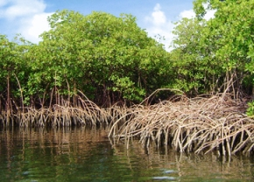
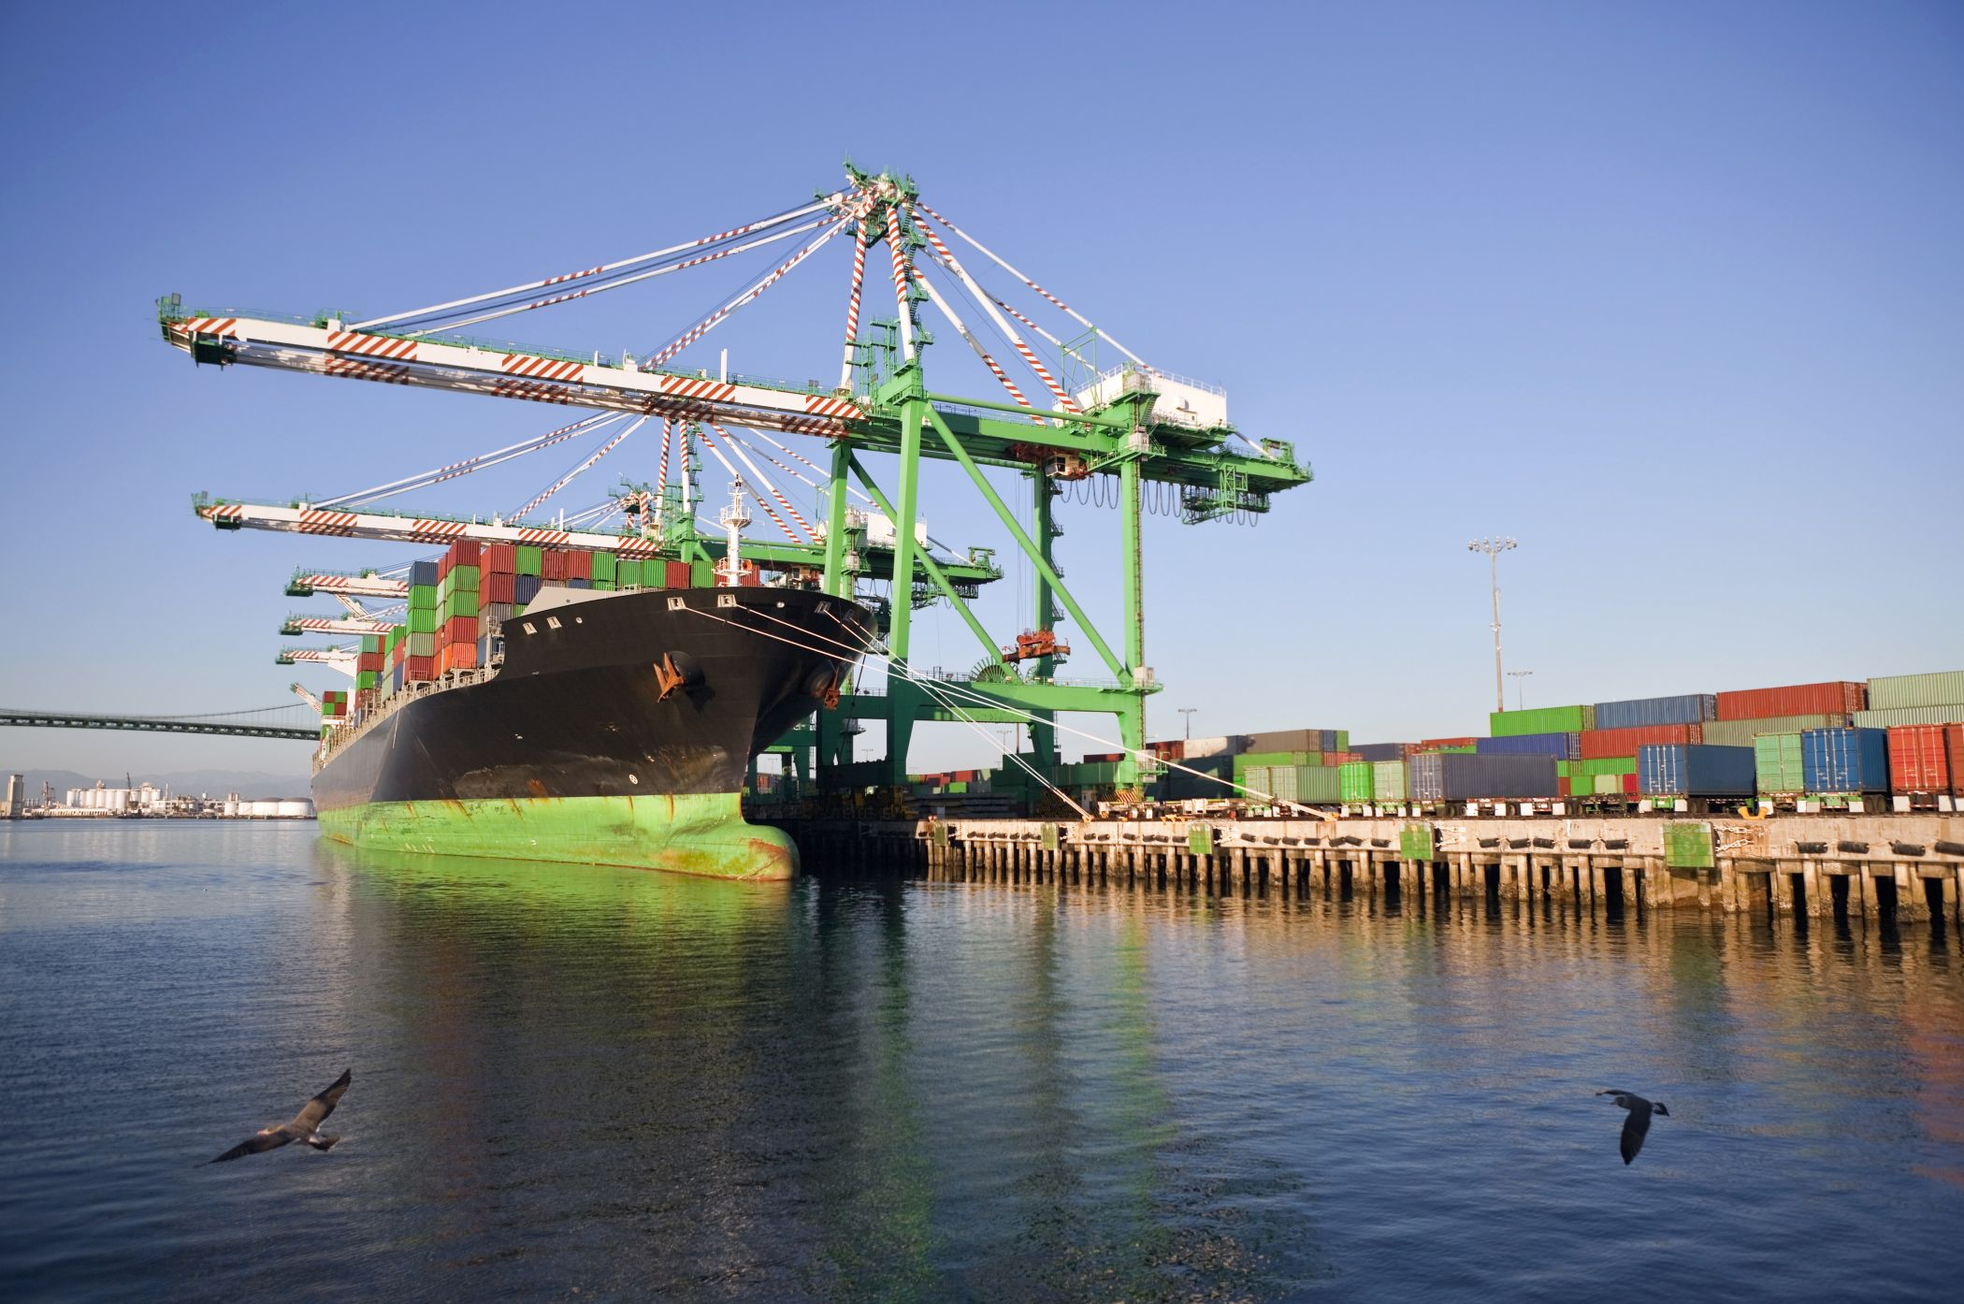
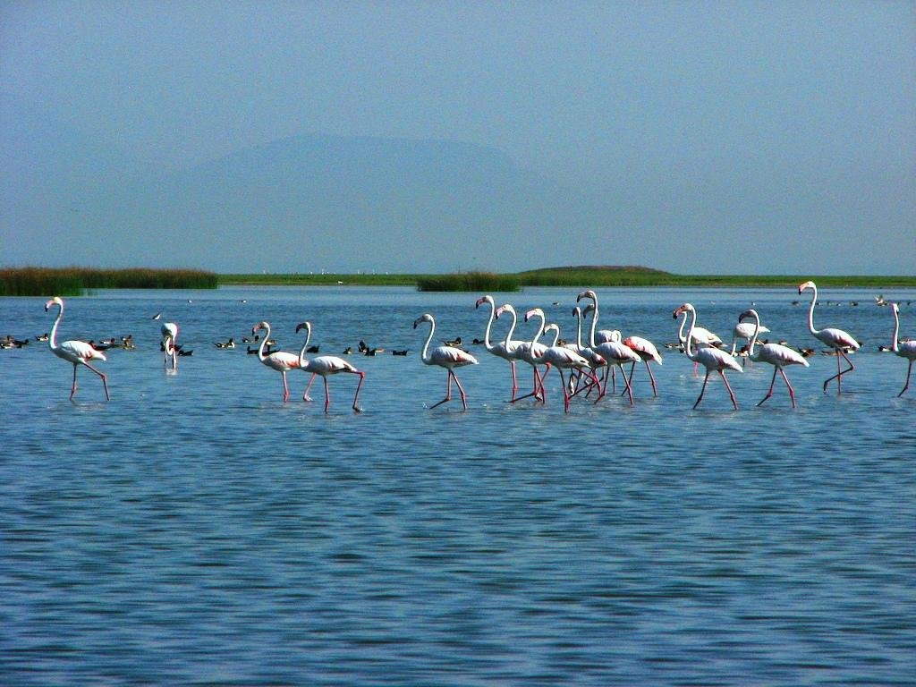

Slide 17
Dense mangroves in the coastal northern districts accretion 50% higher than the rest of the coast
The port of Paradip
Chilika Lake
The coast of Odisha is largely accreting (46.8%), with 36.8% eroding and 14.4% stable.
Pattern - accretion (net deposition) to the north and net erosion to the south.

Slide 18
Threats
Sea level rise and increased frequency and severity of storms. The area is at risk of tropical cyclones and the associated storm surges. In 1999 10,000 people died.
A region lying 30km to the north of the Paradip Port is called the Seven Brothers as there were 7 villages – now only 2 are left. The area retreated 3km inland over the last 40 years. The building of the port in 1966 is thought to be responsible as it has stopped the normal flow of sediment which would have replenished the beaches. The government are planning 15 more ports along the coast!
Lost of agricultural land, communities, industries etc.

Slide 19
Opportunities
Large stocks of fish in the ocean – many people employed in fisheries
Many people work in the ports
Tourism – cultural heritage and beaches attract visitors
Potential for offshore wind farms
35% of the coastline rich in minerals including clay and limestone
Chilika wildlife sanctuary – international importance for bird species

Slide 20
The threat of sea level rise and a history of devastating tropical cyclones have meant that the population have needed to be resilient (The psychological quality of strength of character, of being able to respond positively to adversity).
They have needed to mitigate (Reducing or alleviating the impacts or severity of adverse conditions or events).
They have needed to adapt (Fitting into the natural system and local way of life, which may involve changing behaviour).

Slide 21
ICZM in Odisha
Involvement of: - local communities, Odisha Tourism Board, State Disaster Management Authority, Water Resource Department, Archaeology Department, wildlife organisations etc
The localised management of the coastline was found to cause more long-term harm than good. An integrated approach was needed and implemented in 2011.
Major issues identified | Management solutions
High and increasing rates of coastal erosion Increased vulnerability to tropical cyclones Threat to biodiversity (e.g. Chilika Lake) Threat to livelihoods e.g. fishing Pollution Conservation of cultural/archaeological sites | Development of ecotourism (adaptation) Providing relief supplies ahead of approaching storms, broadcasting warnings and conducting staged evacuations (adaptation) Planting or replanting of mangroves to act as a coastal defence (mitigation) Building cyclone shelters (adaptation) Banning fishing during fish breeding season and developing dried fish industries to maintain incomes (adaptation) Development of craft industries e.g. weaving - local villagers educated to become educators

