Slide 1
Evaluation PowerPoint for Storyboards

Slide 2
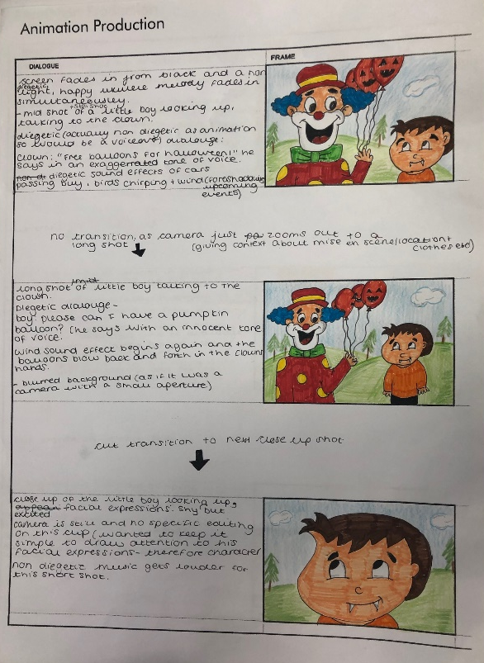
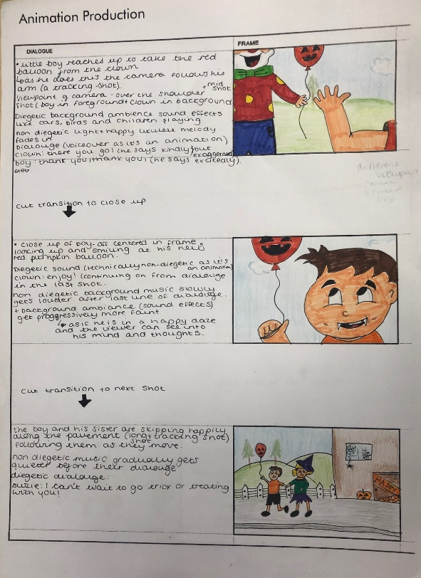
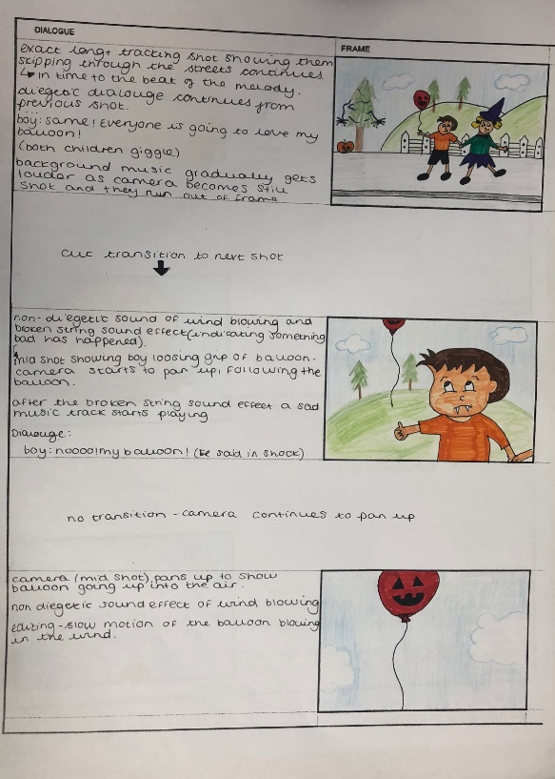
I think this storyboard turned out very well. I took into consideration the feedback that I got from my peers to improve my rough version to get this final animation storyboard. They said that they thought the drawings and design techniques used meant it was fit for purpose so I kept the same colourful and fun aesthetic appearance but made a slight improvement by changing the media I used. I decided to use felt tip pens for the characters and props in the foreground and then use the softer pencil for the background, making the foreground stand out more. Overall I think the aesthetic appearance is presented well and would appeal well to the young demographic due to the simple characters that show expression and the colourful and fun aspects.
For format, I kept it the same as before because my peers said it was clear and made the ease of use great. However I added some arrows to show the transitions in the animation and I think this worked really well to keep the dynamic aspects and flow of the animation. The format for this storyboard was very different to the game production storyboard as it is a different kind of production therefore has a different demographic, so style of design and details about sound and music etc are going to be very different. I think the content in this storyboard was interesting and detailed. I made improvements from the first animation storyboard I made as I had to produce double the panes. This meant I had to expand the content and develop the narrative further. I think this ended up being a huge benefit as it really developed the storyboard and made it a more fun and interesting animation to watch.

Slide 3
When it came to shot types, camera movements, angles and framing my feedback highlighted how I lacked this detail due to the fact it was an animation and how it wouldn’t actually be filmed with a camera, so I tried to develop this by expanding the number of panes and showing a range of different viewpoints. For example in a lot of the storyboard I switched from a long shot to a mid shot or a mid shot to an extreme close up to show the detail and create a dynamic flow that has a range of different camera shot types, making it more interesting for the viewer. I mentioned camera movements when the children are walking down the street as it was difficult to illustrate a camera tracking shot so instead I specified it in the descriptions under the panes. I also showed how the camera would pan up when the balloon flies up into the air by adding description and the different drawings to show the progression of it blowing away higher and higher. I also included a switch from a mid shot to a long shot to give perspective and develop the narrative in this section of the animation.
I used arrows on the storyboard to show the transitions however they weren’t very interesting as the animation duration was so short it would only look professional and flow if I used cut transitions after each shot. These transition didn’t create much meaning therefore this could be an aspect I could develop further if I was to do this again. I could use a more meaningful transition like a graphic match cut between the balloon and his eye. I also included editing information, the slow motion section to make the animation more interesting and dynamic.
The sound directions were detailed and successful in my opinion. Under each pane I specified whether the sound was non diegetic and diegetic and mentioned all features from music type and genre to voiceover dialogue and sound effects, all together giving a clear visual of how the animation will play out if it was to be made.
Finally when it comes to suitability compared to original intentions I think it was better than how I planned it to look. It was thoroughly detailed in all aspects, therefore making it suitable for purpose and my intentions were to create a storyboard exactly like this. I think could have developed this further and to make it more like my intentions I would specify more exciting transitions.

