Slide 1
ELE Factors
The environmental, ethical and legal factors content is part of your year 2 COMP3 specification.
The work we do on this now will form your notes for these topics for next year.
In year 2, it is really important you have knowledge of lots of real world business examples

Slide 2
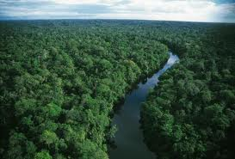
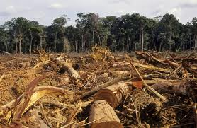
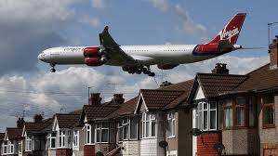
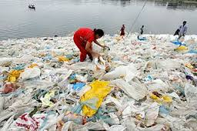
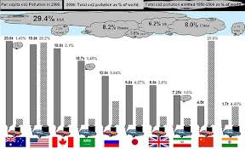
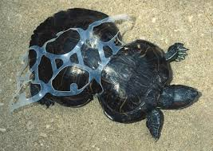
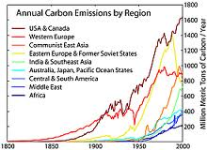
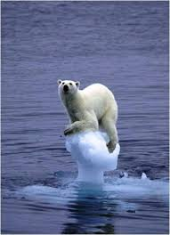
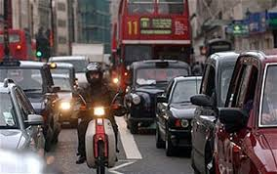
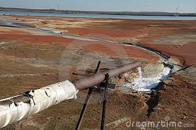
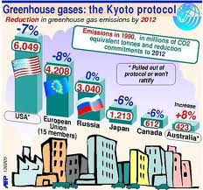
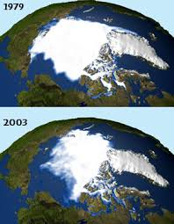
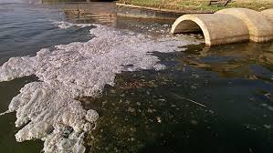
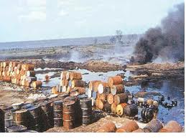
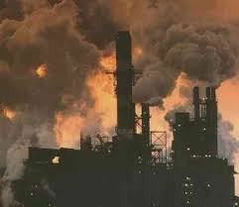

Slide 3
Starter: Environmental Factors
List 3 ways in which businesses contribute to environmental damage.
Give two examples of businesses who HAVE caused environmental damage.

Slide 4
Emissions of gas though production processes
Pollution caused by transporting raw materials
Using less packaging
Global warming
Energy consumption
Recycling
Congestion
Waste disposal
Efficient use of resources
Use of non renewable resources
Pollution of the sea by using it as a ‘free’ dumping ground
Destruction of natural environment

Slide 5
Learning Objective
Explain the potential environment costs of business activity including:
Air, water and noise pollution
Climate change
Congestion
Destruction of the environment
Waste disposal

Slide 6
The costs and benefits of business activity
When businesses produce and sell products or services it is relatively easy for them to see the costs involved and the benefits they will gain.
These are known as PRIVATE COSTS (e.g. wages paid to employees, costs of advertising) and PRIVATE BENEFITS (e.g. total revenue earned from sales, any resulting profit and the dividends paid to shareholders)

Slide 7
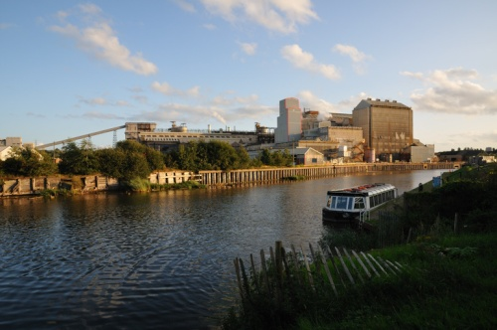
The costs and benefits of business activity
However, businesses may also create SOCIAL COSTS due to EXTERNALITIES. Externalities occur when private costs are different to social costs and private benefits are different to social benefits.
Social costs are made up of the private costs of the business plus NEGATIVE EXTERNALITIES (the costs to the rest of society).
Many externalities affect the environment.
Notes:
There can also be positive externalities such as job creation, improved skills. SOCIAL BENEFITS to society are the private benefits of to business plus positive externalities (the benefits to the rest of society)

Slide 8
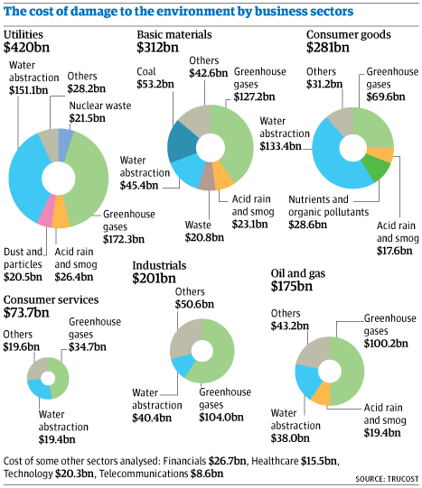

Slide 9
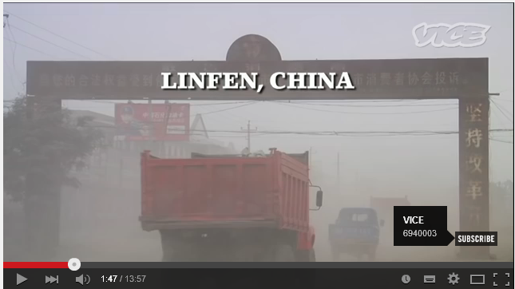
Air and Water Pollution
The pollution from factories, machines or vehicles emitting poisonous gases into the atmosphere.
Many industries use water in their production and are therefore near rivers, making it fairly easy for them to dispose of waste into nearby water.
Industries based near the coast have used the sea to dump waste. Cargo ships have also dumped their waste into the sea. The North Sea for example is one of the most polluted seas in the world!
Watch
Notes:
Click on pics to load,
Linfen video: https://www.youtube.com/watch?v=q4DtOhe2LfQ
Apple article: http://www.huffingtonpost.ca/2015/10/21/apple-china-air-pollution_n_8353408.html
How does this link to public vs pivate benefits and costs?

Slide 10
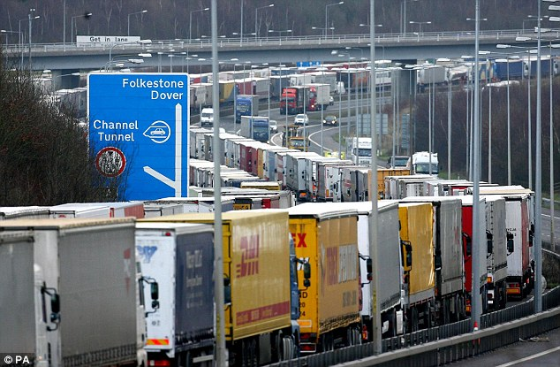
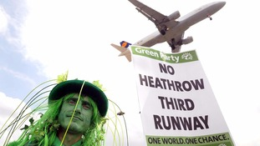
Congestion and Noise
More roads are becoming congested with traffic as a result of business activity (e.g. transportation of goods).
Some business activity can also result in noise pollution for example the opening of a new runway at an airport or the noise of lorries making deliveries to a factory could disturb local residents.

Slide 11
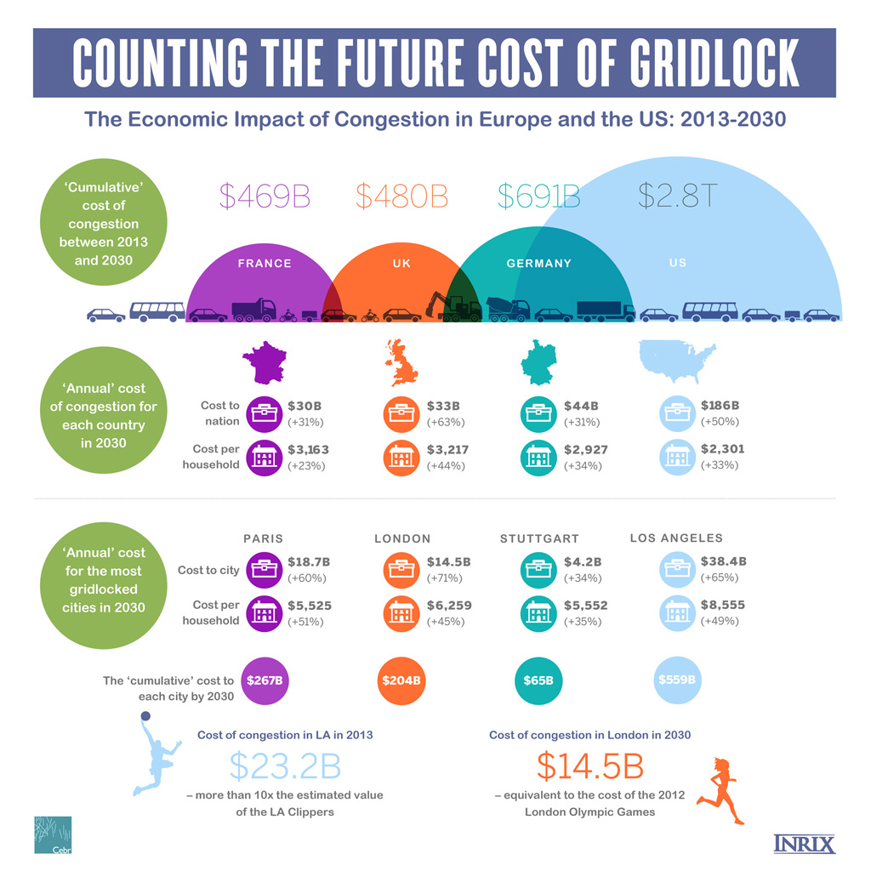
Notes:
http://inrix.com/economic-environment-cost-congestion/

Slide 12
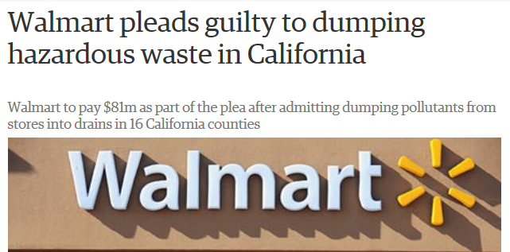
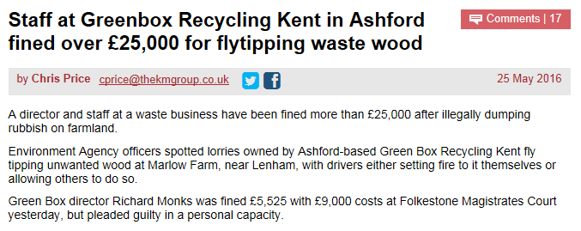
Waste and Waster Disposal
Many business operations result in waste products (chemicals, materials, packaging etc.)
Not maintaining equipment can result in waste (e.g. if a company does not maintain its water pipes and leaks occur)
Notes:
https://www.theguardian.com/business/2013/may/28/walmart-pleads-guilty-hazardous-waste
http://www.kentonline.co.uk/kent-business/county-news/ashford-firm-fined-fly-tipping-96392/

Slide 13
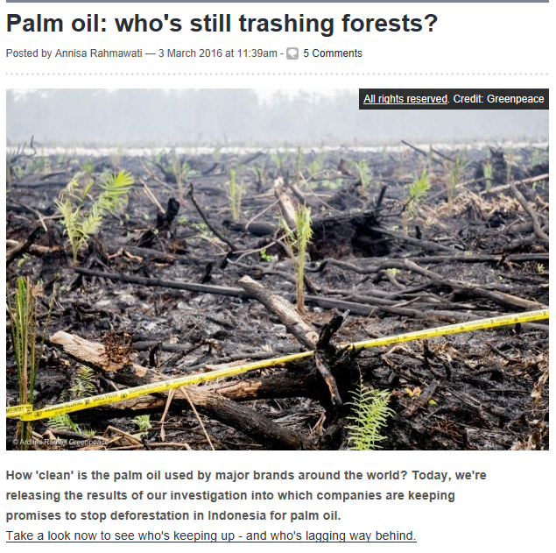
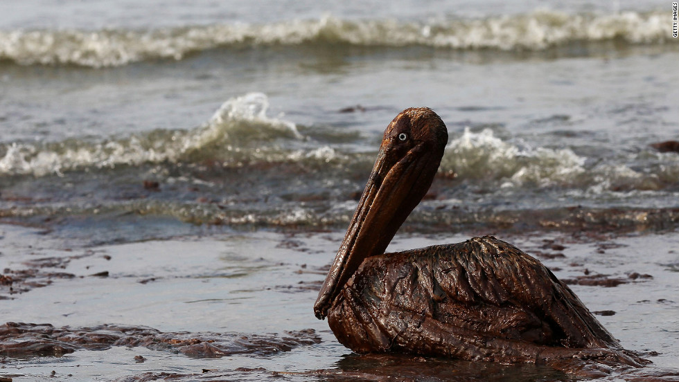
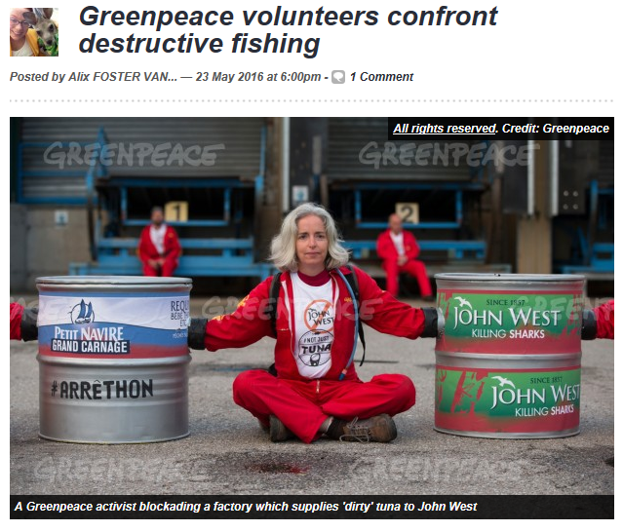
Destruction of the Environment
Examples include:
Logging and associated industries
New buildings in rural areas
Unforeseen events (e.g. BP Deepwater Horizon Oil Spill)
Notes:
Articles taken from Greenpeace blog

Slide 14
Activities
Complete the L1‘Environmental Costs’ scrap book
1. Define/explain each of the environmental costs (see business text book page 734 – 735)
For each issue, carry out research to find an example of a business that has damaged the environment in that way. You should use your research to give a detailed explanation of HOW and WHY the business’ activity produces negative externalities.
2. Complete the “In the news” tasks. Read and analyse the linked articles.

Slide 15
Plenary
Look back at the two examples you wrote down in the starter – which environmental issues have those businesses/industries contributed to?
What are the private/public costs and benefits of your examples?

