Slide 1
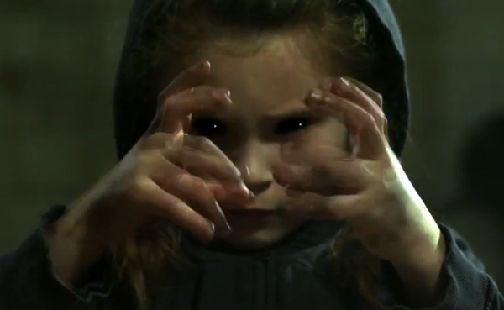
An introduction to music videos
A Level Media Studies

Slide 2
Different types of music videos
Narrative - These type of videos have a story or plot. It may have a strong connection to the lyrics or contain an unconnected story.
Interpretive - interpretive videos offer an interpretation of the songs lyrics. It can be a literal interpretation - i.e. it is very closely linked to the lyrics – or may be more of an ambiguous interpretation which requires the audience to create their own meaning.
Live - A live video of a band or artist will adhere to a number of codes and conventions (crowd reaction shots, cross-cutting between the lead singer and other band members) but is primarily designed to showcase them as strong live performers.
The Streets– Blinded by the lights
Beyonce - Formation
Guns & Roses – Paradise City

Slide 3
Surrealist - Music videos that have a surreal style are those influenced by the surrealist movement. Surreal music videos are designed to be unnerving and illogical, containing the element of surprise and unexpected juxtapositions.
Homage - Homage and allusion is generally used to mean any public show of respect to someone to who you feel indebted. In this sense, a intertextual reference within a creative work to someone who greatly influenced the artist would be considered a homage.
Vance Joy - Riptide
Sinead O’Conner – Nothing Compares 2U the inspiration for Miley Cyrus – Wrecking Ball

Slide 4
Codes and Conventions of music videos
Cutting to beat – the editing pattern will often follow the beat of the song, creating pace and rhythm
Miming and lip sync – the artist will often be required to mime or lip sync to the music, even in a ‘live’ performance video.
Mise-en-scene and iconography – often linked to the genre of music. For example, grime videos may contain urban locations, gangs/crews, sports clothing brands and mobile phones
Camera movements and angles – to help build a dynamic aesthetic, a range of camera angles and movements are used – CUs of the lead singer/ performer, LS of the band etc. These technical elements will play a key role in the representation of the artist/band.
Intertextual references – music videos often feature a rich mix of references to other music videos, films, TV programmes, artists, historical figures etc.

