Slide 1

Starter
Think & Share
What can be done (and by whom) to try to control environmental damage caused by businesses?
Notes:
Promote class discussion

Slide 2
Learning Objective
Explain how potential environmental costs can be controlled by government intervention, the influence of pressure groups and education

Slide 3


Controlling environmental costs
Government intervention:
  Legislation (e.g. mandatory carbon emissions reporting)
  Taxation
  Subsidies (e.g. Green Deal)
  Road charges
  Park and ride schemes
  Environmental audit
  Read: page 1 of exam board notes

Slide 4
What is an environmental audit and why have it?
An independent check on the firm’s impact on the environment. Measures of performance of a business against environmental criteria, such as levels of CO2 emissions.
Good for PR
Can be used in marketing – may attract customers and generate brand loyalty
Prepare for changes to legislation
May save money
May attract and keep staff
Owners’/managers’ views and values
Notes:
Audit includes a check on emission levels, wastage rates, pollution etc.

Slide 5





Controlling environmental costs
Education:
Government and other agencies, such as charities could try to influence consumers and producers through educational and promotional campaigns.

Slide 6
Controlling environmental costs
Pressure groups:
A pressure group is an organised group that seeks to influence government (public) policy or protect or advance a particular cause or interest.
Groups may promote a specific issue and raise it up the political agenda or they may have more general political and ideological objectives in mind when they campaign.

Slide 7
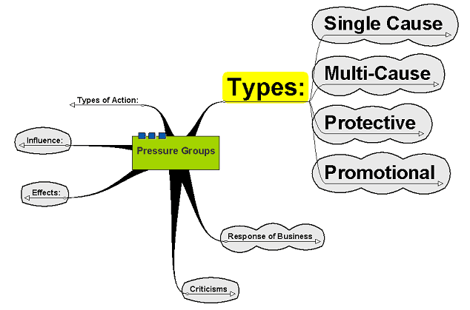
Types of pressure groups

Slide 8
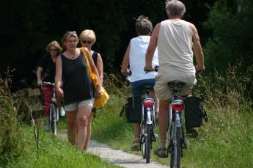
Single Cause
Focus on a particular issue:
Action on Smoking and Health (ASH) – attempt to reduce smoking and encourage a whole society response against smoking
RSPB – Seeking to promote welfare, care and protection of birds
London Cycling Campaign – seeking to promote use of cycles in London and the provision of safe cycle lanes and routes
Single cause pressure groups focus their attention on specific issues such as the improvement of facilities for cyclists.
Image copyright: Patrick Nijhuis, http://www.sxc.hu

Slide 9
Multi-Cause
Focus attention on a wider range of issues often under a generalised heading – e.g. the environment
Trade Unions – seek to influence policy in relation to workers – pensions, insurance, salary, maternity, equal opportunities, discrimination, etc.
Friends of the Earth – seek to influence decision making on wide range of environmental issues
RAC – seek to influence policy in relation to motor transport – petrol taxes, road use, congestion charging, car safety, car insurance, repair and maintenance, fuel efficiency, purchase and sale, etc.

Slide 10
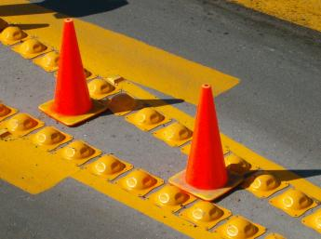
Protective
Seeking to protect the interest of members:
AA – Automobile Association – car owners
RICS – Royal Institution of Chartered Surveyors
CBI – (formerly known as the Confederation of British Industry) represents interest of business leaders and entrepreneurs
The AA may contribute to the debate on road maintenance and road construction to represent the views of motorists.
Image copyright: Oscar Falcon Lara, http://www.sxc.hu

Slide 11
Promotional
Seeking to promote issues of interest to its members and supporters in relation to the particular topic
Greenpeace – seeks to promote environmental issues
Football Supporters' Federation – promoting issues relating to football supporters – crowd control, ticketing, stadium access, safety, etc.
Voluntary Euthanasia Society – promoting the rights of individuals to end their lives

Slide 12
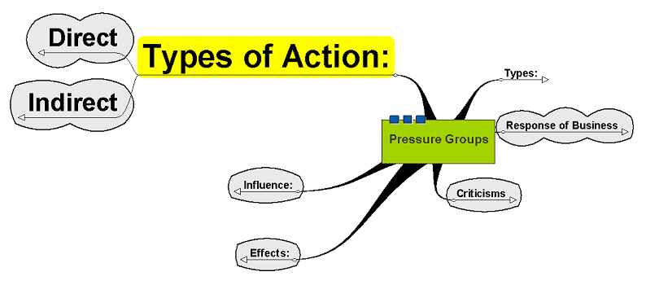
Types of Action

Slide 13
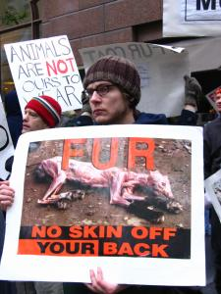
Direct
Illegal Direct Action
Lobbying
Protest
Boycotts
Civil disobedience – e.g. causing obstruction – sit ins, lie downs, making noises, etc.
Protestors from the group, Protestors for the Ethical treatment of Animals (PETA) demonstrate their objections to the fur trade.
Image copyright: Robert Bredvad, http://www.sxc.hu

Slide 14
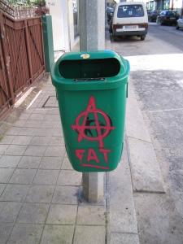
Illegal Direct Action
Terrorism – intimidation of workers or owners/management of a business, for example
Violence – bombings, shootings, threats, attacks
Criminal damage – damage to property, releasing animals into the wild – Animal Liberation Front
Criminal damage can be one way in which pressure groups make their views known but is illegal.
Image copyright: Ricardo Silva, http://www.sxc.hu

Slide 15
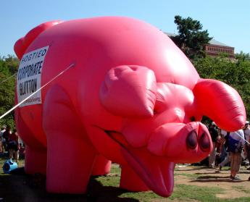
Lobbying
Parliament – seeking interviews and discussions with ministers in parliament to secure their support
Companies – making contact with companies to make them aware of concerns, e.g. at Board level
Local Government – contacting local councillors
Legal system – contacting judges, legal representatives, etc.
Protestors against the IMF and the World Bank inflate a giant pig to represent corporate gluttony in Washington DC, USA.
Image copyright: Michelle Kwajafa, http://www.sxc.hu

Slide 16
Indirect
Publicity
Leaflets/adverts
Petitions
Providing research

Slide 17
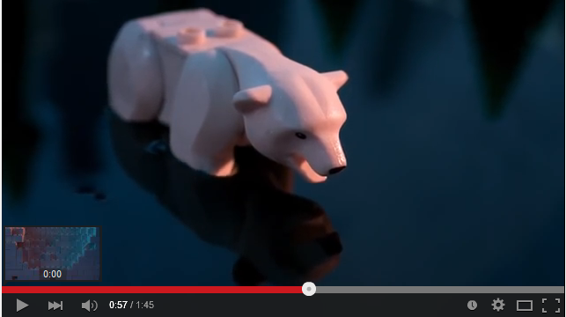
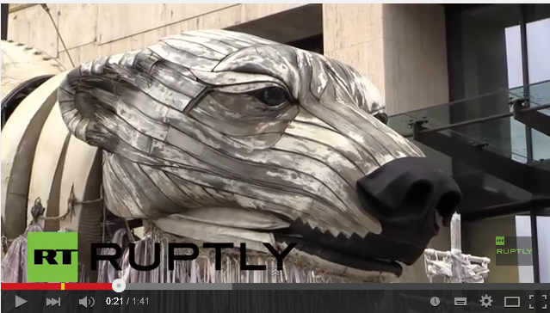
Examples
Greenpeace campaign against Shell

Slide 18
Influence
Success determined by the extent to which the group can capture the popular imagination and keep the issue alive while it is still relevant
Contacts with media, politicians, etc. are crucial to get the issue into the public domain
Reputation of the group as reliable and having integrity may be important in its success but the reputation could be a bad one, e.g. Animal Liberation Front

Slide 19
Effects
Successful campaigns can lead to legal and ethical changes in business practice e.g.
  The increasing practice of environmental audits by businesses
  The movement to the use of synthetic fur in the fashion industry
  The compulsory use of seat belts
  The decrease in the use of CFCs
  The decrease in single use plastic

Slide 20
Response of Business
Businesses might:
Accept the arguments and change its practice
Present its own arguments on the issue
Take legal redress
Seek to publicise its image and what it is doing to counter the damage pressure groups could cause

Slide 21
Activities
Complete the L2 Controlling Environmental Costs workbook
You should use:
The lesson slides. Read the content and watch linked videos
Exam board notes
Links in workbook
Independent research
Upload your workbook by 4:15 pm the day before our next lesson
D2: Tuesday 16th June
E2: Thursday 18th June

