Slide 1
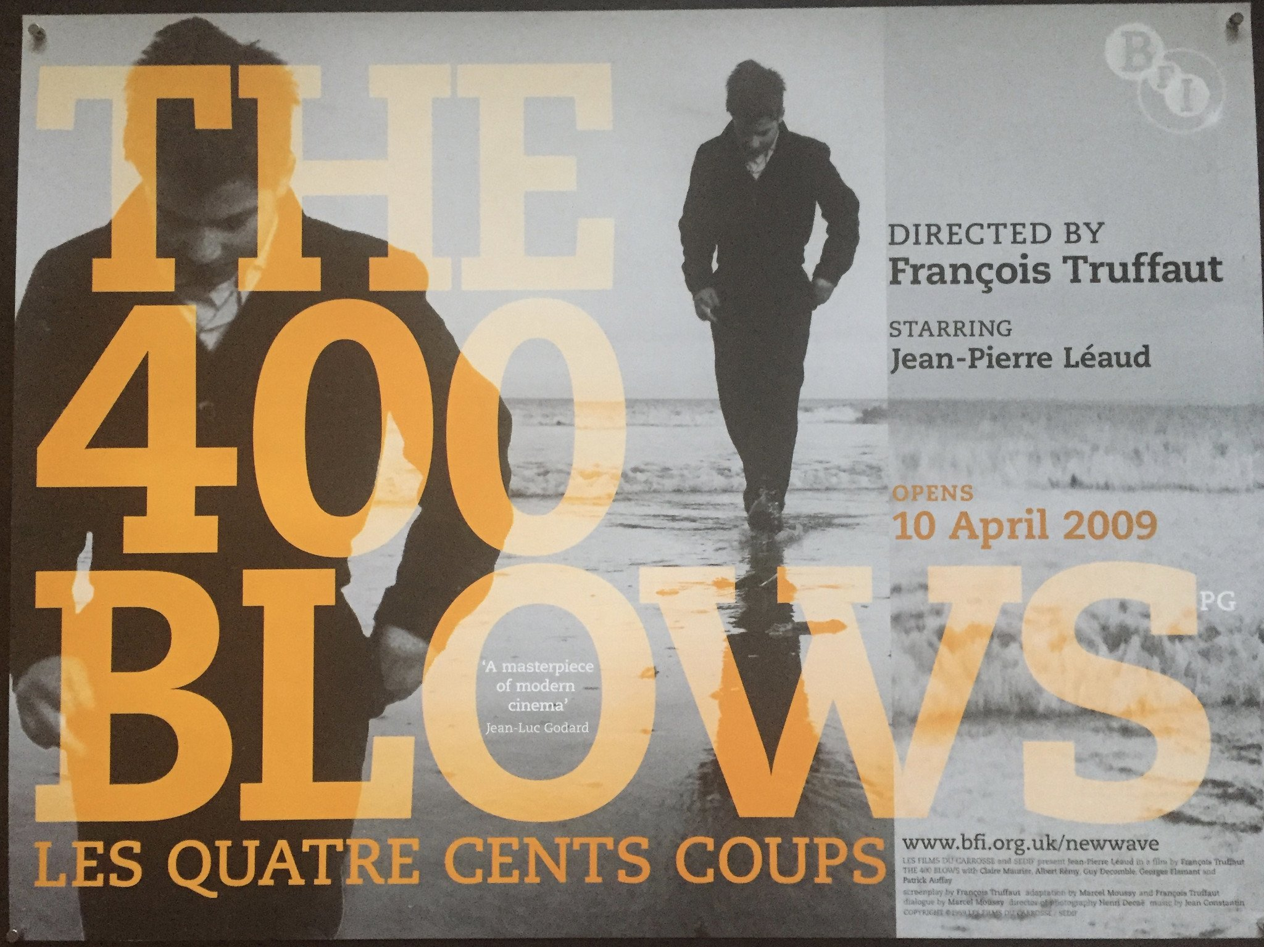
During the screening, look out for:
Handheld, panning and balletic cinematography style [ ]
Playful editing techniques- jump cuts, long takes, freeze frames, breaking 4th wall etc. [ ]
Disjointed narrative structure- meandering, asides, ambiguous character motives [ ]
Characters going through an existential crisis [ ]
Cinephillia- the love of cinema through characters going to the cinema and homage / parody of other films [ ]
Auteur- the director’s personality ‘coming through’ the film (wider research needed) [ ]

