Slide 1
ELE – Environmental Factors
L3 How can businesses respond to environmental issues?

Slide 2
Environmental Costs of Business Activity & Controlling Costs - Recap
You have approx. 5 minutes to jot down answers to the questions below – I will then choose people to share their answers with the class on mic.
Explain what is meant by the term “negative externalities” – use examples to demonstrate
Give an example of a firm/industry that is contributing to destruction of the environment and outline how.
Identify one government intervention and briefly explain how that intervention helps to control the environmental costs of business activity.
For one of the pressure groups that you researched: outline what type of group they are and what they exist to do and give an example of how they are working to control environmental costs of business activity

Slide 3
Can you identify the business that issued this statement?
“We acted to take responsibility for the clean-up, working under the direction of the federal government to respond swiftly to compensate people affected by the impact of the accident, to look after the health, safety and welfare of the large number of residents and people who helped respond to the spill, and to support the economic recovery of the Gulf Coast’s tourism and seafood industries impacted by the spill. We have conducted studies with federal and state natural resource trustees to identify and define the injury to the natural resources in the Gulf of Mexico”.

Slide 4
Learning Objectives
Explain how businesses can respond to environmental issues.
Evaluate the impact on a business of implementing environmentally friendly policies

Slide 5
How can businesses respond to environmental issues
Environmental issues offer both opportunities and threats to businesses.
Those which will gain the most are those selling pro environmental and anti-pollution products.
Those which will lose the most are the high polluters who face competition from other businesses which don’t face similar problems (e.g. A heavily regulated UK company may face competition from at Third World producer whose government places little restriction on its activity)

Slide 6
How can businesses respond to environmental issues?
Marketing
Companies use environmental policies as part of their marketing campaigns (e.g. Body Shop)
Finance
Being environmentally friendly can lead to cost savings (energy savings)
Could increase costs too: introducing new machinery would decrease CO2 production levels, but there are introduction costs.
Operations Management
Pollution controls will affect how a product is made eg. May change raw materials used, production methods and after-sales service
HR
Staff need to be recruited and trained to comply with environmental regulations.
Tensions between financial targets and meeting environmental targets may arise.

Slide 7
How can businesses respond to environmental issues?
Become a sustainable business:
What is sustainability?
Everything that we need for our survival and well-being depends, either directly or indirectly, on our natural environment.
Sustainability creates and maintains the conditions under which humans and nature can exist in productive harmony, that permit fulfilling the social, economic and other requirements of present and future generations.
Sustainability is important to making sure that we have and will continue to have, the water, materials, and resources to protect human health and our environment.

Slide 8
Become a sustainable business
For many businesses, going 'green' is a lot more than a popular trend. It's part of a strategy to improve business sustainability.
Sustainable businesses seek to minimise negative environmental and social impacts and ensure that future generations will have adequate resources to meet their needs.
Becoming a sustainable business is not only good for the environment but can also enhance the competitiveness and reputation of a business.
Notes:
Taken from http://www.businesszone.co.uk/community-voice/blogs/tcii/how-to-make-your-business-sustainable

Slide 9
Become a sustainable business
Areas to consider:
Supply chain: audit the distances involved in transportation of raw materials.
Production: the amount of energy used, use efficient machinery, reduce waste, recycle.
Packaging: is it possible to reduce it without compromising quality? Could more environmentally friendly packaging be used?
Distribution: consider using greener vehicles. In some cases, subsides and allowances are available for green upgrades.
Administration: use energy saving features on equipment, have a recycling and printing policy for the office.
Greening the businesses reputation: if a business has taken steps to go green, they should ensure their customers and clients know about it!

Slide 10
Benefits of being environmentally friendly
Attract consumers/employees/investors
May be able to use environmental policies in marketing activities
May have lower costs (e.g. due to recycling).
My have higher revenues (e.g. due to increased demand).
Can provide market opportunities

Slide 11
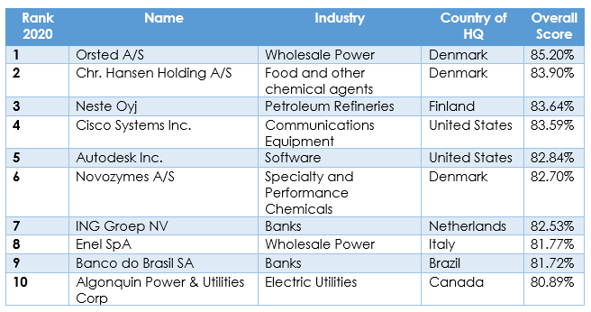
Top 10 sustainable businesses 2020
https://www.corporateknights.com/reports/2019-global-100/

Slide 12
Drawbacks of being environmentally friendly
Can affect how goods and services are produced
Can affect what is produced
Can increase costs
Can restrict certain production processes

Slide 13
Activities
Complete the L3 Business Response to Enviro Issues workbook
You should use:
The lesson slides.
Exam board notes
Links in workbook
Independent research
Text book (Chapter 126 from pg. 734)
Upload your workbook by 4:15 pm the day before our next lesson
Group D2: Tuesday 23rd June
Group E2: Thursday 25th June

