Slide 1
Chromatography

Slide 2
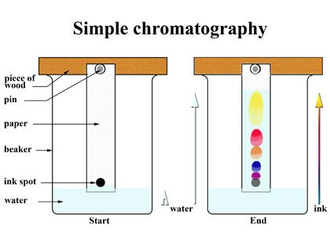
Separating pen inks
Pencil line
Crosses on the line for where the spots start
Make sure the water (solvent is not above the line)
Put a pencil line at the top to show there the solvent got to

Slide 3
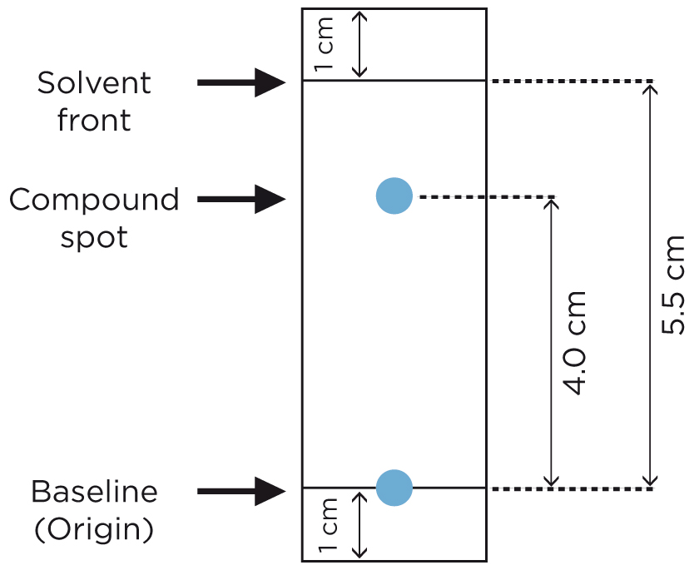

Rf values

Slide 4
Why are the Rf values useful?
They help you to compare different pigments – so you can see if there are similarities and differences
The more polar the pigment the more it moves up the paper with the polar water

Slide 5
Writing up
Aim
Introduction
  What is chromatography used for?
  Explain how it works
  Explain what the Rf values mean
Method for Amino acids on paper
  Include how to be as accurate as possible
Safety
Results
  Write down the Rf value you got and see if it corresponds to the actual ones (google ‘Rf values for amino acids’ and click on first hit)

Slide 6
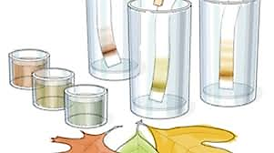
Paper chromatography of plant pigments
Pigment name | Visible color | Rf
Carotene | Yellow | 0.98
Xanthophyll | Yellow | 0.86
Xanthophyll | Red | 0.80
Phaeophytin a | Dark grey | 0.67
Phaeophytin b | Light grey | 0.60
Xanthophyll | Yellow | 0.50
Chlorophyll a1 | Light blue-green | 0.48
Chlorophyll a | Dark blue-green | 0.46
Chlorophyll b1 | Light yellow-green | 0.30
Chlorophyll b | Dark yellow-green | 0.25
Xanthophyll | Yellow | 0.15

Slide 7
Writing up
Aim
Introduction
  What is chromatography used for?
  Explain how it works
  Explain what the Rf values mean
Method and results for all 3 chromatographies (amino acids on paper, plant pigement on paper plant pigment on TLC)
  Include how to be as accurate as possible
Safety
Results
  Write down the Rf value you got and see if it corresponds to the actual ones (google ‘Rf values for amino acids’ and click on first hit)
Evaluation

Slide 8
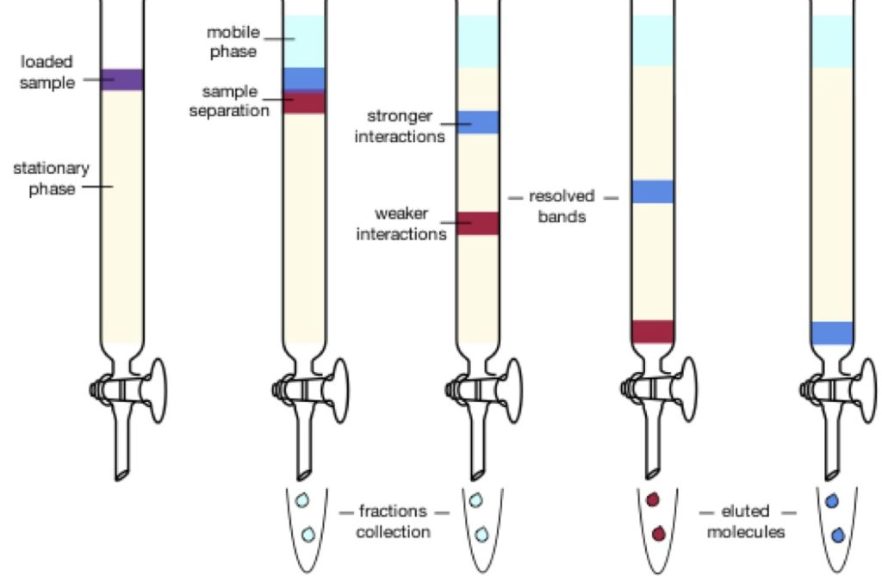
High performance liquid chromatography

Slide 9
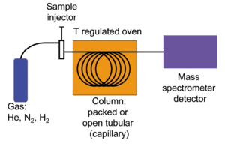
Gas Column Mass Spectrometry (GCMS)

Slide 10
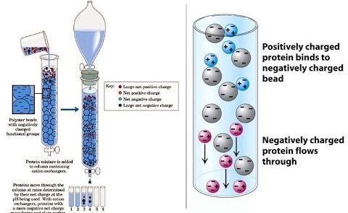
Ion exchange Chromatography

Slide 11
Evaluation
Things to consider:
Correct solvent?
Small, and concentrated sample?
Did it separate/Why might it not separate?
Accurate with where the sample was put and where the solvent went to?
Did the paper touch the side?
Why might the Rf values differ?

