Slide 1
AQA
    AS Level
      Computer Science
      Paper 2
The processor
  Unit 5
  Computer organisation
  and architecture

Slide 2
Objectives
Identify the role and operation of a processor and its major components
Explain the stages of the Fetch-Execute cycle and determine the roles of the various processor registers in facilitating this
Examine factors that affect the performance of a processor
Describe the role of interrupts and interrupt service routines and their effect on the Fetch Execute cycle

Slide 3
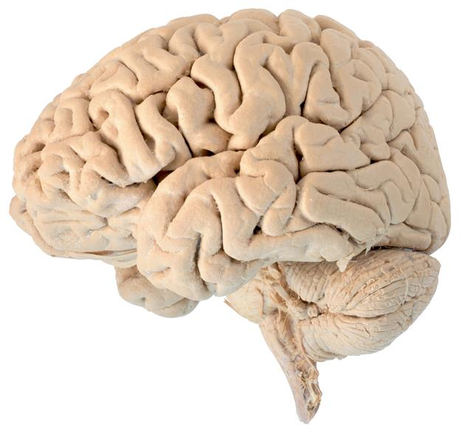
The brain
What functions does the human brain perform?

Slide 4
Central Processing Unit (CPU)
Similar to a human brain, (although it cannot think or make decisions for itself) a computer processor controls, calculates and executes instructions
A processor has a number of different components, each with their own role to perform:
  Arithmetic-Logic Unit (ALU)
  Control Unit
  Clock
  General purpose registers
  Dedicated registers

Slide 5

Arithmetic-Logic Unit (ALU)
The problem solving part of the processor
  This component performs arithmetic, logical and shift operations on data
  Arithmetic operations: Add, Subtract, Multiply and Divide
  Logical operations include: AND, OR, NOT, XOR
  Shift operations: Move bits to the left or right within a register

Slide 6

Control unit
The part of the processor that coordinates the activity of all other components
  Each instruction is accepted and decoded
  Separate steps such as fetching the address of data, and fetching the data itself from memory, are identified
  Each step is synchronised with a regular pulse from the system clock

Slide 7
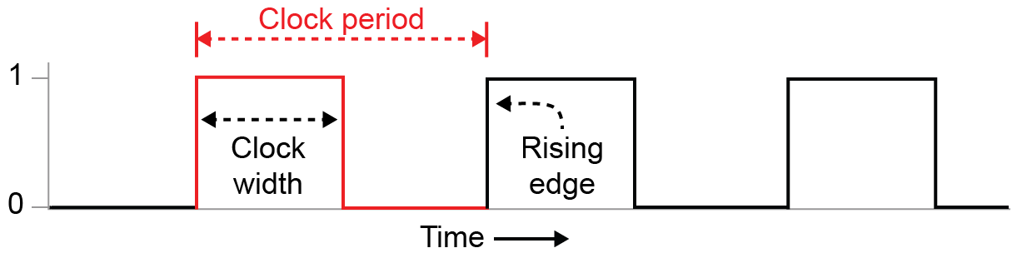
The system clock
A series of regular ON/OFF signals are used to synchronise the operations of the processor components
  Actions are usually carried out on the rising edge of the clock
  Actions each take a fixed number of cycles to complete

Slide 8
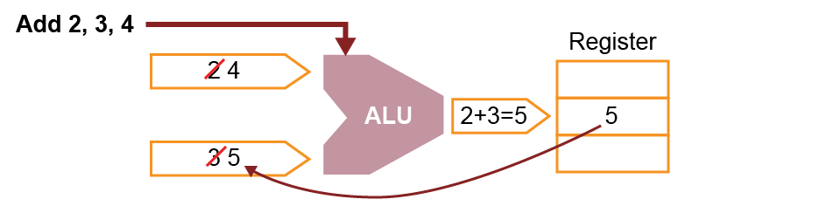
General purpose registers
Results from the ALU need to be stored somewhere
  Rather than writing working data back to ‘slow’ memory, processors have several locations of super-fast memory called registers that are used to temporarily store results
  The processor is then able to immediately access and re-use these results in subsequent calculations, e.g. Add 2 + 3 + 4
  Some processors have a single general purpose register called an Accumulator

Slide 9
Executing instructions
Carrying out sequences of programming instructions requires many different snippets of information to be held
  The processor has to temporarily hold the current instruction being executed
  It has to hold the address of the data that it needs, and also the data itself
  It has to keep track of the address of the next instruction to be executed

Slide 10
Dedicated registers
The processor uses the following dedicated registers:
  Program counter (PC) – holds the memory address of the next instruction to be executed
  Current Instruction Register (CIR) – holds the current instruction
  Memory Address Register (MAR) - holds the address in memory where the processor is required to fetch or store data from or to
  Memory Buffer Register (MBR) – temporarily holds data moving between the processor and main memory
  Status register (SR) – holds information about the current state of operations. It is used to set flags (e.g. carry or overflow) or to detect error conditions

Slide 11
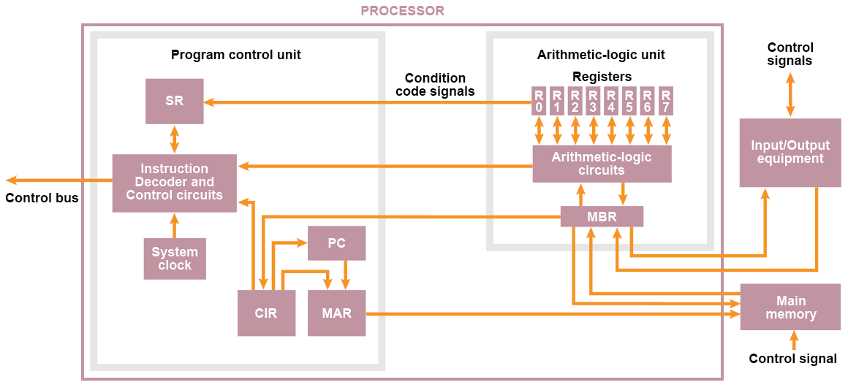
The processor

Slide 12
The processor
Complete Task 1 of Worksheet 2A

Slide 13

Running programs
The role of the processor is to carry out instructions from programs stored in memory
  The Control Unit coordinates components to work together to achieve this in the same way that a conductor controls all the components of an orchestra

Slide 14
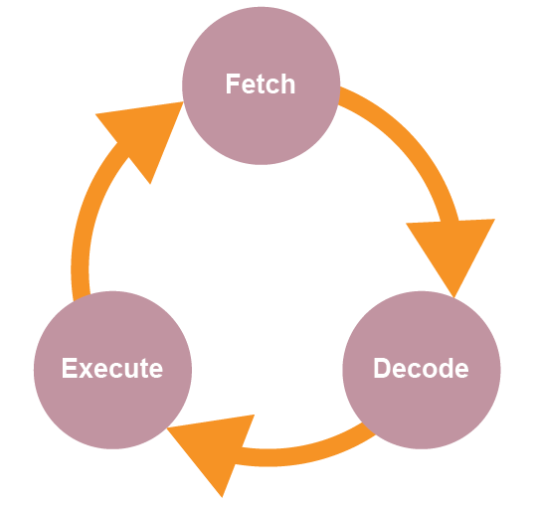
Fetch-execute cycle
Processors operate in defined stages that are used to carry out program instructions
  The process is repeated over and over again for each instruction in a program

Slide 15
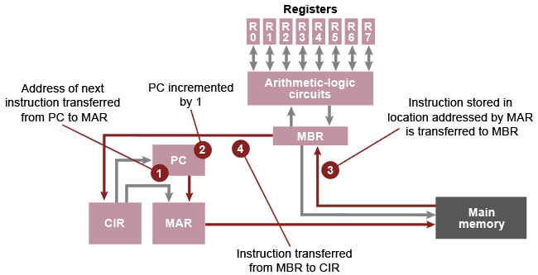
Fetch: (Steps 1 – 4)
The address of the next instruction is fetched from the PC…
What’s next?

Slide 16
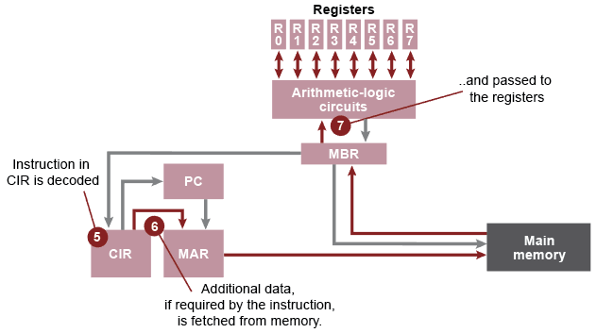
Decode: (Steps 5 – 7)
With the instruction now in the CIR, the Control Unit can work out what needs to be done to carry it out

Slide 17
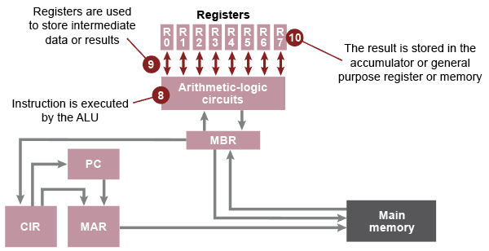
Execute: (Steps 8 – 10)
The registers in the CPU now contain everything that the ALU needs to carry out the instruction

Slide 18
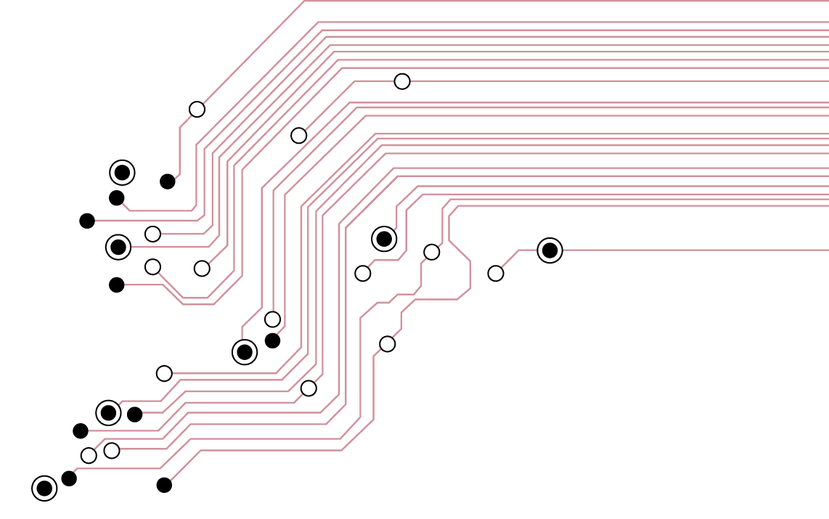
Worksheet 2A
Complete Task 2
Extension task: For a challenge, try Worksheet 2B

Slide 19
Factors affecting performance
The Fetch-Execute cycle is triggered from the clock pulses of the system clock
  The faster the clock speed, the faster a computer can fetch, decode and execute instructions
  This clock can change state many billions of times per second
  A 4GHz processor would tick 4 Billion times per second

Slide 20
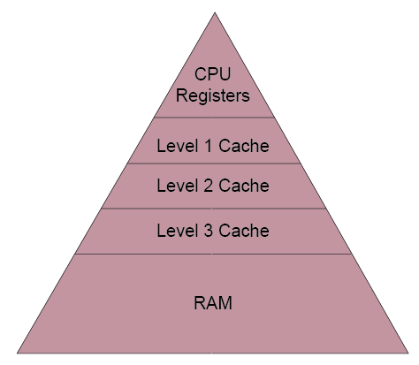
Cache memory
Cache is a small amount of superfast memory that stores data that is frequently used by the processor
  Larger and slower than a register, faster and smaller than RAM
  Larger amounts of cache memory can improve processing speed

Slide 21
Other factors
There are other factors that influence the performance of a processor:
  Number of cores: more processors can be linked together on a single chip allowing more instructions to be executed simultaneously
  Word length: the amount of data that the CPU can process simultaneously
  Address and data bus width

Slide 22
The role of interrupts
A Level Only
An interrupt is a signal by a software program or a hardware device sent to the CPU
  A software interrupt occurs when an application program terminates or requests certain services from the operating system
  A hardware interrupt occurs , for example, when an I/O operation is complete or an error such as “Printer out of paper” occurs

Slide 23
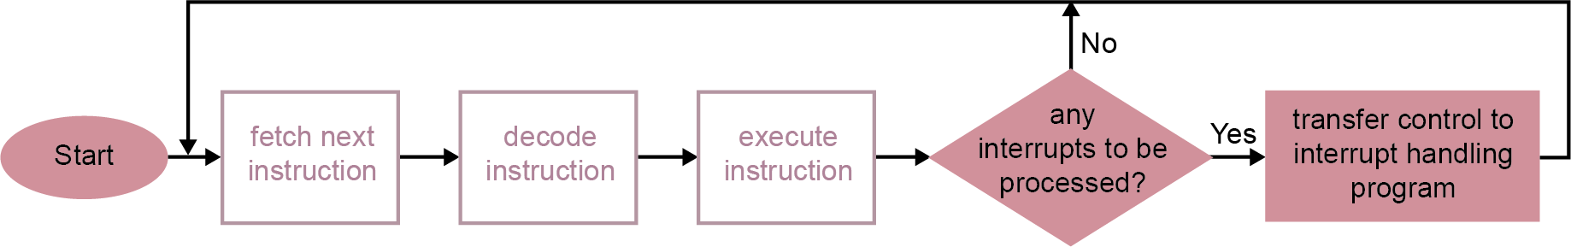
Testing for interrupts
A test for interrupts is made at the end of each instruction cycle:
  Execution is suspended and the contents of all registers are temporarily saved
  An interrupt service routine is called to deal with the interrupt

Slide 24
Interrupt service routine
Depending on the type of interrupt, a particular routine will be run in order to service it
Once the interrupt has been serviced, the original values of the registers are retrieved and the Fetch-Execute cycle resumes from the point that it left off

Slide 25
Plenary
Which computer is theoretically faster? Put the following specifications in descending order of speed:
  A 4GHz quad core processor, 2MB cache, 32-bit word length
  A 4.5GHz processor, 2MB cache, 32-bit word length
  A 4GHz quad core processor, 4MB cache, 32-bit word length
  A 4GHz quad core processor, 2MB cache, 16-bit word length
  A 5GHz quad core processor, 2MB cache, 32-bit word length

