Slide 1
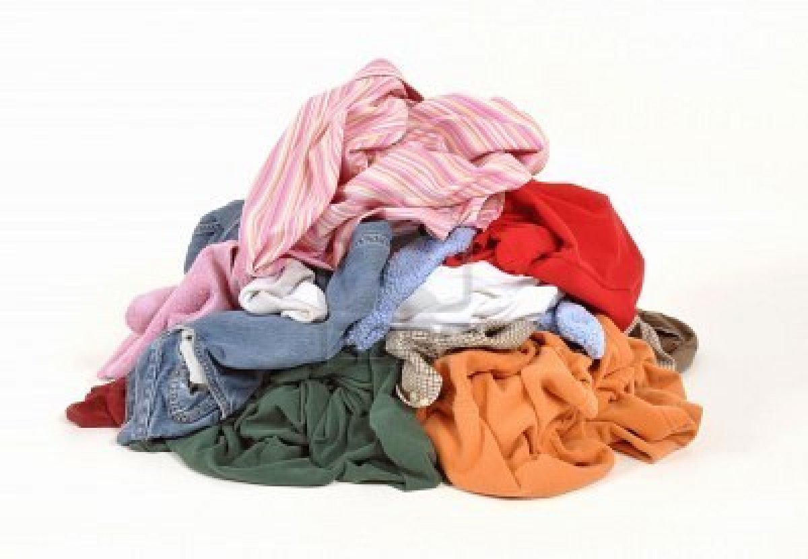
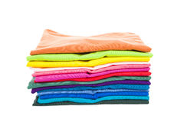
File Compression

Slide 2
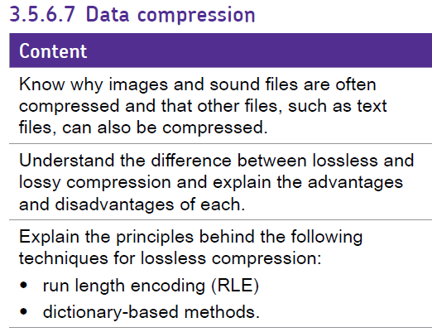

Slide 3
Lossless compression
In lossless data compression, the integrity of the data is preserved.
The original data and the data after compression and decompression are exactly the same because the compression and decompression algorithms are exactly the inverse of each other.
Example:
Run-length encoding
Lempel Ziv (L Z) encoding (dictionary-based encoding)

Slide 4
Run-length encoding
It does not need knowledge of the frequency of occurrence of symbols and can be very efficient if data are represented as 0s and 1s.
For example:

Slide 5
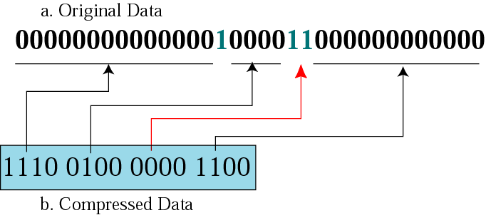
Run-length encoding for two symbols
We can encode one symbol which is more frequent than the other.
This example only encode 0’s between 1’s.
There is no 0 between 1’s

Slide 6
Dictionary Compression
Create an indexed dictionary and substitute the value for the index.
Both the dictionary AND the compressed data need to be stored.
Pitter Patter Example:

Slide 7
Lempel Ziv encoding
LZ encoding is an example of a category of algorithms called dictionary-based encoding.
The idea is to create a dictionary (table) of strings used during the communication session.
The compression algorithm extracts the smallest substring that cannot be found in the dictionary from the remaining non-compressed string.

Slide 8
LZ77
Compress aacaacabcabaaac
LZ77 doesn’t have a separate dictionary:
Instead it refers to data that has already been read. *
e.g. From the * (6,4,y) = ready

Slide 9
Lossy

Slide 10
Lossy compression methods
Loss of information is acceptable in a picture of video.
The reason is that our eyes and ears cannot distinguish subtle changes.
Loss of information is not acceptable in a text file or a program file.
For examples:
Joint photographic experts group (JPEG)
Motion picture experts group (MPEG)

Slide 11
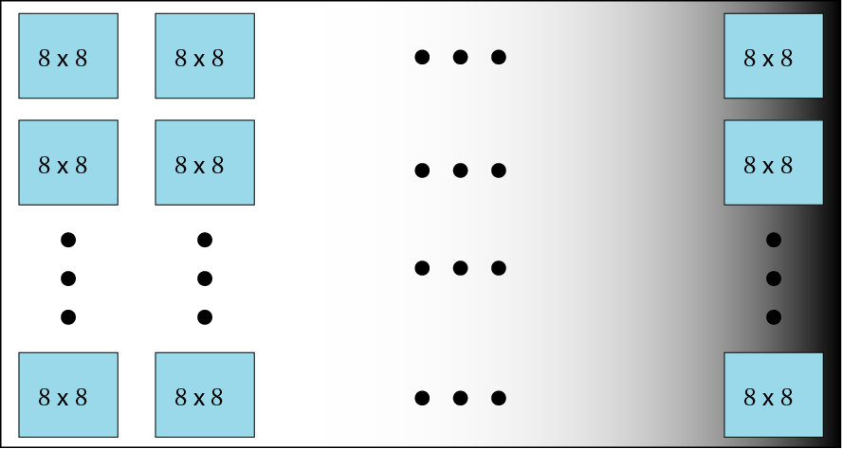
Image compression: JPEG
Figure 15-10
JPEG gray scale example, 640 x 480 pixels

Slide 12
JPEG process
DTC: discrete cosine transform
Quantization
Compression
Basically an average value

Slide 13
Quality :100%

Slide 14
Quality:50%

Slide 15
Quality :10%

Slide 16
Quality :5%

Slide 17
Video compression--MPEG
MPEG method
Spatial compression
The spatial compression of each frame is done with JPEG.
Temporal compression
The temporal compression removes the redundant frames.
MPEG method first divides frames into three categories: I-frames, P-frames, B-frames.

Slide 18
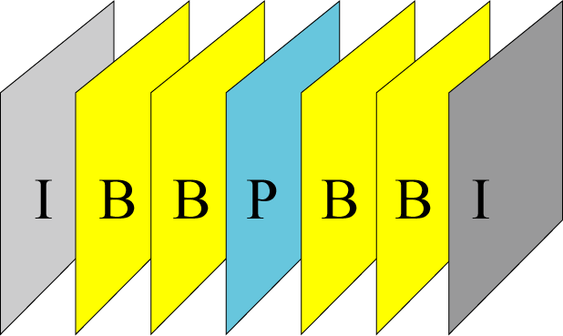
Figure 15-16
MPEG frames
I-frames: (intra-coded frame)
It is an independent frame that is not related to any other frame.
They are present at regular intervals.
I-frames are independent of other frames and cannot be constructed from other frames.

Slide 19
Figure 15-16
MPEG frames
P-frames: (predicted frame)
It is related to the preceding I-frame or P-frame.
Each P-frame contains only the changes from the preceding frame.
P-frames can be constructed only from previous I- or P-frames.
B-frames: (bidirectional frame)
It is relative to the preceding and following I-frame or P-frame.
Each B-frame is relative to the past and the future.
A B-frame is never related to another B-frame.

Slide 20
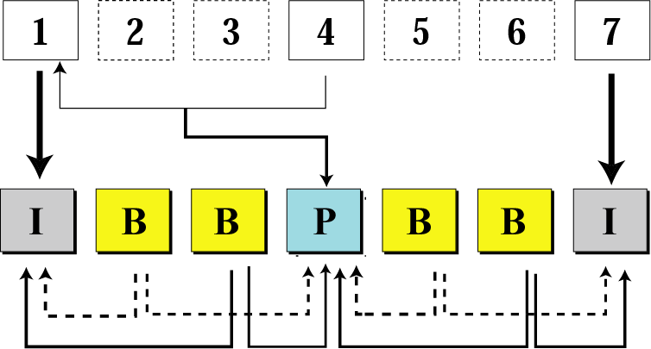
Figure 15-17
Input sequence
MPEG frame construction
MPEG sequence

Slide 21
Key terms
AC value
B-frame
Binary tree
Branch
Compression
Data compression
DC value
Decoding decompression
Dictionary-based encoding
DCT
Huffman coding
I-frame
JPEG
LZ encoding
Lossless data compression
Lossy data compression
MPEG
Node
P-frame
Quantization
Run-length encoding
Spatial compression
Temporal compression

