Slide 1
3.9 Communication Methods

Slide 2
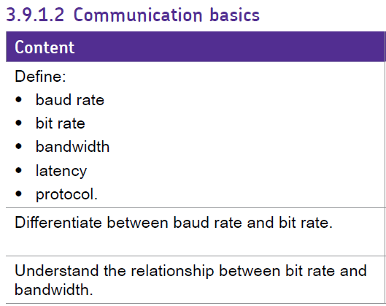
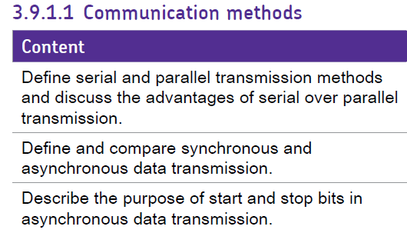
Objectives

Slide 3
Data Transmission
Moving data from one place to another
Occurs in many devices from computers and mobile phones, to televisions, games consoles and mp3 players
Binary digits represent the data e.g. an image
Occurs between a transmitter and receiver over a transmission medium
The connection is called a communication channel
Data are encoded as electromagnetic signals
Guided media e.g. coaxial cables
Unguided media e.g. radio waves

Slide 4
Serial Data Transmission
Single bits are sent one after another along a single wire by varying the signal voltage
One of two possible binary digit values, 0 or 1.
e.g. signals sent at 5 volts represent binary digit 1
Used for long distance communication
Cost of cabling relatively cheap

Slide 5
Parallel Data Transmission
Bits are sent down several wires simultaneously
8 data wires, 1 return wire, 1 strobe wire and 1 ready/busy wire
Used over short distances
If used over long distances
Amount of wires makes it expensive
Problem with skew
Notes:
Difficult to keep voltages on the 8 wires in line with each other beyond a certain distance; this problem is called skew

Slide 6
Transmittion modes
Simplex
Half Duplex
Full Duplex

Slide 7
Baud Rate
The baud rate sets the frequency at which signals on a wire may change
e.g. if a computer’s serial port is set to send at one baud, then the signal sent out by the computer can change only at the end of each second
1 baud is one signal change per second, equivalent to 1 bit per second
Using 10000 baud the time between signal changes is 0.0001

Slide 8
Signal Transmission

Slide 9
Bit Rate
Measured in bits per second
Number of bits transmitted per second
The bit rate is the same as the baud rate when one bit is sent per time between signal changes.
It is possible to send more than one bit between signal changes if more than two voltage levels are used to encode bits

Slide 10
Bandwidth
Is a measure of how fast the data may be transmitted over the transmission medium
The greater the bandwidth, the greater the rate at which data can be sent i.e. higher bit rate
The bandwidth of copper wire is the range of signal frequencies that it may transmit from one end of the wire to the other without reduction in strength
Measured in hertz (Hz). One cycle per second is 1 Hz.

Slide 11
Latency
The time delay that occurs between the moment something is initiated and the moment its first effect begins
e.g. requesting and receiving a web page
In satellite communication significant time delays occurs because of the physical distance between the ground stations involved and the geostationary satellite

Slide 12
Asynchronous Data Transmission
The transmitter and receiver are not kept synchronised
The receiver is synchronised with the transmitter only at the time of transmission
Start bit signals arrival of data
Receiver’s clock synchronises with the transmitter’s clock
The transmission of bits matches the receiver’s reading of bits
Stop bit signals a rest period
7 or 8 bits sent between start and stop bits represent an ASCII character

Slide 13
Odd and Even Parity
A check digit is called a parity bit
Parity bit checks whether data has changed during transmission
Parity bit is calculated from the 7 or 8 data bits by the sending computer
Receiving computer regenerates parity bit from received data bits and checks against received parity bit
Even parity is were the parity bit is set to either a 1 or 0 so that number of 1s across data bits and parity bit is even
Odd parity is were the parity bit is set to either a 1 or 0 so that number of 1s across data bits and parity bit is odd

Slide 14
Handshaking Protocols
A communication protocol is a set of agreed signals, codes and rules to ensure successful communication between computers
Handshaking protocol is when the sending and receiving devices exchange signals to establish a connection and coordinate the sending and receiving of data.

Slide 15
Baseband
A system that uses a single data channel in which the whole bandwidth of the transmission medium is dedicated to one data channel at a time
Used in LANs
e.g. computers connected to a LAN must take turns to use the medium
Offers high performance at low cost

Slide 16
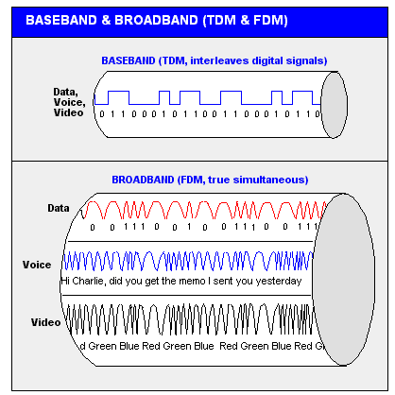
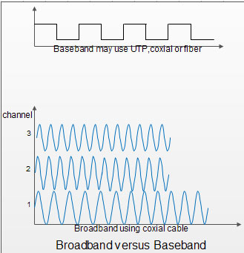
Broadband
A multi channel system
Several data channels share

