Slide 1
Part 1:
Architecture research

Slide 2
Research into the three following architecture themes:
‘Modernism and Brutalism’
‘Angular and Faceted’
‘Fluid and Curvalinear’
You can pick and mix from different architects or follow one as their style changes.
Collect examples of each styles making sure you have Identified the building(s) and their function
Name of architect
Dates when built
Main materials used in construction
Images of both exterior(s) and interior(s) to help with your analysis
Analysis and your thoughts
Analyse and comment on the following plus add any other comments of your own:
- the overall aesthetic quality
- the use of materials (how they contribute to the success of the building)
- how the building stands in its context/surroundings
- what it is like walking around inside
- how the architect has played with the use of light and space
Prepare your three presentations and their layouts (keeping to the three distinct themes)
Your presentations should be multi-layered and reflect the style of each of the movements.

Slide 3
Some suggested architects:
‘Modernism and Brutalism’
Frank Lloyd Wright
Walter Gropius
Mies Van De Rohe
Sir Robert Matthew and Dr Leslie Martin
Le Corbusier
Rem Koolhas
Louis Khan
‘Angular and Faceted’
Daniel Libeskind
Renzo Piano
‘Fluid and Curvalinear’
Jurgen Mayer
Zaha Hadid
MAD Architects
Santiago Calatrava

Slide 4
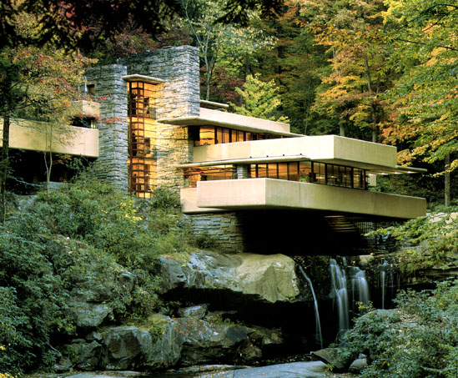
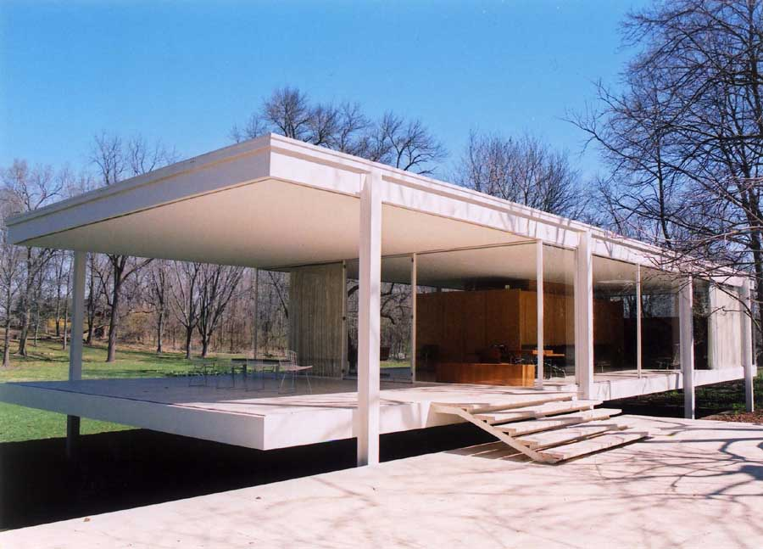
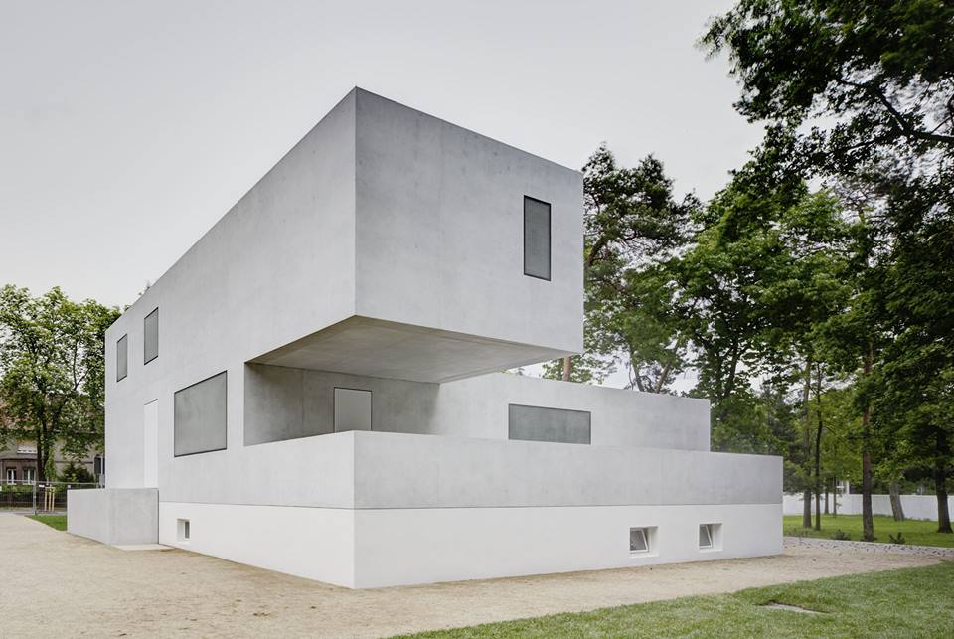
Modernist – Frank Lloyd Wright, Walter Gropius, Mies van der Rohe

Slide 5
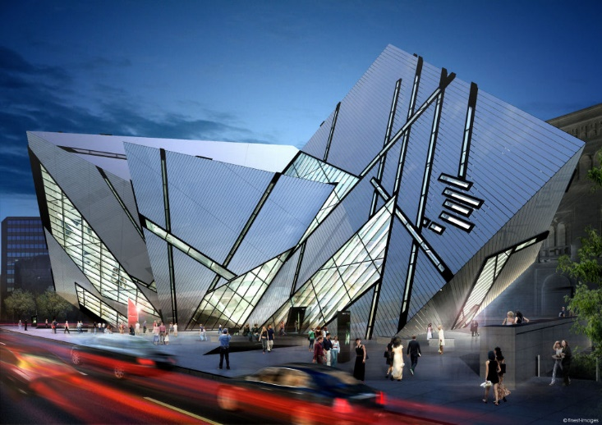
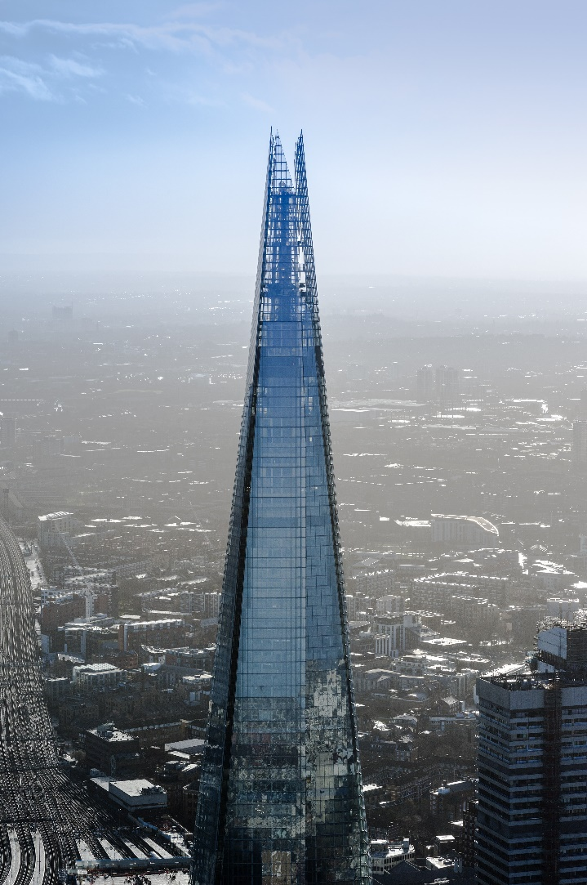
Angular/Faceted – Daniel Libeskine, Renzo Piano

Slide 6
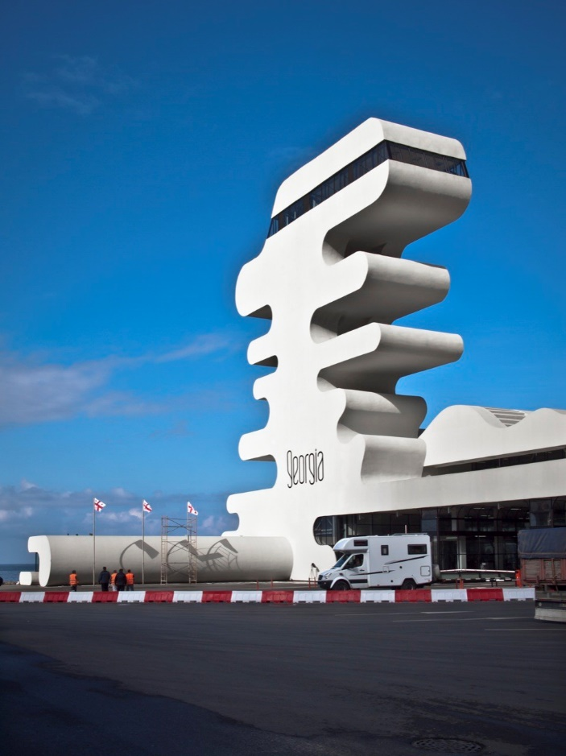
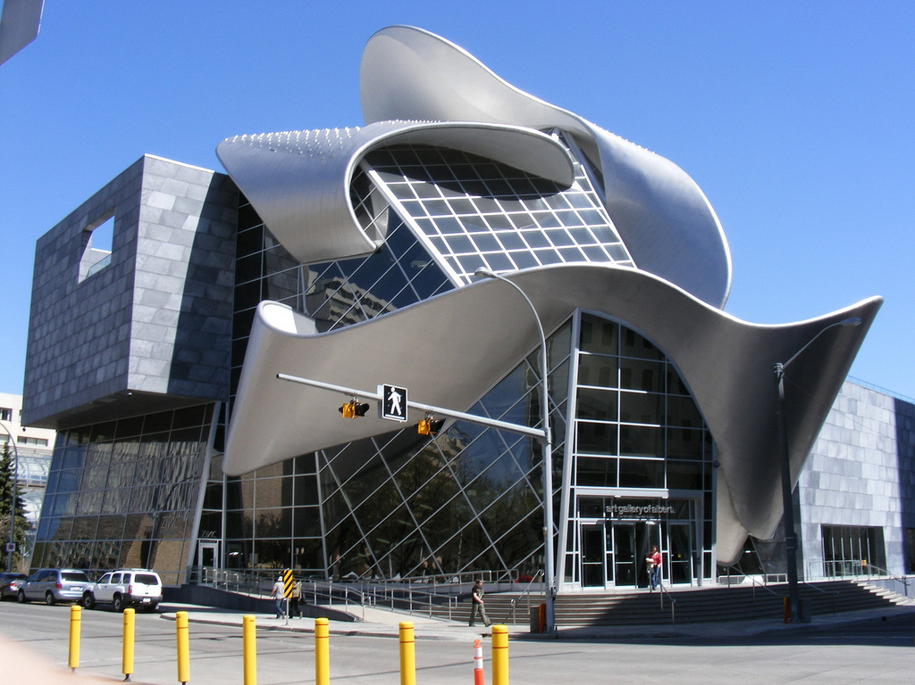
Curvalinear – Jurgen Mayer, Frank Gehry.

Slide 7
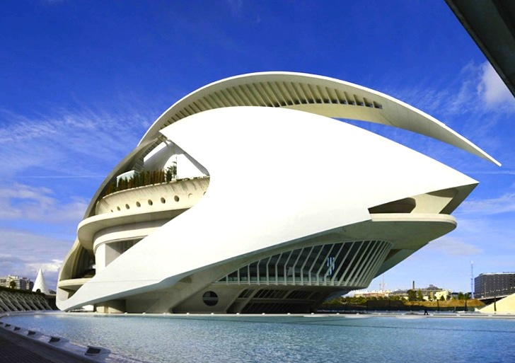
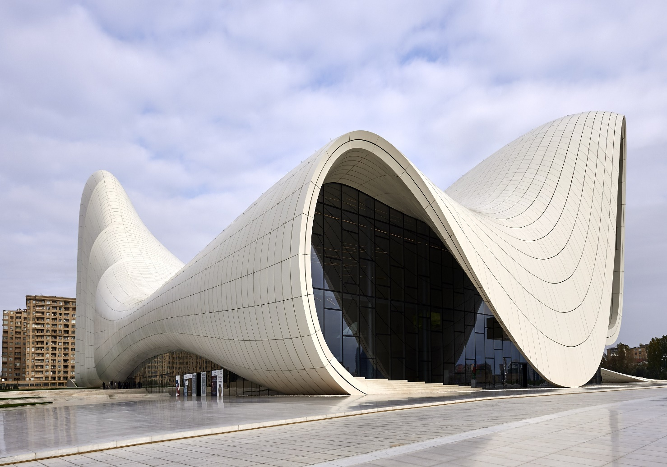
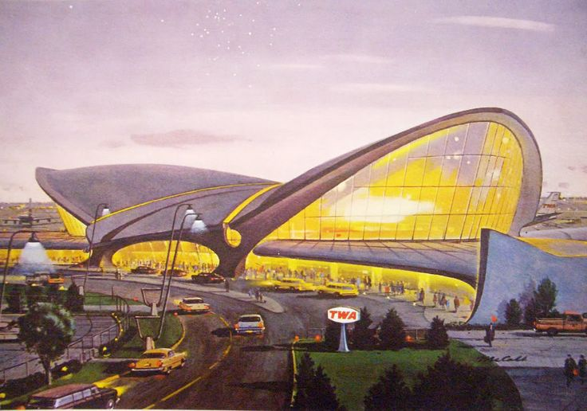
Fluid – Zaha Hadid, Santiago Calatrava, Eero Saarinen

Slide 8
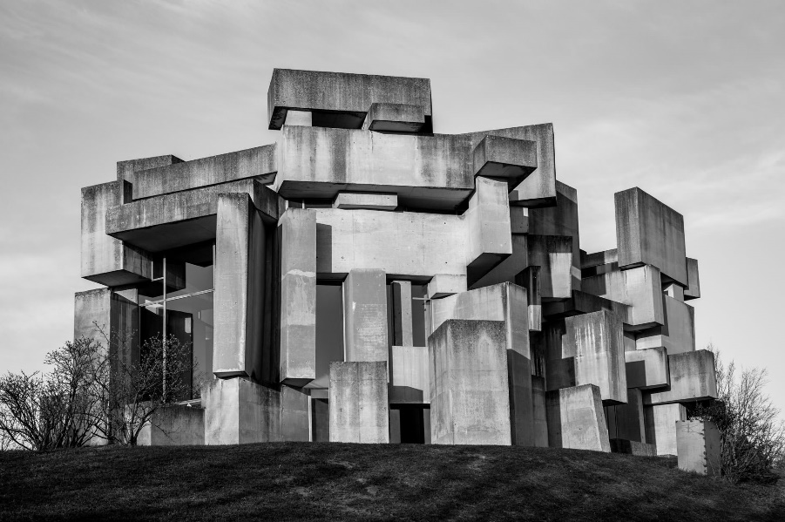
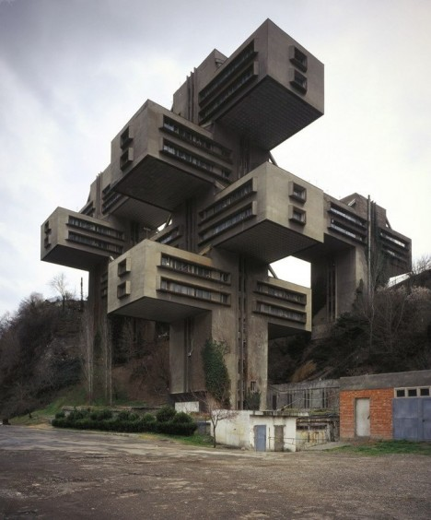
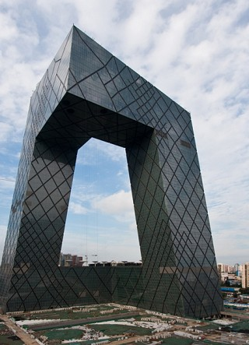
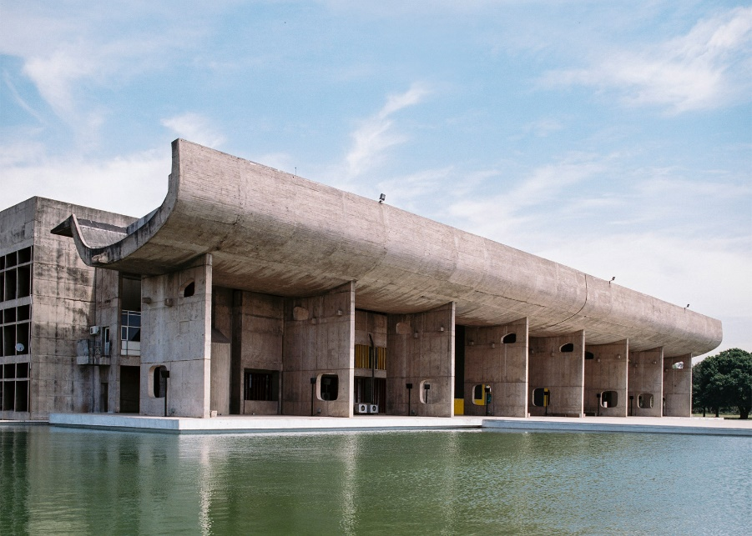
Brutalist – Le Corbusier, Rem Koolhas

Slide 9
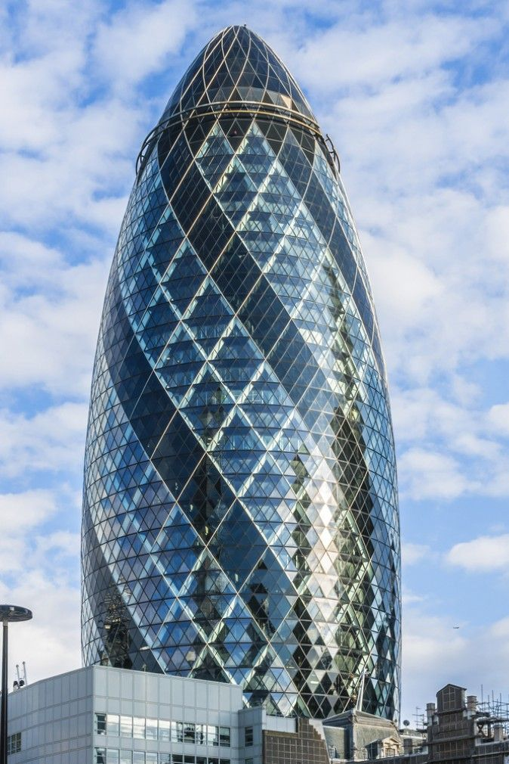
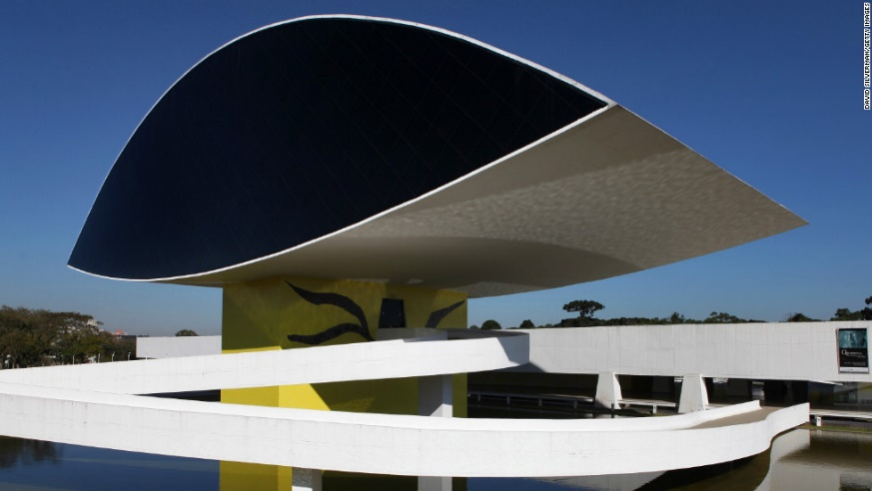
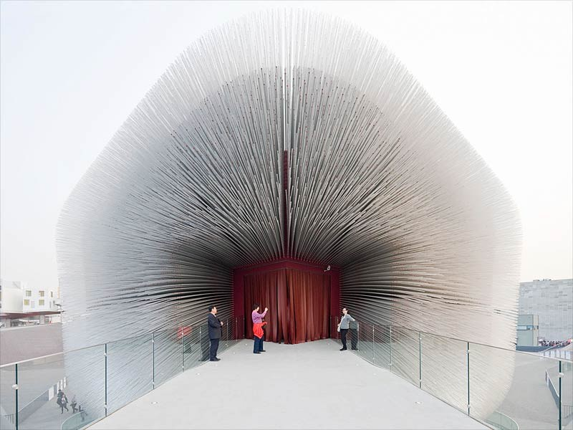
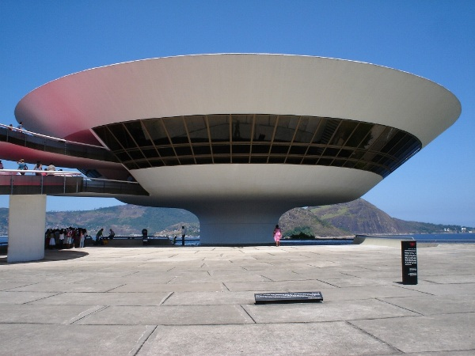
Other interesting architects you could research – Norman Foster, Oscar Neimeyer, Thomas Heatherwick.

Slide 10
Part 2: Analysis –
Compare and contrast
(see accompanying Word document)

Slide 11
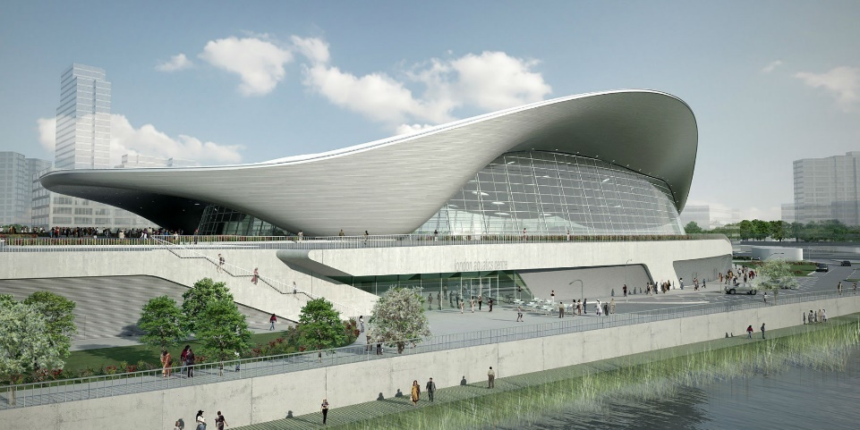
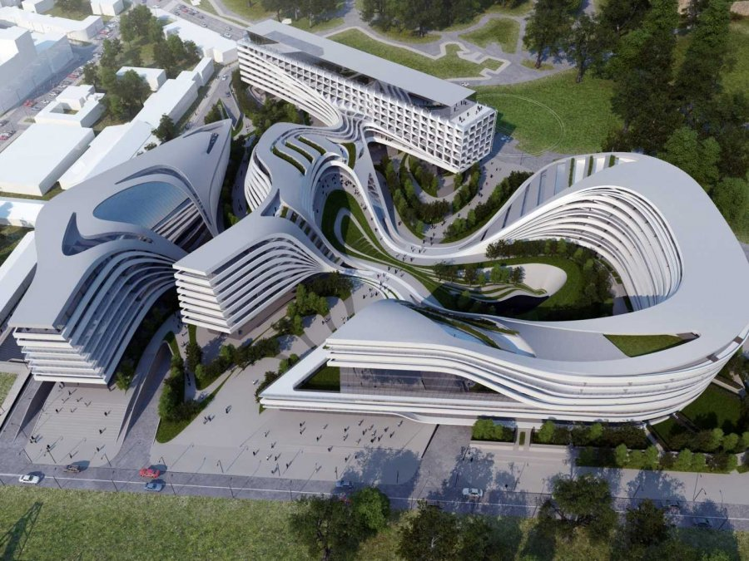
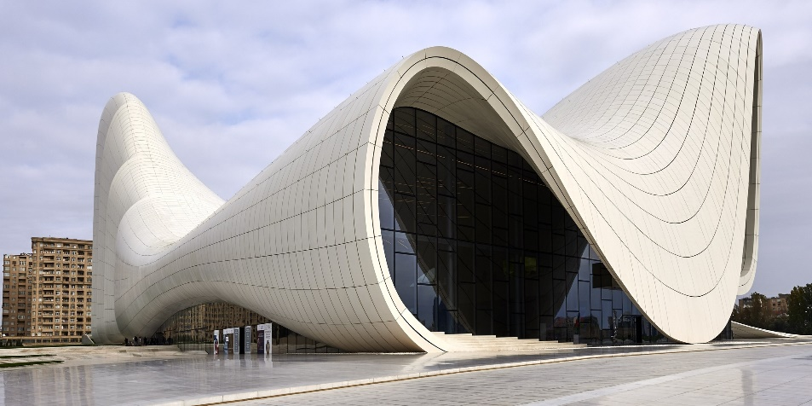
Zaha Hadid - Architecture

Slide 12
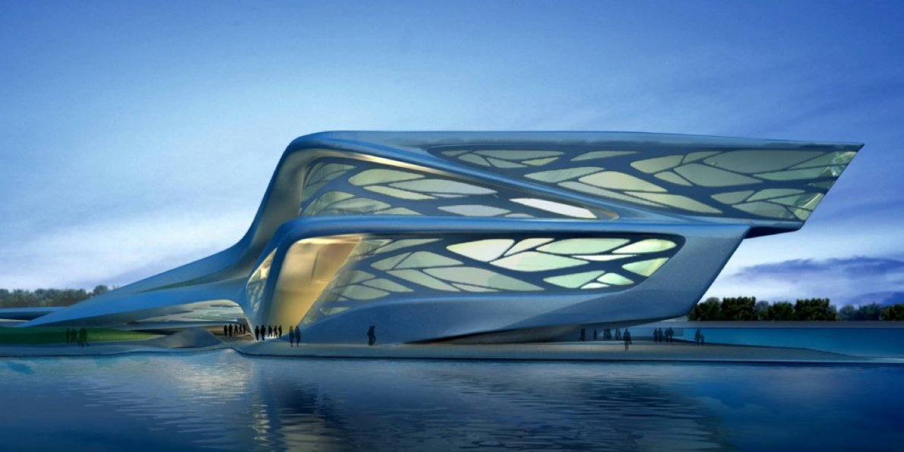
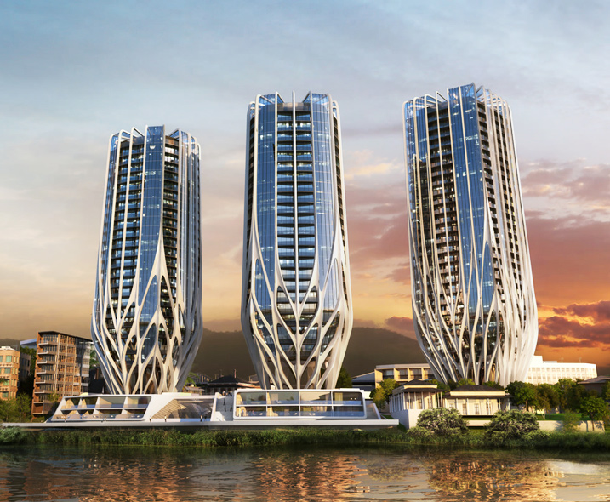
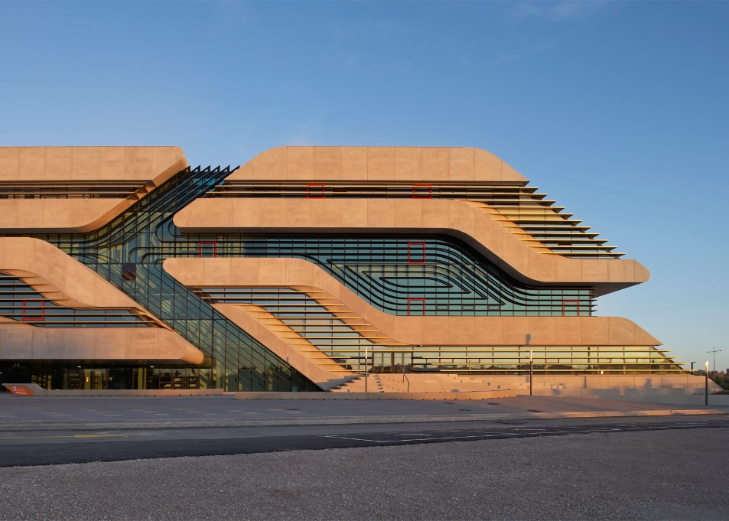
Zaha Hadid - Architecture

Slide 13
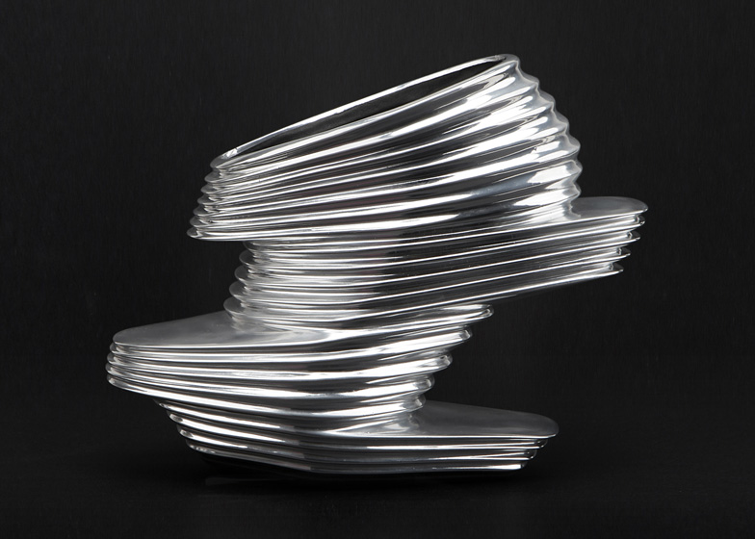
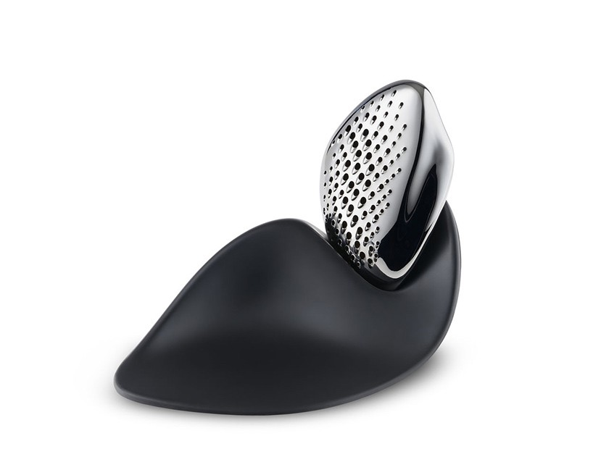
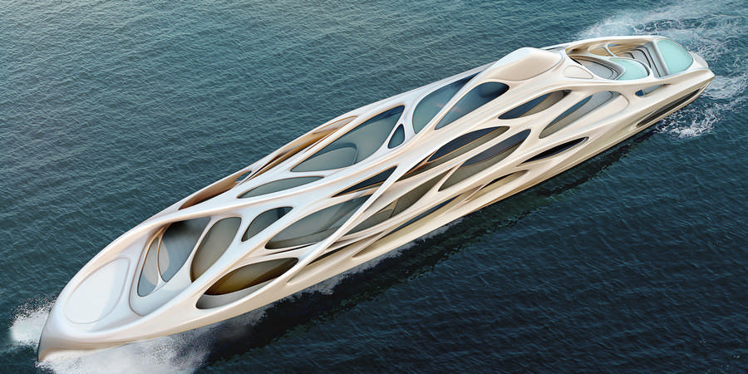
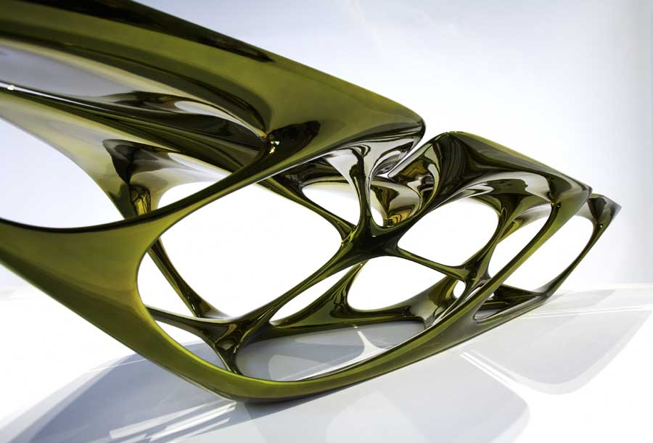
Zaha Hadid – Furniture and product

Slide 14
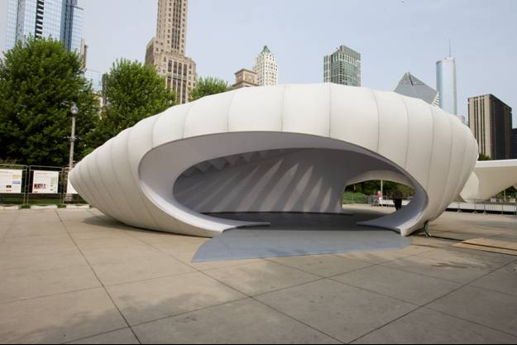
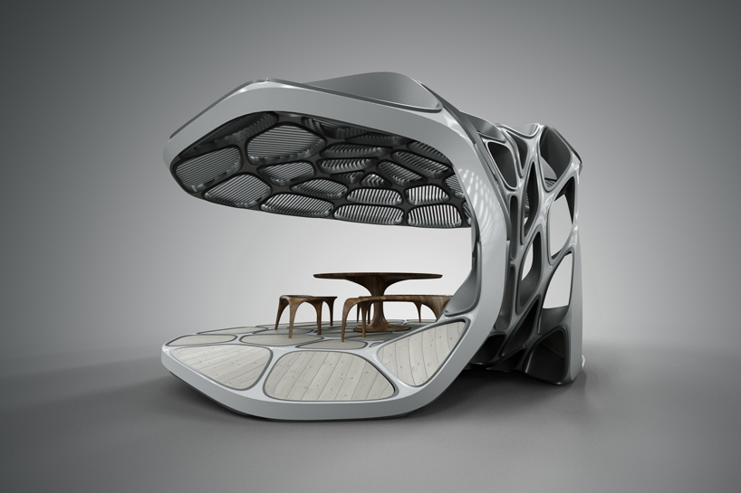
Zaha Hadid - Pavillions

Slide 15
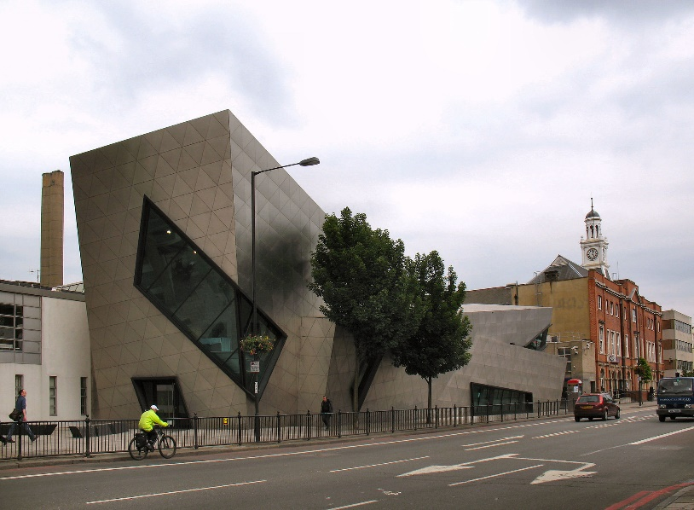
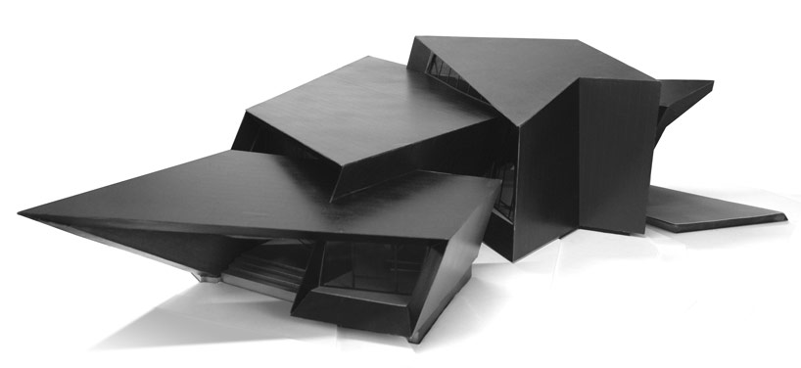
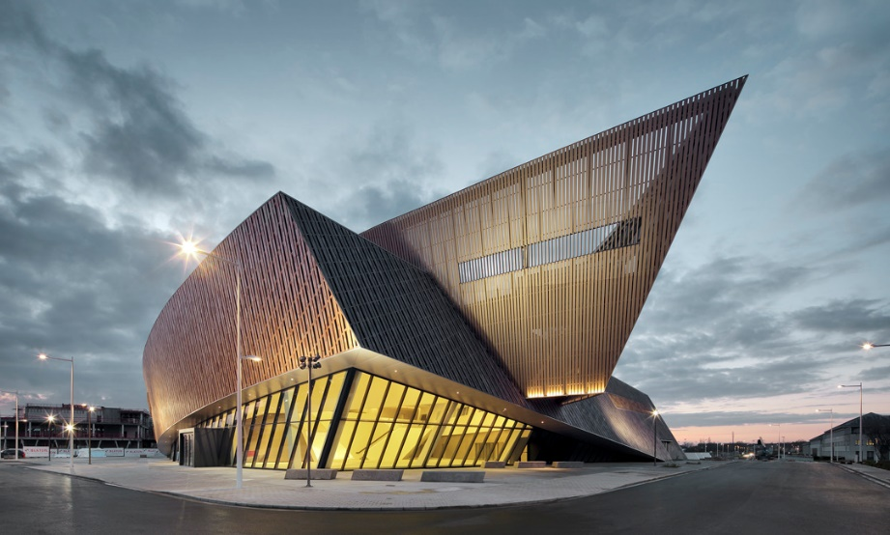
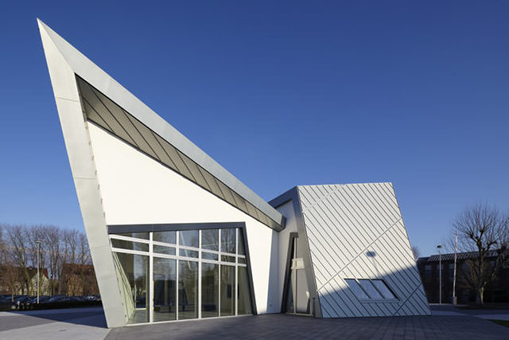
Daniel Libeskind - Architecture

Slide 16
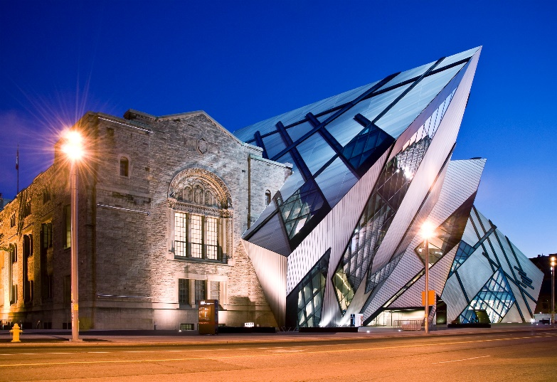
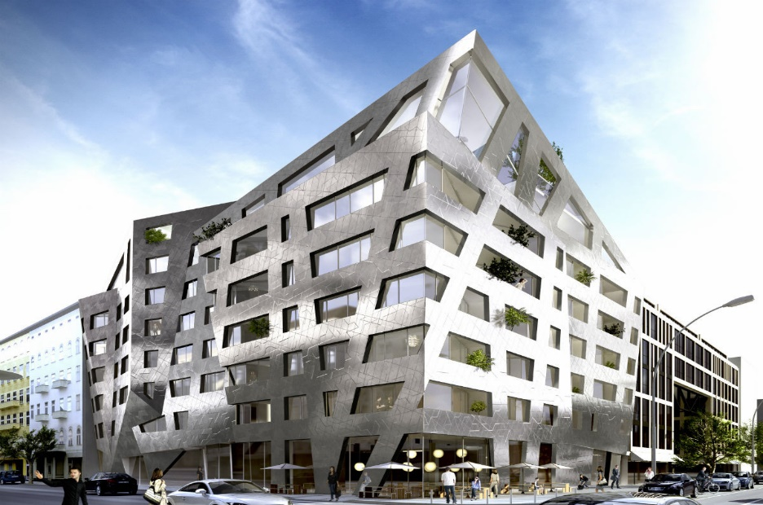
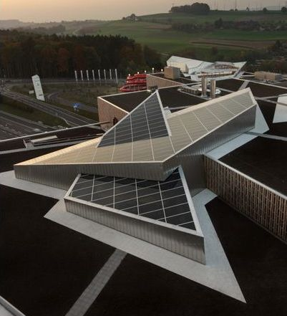
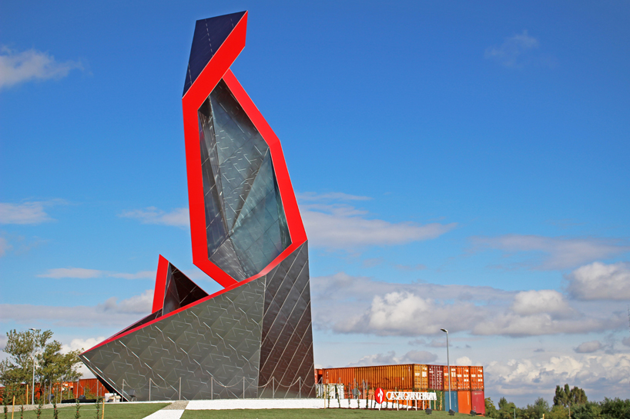
Daniel Libeskind - Architecture

Slide 17
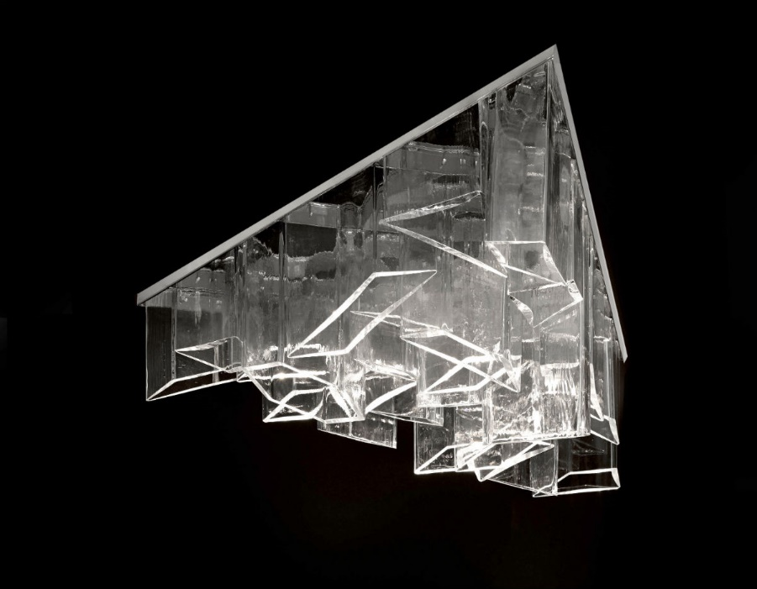
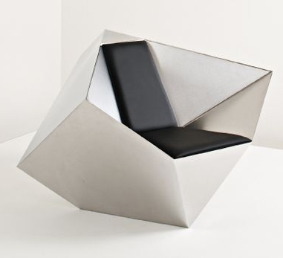
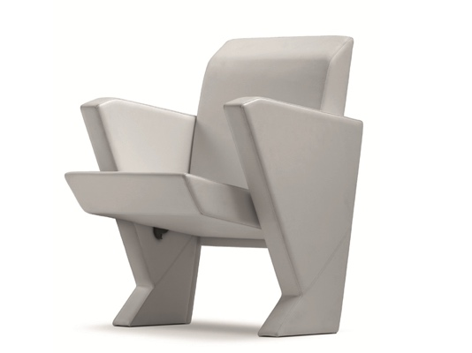
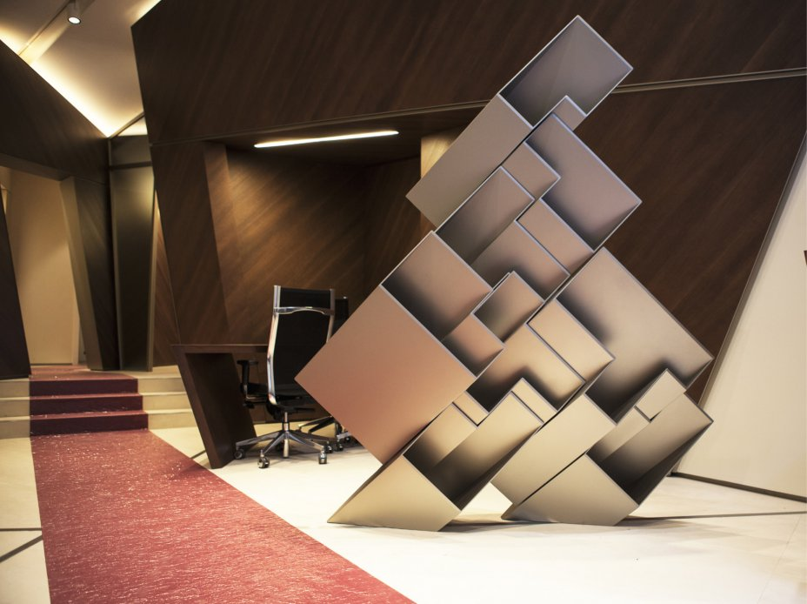
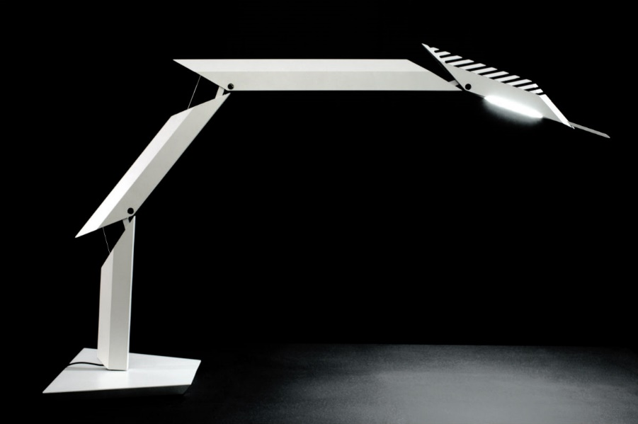
Daniel Libeskind – Furniture and product

Slide 18
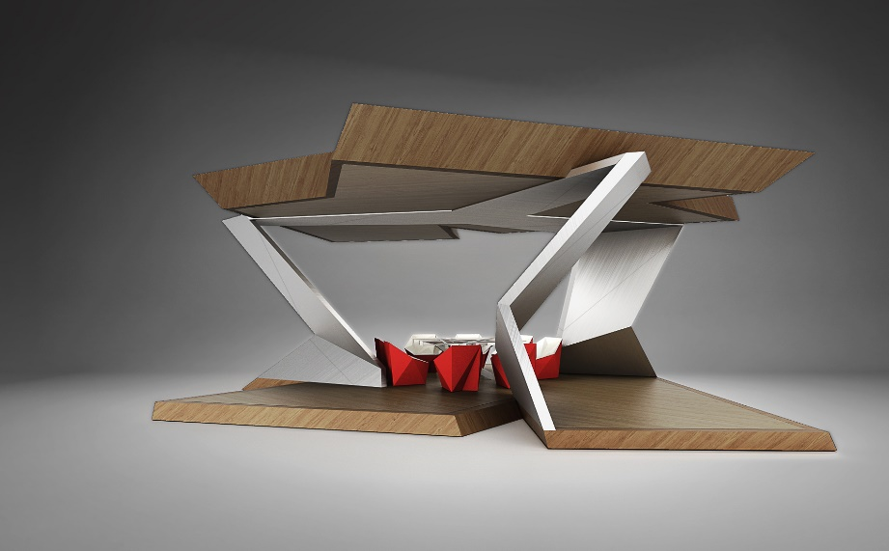
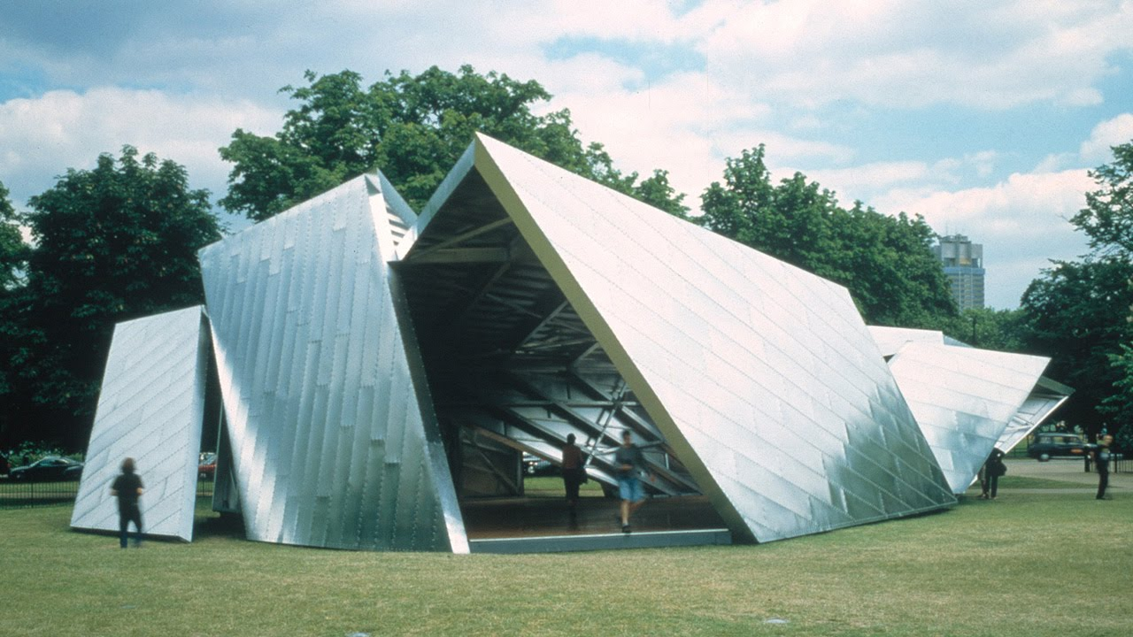
Daniel Libeskind - Pavillions

Slide 19
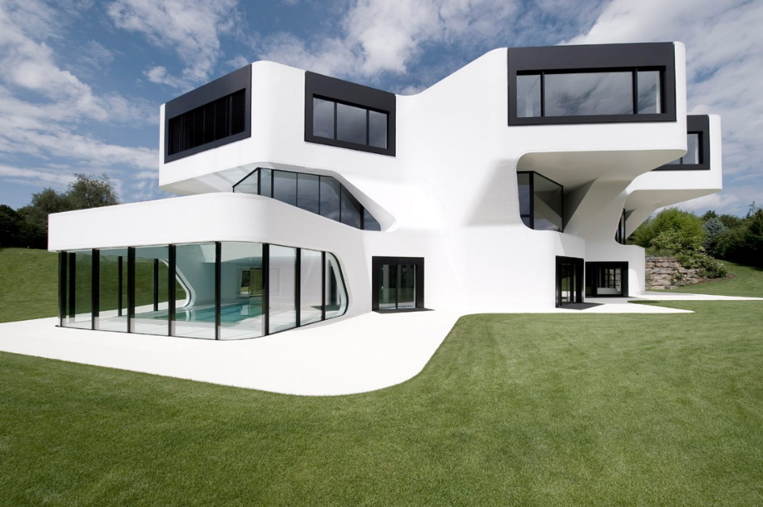
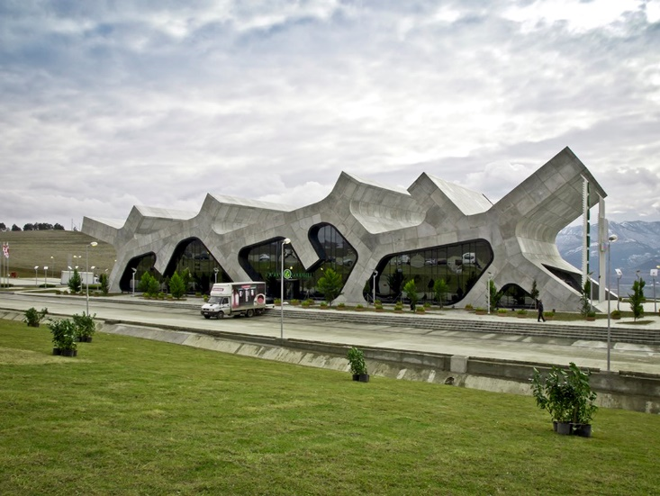
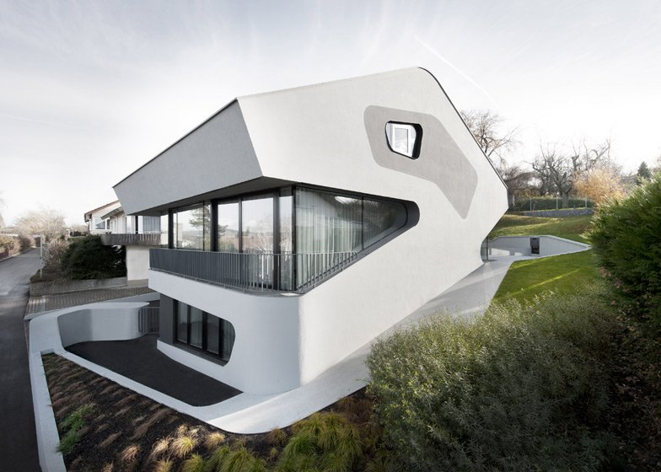
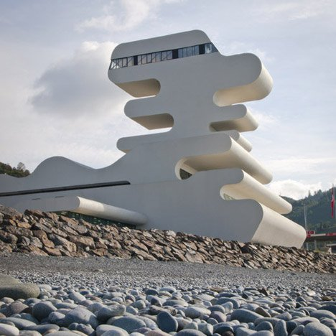
Jürgen Mayer - Architecture

Slide 20
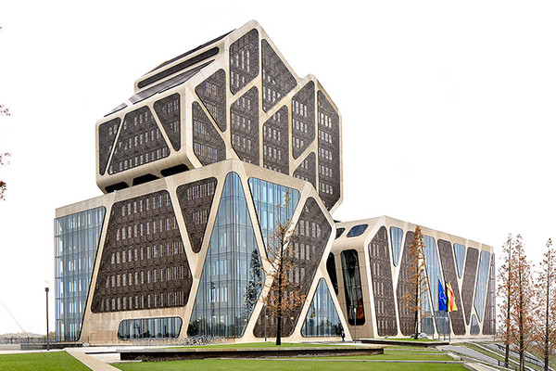
Jürgen Mayer - Architecture

Slide 21
Jürgen Mayer – Furniture and product

Slide 22
Jürgen Mayer – Pavillions

