Slide 1
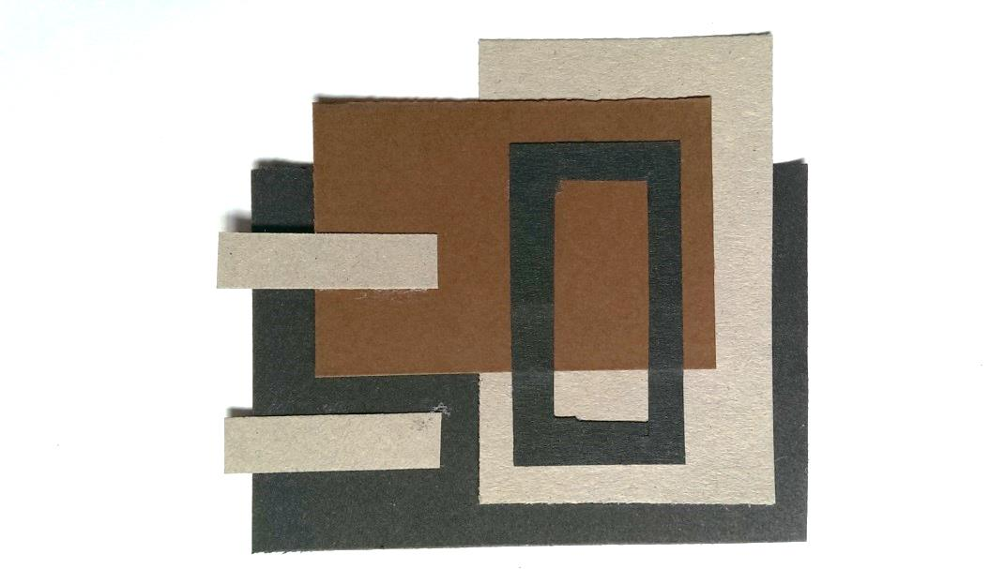
Collage approach to kick starting ideas
You will:
Collage Draw Make 3D

Slide 2
Collage – using squares and straights
Produce one ‘tiled collage’ for each of the following:
1.Vertical and Horizontal alignment
Can be solid or open shapes, just make sure there are plenty of overlaps
2.Same shape but altered scales
Can be solid or open shapes just alter the size and scale, again overlapping

Slide 3
Collage – using squares and straights
3.Detailed
Vertical and Horizontal alignment
Work shapes into shapes, add small details to the layers
4. Movement
Vertical and Horizontal alignment
Try to produce an arrangement that has a feeling of movement, a breakaway

Slide 4
Collage – using squares and straights
Produce one ‘tiled collage’ for each of the following:
5. Use a design movement or designer’s approach
Here Mondrian has inspired a V&H arrangement
6.Other geometric shapes aligned vertical and horizontal
Here circles and triangles have been used but you can use any regular shape e.g. pentagon, hexagon,

Slide 5
Collage – using squares and straights
Produce one ‘tiled collage’ for each of the following:
7. Torn using tiles 1-6
For example a simple vertical and horizontal on the left becomes a ‘torn’ version on the right.

Slide 6
Collage – using irregular shapes
Produce one ‘tiled collage’ for each of the following:
8. Irregular geometric or random shapes
Here Mondrian has inspired a V&H arrangement
9.Positive and negative
+ve & -ve
Here circles and triangles have been used but you can use any regular shape e.g. pentagon, hexagon,

Slide 7
Homework – a minimum of 10 ideas for each of the following:
Square,rectagonol,strip but on the DIAGONAL
- Random CURVED SHAPES
‘Same shape’ but this time on the diagonal
1. Using the supplied shapes, now produce collages on the ‘diagonal’ for tasks 2 – 9 i.e. various angles rather than vertical and horizontal.
2. Now use one of your recent 3D models to repeat the whole process again to develop more ideas….
Two examples of representing the 3D model as a collage, now ready for the drawing tasks

Slide 8
Stage 1 …the collage (minimum of 30 tiles)
You should now have a series of tiles like this:
1 Vertical & Horizontal
4 Movement/break away
7 Irregular shapes
2 Same shape
5 Designer Mondrian
8 Positive Negative
3 Detailed
6 Other geometric shapes
9 Torn

