Slide 1
Architecture Component 2 Homework 2
Quick line sketches tasks
For each task produce a minimum of three variations but the more you have the better!!!!

Slide 2
Start with one or two straight ‘paths’
Then draw around a square template layering up as you go.
Now select which square or part of the squares to ‘show’ thus giving the illusion of depth/ shapes in front/behind.

Slide 3
Start with three lines at angles going down the strip
Then draw a few criss-cross lines across the paper.
Now look for simple shapes within the overlaps.
Use thick lines + parallels to highlight the individual shapes.

Slide 4
POSITIVE SPACE
Start with three to four lines at angles going down the strip
Then draw a few criss-cross lines across the paper.
Now look for simple shapes within the overlaps which can form closed ones - you can add a line if it helps to make an interesting shape.
Use a thick line or one colour to highlight the individual shapes.

Slide 5
NEGATIVE SPACE
Start with three to four lines at angles going down the strip
Then draw lots of criss-cross lines across the paper. They don’t have to reach all the way.
Now look for simple shapes within the overlaps which can form shapes with ‘bites’ taken out.
Use a thick line or one colour to highlight the individual shapes.

Slide 6
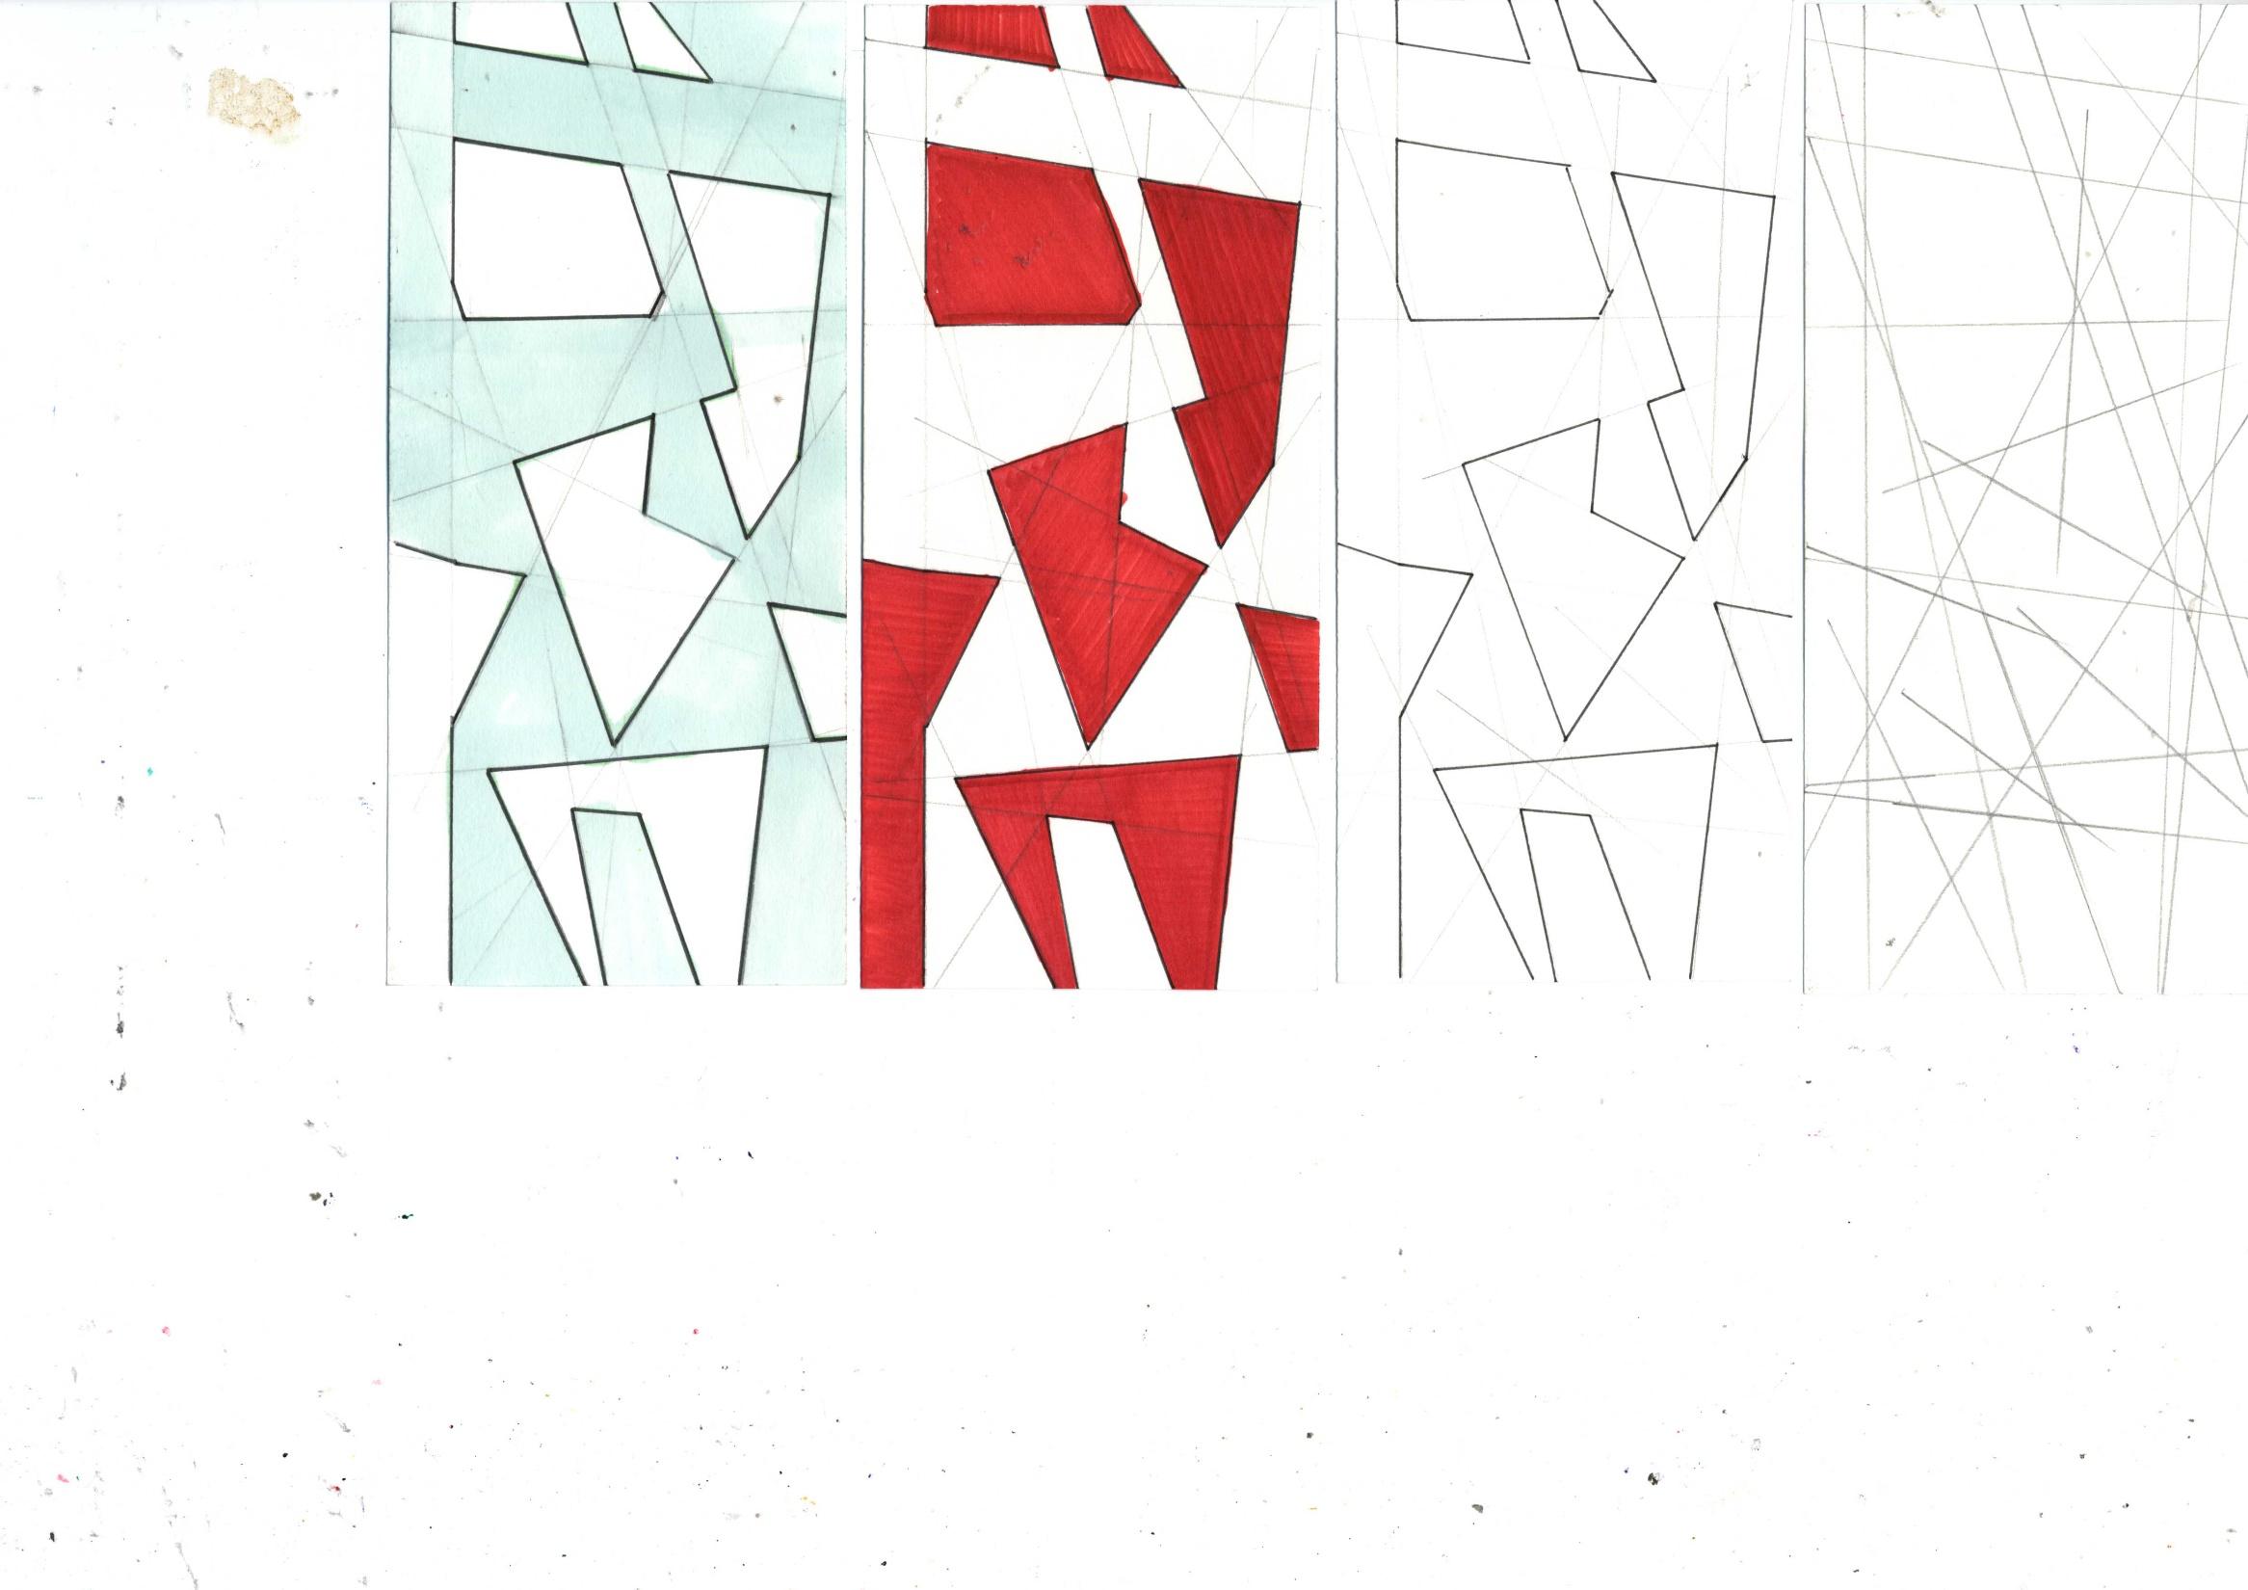
Start with lots of lines criss-crossing the paper. Some can be full, some can stop short of the paper’s edges.
Now look for simple shapes within the overlaps.
Use thick lines + parallels to highlight the individual shapes.
Now copy the shapes onto a new sheet and produce one ‘positive’ and one ‘negative’ coloured versions (can be the same colour for both).

Slide 7
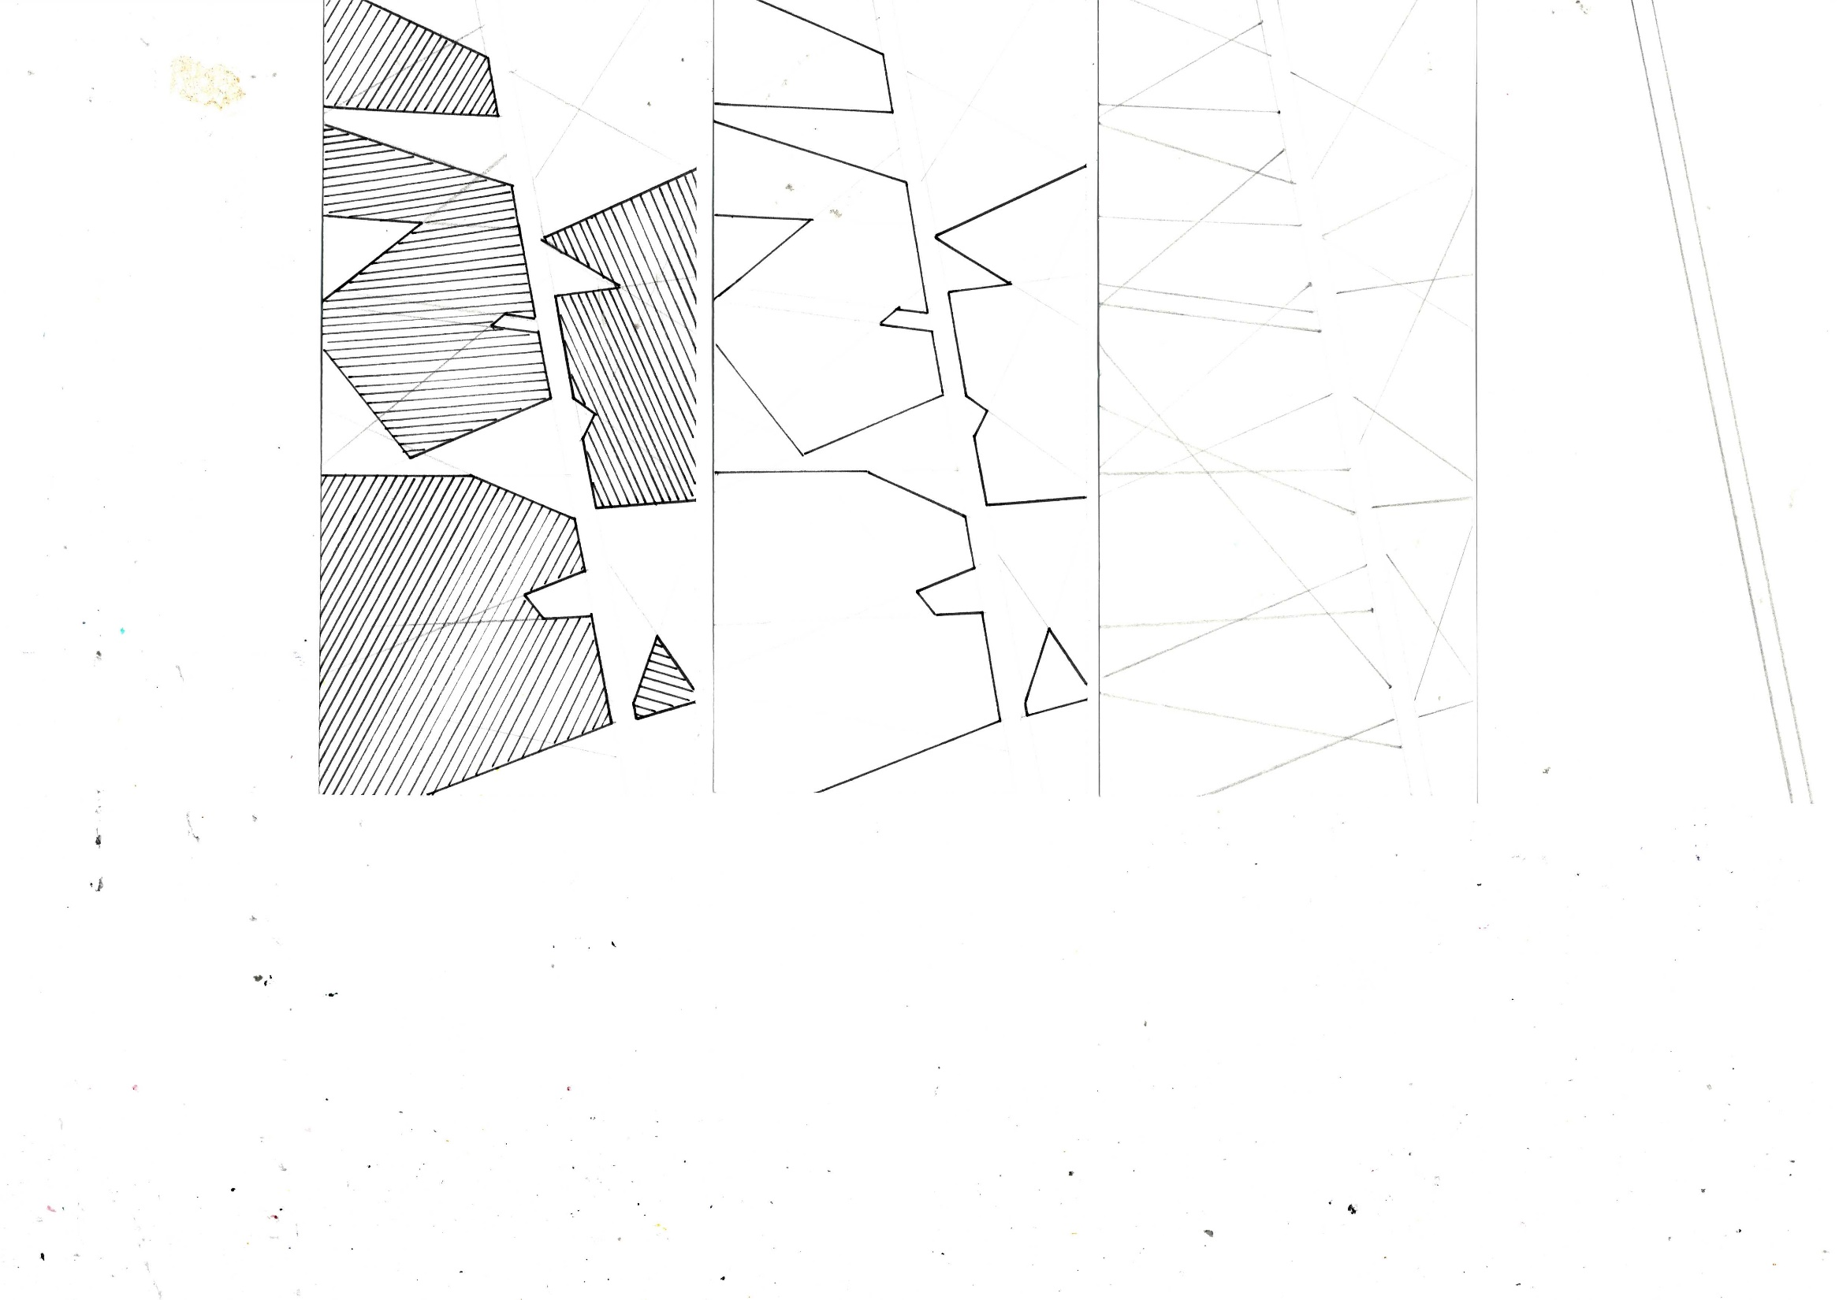
‘THE AVENUE’
Draw a ‘street/avenue’ at an angle using parallel lines.
Now project AWAY from each side of the ‘street’ lines at various angles.
Then look for interesting shapes/blocks and outline them.
Now using ‘HATCHED’ lines shade the shape. Take care to keep the hatching even and NOT parallel to one of the shape’s outlines.

Slide 8
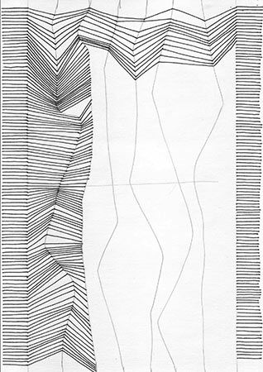
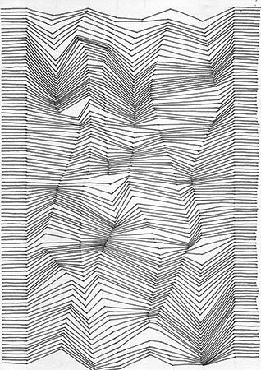
Start with two borders and plot the short horizontal start/finish lines.
Then draw free hand three to four wavy lines.
Now connect across.

