Slide 1
Homework week commencing 5th March
Analysing a building through tracing
You will need to prepare:
A suitable picture of your chosen building showing its key design aspect(s)
Shrink this image to no bigger than 180mm x 120 mm and then print.
You will need the following:
Black pen/fineliner
5 sheets of the white layout paper
1 to 2 sheets of the tracing paper
You will produce:
Minimum of two ‘quick’ line drawings showing the basic shapes used (traced)
A more detailed elements drawing (traced)
A detailed line drawing on tracing paper (can have thick and thin lines added)

Slide 2
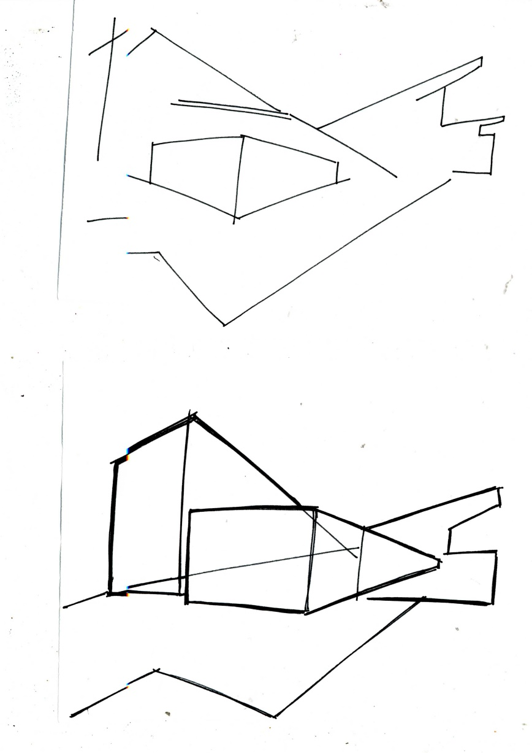
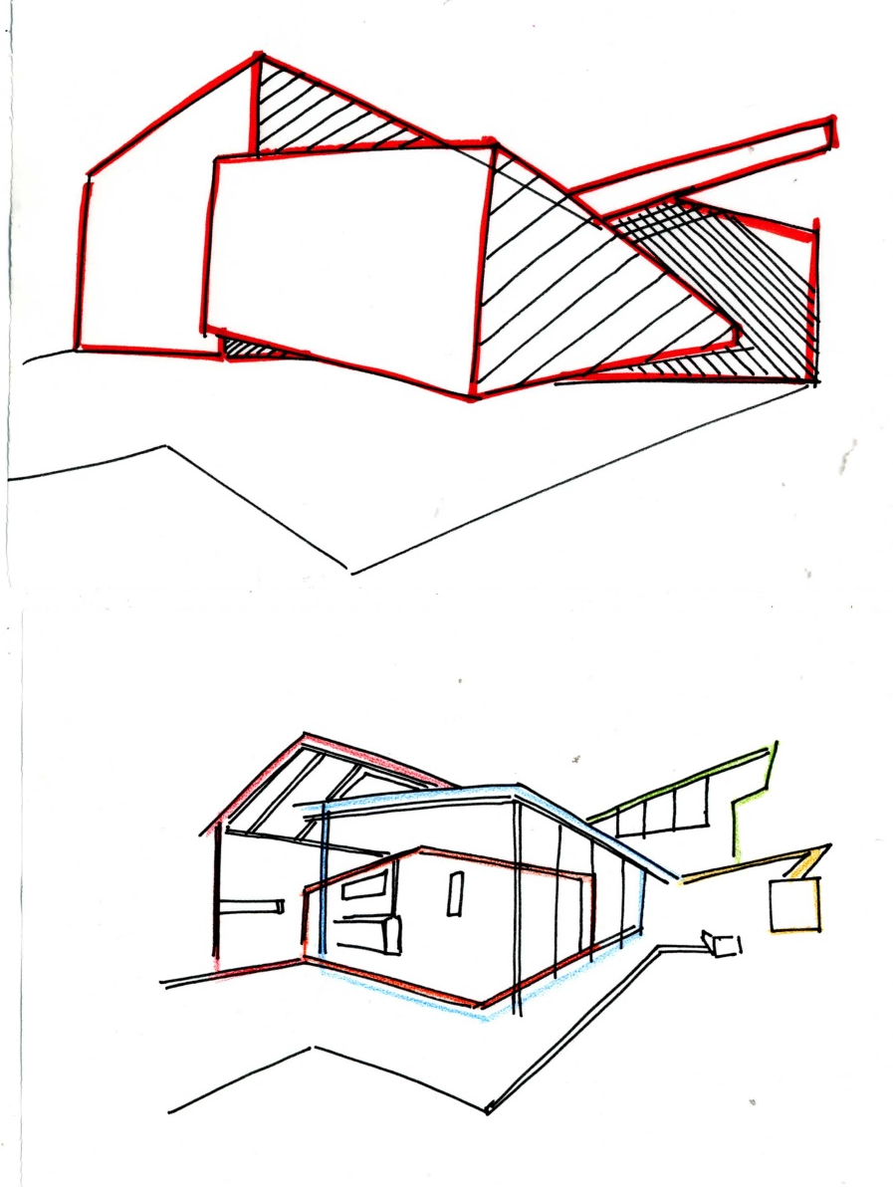
Examples of the tasks
‘Quick’ lines showing the key shapes Red shows the ‘blocks’ and ‘faces’ used, A detailed tracing version
Colour is the first detailed version

Slide 3
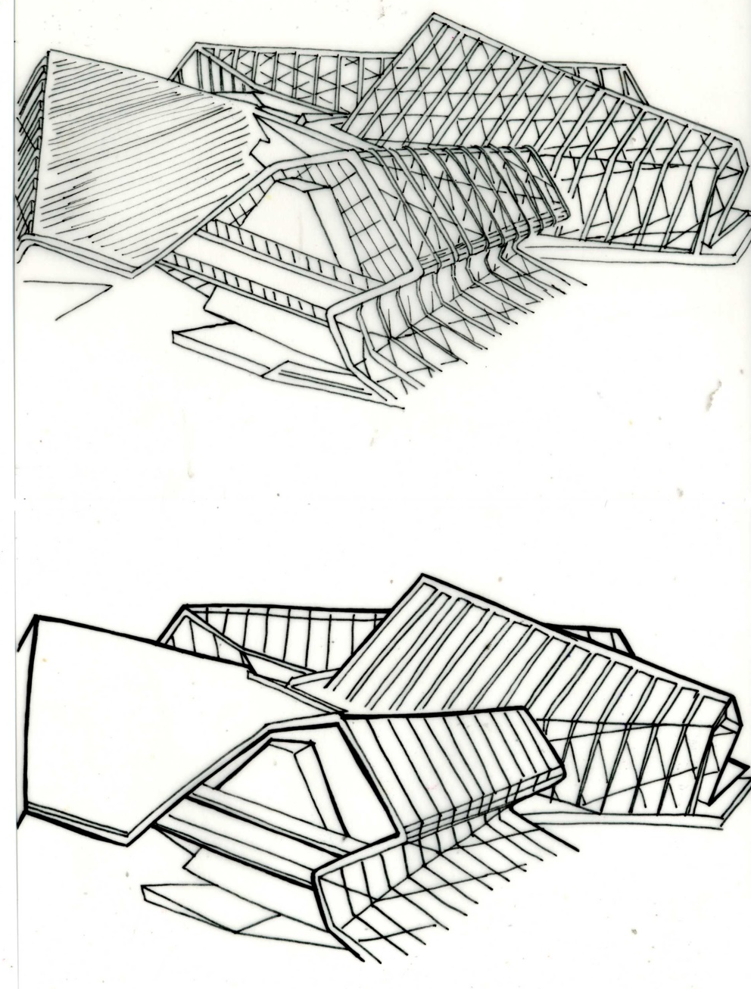
Examples of the tasks
Original picture A detailed version
‘Quick’ lines showing the key shapes A detailed ‘thick and thin’ line tracing version

