Slide 1
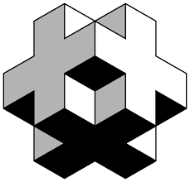
Isometric Drawing

Slide 2
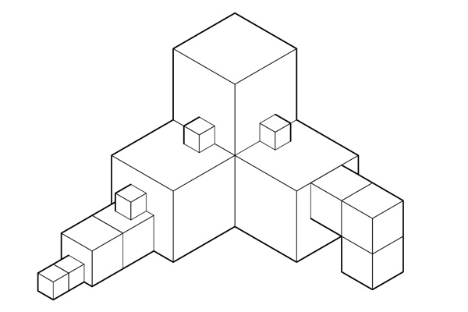
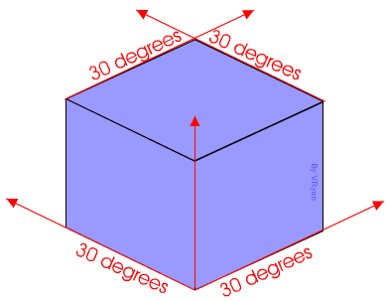
Isometric Rules:
30 Degrees
Parallel lines
Drawing to scale
3 sides of the object visible

Slide 3
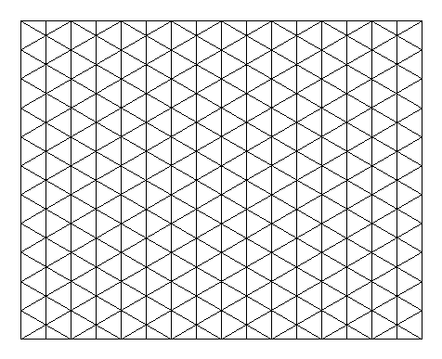

Slide 5
These shapes are all created by wasting within a 6x4x3 crate.
Notes:
Teacher led demo of using a 4 x 6 x 3 crate and subtracting material.

Slide 6
Examples of rendered Isometric shapes.

Slide 7
Can you now
draw this shape freehand?
If you’re struggling use gridpaper.
REMEMBER:
All lines vertical or at 30 degrees.
REMEMBER:
Keep lines parallel.

Slide 8
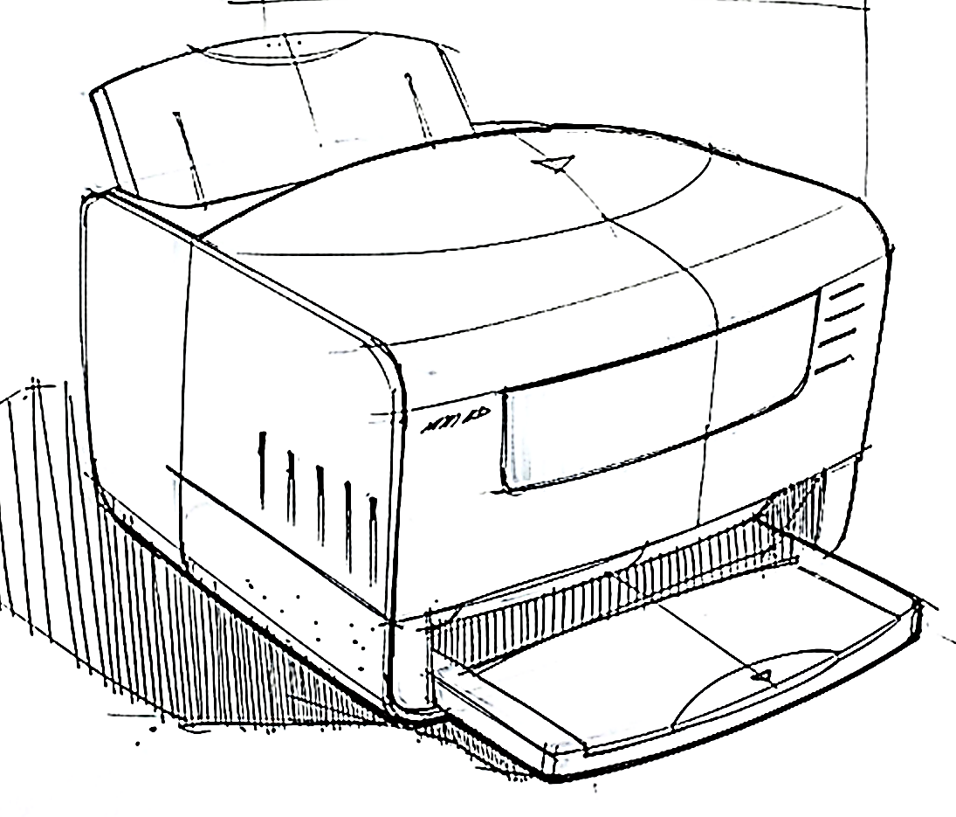
Freehand Isometric Drawing
Attempt to recreate this isometric drawing using the skills you have learned.
Get the rough shape down first using the freehand crating technique (you may use grid underlay to draw initial crate if you wish), then add the curves and detail.
One rule: you may only use a Biro and rubber, nothing else!

