Slide 1
Aggregate Supply
What is Fiscal Policy made up of?
What is ‘Expansionary Fiscal Policy’?
Diagrams on mini-whiteboards

Slide 2
Use an AD/AS diagram to show the impact of the following…
Expansionary Fiscal Policy in the SHORT RUN
A rise in Money Wages in the SHORT RUN
A rise Investment in the LONG RUN
Draw the ‘Classical Equilibrium’ – draw the impact of a fall in C during a recession – how does the economy correct itself?

Slide 3
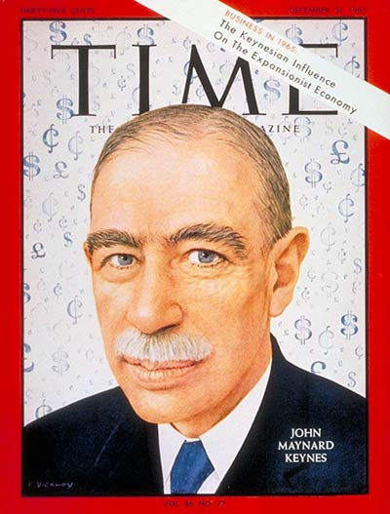
2 Questions
What do Classical Economists believe?
Why are they like my dad?
John Meynard Keynes (1883-1946)
Argued that state intervention was necessary to moderate ‘boom’ and ‘bust’ cycles
Keynesian ideas adopted by almost all capitalist governments post WWII

Slide 4
Keynesian Theory
Keynesian economists do not make the distinction between LRAS and SRAS curves
Keynes famously said that “in the long run, we’re all dead”
Keynesians do not believe that economies will automatically fix themselves when there is low economic growth and high unemployment. For Keynesians, Government must intervene in the economy to encourage growth

Slide 5
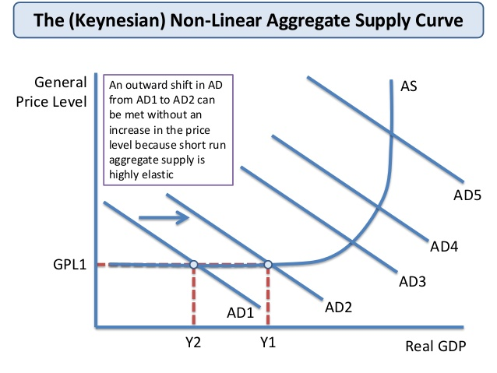

Slide 6
Unemployment
Starter
Define ‘unemployment’ (3 marks)
What are the 2 methods of measuring unemployment?
Complete Activity 1

Slide 7
Activity 2: Using the articles provided make a list of the main reasons for unemployment

Slide 8
Types of Unemployment
Seasonal Unemployment
Regular seasonal changes in employment / labour demand
Unemployment data is usually given a seasonal adjustment to reflect this
Not a major concern for labour market economists
Affects certain industries more than others
Catering and leisure
Construction
Retailing
Tourism
Agriculture

Slide 9
Types of Unemployment
Cyclical unemployment (Demand deficient)
Changes in the level of Aggregate Demand in the economy cause movements in the economy we refer to as the economic cycle.
Where AD is not high enough to create sufficient demand for goods and services

Slide 10
Types of Unemployment
Frictional Unemployment
Unemployment in a dynamic economy where there are new jobs being created and old ones being lost all of the time
Includes new and returning entrants into the labour market e.g. after starting a family
Imperfect information about available jobs can lengthen the period of job search
Some frictional unemployment is good for the economy – a pool of available workers, can help to keep wage inflation down

Slide 11
Types of Unemployment
Structural Unemployment
Arises from the mismatch of skills and job opportunities as the pattern of labour demand in the economy changes over time
Occupational immobility of labour is a major cause of structural unemployment – labour market failure
Often involves long-term unemployment
Prevalent in regions where industries go into long-term decline and have been major sources of employment

Slide 12
Types of Unemployment
Voluntary unemployment
Voluntary unemployment exist where workers are not prepared to work at the prevailing wage rate.

Slide 13
Activity 3
What are the costs of unemployment?
Complete the boxes below by explaining what the costs of unemployment might be to the following groups:

Slide 14
The cost of unemployment
Cost to unemployed and their dependants
Cost to local communities – crime rates rise, shops go out of business, spiral of decline.
Cost to tax payers – Government loses out on Tax revenue and has to pay out benefits.
(Income Tax, VAT returns = lower)
(Job Seekers Allowance payouts = higher)

Slide 15
Discuss: Are the types of unemployment below a consequence of Demand Side or Supply side factors?
Frictional unemployment
Structural unemployment
Cyclical / Demand deficient
Voluntary
Seasonal

Slide 16
Discuss: For each of the types of unemployment below suggest what Governments could do to try to reduce it
Frictional unemployment
Structural unemployment
Cyclical / Demand deficient
Voluntary

Slide 17
Possible answers.
Frictional – job centres, relocation grants
Structural – relocation grants, occupational retraining

Slide 18
Activity 4: Which type of unemployment?

