Slide 1
Inflation
UK CPI inflation
0.1% Nov ‘15
Killer question – is
inflation good or bad?
Discuss in pairs…
It depends…
Complete Activity 1
Notes:
http://www.slideshare.net/tutor2u/as-macro-revision-inflation-and-deflation-31476072

Slide 3
Complete activity 3
There are 2 types of inflation
Demand pull inflation is caused by increasing AD
Cost push inflation is caused by a fall in AS

Slide 4
Complete activity 3
Rising I: low interest rates, low corporation tax, rising business confidence, rising profits, more available credit
Rising G: Political ideology e.g. on education, healthcare, defense, infrastructure
Rising (X-M): weaker pound, higher quality exports, higher incomes abroad

Slide 5
Complete activity 4

Slide 6
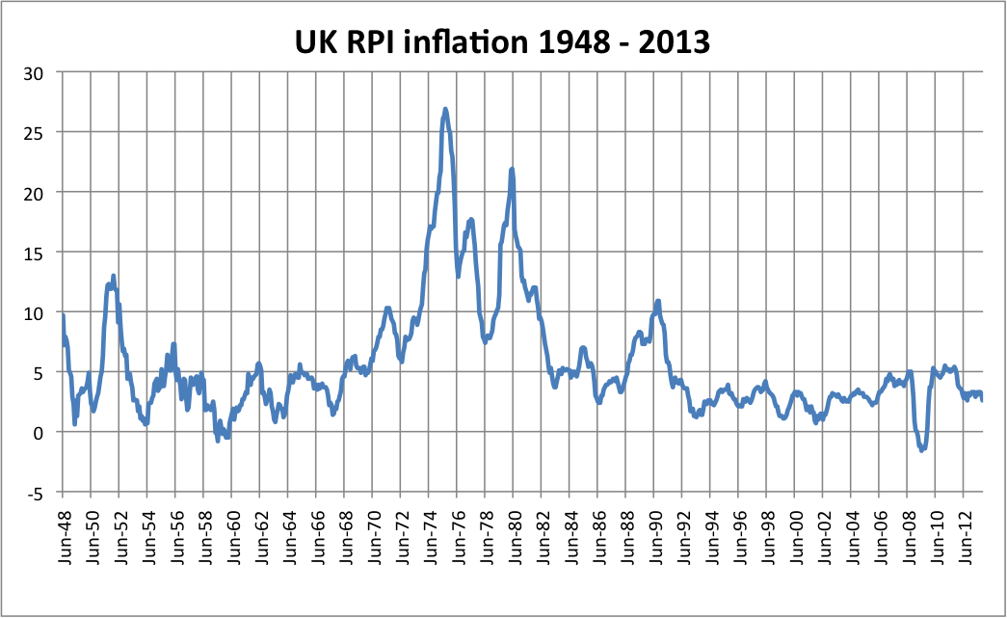
Wage price spiral

Slide 7
Wage Price Spiral
Complete activity 5

Slide 8
Complete activity 6

Slide 9
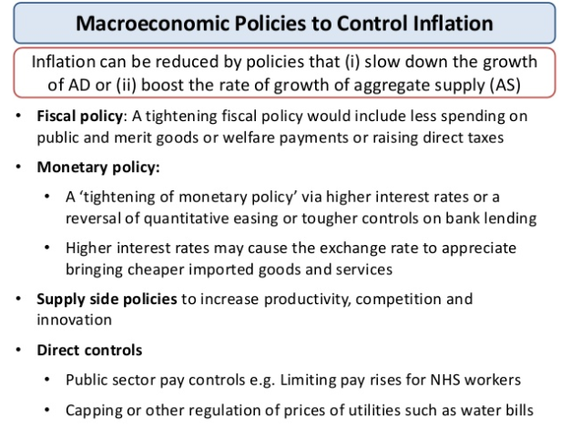
Slide 18

Slide 10
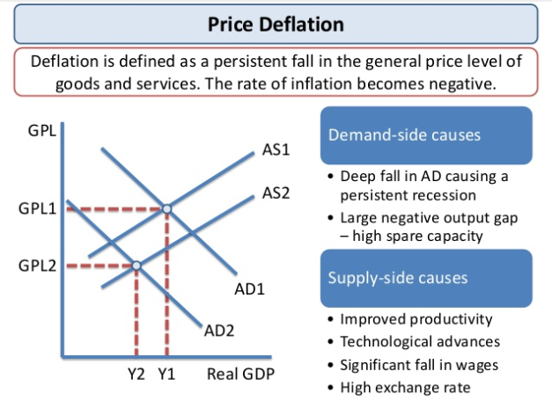
Slide 19

Slide 11
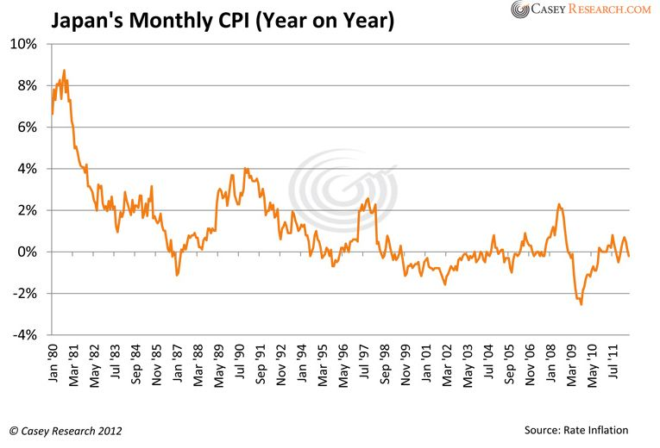
Deflation in Japan
http://www.bbc.co.uk/news/business-11878314

Slide 12
Complete activity 7

Slide 13
Killer question
Keynesian analysis: At what stage of the economic cycle will a rise in AD lead to a large amount of demand pull inflation?
Why is this so?
Hint: think about the link between the availability of the factors of production and the spare capacity in the economy

Slide 14
Could ‘good’ low inflation become ‘bad’ deflation?
Notes:
http://www.bbc.co.uk/news/business-30795424

