Slide 1
Economic Growth
Define economic growth (3 marks)
Notes:
http://www.slideshare.net/tutor2u/as-macro-revision-economic-growth-31476050?qid=44b0294f-98c5-461f-860c-8b6053cc82f1&v=default&b=&from_search=10

Slide 2
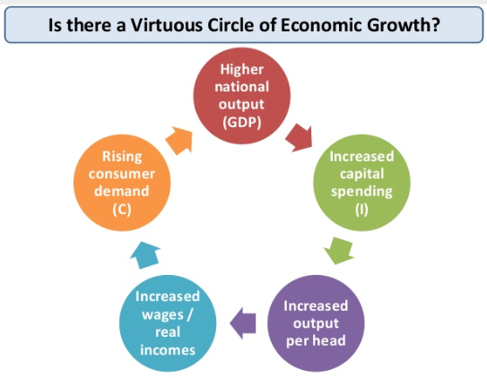
Slide 10
Virtuous circle of economic growth

Slide 3
In pairs, complete activity 2

Slide 4
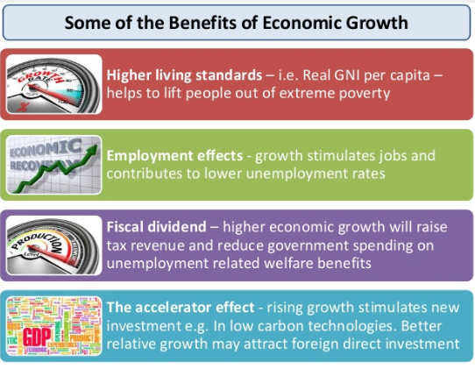
Slide 9

Slide 5
Slide 13

Slide 6
Case Study: China
https://www.youtube.com/watch?v=_wTIcYajq9k

Slide 7
June ‘13
01 (4 marks)
04 (25 marks)
http://filestore.aqa.org.uk/subjects/AQA-ECON2-W-MS-JUN13.PDF

