Slide 1
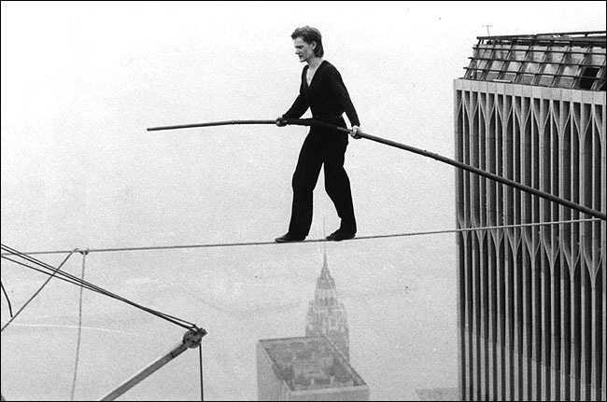
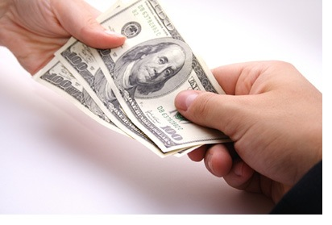
OF

Slide 4
` | Exports | Imports | Goods (Visible) | Services (Invisibles)
A Chinese company buying insurance in the City of London
The Dyson’s purchase a new VW
Selling french cheese in the Godalming Cafe
Australian hotel buys a Dyson vacuum cleaner
An example of your own

Slide 6
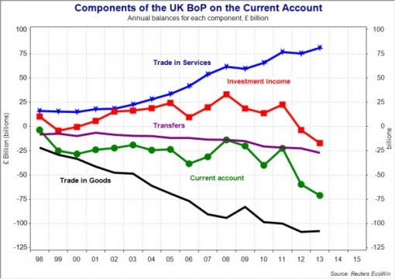

Slide 7
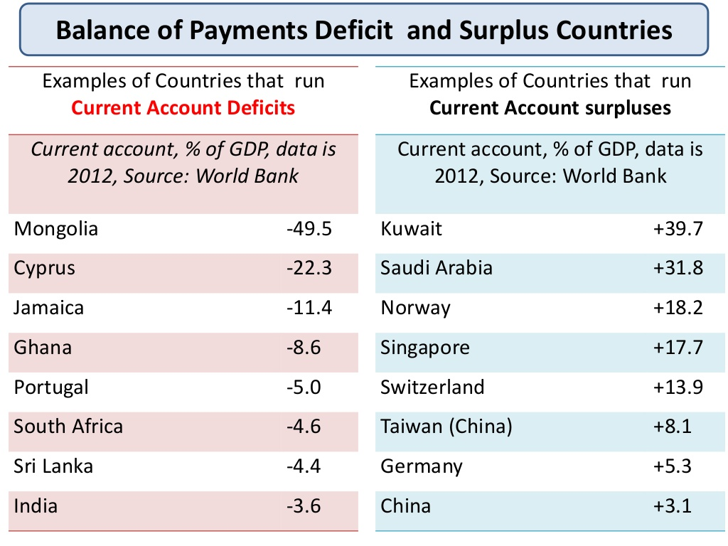

Slide 8
Activity
In pairs
Write a sentence to identify the causes of a surplus/deficit
Extension: which factor is going to have the biggest impact on the current account and why?

