Slide 1
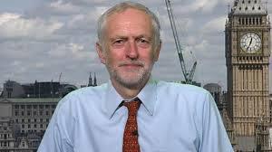
Who is this man?
http://www.bbc.co.uk/news/business-34175069

Slide 2
Economics as a Social Science
Economics is regarded as a social science because it uses scientific methods to build theories that can help explain the behaviour of individuals, groups and organisations.
Economics attempts to explain economic behaviour, which arises when scarce resources are exchanged.

Slide 3
Positive & Normative Statements
Positive statement: objective statements that can be tested, amended or rejected by referring to the available evidence
Normative statement: A value judgement is a subjective statement of opinion rather than a fact

Slide 4
Positive or Normative?
A rise in ‘real’ income of 5% will lead to a rise in the demand for sports cars of £10%.
The level of duty on petrol is too unfair and unfairly penalizes motorists.

Slide 5
Scottish Independence Quiz (4 groups of 5 people)

Slide 6
1/6 Positive or Normative
The Scottish government, led by First Minister Alex Salmond, says the 300-year-old Union is no longer fit for purpose

Slide 7
2/6 Positive or Normative
Britain is one of the world's most successful social and political unions argues David Cameron

Slide 8
3/6 Positive or Normative
Scotland currently has 59 seats in Westminster

Slide 9
4/6 Positive or Normative
If Scotland votes for independence the UK will lose 32% of its land

Slide 10
5/6 Positive or Normative
An independent Scotland would be best to adopt sterling as its currency

Slide 11
6/6 Positive or Normative
Economics graduates can expect to be earning £45,000 within five years of graduation, according to the salary benchmarking website Emolument

Slide 12
Tiebreaker

Slide 13
What is the Short Run?
What is the Long Run?
Key words:
Fixed
Variable
Factors of Production

Slide 14
SR: Period of time when at least one FoP remains fixed
LR: Period of time when all FoP are variable
A PPF shows all the maximum combination of goods and services that can be produced in a given period with available resources being used efficiently

Slide 15
Where we’ve been
Economic problem, scarcity, opportunity cost
Economics as a social science
Positive and normative statements
Where we’re going
Production Possibility Frontiers (PPFs)

Slide 16
Activity 1 (5 mins)
Extension: why is the PPF curved and not straight?

Slide 17
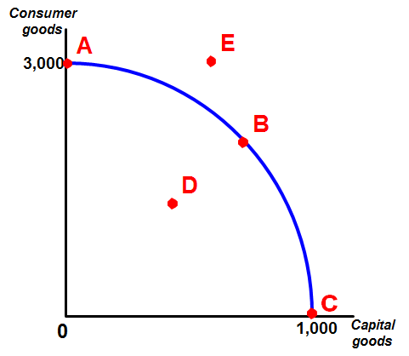
Opportunity Cost
D to B?
B to C?
C to A?

Slide 18
Turn over the page (PPF & OC)
The example states that the OC of producing 3 more cows is 4 tonnes of wheat
Do you agree? Why/why not?

Slide 19
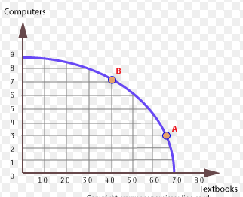
What is the Opportunity Cost of moving from Point A to B?
(Assume at Point A the economy is producing 65 textbooks and 3 computers)
Complete Activity 2

Slide 20
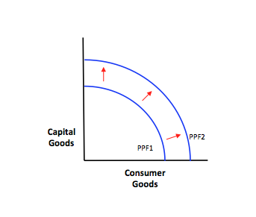
Read PPFs and Econ Growth
Complete Activity 3
5 groups of 4 people
Each group to analyse
impact on FoP
Any downsides?

Slide 21
Pareto efficiency is achieved in an economy when it is not possible to make anyone better off without making someone else worse off OR you cannot produce more of one good without making less of another.
Allocative efficiency: Is concerned with whether resources are being used to produce the goods and services that people want to buy.

Slide 22
On the board…
How do you show Economic Growth on a PPF
How do you show Economic Decline?
Extension: Show the impact of improvements in the production of computers on the PPF (ceteris paribus)

Slide 23
Consolidation Activity

