Slide 1
Measuring Inflation
Price surveys:
Calculates how much goods cost in shops
Allows average price to be found across the UK for each good and service
180,000 prices are calculated on a monthly basis in 150 different areas of the UK

Slide 2
Measuring Inflation
Family Expenditure Survey (FES)
7,000 households – how much are households spending on each good/service?
Data is used to give a weighting to each item (approx. 700 items) in terms of importance
FES is done every year – weightings are updated so that only the most purchased goods are included
Limitations with Inflation measurement?

Slide 3
Only an average: ‘Personal rate of inflation’ may be higher or lower than this (different income groups)
Weightings change over time: affects the ability to compare prices over time. Weightings are updated every year – fashion can change faster
The index does not indicate changes in quality: price rises may just reflect better quality
Sampling issues: quality of the inflation measure depends on the people surveyed and the accuracy of responses (about half respond)

Slide 4
Index
= current year x 100 base year
The price of a Snickers was 50 pence in 2010 (base year) and has risen to 60p by 2014
On rough paper, calculate the 2014 index:
a) 60 = 1.2 b) 1.2 x 100 = 120
50

Slide 5
Percentage change = Change x 100
Original
In 2014 the index for Snickers is at 120
In 2015 the index for Snickers rises to 133
What was the percentage change between 2014 and 2015? Show workings on rough paper:
a) 13 = 0.11 b) 0.11 x 100 = 11%
120

Slide 6
Calculating Index Numbers
Index
= current year x 100 base year
Average weighted index
= Sum of weighted indices Total weights
Activity 1: Calculating Inflation using Index Numbers
Activity 2:
Follow up questions

Slide 7
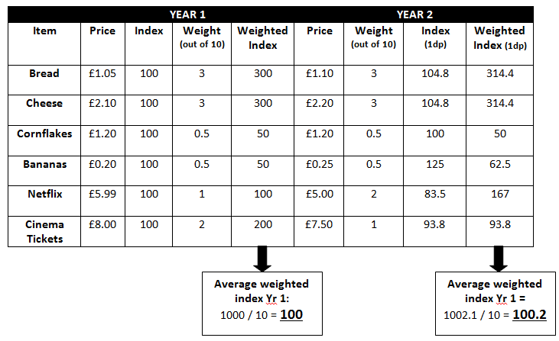

Slide 8
Home Work
Read and make notes on:
Employment and Unemployment
Measuring Unemployment
Must not amount to more than 1 double sided page of A4
Read over Macro notes
Macro Test next week
No lesson Thursday

Slide 9
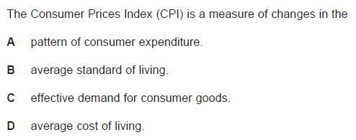

Slide 10
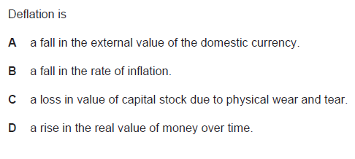

Slide 11
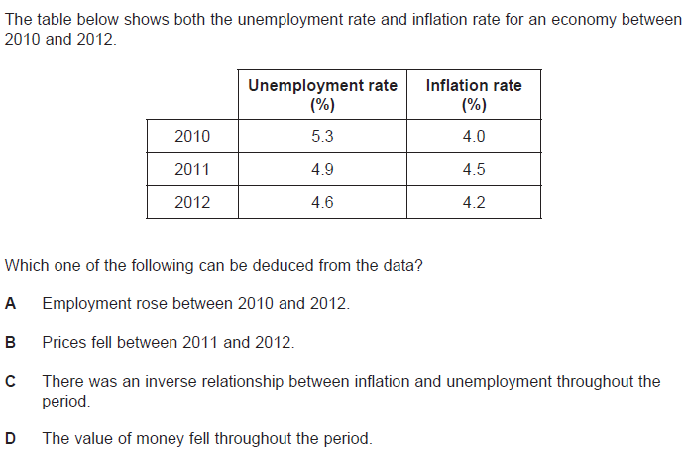

Slide 12
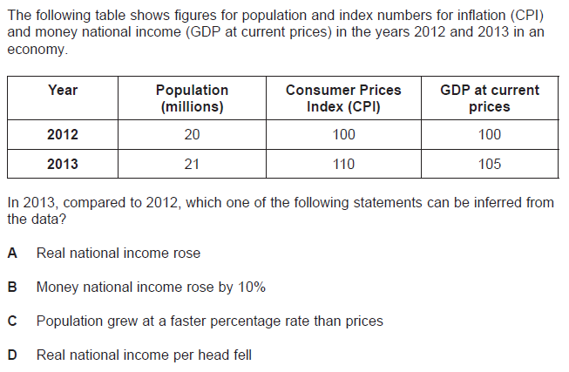

Slide 13
