Slide 1
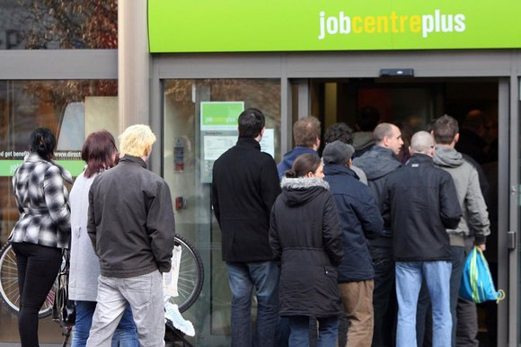
Who is Unemployed?

Slide 2
Define Inflation
Inflation is a general and persistent rise in the price level.
Inflation represents a fall in the ‘purchasing power’ of money
Impact of inflation on the ‘purchasing
power’ of money?
Extension: Difference between REAL
and NOMINAL values?

Slide 3
Nominal v Real Values - difference?
Values unadjusted for inflation are called NOMINAL VALUES. These prices are expressed at CURRENT PRICES.
If data are adjusted for inflation this is at REAL VALUES. Data is adjusted assuming that prices were the same throughout the period.
To convert a nominal value into a real value
simply deduct the rate of inflation from the
variable you are looking at.

Slide 4
Nominal GDP has increased by 5% during a period where the rate of inflation has been 2%
What is the impact of Real GDP?

Slide 5
Activity 1
Between 2009 and 2012 percentage change in CPI increased from 1% to 5.2%. How might the following have been affected by the change?
A pensioner on a fixed income
A saver (assuming that the best rate of interest offered by banks was 2% throughout this period)
Business executives who receive a 10% pay rise per annum
Real Income?
Disposable Income?
Purchasing Power?

Slide 6
starter

Slide 7
How is inflation measured?
Retail Price Index (RPI)
Measures the average price of a ‘typical basket’ of goods bought by the average household.
Consumer price index (CPI)
CPI is a standard measure developed by the European Union.
It has been used in the UK since 1996 but became the official measure of inflation in 2003.
CPI v RPI: Similarities and Differences?

Slide 8
Data collection CPI and RPI
‘Price Survey’ carried out every month
Prices are recorded in 150 areas of the UK
110,000 prices are collected per month.
Around 700 items are included in a typical basket of goods.
The RPI and CPI are weighted to reflect the importance of certain goods or services (e.g. the price of gas is weighted more than the price of fruit)
What goes into the basket of goods is determined by the annual Family Expenditure Survey (FES).

Slide 9
What is the target rate of inflation?
2% (plus or minus 1%)
Who is in charge of controlling
the rate of inflation?
Bank of England
How is inflation controlled?
Use of interest rates (set by the
Monetary Policy Committee)

Slide 10
Activity
Scenario 1
CPI Inflation was 2% in June 2014. Assuming that a loaf of bread in June 2013 cost £1.50, calculate the price of a loaf of bread in June 2014
Extension: Why might this not be accurate?

Slide 11
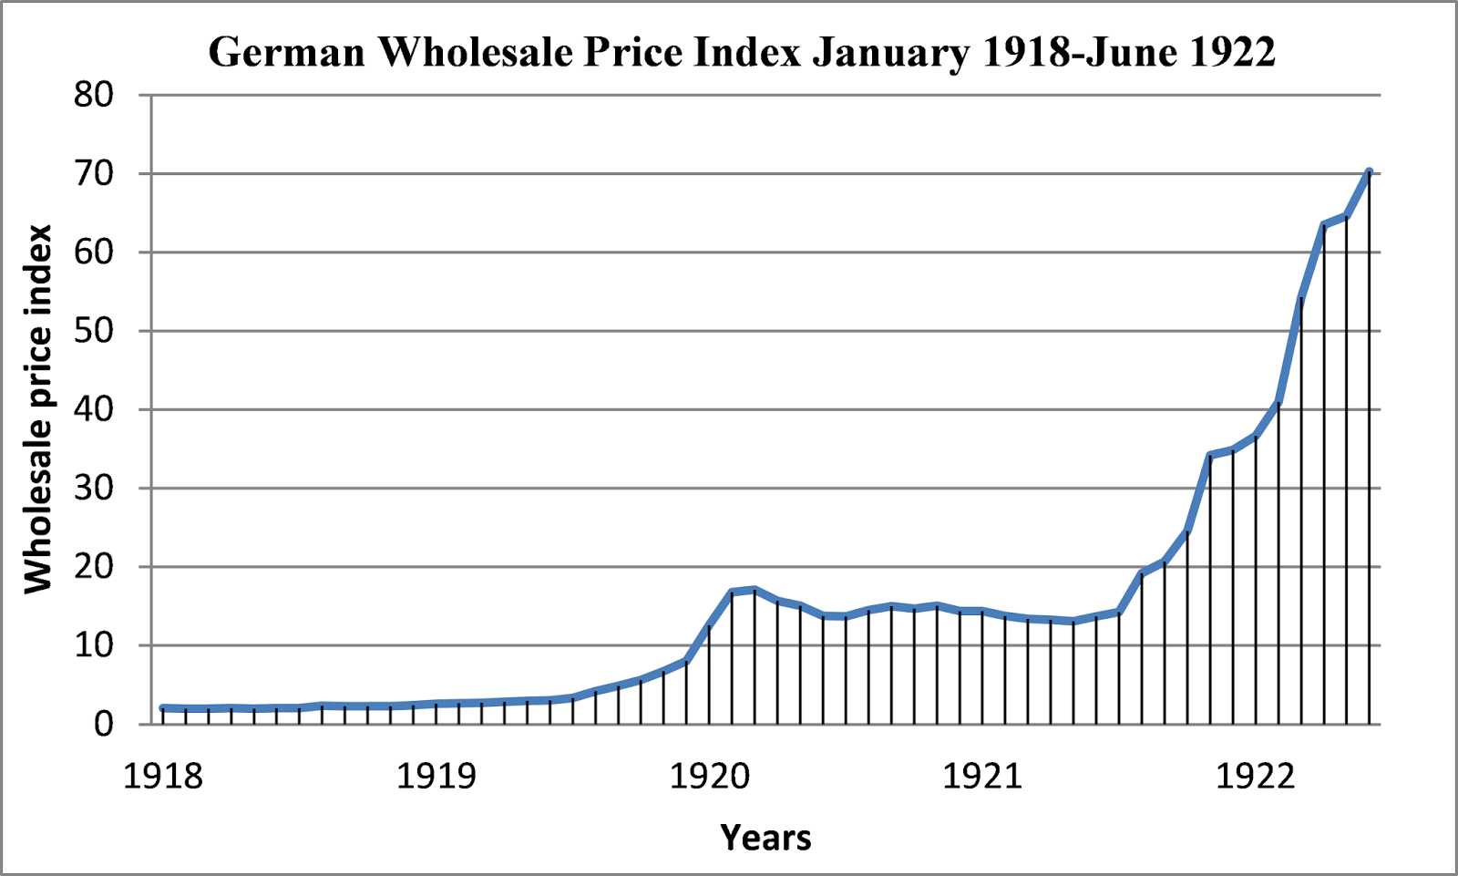
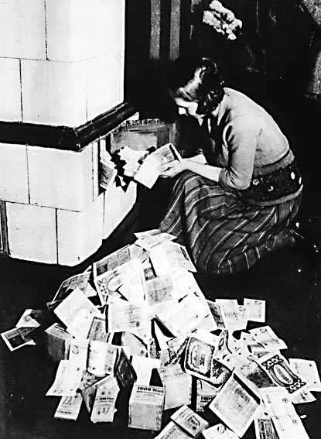
The effects of Hyperinflation in Germany (Post WW1)
It was cheaper to use money as wallpaper than to buy new wallpaper
Children used money as a toy to play with.
It was cheaper to use money as fuel for a fire than buy lighter fuel.
Notes:
Hyperinflation; Causes:
National debt - Printing money (quantitative easing) – devalued existing money

Slide 12
What are the negative consequences of inflation ?
Copy
Pensioners on fixed incomes will suffer as the ‘purchasing power’ of their pension will fall. In the UK many pensioners have private pensions that are not adjusted for inflation.
Any group of workers that fails to negotiate pay rises in line with inflation
If real interest rates fall as a result of inflation there will be a transfer of resources from Savers to borrowers.

Slide 13
activity
The CPI rate of inflation is 4.5% per annum and nominal interest rates are at 0.5%. What is the real interest rate ?
The inflation rate is 4% and the nominal growth in Nominal GDP is 4%. What is the real rate of GDP growth ?

