Slide 1
Welcome back!
Home work out
On rough paper, write down the 4 Macroeconomic Objectives and how they are measured (3 mins)
Extension: What do you think is the most important Macroeconomic Objective and why?

Slide 2
Welcome back!
Home work out
Complete the ‘Economic Cycle’ diagram
Extension: How do you show a ‘negative output gap’ on a PPF?

Slide 3
Home Work
Lararde: China’s economy is not all doom and gloom
Read article and answer questions
Due in next Monday

Slide 4
Where we’ve been:
Basic Economic Problem
Division of Labour
Positive and Normative statements
Measuring Inflation and Unemployment
Economic Growth and the Economic Cycle
Where we’re going:
Circular Flow of Income
Balance of Payments
Aggregate Demand & Aggregate Supply

Slide 5
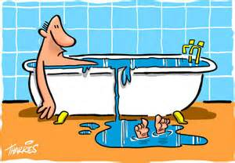
What does a bath and the economy have in common?
Lets ask Paj
https://www.youtube.com/watch?v=gaEY-p-21F8

Slide 6
The interdependence of goods and factor markets
FIRMS
(suppliers of goods and services,
demanders of factor services)
HOUSEHOLDS
(demanders of goods and services,
suppliers of factor services)

Slide 7
Circular Flow in equilibrium:
Income = Output = Expenditure

Slide 8
Circular Flow Worksheet
Draw a diagram to show the circular flow of income for a simple closed economy
Summarise what is happening in the diagram in the box below
Ext: Would the diagram look different in an ‘open economy’? How/why?
6 minutes

Slide 9
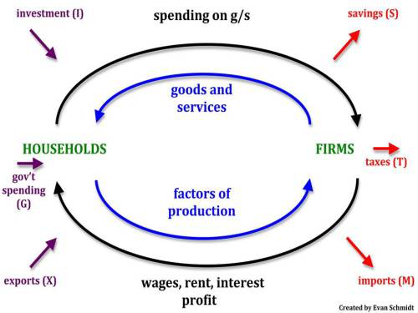

Slide 10
Outside Activity

Slide 11
1. Complete Activity 1 2. Complete ‘55. The Circular Flow’ Ext: What is the multiplier effect?
Notes:
Income = Output = Expenditure

Slide 13
Income
Income is a flow of money going to factors of production:
Wages and salaries paid to people from their jobs
Money paid to people receiving welfare benefits
Profits flowing to businesses and dividends distributed to shareholders
Interest paid to those who hold money in deposit accounts

Slide 14
Wealth
Wealth is a stock concept – it is a large amount of money or valuable possessions and can be held in different ways:
Savings held in bank deposit accounts
Ownership of shares issued by listed companies
The ownership of property

Slide 15
What does a bath and the economy have in common?

Slide 16
Learning Objectives
Understand what is meant by the ‘Circular Flow of Income’
Analyse leakages and injections in the Circular Flow
Explain the difference between between flow concepts and stock concepts

Slide 17
In the circular flow of income model, which one of the following equations is correct?
Income = Output = Expenditure
Income = Output = Injections
Output = Expenditure = Withdrawals
Expenditure = Income = Injections = Withdrawals

