Slide 1
WEEK 1

Slide 2
35

Slide 3
STARTER ACTIVITY: Please complete this worksheet in the first 10 minutes of the lesson
KEY TERMS
Boom - the level of growth is higher than the trend
Downturn - where economic growth decreases
Recovery - economic growth rises after a recession
Recession - when economic growth becomes negative in two successive quarters of time
Positive Output Gap - where the actual growth rate is higher than the trend growth rate
Negative Output Gap - where the actual growth rate is lower than the trend growth rate
Sustainable Growth - where we are able to grow today and grow tomorrow (or in the future)
Depression - a prolonged period of recession
The Economic Cycle
Real GDP %
A
ACTUAL growth
The level of real output produced in an economy year on year.
D
F
E
TREND growth
What the economy SHOULD grow at (or is capable of growing at) year on year. In the UK it has historically (on average been 2.5% per year)
INSTRUCTIONS: Using the key terms above, label the points.
RULES: You are only allowed to use one key term per letter AND you may not be able to use all the key terms
C
0
B
Time

Slide 4




TODAY: Paper 2 - MACROECONOMICS
Economic Cycles
Boom/Peak
Boom/Peak
Introduction to Economic Cycles and Key Terms
Evaluating Economic Growth RECAP (from Paper 3 lesson)
Causes of Economic Growth (briefly)
The UK Economic Cycle 1970-2016
Downturn
Recovery
Downturn
Recession (or longer recession is called a depression?)
Notes:
Unemployment (slack capacity or natural rate?)
Empty shops/buildings
Increase in crime
Reduction in consumption of normal goods and increase in inferior goods

Slide 5
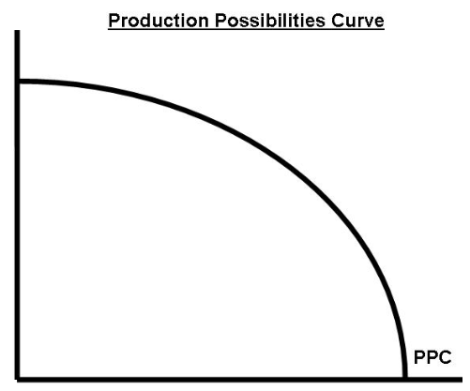
Economic Cycles continued
Economic Cycles and PPF’s
KEY TERMS
Boom - the level of growth is higher than the trend
Downturn - where economic growth decreases
Recovery - economic growth rises after a recession
Recession - when economic growth becomes negative in two successive quarters of time
Positive Output Gap - where the actual growth rate is higher than the trend growth rate
Negative Output Gap - where the actual growth rate is lower than the trend growth rate
Sustainable Growth - where we are able to grow today and grow tomorrow (or in the future)
Depression - a prolonged period of recession
Goods
INSTRUCTIONS: Using the key terms above, try to model as many of these terms on the PPF to your right. RULES: You are allowed to manipulate the PPF in any way you would like. Use the labels (A,B,C etc.) next to the key terms above to highlight them on your PPF. Remember that you will not be able to show all the terms on a PPF.
Services

Slide 6
35

Slide 7
History of the UK Cycle 1970-1997
Make notes on your economic cycles sheet
Using Anderton 5th Ed – pp467 to 468, For each section of history (apart from the last circle):
What happened during this period
List the reason or reasons for why this particular episode happened
In brackets write whether each point was a demand or supply side factor
Was your point an economic shock or was the Government responsible?
1950 – 1970: “Golden Era”
Associated with low unemployment (full!?) and steady economic growth
Keynesian demand management – i.e. fiscal policy
Demand in the short run but longer term supply factors
Government responsible
(1) Early 70’s: The Barber Boom
High growth and inflation (up to 25%)
Loosening of monetary policy and fiscal expansion leading to a boom
Demand side factor
Government responsible

Slide 8
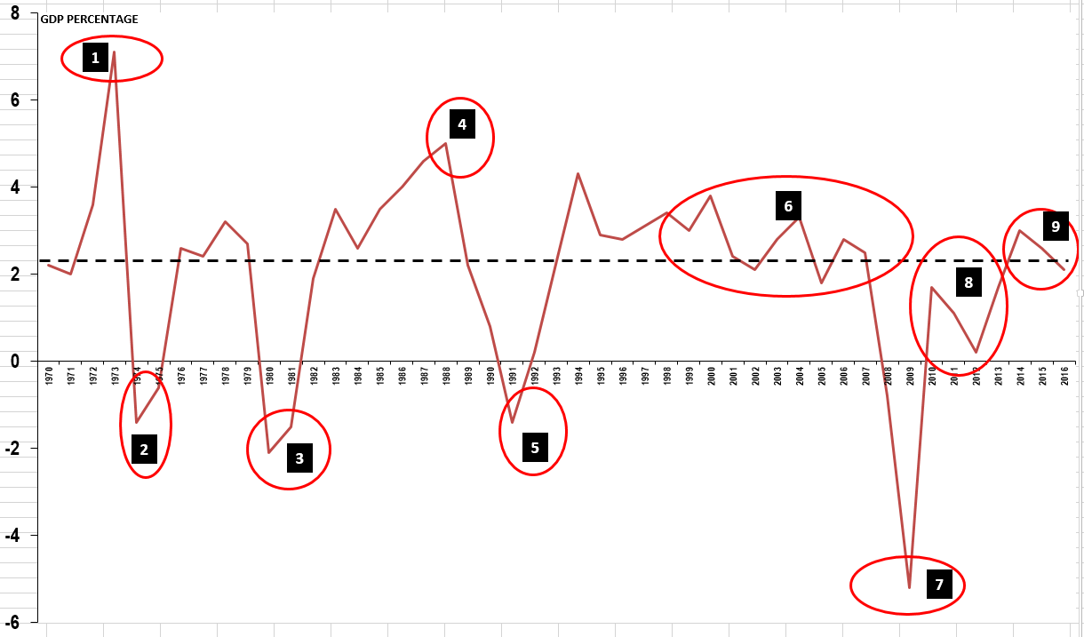

Slide 9
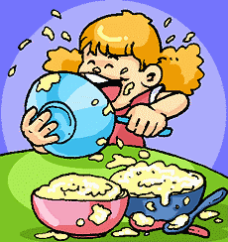
(6) Economic Paradigm: 1997-2007
“The Goldilocks Economy”
Economic growth is strong (above trend) and unemployment is low
  Consumer Boom
  Increases in Government Spending
  Unemployment is low
  Immigration increases
Inflation stable
  Bank of England Independence
  Globalisation = cheap imports from China
  Strong Pound = export earnings reduced
HOWEVER
  Unsustainable consumer boom = rising debt problem?
  Lack of investment and export earnings (large trade deficit)
  Rise in Government debt?
  Downward pressure on unskilled workers wages and job prospects?
  Volatile oil prices
Notes:
Read the article “The UK Economic Picture over the Past 15 Years” and write down reasons as to why the UK economy experience strong economic growth, with low inflation and low unemployment – i.e. not too hot or cold…a Goldilocks economy (without the bears and wolf)

Slide 10
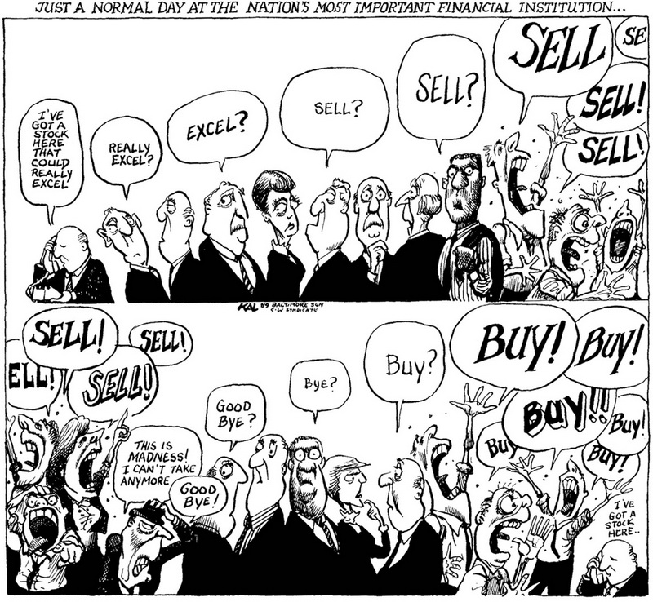
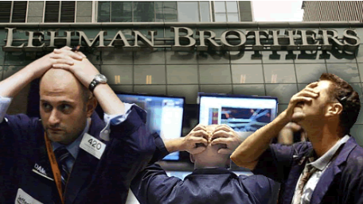
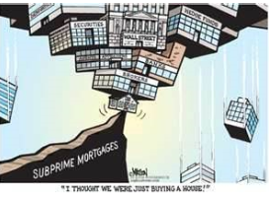
(7) Financial Crisis….2007 to 2009

Slide 11
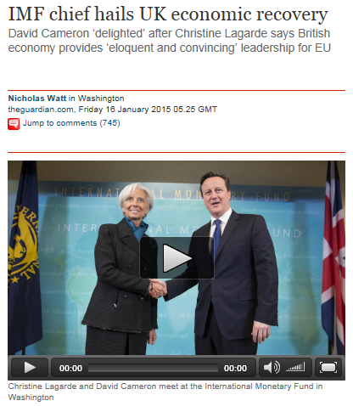
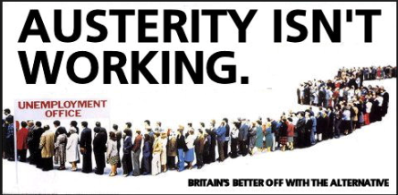
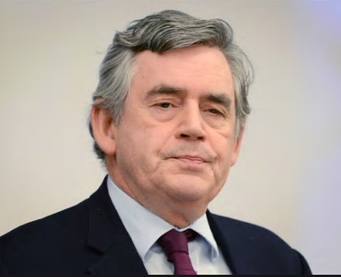
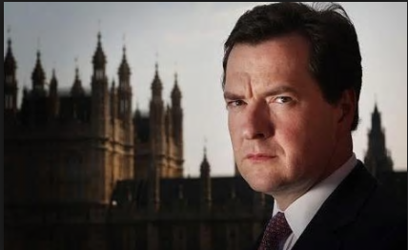
(8) Recovery? 2009 to 2015

Slide 12
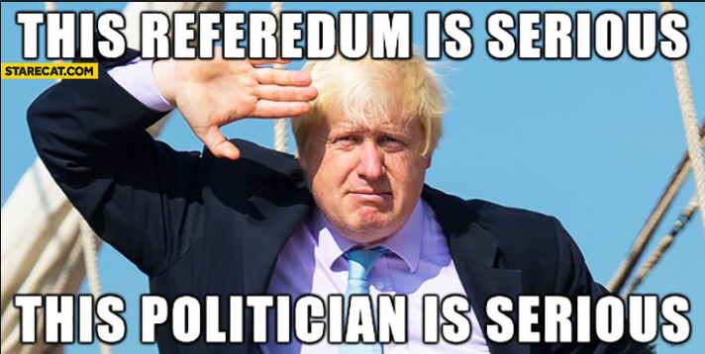
(9) BREXIT? 2015-16

Slide 13
10

Slide 14
WEEK 2

Slide 15
20

Slide 16

STARTER EXERCISE (5 minutes)
Finish off the unemployment worksheet, ready for further discussion as you arrive
Remember to discuss the last question at the bottom

Slide 17
Defining and Causes of Unemployment
LABOUR FORCE – the amount of people who are willing to work – sometimes called the workforce or economically active
EMPLOYED – members of the workforce who have a job – it could be a part-time or full time job
UNEMPLOYED – members of the workforce who have no job but are seeking work. They may be unemployed for a number of reasons – they may be looking for a better job, they may no longer have useful skills, there may not be enough work for them or they are refusing to accept the going wage rate but still want to work.
ECONOMICALLY INACTIVE – these are members of society who are considered to be out of the workforce. This may be because they have health issues, they may look after relatives, children, friends etc., they may be students.
VOLUNTARY UNEMPLOYED – these are a group of the unemployed who are considered to be actively choosing not to work because they are refusing to obtain new skills, are not willing to work at the going wage rate etc.
INVOLUNTARY UNEMPLOYED – these are the group of unemployed where there lack of a job is out of there control.

Slide 18
25

Slide 19
Economic Cycles - Causes of Economic Cycles

Slide 20
CAUSES OF ECONOMIC CYCLES
Demand Side or Supply Side / Exogenous or Endogenous?
Actual Growth Rate (Demand or Supply?)
  Demand or Supply Shocks to the Economy?
    Exogenous - factors outside of the economy
    Endogenous - factors within the economy
  Short term Government policy (endogenous)?
Long Term Trend Growth Rate (Supply Side)
  Quality:
    Labour (Education)
    Capital (Technology)
  Quantity
    Labour (Greater population - birth rates, death rates, immigration etc.)
    Capital (Greater long term investment etc.)
TASK: Using your A3 sheet for economic cycles, for each number, state whether:
It was caused by demand (D) and/or supply (S) factors
Whether the events were exogenous (EX) and/or endogenous (EN) shocks
Whether the factors were shocks (SH) and/or short-term Government Policy (GP) in your view.
Notes:
Trend growth rate is an after thought - focus on actual growth rate for the moment.

Slide 21
45

Slide 22
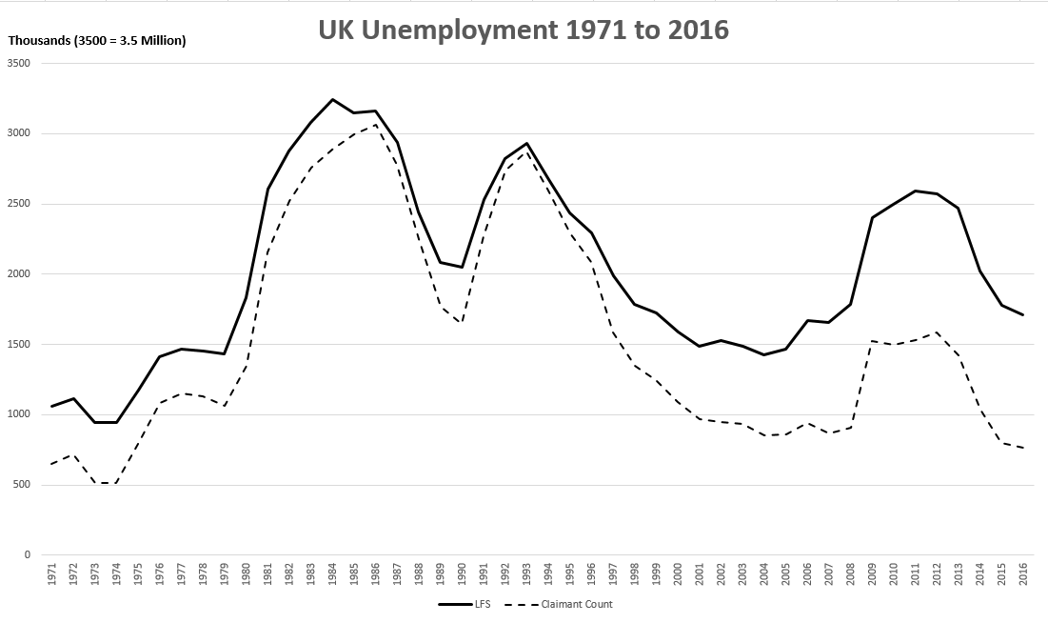
EFFECTS OF ECONOMIC CYCLES
Measuring Unemployment…
QUESTIONS:
Describe two significant points of the data (4 marks)
Circle the 9 areas ‘of interest’ from the economic cycle
Is there a pattern between the economic cycle and the levels of unemployment?

Slide 23
EFFECTS OF ECONOMIC CYCLES
Greater Unemployment - What are the Costs?
INDIVIDUAL
Loss of earnings to the unemployed. Unemployment is the biggest causes of poverty in the UK.
Potential homelessness . Loss of income can leave people without sufficient income to meet housing costs. Rises in unemployment often exacerbate the rates of homelessness. (BBC)
Hysterisis - Those who are unemployed will find it more difficult to get work in the future
Stress and health problems of being unemployed. Amongst studies of unemployed men, signs of depression, mental anxiety and health problems are noticeably higher.
ECONOMY
Increased government borrowing. Higher unemployment will cause a fall in tax revenue because there is less people paying income tax and also spending less (hence lower VAT). Also the government will have to spend more on unemployment and related benefits. The government doesn’t just pay unemployment benefit, but a family who has unemployment will be more likely to receive housing benefit and income support. One study shows that the cost to the exchequer for one person being unemployed is £6,243 a year in benefits and lost tax revenue.
Lower GDP for the economy. High unemployment indicates the economy is operating below full capacity and is inefficient. This will lead to lower output and incomes. Might indicate a downturn or recession?
Increase in social problems. Areas of high unemployment (especially youth unemployment) tend to have more crime and vandalism. It can lead to alienation and difficulties in integrating young unemployed people into society.

