Slide 1
WEEK 1

Slide 2
30

Slide 3
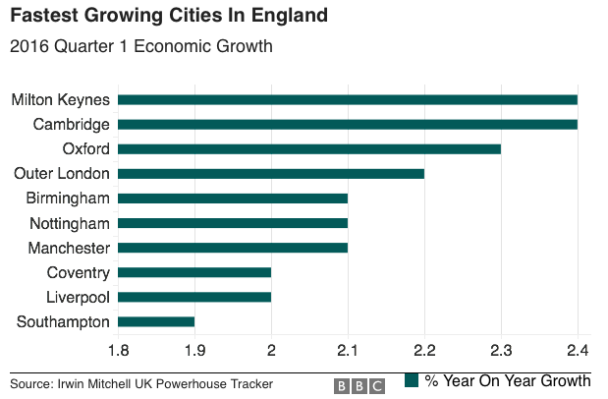
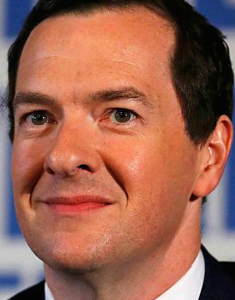
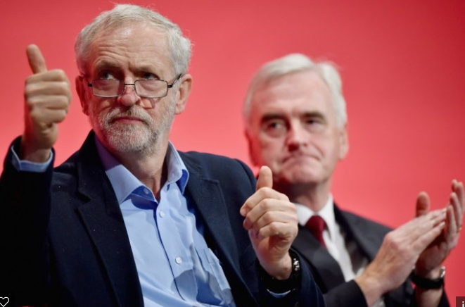
Economics in the News….Paper 3 Lesson
TASKS (10 minutes)
Have your homework out for collection (make sure your name is on the work)
What economics news story do these pictures relate to?
Have an opinion on the news stories, if asked/picked on!
Are there any other stories in the news you have come across?

Slide 4
PAPER 3 (Micro and Macro): TODAY
ADMIN
Economics in the News
Homework Collection
Homework PREP for first lesson next week
MICRO: Introduction to demand, supply and the law of price
Concepts of demand and supply
The law of price
MACRO: Evaluating Economic Growth
Economic growth, booms and recessions
Economic growth: The case of China and the UK
What is sustainability and why do we want it as an objective of economic growth?

Slide 5
30

Slide 6
MICROECONOMICS OVERVIEW
THE BASIC ECONOMIC PROBLEM
Scarcity (resources), unlimited wants forces a choice which involves an opportunity cost. There is not enough for everyone so how best to distribute our scarce resources to meet everyones wants.
PPF Diagrams….
Direct Controls
Legislation and regulation
Price controls - max and min prices and buffer stocks
Government provision
SOCIALISM
CAPITALISM
Theory of the Firm
Basics of the firm – types of firm and objectives of firms
Specialisation, division of labour and economies of scale
Total, Average and Marginal Costs, Revenue and Profit (you need to calculate as well as define)
Price determination
Equilibrium and disequilibrium
Demand & Supply Curve shifts
Elasticity - PED, XED, YED, PES
Roles of Prices - signaling, rationing and incentives
Price Mechanism
Indirect taxation
Subsidies
GOVERNMENT INTERVENTION
MARKET SUCCESS
Persuasion
Guidance
Nudge Theory
Efficiency
Productive
Allocative
Unintended effects
Moral Hazard or Dependency
Disincentive effects
Shortages/surpluses
Inefficiency
Political Conflicts
Minority influence
Corruption
Externalities (positive and negative)
Production externalities
Consumption externalities
Merit Goods (underproduction)
Demerit Goods (overproduction)
Imperfect Competition
Natural Monopoly & Monopoly Power
Labour Market Failure:
Immobility of Factors of Production (Geographical and Occupational)
Poverty and Inequality (Absolute and Relative Poverty and Inequality issues - inequity of opportunity etc.)
GOVERNMENT FAILURE
MARKET FAILURE
Imperfect information
Unable to put a value on costs or benefits
Admin Errors/Costs
Bureaucractic costs of say taxation, subsidy’s and regulation?
Missing Markets
Public Goods and the ‘Free Rider’ Problem
Quasi Public Goods

Slide 7
MICRO: The Law of Price and Supply
P
SUPPLY CURVE
Quick Exercise:
(1) Why does the supply curve slope upwards?
(2) What do you think would happen to the supply of paint if the price of paint increases?
EXTENSION (harder question): Volkswagen cars are thought of as dirty polluters and as a result demand falls for this product. What would happen to the supply of Volkswagen cars? Draw a supply diagram to demonstrate the effect on quantity supplied of VW Cars
Qs

Slide 8
PEDRO CABBAGE INC.
Pedro’s Farm and the town of POG

Slide 9
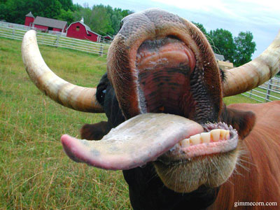
PEDRO COW FARM INC.

Slide 10
MICRO: The Law of Price and Demand
GROUP EXERCISE TO SKETCH DEMAND CURVES AND DEMONSTRATE THE LAW OF DEMAND:
Stagecoach is a bus company. It charges different prices to different passengers for the same journey. Draw a demand curve for each scenario below and use the demand curve to explain what happens when:
Children are charged half price for a bus journey instead of being charged full price
Senior citizens are given a free bus pass paid for by the local authority rather than having to pay the full fare
Stagecoach increases its prices on a route by 5%
Passengers can get a 60% reduction by buying a day return if they travel after 10.30 compared to having to pay the full fare
Households/Consumers Definition
Law of Demand: The demand for a good is often determined by the price of that good
‘You are Consumers’ Exercise - how many drinks would you buy in one week at the following prices:
£4.00
£2.00
£1.50
£1.00
£0.50
£0.25
Diagrams in Economics
The importance of the axis (price and quantity)
Labelling
A title

Slide 11
The Law of Demand, Price and the Demand Curve EXERCISE: Which point (P1, P2 or P3) represents an increase in demand?
Price
P2
P1
P3
Demand (D)
Quantity Demanded (Qd)

Slide 12
30

Slide 13
Government Policies
(policies available to the Government to influence the economy – demand side tend to be short run strategies and supply side, long run)
Economic Analysis
(the economic theory to explain how government policy might affect the macroeconomic performance of the UK. Remember to label your axis on the graphs correctly)
UK Macroeconomic Performance
(how we judge how well an economy is doing)
Fiscal Policy
(changes in taxes and spending – the budget balance. The Government borrows money by issuing Government bonds
Consumption
(C)
Spending by households in the economy
Investment
(I)
Spending by firms in the economy
Government
Spending
(G)
Spending by the Government in the economy
Trade Balance
(X-M)
Spending by “foreigners” in the economy compared to us spending in “foreign” countries
ECONOMIC
GROWTH
(increase in GDP? GDP represents the total output that an economy is making. The higher the GDP, the more output and the better the standard of living in that country)
DEMAND SIDE POLICIES
Aggregate Demand
AD
The total amount of demand for resources in the economy
UNEMPLOYMENT
(number of people out of work – measured by the JSA number or through the ILO survey. There are different types of unemployment – structural, frictional etc. which you need to know about)
Monetary Policy
(mainly changes in interest rates – but also changes in money supply and exchange rates. Today the Bank of England has independence from the Government in setting interest rates)
AGGREGATE
DEMAND AND SUPPLY
ANALYSIS
Free Market Method
(removing Government intervention from the economy – e.g. reducing direct taxes and benefits to provide a greater incentive to enter work; privatisation to make markets more efficient etc.)
PRICE LEVEL
Inflation or Deflation (prices rising or falling? – we want to keep that stable – measured using the CPI. If price rise by too much, then people lose their ability to purchase goods and their standard of living will fall)
Aggregate Supply
AS
The total amount of resources in the economy
SUPPLY SIDE POLICIES
BALANCE OF PAYMENTS
(the balance of payments measures all the flows of money into and out of the economy. At AS the current account is all you need to know about – it measures the money flowing in terms of trade and income from foreign assets)
Interventionist Method
(increasing Government intervention into the economy – e.g. education and training, subsidies for research and development etc.)
Short Run
Aggregate Supply
(SRAS)
(short run changes in costs of production – e.g. higher import prices etc.)
Long Run
Aggregate Supply
(LRAS)
(quality and quantity of
labour and capital)

Slide 14
MACRO: Evaluating Economic Growth
Key TERMS:
Economic Growth – an increase in output per year, measured via GDP.
Economic Development – an improvement in living standards
Boom – growing more than expected
Recession – two consecutive quarters of negative growth
Economic Sustainability – growing today and making sure there are enough factor inputs to produce and grow in the future. We are unsustainable if we are using up the majority of our finite resources today which means less for economic growth in the future.
Absolute Poverty – people living with an inability to meet their basic needs (water, food, shelter etc.)
Relative Poverty – people living in a society where they are unable to meet their needs compared to others in society

Slide 15
Evaluating Economic Growth Sustainable Growth Case Study? The Baby Boomers in the UK
Born in late 1940’s
Welfare state from 1947
Housing market bubble
Living longer
Pensions
Climate change

Slide 16
WEEK 2

Slide 17
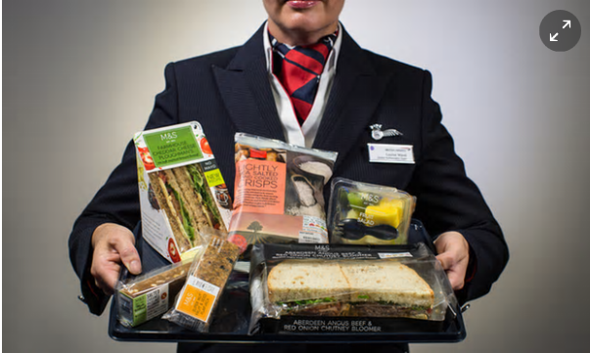
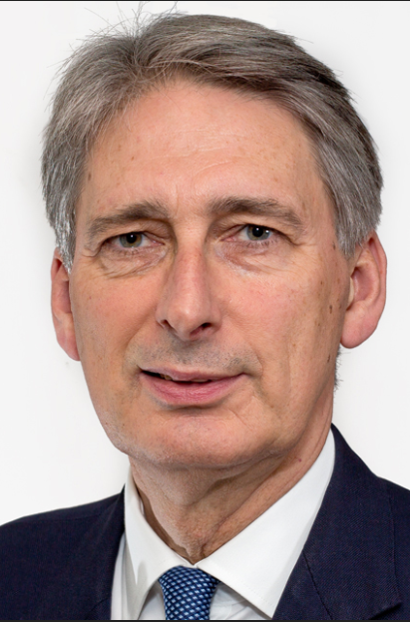
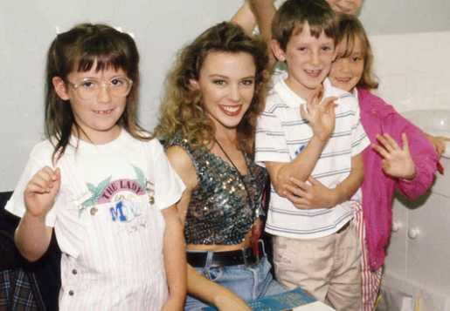
Economics in the News this Week….
BRITISH
AIRWAYS
TASKS (10 minutes)
Have your homework out for INSPECTION
What economics news story do these pictures relate to?
Which is the micro story and which is the macro story?
Have an opinion on the news stories, if asked/picked on!
BORN IN THE 1980’s??
Why is this man in the news MONDAY MORNING (3rd Oct!?)

Slide 18
Lesson Plan Idea
Tues
30: RWS and ADMIN
60: MICRO – Price Eqm Intro and Practice
Wed
60: MICRO – Price Equilibrium Practice
30: MACRO - Unemployment Worksheet
Fri
30: MICRO – Price Equilibrium RECAP
15: MACRO – Unemployment worksheet RECAP
45: Unemployment and economic cycles

Slide 19
PAPER 3 (Micro and Macro): TODAY
ADMIN
Economics in the News
Homework Collection
Revision worksheets back - review of grading
MICRO: PREP Assessment - Interrelationships in Markets
Testing your knowledge
MACRO: PREP Assessment - Defining, Measuring and Effects of Unemployment
Type of unemployment case studies

Slide 20
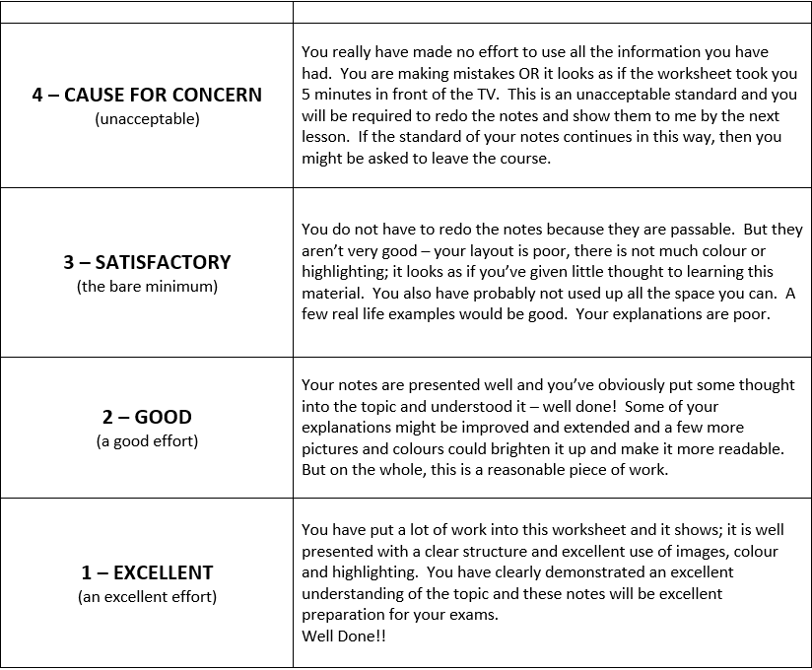
Revision Worksheets Back
TASK: Please use the key below to write your own comments about how to improve. If you are unsure, check within your group to see if they can work it out. If you are still unsure, move onto the next bit and wait for me to come around to talk to you.
If you have finished, then…..help others in your group and suggest ways they can improve their revision worksheets.
KEY TO OLLY’s MARKING
A = Headings - could you have more headings to break up your writing?
B = it looks like this has been copied and pasted from another source. Please do not do this.
C = You are missing work from the original instructions - what is it?
D = You need to draw on your PPF and label letters to illustrate your points on the diagram (this was especially true for opportunity cost demonstrations for a lot of you).
E or ‘Conc’ = Conclusion is lacking?
F = Poor presentation - can you use bullet points, sub-headings, emphasise key words?
e.g. = you need an example to illustrate your point
X? = this is wrong but why?
- = nearly down to
+ = nearly up to
S? = White space
NOTE ABOUT PLAGARISM

Slide 21
Interrelationships between markets Price of other goods…(POG)
Joint Demand = Complements - two goods which we demand together
EXERCISE: Draw a 2 supply and demand diagrams for breakfast cereals and milk. What would happen in these markets if there was an increase in supply of breakfast cereals for a complementary good like milk
Competitive Demand = Substitutes - two goods in which we demand either one or the other
EXERCISE: Draw 2 supply and demand diagrams for beef and pork. What would happen in these in markets if the supply of beef suddenly fell and what impact this would have on the market for Pork.
Derived Demand = One good is demanded because it is needed for the production of another
EXERCISE: Draw 2 supply and demand diagrams for cars and steel. What would happen in these markets if peoples wanted to drive less cars due to the pollution they caused?
Composite Demand = a good is demanded for two or more distinct uses. Economic theory says that an increase in demand for one composite good will lead to a fall in the supply for another
EXERCISE: Draw 2 supply and demand diagrams for ‘Oil for Plastics’ and ‘Oil for Petrol’. What would happen in these markets if there was an increase in the demand for plastics?
Joint Supply = a good is in joint supply with another good when one good is supplied for two different purposes.
EXERCISE: Draw 2 supply and demand diagrams for ‘Steaks’ and ‘Leather’. What would happen in these markets if there was an increase in the demand for steaks?
Demand
Price of Other Goods (POG)
Supply
Price of Other Goods (POG)

Slide 22
MICRO (Paper 1) Interrelationships between markets
TASK: For each scenario below, answer by drawing a demand OR supply curve shifting to the left or right
What would happen to the demand for steel if the demand for cars increases?
What would happen to the demand for Orangina if the price of Fanta decreased?
What would happen the supply of leather if steak prices increased?
What would happen to the supply of wheat which is used for food) if the price of wheat for bio fuel increased?
What would happen to the demand for lighters if the price of cigarettes rose?
What would happen to the supply of wool if the price of lamb fell?
What would happen to the supply of plastic if the price of petrol increased?
What would happen to the demand for playstations if demand for Xbox’s increased suddenly?

Slide 23
e.g. Joint Demand EXERCISE: Draw a 2 supply and demand diagrams for breakfast cereals and milk. What would happen in these markets if there was an increase in supply of breakfast cereals for a complementary good like milk
Breakfast Cereals
Milk
Price
Price
S1
S
S2
P2
B
P1
A
P1
A
P2
B
D2
D
D1
Q1
Q2
Quantity
Q1
Q2
Quantity
Explanation: The increase in demand for breakfast cereals will mean an increase in demand for milk as they are complementary goods. Consequently, the demand curve will shift to the right, causing the price to rise which gives an incentive for milk suppliers to supply more to the market.
Explanation: The increase in supply would lead to a fall in price and therefore an increase in demand for Cereals along the line because they are now cheaper.

Slide 24
MACRO (Paper 2) L1 Types (and Causes) of Unemployment
Specific Definitions of Unemployment?
FRICTIONAL UNEMPLOYMENT
STRUCTURAL UNEMPLOYMENT
CYCLICAL UNEMPLOYMENT
REAL WAGE (or CLASSICAL) UNEMPLOYMENT
Voluntary or Involuntary Unemployment?
VOLUNTARY UNEMPLOYMENT
INVOLUNTARY UNEMPLOYMENT
Demand or Supply Side Unemployment?
DEMAND SIDE OF THE ECONOMY
SUPPLY SIDE OF THE ECONOMY

