Slide 1
MACRO PRACTICE QUESTIONS

Slide 2
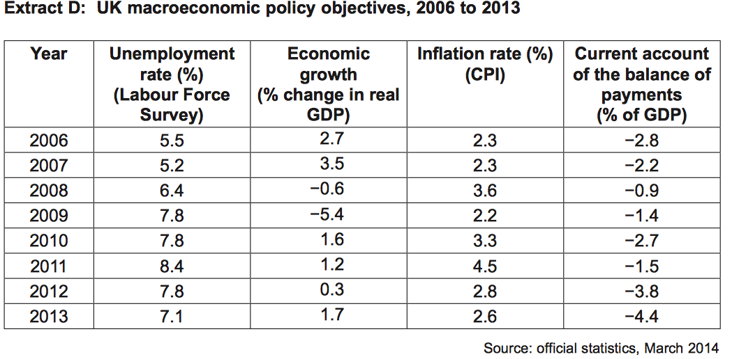
QUESTION 1
(1) Calculate the mean average inflation rate from 2010 to 2013 (2 marks)
(2) Using Extract D, identify two significant points of comparison between economic growth and inflation in the UK over the period 2006 to 2013. (4 marks)
(3) Using a relevant diagram, explain how actual growth might lead to a reduction in unemployment (9 marks)

Slide 3
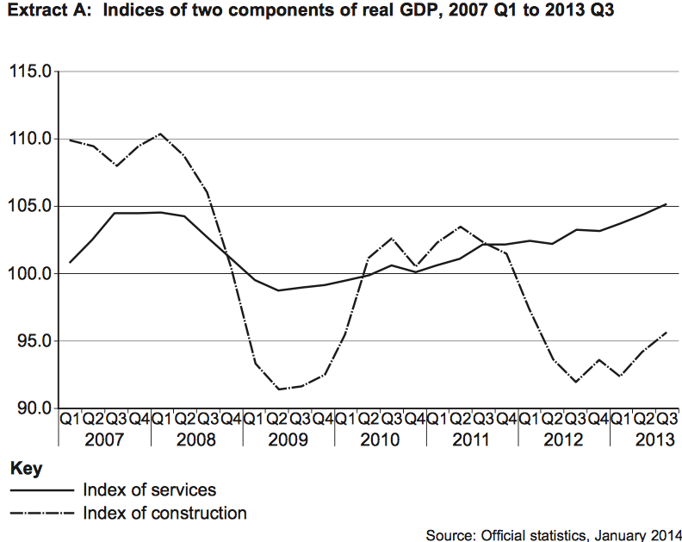
QUESTION 2
(1) Calculate the percentage change in ‘index of construction from 2007 Q1 (110) to Q3 2013 (96) to 2 decimal places (2 marks)
(2) Using Extract A identify two possible significant points from the data (4 marks)
(3) Explain how an increase in the construction industry will increase economic growth in an economy (9 marks)

Slide 4
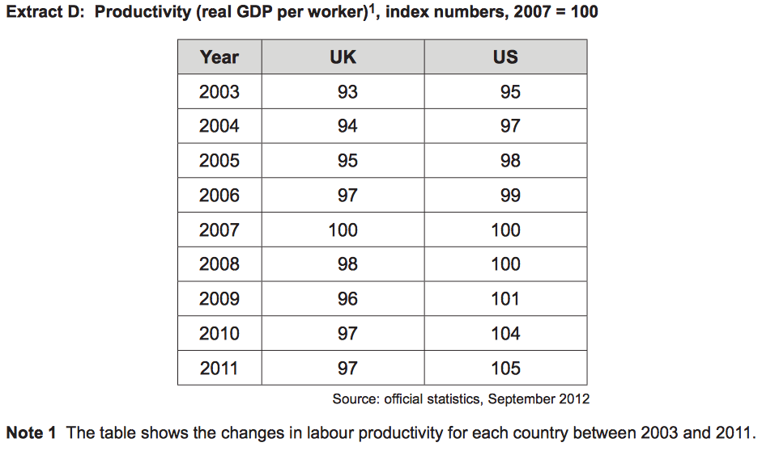
QUESTION 3
(1) Calculate the percentage decrease for the UK productivity from 2005 to 2006 to 2 decimal places (2 marks)
(2) Using Extract D identify two possible significant points from the data (4 marks)
(3) Using a diagram, explain how trend and actual growth might increase in an economy (9 marks)

Slide 5
QUESTION 4
(1) Calculate to 2 decimal places the percentage decrease in unemployment from 2008 to 2009 (2 marks)
(2) Using Extract identify two possible significant points from the data (4 marks)
(3) Explain why structural unemployment might be considered to be both voluntary and involuntary unemployment (9 marks)

