Slide 1
WEEK 1

Slide 2
90+45

Slide 3
See Enrolment Intro PP
Basic Skills and Enrolment Pack
Scarce Resources, Unlimited Wants and the Cost of Choices (Opportunity Cost)

Slide 4
WEEK 2

Slide 5
90

Slide 6
What is Economics?
How much do you remember from last week?
STARTER ACTIVITY: Last Week
As you arrive, in pairs answer the following questions. Make sure you have an answer as you may get picked upon!
What is the difference between micro and macro economics?
What are the four key “roles” to success in economics
What is the difference between the natural and social sciences?
Why do economists get ‘physics envy’?
What are the three key assumptions economists make?
What is the economic problem?
What is the ‘opportunity cost’?
What is specialisation?
Current affairs news in Economics? What has happened this week? Micro or macro?
Please can you get out your PREP homework into 4 piles at the front of your desk
TODAY
Homework Review
Capitalism .v. Socialism debate
Judging Economies…
Notes:
5: Intro - slides 3 and 4

Slide 7

15: Homework
How was it?!
GROUP DISCUSSION
Problems you encountered with your PREP work (and how you overcame them)
HOMEWORK FOR NEXT WEEK
NEXT HOMEWORK: Revision worksheets on GOL: Monday 24th September
  Introduction to Microeconomics (2.25 hours)
  Introduction to Macroeconomics (2.25 hours)
Notes:
15

Slide 8
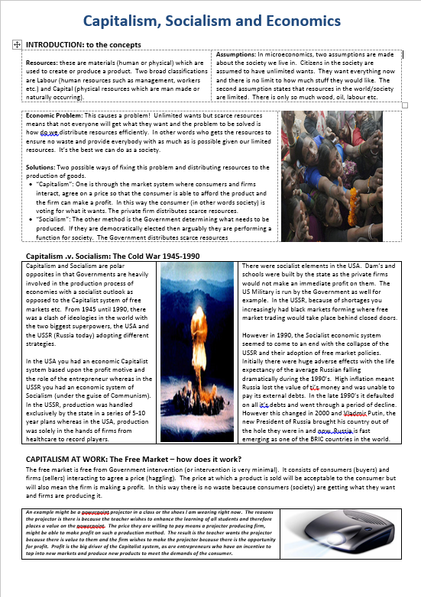
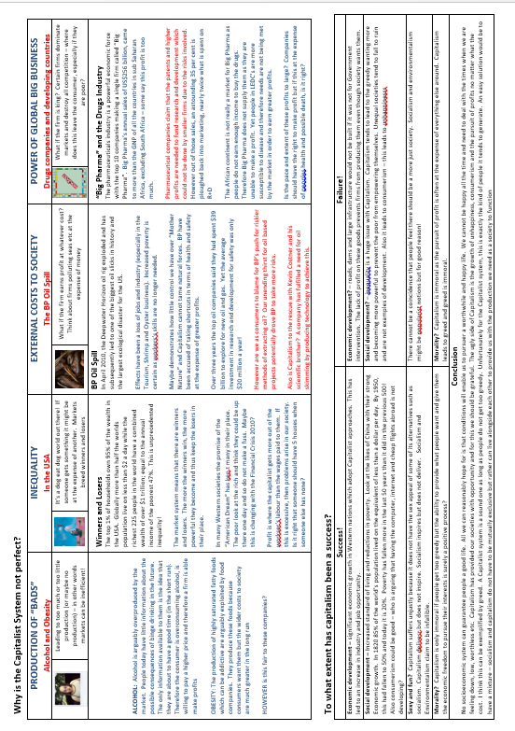
Revision Worksheets
‘Avoid Cramming and Revise as you go’
How are they marked?
  Excellent = 1 (pulling out all the stops/extra reading/great presentation etc.)
  Good = 2 (good effort but maybe some more reading and fuller notes would be useful for you
  Requires Significant Improvement = 3 (bare minimum…at this rate, probably will not hit target grade)
  Cause for Concern = 4 (unacceptable work that is not at an A-level standard….please redo)
Consolidation Exercise for the past 2 weeks
Instructions and resources are on GOL
Structure of teaching reminder?
How to approach a RWS
Notes:
Do they work?
YES! A*-B rate shot up from 55% to 80% in one year
You do all the revision throughout the year, so that when the exams loom you can concentrate on answering past questions

Slide 9

Resources to help you
ONLINE??
  Google:
  Economics Help
  Tutor2u
USE EACH OTHER!
VISIT A DEPARTMENT WORKSHOP FOR A DROP IN 1-2-1
EMAIL ME!
£24.99 from Amazon, library or free online

Slide 10
45

Slide 11

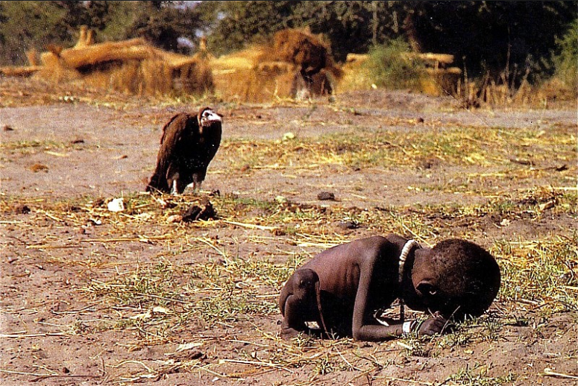

MICRO PREP - Assessment
What is the best way to solve the Economic Problem?
EXERCISE IN THREES: “Capitalism is an effective way to allocate resources and solve the economic problem”. To what extent do you agree with this statement? Write a conclusion as a group. Remember to:
State your position (1 sentence)
Justify your position (2-5 sentences)
Explain why opposition to your position is wrong (2-5 sentences)
Roles
Scribe
Reader
Talker

Slide 12
MACRO PREP - Assessment
How do we measure an economy’s success using economic Indicators?
DEFINITIONS: Check your definitions in your group and make sure you understand the basics
The UK or USA? Agree as a group which is the better economy and justify your groups position (remember you might have to compromise!). Use the statistics to reinforce your position.
WORST COUNTRY (if time): Pick the worst country you have found and explain why it is the worst country using the statistics

Slide 13
90

Slide 14
MICROECONOMICS - STARTER ACTIVITY
As you arrive, read the info below and complete the two questions
TV Sets | Radio Sets
0 | 28
1 | 24
2 | 20
3 | 16
4 | 12
5 | 8
6 | 4
7 | 0
SCENARIO:
A small electrical manufacturer can produce either TV sets or radio sets using all of its available resources.
The table to the left shows all the possible combinations of production that the firm can produce
QUESTION:
Draw a graph with TV sets on ‘x-axis’ and radio sets on the ‘y-axis’ and plot the numbers. What does the graph look like?
Assume this firm is making 1 TV set and 24 Radio sets. What would the opportunity cost be of increasing production to 2 TV sets? Draw this on your graph above.

Slide 15
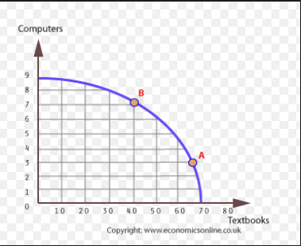
TODAY
RWS1: Intro to Microeconomics
SUB-TOPIC: Opportunity Cost and the Production Possibility Frontier Model: Modelling the Economic Problem
Be able to…
Explain Opportunity Cost (with examples)
Draw a Production Possibility Frontier and be able to:
  Define and Identify productive efficiency (and inefficiency) on a PPF
  Total production
  Opportunity cost
  Growth in production
  Changes to productivity
  Define allocative efficiency

Slide 16


YOUR FIRST ECONOMIC MODEL!
Using PPF Diagrams to illustrate opportunity cost in Microeconomics for PRODUCTION
Olly example….for firm (using TV sets and Radio example) and example
On your graph, how would you demonstrate the following?
If you were under producing - i.e. not using up all your resources in production
An sudden increase in inputs for the firm occurs (i.e. there are suddenly more resources available to produce both products)

Slide 17
Using PPF’s for CONSUMPTION
I want you to draw a PPF (Production Possibility Frontier) to represent yourself for two goods: “Watching Netflix” and “Playing on the Playstation”
  What is the ‘scarce resource’ in this context?
  Where is the most ‘efficient’ allocation of resources in your view?
Label on your PPF
  A point at where all your scarce resources are used up
  A point on the PPF where it is impossible to be
  A point at where your wants are not fully satisfied, given the resources available to you
  The opportunity cost of consuming more “Watching TV”

Slide 18
Opportunity Cost Exercise - Firm
TV Sets | Radio Sets
0 | 30
1 | 29
2 | 27
3 | 24
4 | 20
5 | 15
6 | 9
7 | 0
SCENARIO:
A small electrical manufacturer can produce either TV sets or radio sets using all of its available resources.
The table to the left shows all the possible combinations of production that the firm can produce
QUESTION:
What happens to the opportunity cost of TV sets in terms of radio’s as TV set production starts to increase from zero to seven sets
Why would this PPF look different to the one you drew before?
Why do you think this might happen?

Slide 19
PPF’s….and Firms
All the PPF’s in this exercise demonstrate a firm producing laptops and/or mobile phones.
Draw a PPF (sketch) and draw an X on the curve somewhere. Now, demonstrate on the diagram, the opportunity cost for this firm of devoting more resources to the production of laptops than mobile phones.
Draw a PPF diagram showing productive inefficiency in the production of mobile phones and laptops for an individual firm
Draw a PPF and show how it might change for a firm which finds new technology which enables it to produce laptops more efficiently but the productivity for mobile phones stays constant.
Mobile Phones
Laptops
EXTENSION: Draw a PPF for one firm producing guns and butter. Explain how PPF’s can be used to demonstrate the following concepts:
  Scarcity
  Choices ‘agents’ have made
  Opportunity cost
  Productive efficiency
  (A harder one!): Changes in productivity
  (An even harder one!): Why the opportunity cost is not constant

Slide 20
PPF’s and Efficiency
Allocative Efficiency
Productive Efficiency
Productivity changes?
Production changes overall?

Slide 21
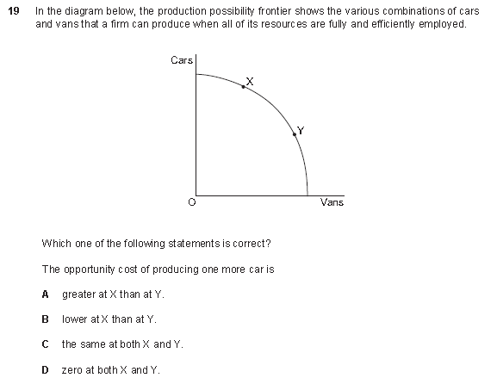

Slide 22
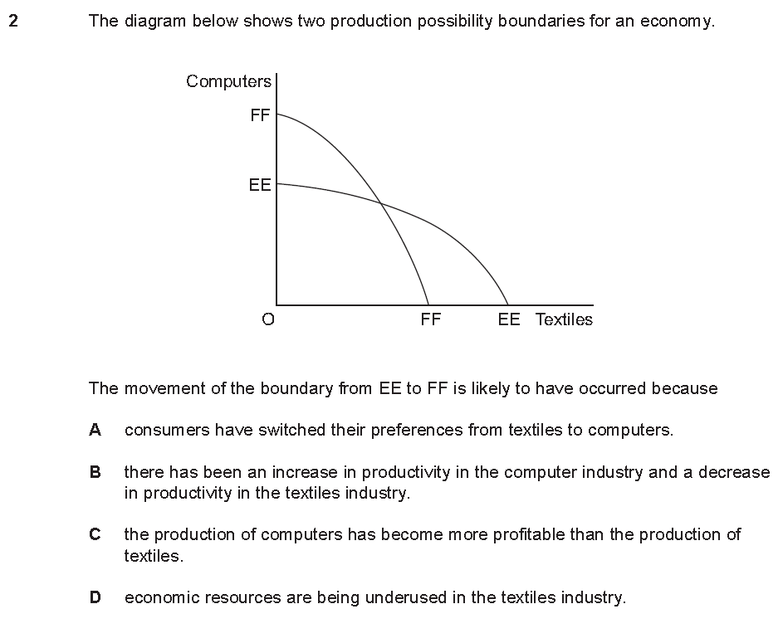

Slide 23
END

