Slide 1
WEEK 1

Slide 2
90
Monday

Slide 3
Economics in the News….Paper 3 Lesson
PAPER 3 (Micro and Macro): TODAY
ADMIN
Economics in the News
Homework Collection
Homework PREP for first lesson next week
Reading a book!!
MICRO: Introduction to demand, supply and the law of price
Concepts of demand and supply
The law of price
MACRO: Evaluating Economic Growth
Economic growth, booms and recessions
Economic growth: The case of China and the UK
What is sustainability and why do we want it as an objective of economic growth?
TASKS (First 10 minutes)
Have your homework out for collection (make sure your name is on the work)
What economics news story do these pictures relate to?
Have an opinion on the news stories, if asked/picked on!
Are there any other stories in the news you have come across?

Slide 4
PREP HOMEWORK (4.5 Hours TOTAL) Due w/b 1st October
MICROECONOMICS RWS2: Demand and Supply Curves
[1.5 Hours]
Inter-relations between markets
See GOL for instructions; Involves reading the textbook and researching on the internet to answer a worksheet
MACROECONOMICS RWS2: Economic Growth and Unemployment
[3 Hours]
Types, Effects and Measures of Unemployment
See GOL for instructions; involves reading textbook, researching on internet, watching a documentary, creating mind maps of notes and filling in a worksheet

Slide 5
Tips on Reading a BOOK
Expectations – University?
Habit not a mountain
Importance of Contents and Introduction and reading the last page.
Chapter skimming technique

Slide 7
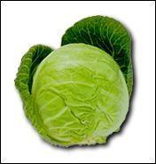
PEDRO CABBAGE INC.
Pedro’s Farm and the town of POG

Slide 8
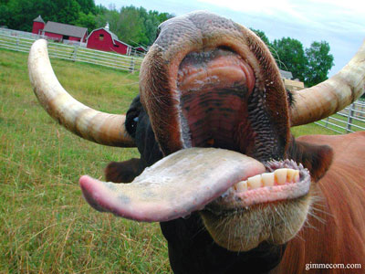
PEDRO COW FARM INC.

Slide 9
MICRO: The Law of Price and Supply
P
SUPPLY CURVE
Quick Exercise:
(1) Why does the supply curve slope upwards?
(2) What do you think would happen to the supply of paint if the price of paint increases?
EXTENSION (harder question): Volkswagen cars are thought of as dirty polluters and as a result demand falls for this product. What would happen to the supply of Volkswagen cars? Draw a supply diagram to demonstrate the effect on quantity supplied of VW Cars
Qs

Slide 10
MICRO: The Law of Price and Demand
Households/Consumers Definition
Law of Demand: The demand for a good is often determined by the price of that good
‘You are Consumers’ Exercise - how many drinks would you buy in one week at the following prices:
£4.00
£2.00
£1.50
£1.00
£0.50
£0.25
Diagrams in Economics
The importance of the axis (price and quantity)
Labelling
A title
GROUP EXERCISE TO SKETCH DEMAND CURVES AND DEMONSTRATE THE LAW OF DEMAND:
Stagecoach is a bus company. It charges different prices to different passengers for the same journey. Draw a separate demand curve for each scenario below and use the demand curve to explain what happens when:
Stagecoach increases its prices on a route by 5%
Children are charged half price for a bus journey instead of being charged full price
Senior citizens are given a free bus pass paid for by the local authority rather than having to pay the full fare
Passengers can get a 60% reduction by buying a day return if they travel after 10.30 compared to having to pay the full fare

Slide 11
The Law of Demand, Price and the Demand Curve EXERCISE: Which point (P1, P2 or P3) represents an increase in demand?
Price
P2
P1
P3
Demand (D)
Quantity Demanded (Qd)

Slide 12
30

Slide 13
See RWS 2 MACRO

Slide 14
90
Tuesday

Slide 15
40

Slide 16
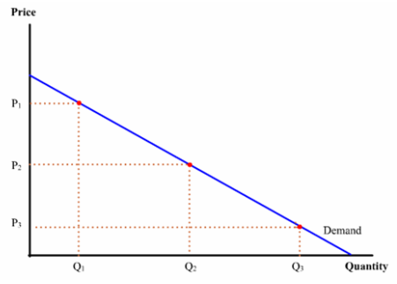
STARTER: First 10 Minutes
What else effects Demand other than price?
In the last lesson we established that a rise in price would reduce demand and a fall in price would increase demand.
But what else effects demand? Please complete the following exercises in groups.
“What factors apart from price encourage you to buy a drink?” Make a list of all the things (apart from price) that affect how many drinks you will buy in one week.
Can you classify your reasons into 4 areas?

Slide 17
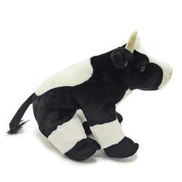
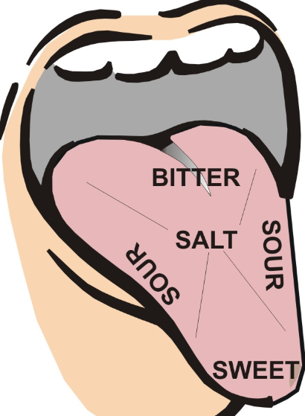
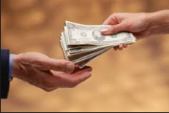
FACTORS AFFECTING DEMAND
PRICE
(movement along)
INCOME
(shift)
OTHER FACTORS
(shift)
PRICE OF OTHER GOODS
(shift)
PRICE
(movement along)
INCOME
(shift)
TASTES
(shift)
SUBSTITUTES (Competitive Demand):
Goods which can be substituted for one another? So if the price of Coke increases, the demand for Pepsi will be affected.
COMPLEMENTS (Joint Demand):
Goods which tend to be bought together. If the price of strawberries increased, this woulde affect the demand for cream.
Derived Demand:
Goods which are demanded to make other goods. If the price of ships increases, this will have an impact on the demand for steel.

Slide 18
P
What other factors affect Demand when price stays the same? (Income, Tastes and Other Factors)
Qd
Individually, using a demand curve diagram
(Y-axis=P and the X-axis=Qd): (i) Sketch a demand curve for a drink and demonstrate on the graph what will happen to the amount of drinks you demand when your income increases.
(REMEMBER THE PRICE STAYS THE SAME, IT IS JUST THE INCOME INCREASING)
(ii) Now sketch a demand curve for sandals and demonstrate on the graph what will happen to the amount of sandals you demand if they go out of fashion.
(REMEMBER THE PRICE STAYS THE SAME, IT IS JUST THE INCOME INCREASING)

Slide 19
Shifts in Demand
Contraction in Demand
Expansion in Demand
P1
D1
D2
D3
Q3
Q1
Q2
Quantity Demanded

Slide 20
An Rightward Shift of Demand
Price
An expansion (right shift) in the demand curve shows that more of the product is being demanded at each price.
P1
Demand (D)
D2
Quantity Demanded (Qd)

Slide 21
A Leftward Shift of Demand
Price
A contraction (left shift) in the demand curve means that less is bought at each price level. There has been a reduction in the quantity that consumers are willing and able to see at each and every price
P1
D3
Demand (D)
Quantity Demanded (Qd)

Slide 22
FINAL EXERCISE: Factors affecting Demand (and Demand Curves) Price, Other Goods (Prices), Tastes (& Population) and Income
INSTRUCTIONS FOR EACH MARKET, draw a demand diagram and explain how the demand curve would be affected within that market.
MARKET for COFFEE - The UK population has grown since 2000.
MARKET for CARS - What would happen between the period of 2007 and 2012 when the UK Economy faced a downturn and a recession of economic growth with many people having lower incomes?
MARKET for PAINT - the price of paint rises
MARKET for EGGS - Jamie Oliver claims that eggs have amazing health properties
MARKET FOR PETROL - Since January, petrol prices have been falling.
MARKET FOR CHICKEN - a new strain of bird flu is discovered on a farm in the UK which can be passed to humans
MARKET FOR SOCKS AND SANDELS - Kim Kardashian, Justin Bieber and Brooklyn Beckham all start wearing white socks pulled up to their mid calf, whilst wearing sandals.
Harder Questions…you shouldn’t be able to answer these until next week!
MARKET for LIGHTERS – what would happen to the demand for lighters if the price of cigarettes increased.
MARKET FOR MILK – what would happen to demand for milk if the price of cookies doubled.

Slide 23
40

Slide 24
SUPPLY CURVE
Why does the supply curve slope upwards?
P
SUPPLY CURVE
Qs

Slide 25
PEDRO’s FIRM
EXERCISE:
What factors OTHER than the price of the product he is selling might affect his supply? Make a list.
See if you can classify your list into 3 key areas?

Slide 26
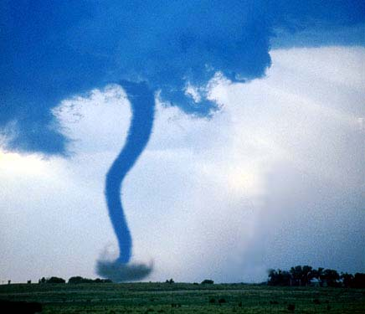
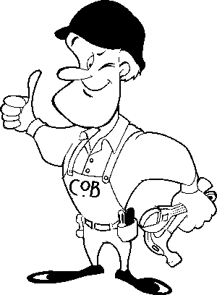
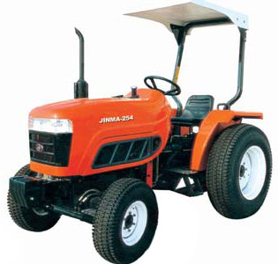
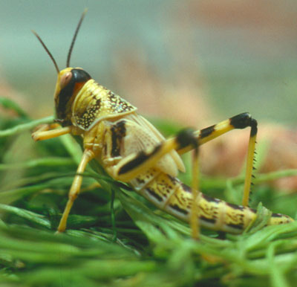
FACTORS AFFECTING SUPPLY
PRICE
(movement along)
COSTS OF PRODUCTION
(shift)
OTHER FACTORS
(shift)
PRICE OF OTHER GOODS
(shift)
Composite Demand
Goods which have similar production techniques. e.g. cow farming and pig farming. The supply of pig farming might be affected if demand for cow farming changes.
Joint Supply:
Goods which can be made together – they are in “joint supply”.
e.g. if more cow meat is supplied, this means there is more leather available

Slide 27
A Rightward Shift in the Supply Curve
Price
S1
S2
P1
Quantity Supplied (Qs)
Shifts in the supply curve mean that more or less will be supplied onto the market at each price level

Slide 28
A Leftward Shift in the Supply Curve
Price
S3
A fall in supply means that less is supplied onto the market at each price
S1
P1
Quantity Supplied (Qs)

Slide 29
HOW MUCH DO YOU KNOW ABOUT SUPPLY?
INTRODUCTORY QUESTIONS:
Demonstrate what happens to the supply of PEDRO’s CABBAGES on a diagram when:
Cabbages are attacked by a plague of locusts one year
New ‘cabbage making’ technology is introduced which improves Pedro’s productivity by 50%.
The price of cabbages increases by 50%
The oil market is suddenly hit by the news that a Hurricane to rival Katrina will wipe out most of the oil rigs in the Mexican Sea
New laws are put in place to guarantee a ‘living wage’ for Pedro’s ‘cabbage workers’ which is much higher than Pedro is paying them currently
Harder Question: Nobody wants cabbages anymore…because they give really bad wind…
FURTHER QUESTIONS - that you shouldn’t be able to answer until next week
What happens to the supply of cabbages if the price of carrots increases by 70%!
The price of steaks increases. What would happen to the supply of leather?
The crude oil price has increased to $80 a barrel recently for some reason. Draw diagrams (for each question) explaining the effect on the supply of:
(a) Crude Oil (b) Petrol

Slide 30
10

Slide 31
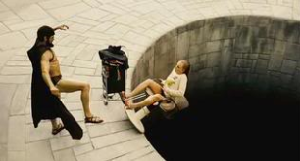
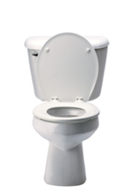
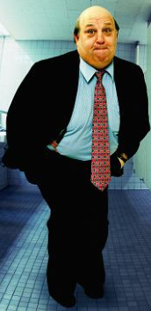
Factors Affecting Demand and Supply??? How do we remember all of this? Answer: Pedro and the Town of POG

Slide 32
Causes of demand change: P IT OF POG
Income
Change in
D
Change in
P
Change in
S
Tastes
Other Factors
Population?
Price of Other Goods
Price of substitutes (competitive demand), complements (joint demand), derived demand.
Shift in Curve
Movement along Curve
Causes of supply change: P COP OF POG
Costs Of Production
Any factor which might affect supply or production? Natural disasters, weather etc.
Change in
S
Change in
P
Change in
D
Other Factors
Any factor which might affect supply or production? Natural disasters, weather etc.
Price of Other Goods
Price of goods in ‘composite demand’ (i.e. the good can be used by the supplier for different uses) and ‘joint supply’ (i.e. the production of one good has multiple outputs).
Shift in Curve
Movement along Curve

Slide 33
WEEK 2

Slide 34
90
Monday

Slide 35
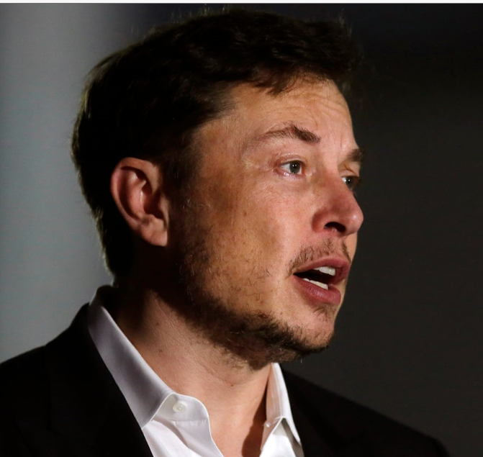
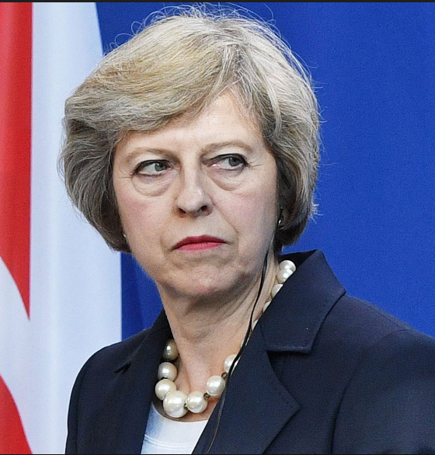
Economics in the News this Week….
TASKS (10 minutes)
Have your homework out for INSPECTION
What economics news story do these pictures relate to?
Which is the micro story and which is the macro story?
Have an opinion on the news stories, if asked/picked on!
TODAYS LESSON
ADMIN
Economics in the News
Homework Collection
Revision worksheets back - review of grading
MICRO: PREP Assessment - Interrelationships in Markets
Testing your knowledge
MACRO: PREP Assessment - Defining, Measuring and Effects of Unemployment
Type of unemployment case studies

Slide 36
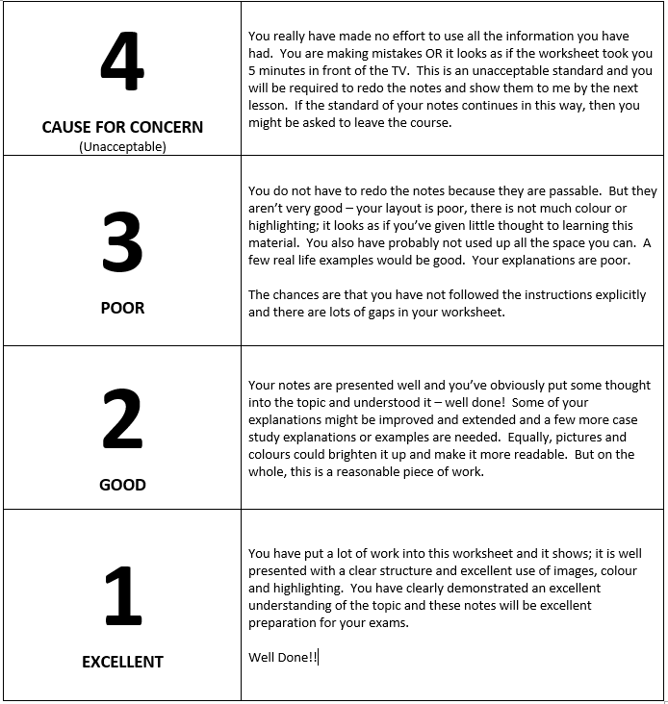
Revision Worksheets Back
TASK: Please use the key below to write your own comments about how to improve. If you are unsure, check within your group to see if they can work it out. If you are still unsure, move onto the next bit and wait for me to come around to talk to you.
If you have finished, then…..help others in your group and suggest ways they can improve their revision worksheets.
KEY TO OLLY’s MARKING
H = Headings - could you have more headings to break up your writing?
C+P? = it looks like this has been copied and pasted from another source. Please do not do this.
M? = You are missing work from the original instructions - what is it?
D? = You need to draw on your PPF and label letters to illustrate your points on the diagram (this was especially true for opportunity cost demonstrations for a lot of you).
E? = Lack of explanation
‘Conc’? = Conclusion is lacking?
PP? = Poor presentation - can you use bullet points, sub-headings, emphasise key words?
e.g.? = you need an example to illustrate your point
X? = this is wrong but why?
S? = White space – please use the full 2 sides
NOTE ABOUT PLAGARISM

Slide 37
Homework (4.5 Hours) Monday 8th November 2018
Complete 2x Revision Worksheets on:
MICRO: RWS2 – Demand and Supply Curves
MACRO: RWS2 – Economic Growth and Unemployment
ALL RESOURCES ARE ON GOL

Slide 38
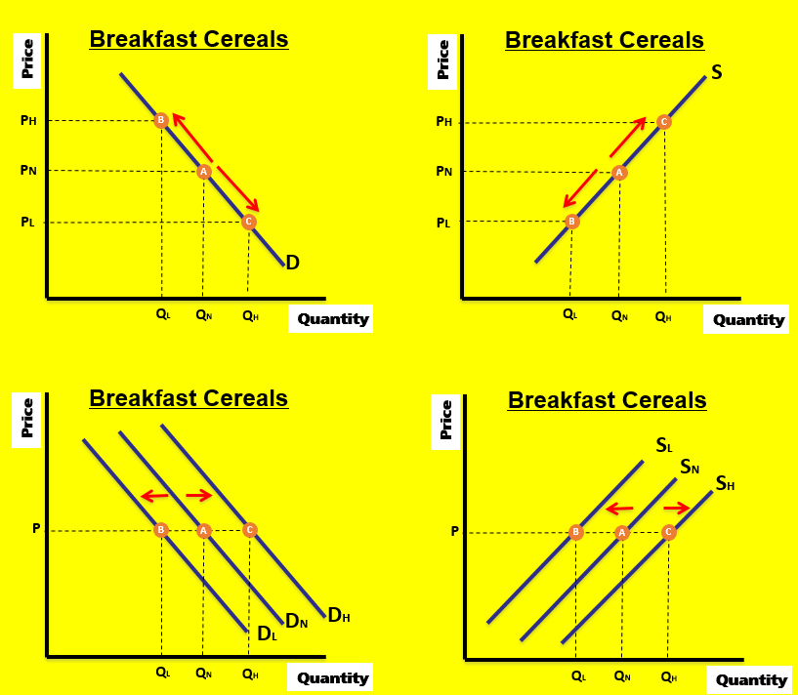
Factors affecting Demand and Supply of a Product Represented on Graphs
Movement Along the Curve
P = Price
Shifts in the Curve
I=Income
T=Tastes
OF = Other Factors (Population etc.)
POG = Price of Other Goods (Joint demand, competitive demand and derived demand)
Movement Along the Curve
P = Price
Shifts in the Curve
COP=Costs of Production
OF=Other Factors (Climate, environment etc.)
POG = Price of Other Goods (composite demand and joint supply)

Slide 39
Interrelationships between markets Price of other goods…(POG)
Joint Demand = Complements - two goods which we demand together
EXERCISE: Draw a 2 supply and demand diagrams for breakfast cereals and milk. What would happen in these markets if there was an increase in supply of breakfast cereals for a complementary good like milk
Competitive Demand = Substitutes - two goods in which we demand either one or the other
EXERCISE: Draw 2 supply and demand diagrams for beef and pork. What would happen in these in markets if the supply of beef suddenly fell and what impact this would have on the market for Pork.
Derived Demand = One good is demanded because it is needed for the production of another
EXERCISE: Draw 2 supply and demand diagrams for cars and steel. What would happen in these markets if peoples wanted to drive less cars due to the pollution they caused?
Composite Demand = a good is demanded for two or more distinct uses. Economic theory says that an increase in demand for one composite good will lead to a fall in the supply for another
EXERCISE: Draw 2 supply and demand diagrams for ‘Oil for Plastics’ and ‘Oil for Petrol’. What would happen in these markets if there was an increase in the demand for plastics?
Joint Supply = a good is in joint supply with another good when one good is supplied for two different purposes.
EXERCISE: Draw 2 supply and demand diagrams for ‘Steaks’ and ‘Leather’. What would happen in these markets if there was an increase in the demand for steaks?
Demand
Price of Other Goods (POG)
Supply
Price of Other Goods (POG)

Slide 40
MICRO (Paper 1) Interrelationships between markets
TASK: For each scenario below, answer by using a demand or supply diagram depending on what you think is appropriate. Make sure you show on the graph whether there has been an increase or decrease in demand/supply.
What would happen to the demand for steel if the demand for cars increases?
What would happen to the demand for Orangina if the price of Fanta decreased?
What would happen the supply of leather if steak prices increased?
What would happen to the supply of wheat which is used for food) if the price of wheat for bio fuel increased?
What would happen to the demand for lighters if the price of cigarettes rose?
What would happen to the supply of wool if the price of lamb fell?
What would happen to the supply of plastic if the price of petrol increased?
What would happen to the demand for playstations if demand for Xbox’s increased suddenly?

Slide 41
e.g. Joint Demand EXERCISE: Draw a 2 supply and demand diagrams for breakfast cereals and milk. What would happen in these markets if there was an increase in supply of breakfast cereals for a complementary good like milk
Breakfast Cereals
Milk
Price
Price
S1
S
S2
P2
B
P1
A
P1
A
P2
B
D2
D
D1
Q1
Q2
Quantity
Q1
Q2
Quantity
Explanation: The increase in demand for breakfast cereals will mean an increase in demand for milk as they are complementary goods. Consequently, the demand curve will shift to the right, causing the price to rise which gives an incentive for milk suppliers to supply more to the market.
Explanation: The increase in supply would lead to a fall in price and therefore an increase in demand for Cereals along the line because they are now cheaper.

Slide 42
90
Tuesday

Slide 43
20

Slide 44
INTRODUCTION:
What is a Market?
Which two groups need to come together to form what we call a ‘market’?
? + ? = a market
If the two groups meet to supply and demand ANYTHING, it’s a ‘market’.
SELLERS
(creating supply)
BUYERS
(creating demand)

Slide 45
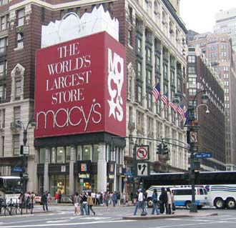
RECAP SUPPLY AND DEMAND CURVES
Price
RECAP:
Why is it downward sloping and why does it shift??
P
I
T
OF
POG
DL
Do
DH
REMEMBER: The market consists of BOTH buyers and sellers inter-acting to agree on a suitable price
Quantity
Price
SL
So
SH
RECAP:
Why is it upward sloping and why does it shift??
P
COP
OF
POG
Quantity

Slide 46
INITIAL EQUILIBRIUM:
Putting the Demand & Supply Curves Together
Price
Price
S
EQUILIBRIUM:
The point at which both buyers are happy to pay the price and suppliers are happy to sell the good at that price
D
Quantity
P
Price
S
D
Q
Quantity
Quantity

Slide 47
Changes in Equilibrium Pedro’s Fishy Delights
Pedro’s cow farm collapses due to the international price for cow’s plummeting. He packs his bags (again) and decides to set up another fish stall as THAT is where the money is…..
Sketch a demand and supply curve (and equilibrium price) for the fish market Pedro will face when he enters the market
People suddenly decide that because of all the omega oils in fish, it is a healthy thing to eat and people want more of it. Demonstrate on your D+S graph what will happen to the price of fish?
A new “fish catcher” is invented which improves the productivity of fisherman. Demonstrate on a NEW diagram what would happen to the price of fish.
Incomes in the UK fall. Demonstrate on a NEW diagram what would happen to the price of fish.
Due to global climate change, the fish stocks of the world fall as loads of fish die! Demonstrate on a NEW diagram what would happen to the price of fish.
HARDER QUESTION: The price of steak plummets…..demand and supply diagram to demonstrate what might happen to the fish market?

Slide 48
Causes of demand change: P IT OF POG
Income
Change in
D
Change in
P
Change in
S
Tastes
Other Factors
Population?
Price of Other Goods
Price of substitutes (competitive demand), complements (joint demand), derived demand.
Shift in Curve
Movement along Curve
Causes of supply change: P COP OF POG
Costs Of Production
Any factor which might affect supply or production? Natural disasters, weather etc.
Change in
S
Change in
P
Change in
D
Other Factors
Any factor which might affect supply or production? Natural disasters, weather etc.
Price of Other Goods
Price of goods in ‘composite demand’ (i.e. the good can be used by the supplier for different uses) and ‘joint supply’ (i.e. the production of one good has multiple outputs).
Shift in Curve
Movement along Curve

Slide 49
A
Changes in Price Equilibrium
B
Price
Price
S
S
P2
DEMAND
B
P1
A
P1
A
P2
B
D2
D1
D2
D1
Q1
Q2
Quantity
Q2
Q1
Quantity
Price
Price
S2
C
S1
S1
P2
B
SUPPLY
S2
P1
D
P1
A
A
P2
B
D2
D
D1
Q1
Q2
Quantity
Q2
Q1
Quantity

Slide 50
PRICE EQUILIBRIUM CHANGES TASK: Complete the following exercises by drawing a supply and demand diagram to demonstrate your answer. Ensure you have correctly labeled your diagram. Can you provide a sentence of explanation as well.
BASIC QUESTIONS
What might happen to the price of steak if eating steak becomes more fashionable?
What might happen to the price of TV’s if incomes in the UK fall?
What might happen to the price of BA flights if costs of production are reduced by not providing free food?
What might happen to the price of petrol if OPEC decides to reduce it’s output of oil?
HARDER QUESTIONS
What would happen to the demand for steel if the demand for cars increases?
What would happen to the price for Orangina if the price of Fanta increased?
What would happen to the supply of leather if steak prices fall?
What would happen to the supply of wheat which is used for food) if the price of wheat for bio fuel increased?
What would happen to the price for lighters if the price of cigarettes rose?
What would happen to the price of wool if the demand of lamb fell?
What would happen to the price of plastic if the demand of petrol increased?
What would happen to the demand for playstations if Xbox demand increased suddenly because of a new game which is exclusive to Xbox?
OTHER QUESTIONS TO PRACTICE
What would happen to the price of chicken if a new strain of Bird Flu are discovered which can be past onto humans if they consume chicken?
BREXIT occurs in March next year and the economy plunges into a recession. What would happen to the price of luxury cars in the UK?
It becomes more fashionable to wear wool. What would happen to the price of lambs meat?
Climate change results in a rise in temperatures in Northern Spain where they grow wine. What would happen to the price of wine?
New robots are invented to produce cars. What might happen to the price of cars?
DOUBLE SHIFTS – these questions may result in a shift in two curves…and/or you will need to draw two separate markets.
What might happen in the car market if OPEC cut oil production by 20% and there is bad publicity about the damage cars have on the environment.
What might happen in the market for pig cheeks if studies show consumption makes you more intelligent. At the same time what might happen to the market for pork chops?
EXTENSION:
Invent your own scenario for a friend to practice

Slide 51
A
Changes in Price Equilibrium
B
Price
Price
S
S
P2
DEMAND
B
P1
A
P1
A
P2
B
D2
D1
D2
D1
Q1
Q2
Quantity
Q2
Q1
Quantity
Price
Price
S2
C
S1
S1
P2
B
SUPPLY
S2
P1
D
P1
A
A
P2
B
D2
D
D1
Q1
Q2
Quantity
Q2
Q1
Quantity

Slide 52
END

Slide 53
What other factors affect Demand when price stays the same? (The Prices of Other Goods)
Substitutes are goods in competitive demand
They are replacements for another product
For example, a rise in the price of Esso petrol (other factors held constant) should cause a substitution effect away from Esso towards Shell or other competing brands
Complements are said to be in joint demand
Examples include: fish and chips, DVD players and DVDs, iron ore and steel
A rise in the price of a complement to Good X should cause a fall in the demand for X

Slide 54
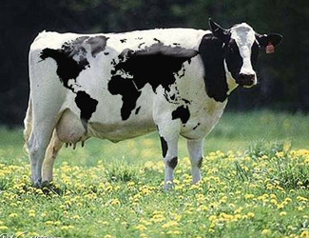
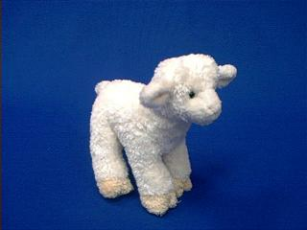
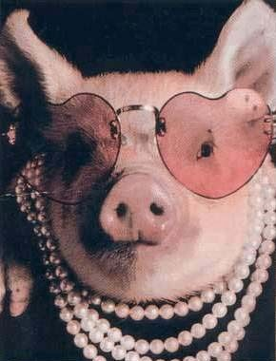
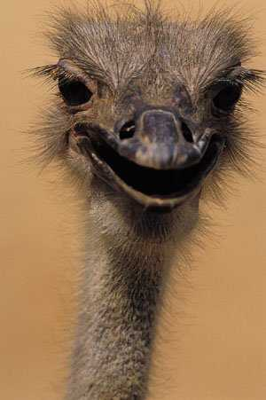
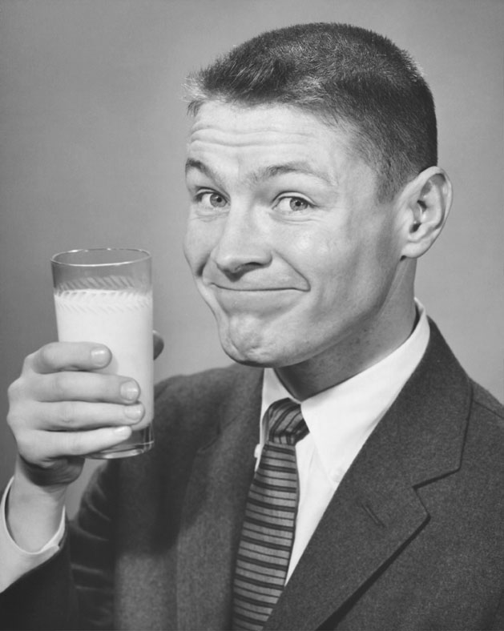
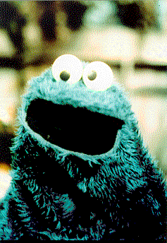
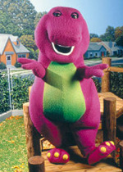
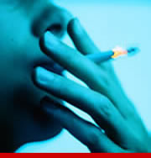
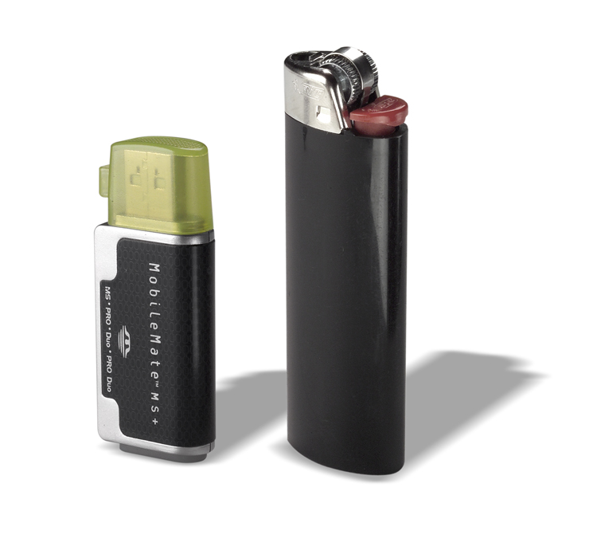
SUBSTITUTE?
SUBSTITUTE?
COMPLEMENT?
SUBSTITUTE?
COMPLEMENT?

Slide 55
Interrelationships between markets Price of other goods…(POG)
Joint Demand = Complements - two goods which we demand together
EXERCISE: Draw a 2 supply and demand diagrams for breakfast cereals and milk. What would happen in these markets if there was an increase in supply of breakfast cereals for a complementary good like milk
Competitive Demand = Substitutes - two goods in which we demand either one or the other
EXERCISE: Draw 2 supply and demand diagrams for beef and pork. What would happen in these in markets if the supply of beef suddenly fell and what impact this would have on the market for Pork.
Derived Demand = One good is demanded because it is needed for the production of another
EXERCISE: Draw 2 supply and demand diagrams for cars and steel. What would happen in these markets if peoples wanted to drive less cars due to the pollution they caused?
Composite Demand = a good is demanded for two or more distinct uses. Economic theory says that an increase in demand for one composite good will lead to a fall in the supply for another
EXERCISE: Draw 2 supply and demand diagrams for ‘Oil for Plastics’ and ‘Oil for Petrol’. What would happen in these markets if there was an increase in the demand for plastics?
Joint Supply = a good is in joint supply with another good when one good is supplied for two different purposes.
EXERCISE: Draw 2 supply and demand diagrams for ‘Steaks’ and ‘Leather’. What would happen in these markets if there was an increase in the demand for steaks?
Demand
Price of Other Goods (POG)
Supply
Price of Other Goods (POG)

Slide 56
e.g. Joint Demand EXERCISE: Draw a 2 supply and demand diagrams for breakfast cereals and milk. What would happen in these markets if there was an increase in supply of breakfast cereals for a complementary good like milk
Breakfast Cereals
Milk
Price
Price
S1
S
S2
P2
B
P1
A
P1
A
P2
B
D2
D
D1
Q1
Q2
Quantity
Q1
Q2
Quantity
Explanation: The increase in demand for breakfast cereals will mean an increase in demand for milk as they are complementary goods. Consequently, the demand curve will shift to the right, causing the price to rise which gives an incentive for milk suppliers to supply more to the market.
Explanation: The increase in supply would lead to a fall in price and therefore an increase in demand for Cereals along the line because they are now cheaper.

Slide 57
Breakfast Cereals
Breakfast Cereals
Price
Price
S
PH
B
PH
C
PN
A
PN
A
PL
C
PL
B
D
QL
QN
QH
Quantity
QL
QN
QH
Quantity
Breakfast Cereals
Breakfast Cereals
Price
Price
SL
SN
SH
P
B
A
C
P
B
A
C
DN
DH
DL
QL
QN
QH
Quantity
QL
QN
QH
Quantity

