Slide 1
WEEK 6

Slide 2
PREP1
15

Slide 3
Economics in the News
TODAYS LESSON
What’s next?
PREP Homework – Monday 29th October
Introduction to Housing and Agriculture Markets
Introduction to concept of elasticity
Introduction to Globalisation and the Balance of Payments
STARTER: First 2 Minutes
What is your opinion? Pick at least one question to discuss and formulate an answer to if chosen.
Do you think Theresa May will be able to negotiate a deal with the EU over BREXIT?
How damaging will BREXIT be to the UK’s economic growth and therefore unemployment do you think?

Slide 4
SCHEME OF WORK – What’s NEXT
MICROECONOMICS
RWS 1 – Introduction to Micro
RWS 2 – Basic Price Toolkit
Benchmark 1
HALF-TERM
RWS 3 – Advanced Price Toolkit (Elasticity Concepts)
RWS 4 – The Role of Free Markets
Benchmark 2
CHRISTMAS
Student Review to Parents (REPORT)
MACROECONOMICS
RWS 1 – Introduction to Macro
RWS 2 – Economic Growth and Unemployment Introduction
Benchmark 1
HALF-TERM
RWS 3 – Balance of Payments (and Globalisation) Introduction
RWS 4 – Price Levels (Inflation and Deflation) Introduction
Benchmark 2
CHRISTMAS
Student Review to Parents (REPORT)

Slide 5
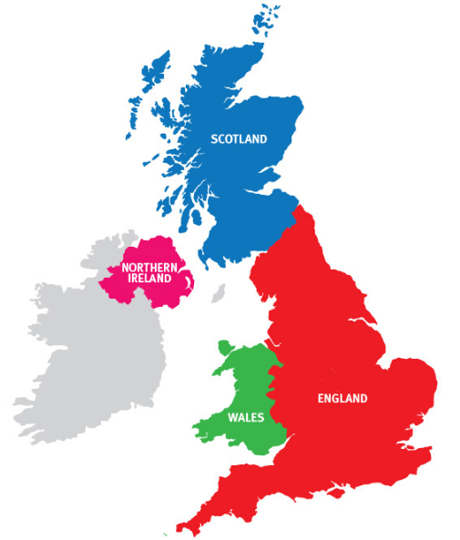
PREP 1 Homework: RWS 3 Due for Monday 29th October 2018
MICRO (2.5 to 3 Hours)
Resources on GOL under ‘RWS 3: The Concept of Elasticity’ in the Micro section
Complete the two mind maps using resources in the folder BUT also your own internet research on HOUSING and AGRICULTURAL MARKETS.
MACRO (2.5 to 3 Hours)
Resources on GOL under ‘RWS 3: Globalisation and the Balance of Payments’ in the Macro section
Watch the 4 documentaries on Globalisation and complete the worksheet questions by hand.
ALSO DO NOT FORGET……The Macroeconomics Book….where should I be?
Book is 280 Pages and I wanted you to read it by Christmas….therefore that is 9 weeks away. You have already had 3 weeks with the book. So that means you should have read 25% of the book already….which means 90 pages read….which means by Monday 29th October, you should be at page 78 (which is the end of chapter 3). So there will be a multiple choice test in the first week back after half-term on GOL for you to complete so MAKE SURE YOU HAVE READ 3 CHAPTERS by Monday 29th October!

Slide 6
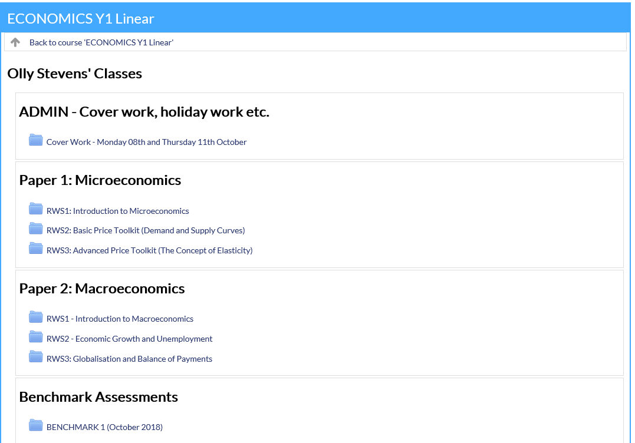

Slide 7
45
15 – Intro to elasticity
30 – Intro to markets

Slide 8
Introduction to the Housing and Food Markets
P
DEMAND
SUPPLIERS:
S
Tertiary
Retail
P1
D
Q1
Q
P
S
DEMAND
SUPPLIERS:
Secondary
Manufacturing
P1
D
Q1
Q
P
S
DEMAND
SUPPLIERS:
Primary
Extractive Industries (Farming, Mining etc.)
P1
D
Q1
Q

Slide 9
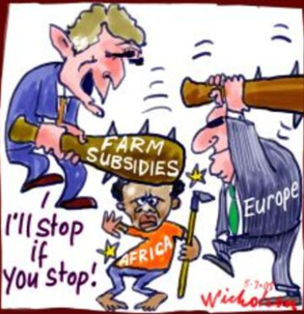
Introduction to the Housing and Food Markets
P
DEMAND
Housing: Consumers (via Estate Agents?) for rental market and ownership market
Food: Consumers
SUPPLIERS:
Housing: Estate Agents renting or selling existing houses? Property developers selling houses?
Food: Supermarkets (Tesco’s?), independent shops
The Supply Chain
Wholesale .v. Retail
UK Agriculture
Role of Subsidies
Role of EU and the CAP (Common Agricultural Policy)
UK Housing Market
The property crisis in the UK?
Inter-generational inequality?
S
Tertiary
Retail
P1
D
Q1
Q
P
S
Secondary
Manufacturing
DEMAND
Housing: Consumers, Property developers (buy to let?)
Food: Tesco’s
SUPPLIERS:
Housing: Building houses (property developers)
Food: Unilever, Supermarkets?
P1
VIDEO 1 (CAP): 15 Mins
D
Q
USA
Q1
P
Primary
Extractive Industries (Farming, Mining etc.)
S
DEMAND
Housing: Building companies?
Food: Unilever? Supermarkets?
SUPPLIERS:
Housing: Building suppliers (cement, bricks etc.)?
Food: Farmers?
P1
D
VIDEO 2 (Housing Trap): 15 mins
Q1
Q

Slide 10
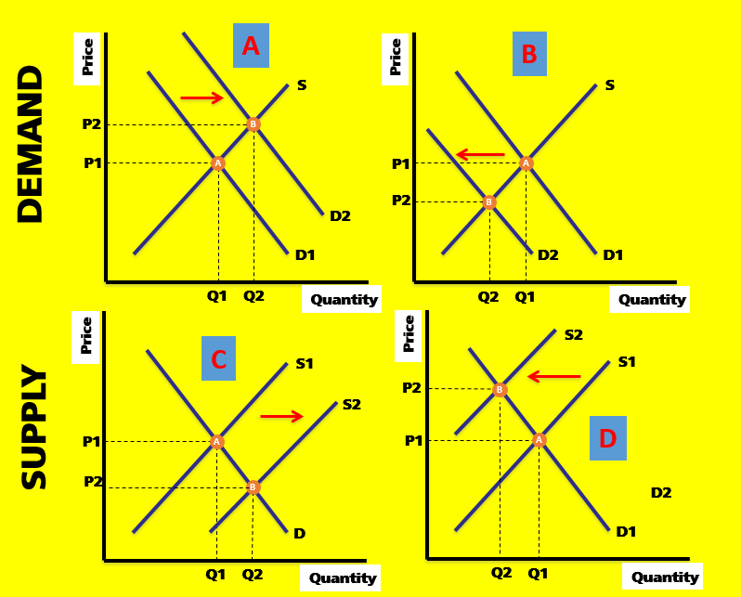
Introduction to RWS 3: The Concept of Elasticity
Revision Worksheet 2: Basic Price Toolkit
What do the diagrams on the right ALL have in common?
ANSWER: They all have similar shaped curves….

Slide 11
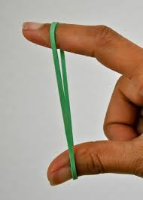
Introduction to RWS 3: The Concept of Elasticity
PED = Price Elasticity of Demand
Price of good X changes and the response of Demand for good Y
YED = Income Elasticity of Demand
Income changes on the Demand for good X
Normal, Inferior and Luxury Goods
XED = Cross Price Elasticity of Demand
Price of good X on the Demand for good Y
Inter-relationships of ‘Substitutes’ and ‘Complements’
PES = Price Elasticity of Supply
Price of good X on the Supply of good X

Slide 12
RESEARCH EXERCISE
TASK TO COMPLETE
What is ‘Buy to Let’ and name a disadvantage of this within the housing market
Find out what the CAP is and name one controversy of the scheme
What does FDI stand for and how might it relate to economic growth?
Importance of internet research….
TIPS?
“….”
Changing key terms
CTRL F
Reflection - Questions to Consider:
What problems did you encounter in researching on the internet? (Try to think of three main issues?)
How might you overcome these problems?
Do you have any further tips? Good search engines? Keyboard shortcuts etc?

Slide 13
WEEK 1

Slide 14
PREP2

Slide 15
PREP 2 Homework (all completed by HAND) Due for Monday 5th November 2018
MICRO (2.5 to 3 Hours + class time on the Tuesday)
Resources on GOL under RWS 3 in the Micro section
(1.5 to 3 hours) Complete the worksheet on elasticity by hand using PREP1 homework and other sources to help you understand the concept of elasticity and the four classifications of elasticity (PED, YED, XED and PES).
MACRO (2.5 to 3 Hours + class time on the Tuesday)
Resources on GOL under RWS 3 in the Macro section
(1.5 hours) Prepare some mindmaps on debates around globalisation using your PREP homework and other research sources on the internet
(1 to 1.5 hours) Complete the balance of payments introduction worksheet (involves watching 30 minutes of videos, taking brief notes and then answering some questions)

Slide 16
Economics in the News
What do you know?

Slide 17
90
BENCHMARK BACK

Slide 18
90
BENCHMARK BACK

Slide 19
WEEK 2

Slide 20
PREP3

Slide 21
PREP 3 Homework (all handwritten) Due for Monday 12th November 2018
MICRO (2.5 to 3 Hours + class time on the Tuesday)
Resources on GOL under RWS 3 in the Micro section
(45 minutes) Watch the following 4 videos and write no more than an A4 of HANDWRITTEN notes. Ignore the graphs for YED and XED…you do not need to know them.
PED = Price Elasticity of Demand (LINK)
https://www.youtube.com/watch?v=nOlOf_KEnrw
YED = Income Elasticity of Demand (LINK)
https://www.youtube.com/watch?v=8eMn4h4JpqI&index=17&list=PLWeicFreBUYCOFC2A0SlKrpEYgwaSF63t&t=0s
XED = Cross Price Elasticity of Demand (LINK)
https://www.youtube.com/watch?v=5cW7xdanyd0&index=16&list=PLWeicFreBUYCOFC2A0SlKrpEYgwaSF63t&t=0s
PES = Price Elasticity of Supply (LINK)
https://www.youtube.com/watch?v=ICjglEvPL44&index=15&list=PLWeicFreBUYCOFC2A0SlKrpEYgwaSF63t&t=0s
(1.5 to 2.25 hours) Complete the worksheet on elasticity calculations (print out the worksheet)
MACRO (2.5 to 3 Hours + class time on the Tuesday)
Resources on GOL under RWS 3 in the Macro section
(45 mins) Read the following two articles on exchange rates and make no more than an A4 side of HANDWRITTEN notes.
Article 1: https://www.economicshelp.org/blog/749/economics/understanding-exchange-rate/
Article 2: https://www.economicshelp.org/blog/9328/business/effect-exchange-rate-business/
(1.5 to 2.25 hours) Complete the introduction to exchange rates worksheet

Slide 22
30

Slide 23
STARTER EXERCISE: Elasticity Complete the following tasks in threes as you arrive
OVERVIEW OF MICRO RWS3
Elastic .v. Inelastic: What does it mean?
What you need to know
4 concepts: PED, PES, YED and XED
Diagram: PED and PES
Applications of elasticity: PED. For firms (revenue) and Government (taxation and subsidies)
Calculations: PED, PES, YED and XED
PREP HOMEWORK INSPECTION
Get out your homework for inspection…you should have:
Microeconomics: RWS 3 Elasticity
Completed worksheet
Macroeconomics: RWS 3 Balance of Payments
Globalisation – 2 sides of A4 of handwritten notes
Balance of payments worksheet answers and notes
TASKS: To be completed in the first 8 minutes of arriving once homework is out for inspection
Make sure you can explain what elasticity is! What are the four concepts of elasticity you need to know about.
Luxury, Normal or Inferior Goods?
Heinz Baked Beans
Big Mac Meal
Ferrari Car
Clothes from a charity shop
Using the white boards in threes, each draw a diagram to demonstrate:
An elastic demand curve
An inelastic demand curve
An elastic supply curve

Slide 24
MICROECONOMICS OVERVIEW
THE BASIC ECONOMIC PROBLEM
Scarcity (resources), unlimited wants forces a choice which involves an opportunity cost. There is not enough for everyone so how best to distribute our scarce resources to meet everyones wants.
PPF Diagrams….
Direct Controls
Legislation and regulation
Price controls - max and min prices and buffer stocks
Government provision
SOCIALISM
CAPITALISM
Theory of the Firm
Basics of the firm – types of firm and objectives of firms
Specialisation, division of labour and economies of scale
Total, Average and Marginal Costs, Revenue and Profit (you need to calculate as well as define)
Price determination
Equilibrium and disequilibrium
Demand & Supply Curve shifts
Elasticity - PED, XED, YED, PES
Roles of Prices - signaling, rationing and incentives
Price Mechanism
Indirect taxation
Subsidies
GOVERNMENT INTERVENTION
MARKET SUCCESS
Persuasion
Guidance
Nudge Theory
Efficiency
Productive
Allocative
Unintended effects
Moral Hazard or Dependency
Disincentive effects
Shortages/surpluses
Inefficiency
Political Conflicts
Minority influence
Corruption
Externalities (positive and negative)
Production externalities
Consumption externalities
Merit Goods (underproduction)
Demerit Goods (overproduction)
Imperfect Competition
Natural Monopoly & Monopoly Power
Labour Market Failure:
Immobility of Factors of Production (Geographical and Occupational)
Poverty and Inequality (Absolute and Relative Poverty and Inequality issues - inequity of opportunity etc.)
GOVERNMENT FAILURE
MARKET FAILURE
Imperfect information
Unable to put a value on costs or benefits
Admin Errors/Costs
Bureaucractic costs of say taxation, subsidy’s and regulation?
Missing Markets
Public Goods and the ‘Free Rider’ Problem
Quasi Public Goods

Slide 25
RWS2: The Basic Price Toolkit
A
B
Price
Price
S
S
P2
B
DEMAND
P1
A
P1
A
P2
B
D2
D1
D2
D1
Q1
Q2
Quantity
Q2
Q1
Quantity
Price
Price
S2
C
S1
S1
P2
B
SUPPLY
S2
P1
P1
D
A
A
P2
B
D2
D
D1
Q1
Q2
Quantity
Q2
Q1
Quantity

Slide 26
Price Elasticity of Demand (PED)
Price
“The responsiveness of demand to a change in the price level”
P2
P1
D Inelastic
Q2
Q1
Quantity
Price
Price
P2
P2
P1
D Elastic
P1
D Unitary
Q2
Q1
Quantity
Q2
Q1
Quantity

Slide 27
Price Elasticity of Supply (PES)
Price
S Inelastic
“The responsiveness of supply to a change in the price level”
P2
P1
Q1
Q2
Quantity
Price
Price
S Unitary
S Elastic
P2
P2
P1
P1
Q1
Q2
Quantity
Q1
Q2
Quantity

Slide 28
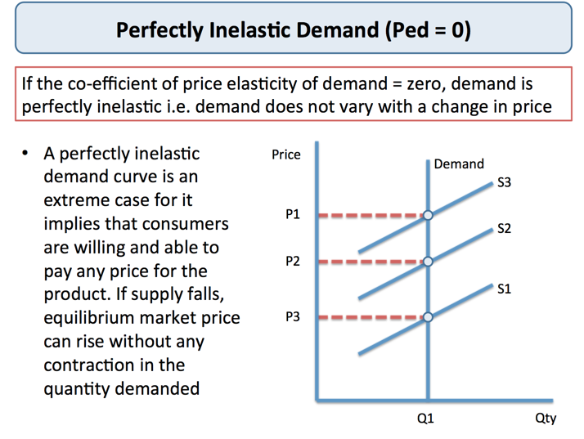
Perfectly Elastic and Perfectly Inelastic Demand
Think, Pair, Share:
What might a perfectly inelastic and perfectly elastic demand curve might look like?
What goods might be perfectly inelastic demand and perfectly elastic demand?

Slide 29
Perfectly Elastic and Perfectly Inelastic Supply
Think, Pair, Share:
What might a perfectly inelastic and perfectly elastic supply curve might look like?
What goods might be perfectly inelastic supply and perfectly supply demand?
Price
S Perfectly Inelastic
Price
P2
P
S perfectly elastic
P1
Q1
Quantity
Q1
Q2
Quantity
Q2

Slide 30
90

Slide 31
STARTER EXERCISE: Elasticity Complete the following tasks in threes as you arrive
OVERVIEW OF MICRO RWS3
Elastic .v. Inelastic: What does it mean?
What you need to know
4 concepts: PED, PES, YED and XED
Diagram: PED and PES
Applications of elasticity: PED. For firms (revenue) and Government (taxation and subsidies)
Calculations: PED, PES, YED and XED
TASKS: To be completed in the first 5 minutes
Make sure you can explain what elasticity is! What are the four concepts of elasticity you need to know about.
Luxury, Normal or Inferior Goods?
Heinz Baked Beans
Big Mac Meal
Ferrari Car
Clothes from a charity shop
Using the white boards in threes, each draw a diagram to demonstrate:
An elastic demand curve
An inelastic demand curve
An elastic supply curve
PREP HOMEWORK INSPECTION
Please get out your
A4 side of NOTES on elasticity
‘Elasticity Worksheet’
which was your PREP homework for Micro this week.

Slide 32
RWS2: The Basic Price Toolkit
RWS3: Elasticity
Concept
Diagrams
Calculations
A
B
Price
Price
S
S
Go through elasticity WORKSHEET
Key Terms
Elastic – Very responsive
Unitary – Proportionately responsive
Inelastic – Unresponsive
PED = Price Elasticity of Demand
YED = Income Elasticity of Demand
Inferior Goods
Normal Goods (Necessity and Luxury)
XED = Cross Price Elasticity of Demand
Substitutes
Complements
PES = Price Elasticity of Supply
P2
B
DEMAND
P1
A
P1
A
P2
B
D2
D1
D2
D1
Q1
Q2
Quantity
Q2
Q1
Quantity
Price
Price
S2
C
S1
S1
P2
B
SUPPLY
S2
P1
P1
D
A
A
P2
B
D2
D
D1
Q1
Q2
Quantity
Q2
Q1
Quantity

Slide 33
Price Elasticity of Demand (PED)
Price
“The responsiveness of demand to a change in the price level”
P2
P1
D Inelastic
Q2
Q1
Quantity
Price
Price
P2
P2
P1
D Elastic
P1
D Unitary
Q2
Q1
Quantity
Q2
Q1
Quantity

Slide 34
Price Elasticity of Supply (PES)
Price
S Inelastic
“The responsiveness of supply to a change in the price level”
P2
P1
Q1
Q2
Quantity
Price
Price
S Unitary
S Elastic
P2
P2
P1
P1
Q1
Q2
Quantity
Q1
Q2
Quantity

Slide 35
Perfectly Elastic and Perfectly Inelastic Demand
Think, Pair, Share:
What might a perfectly inelastic and perfectly elastic demand curve might look like?
What goods might be perfectly inelastic demand and perfectly elastic demand?

Slide 36
Perfectly Elastic and Perfectly Inelastic Supply
Think, Pair, Share:
What might a perfectly inelastic and perfectly elastic supply curve might look like?
What goods might be perfectly inelastic supply and perfectly supply demand?
Price
S Perfectly Inelastic
Price
P2
P
S perfectly elastic
P1
Q1
Quantity
Q1
Q2
Quantity
Q2

Slide 37
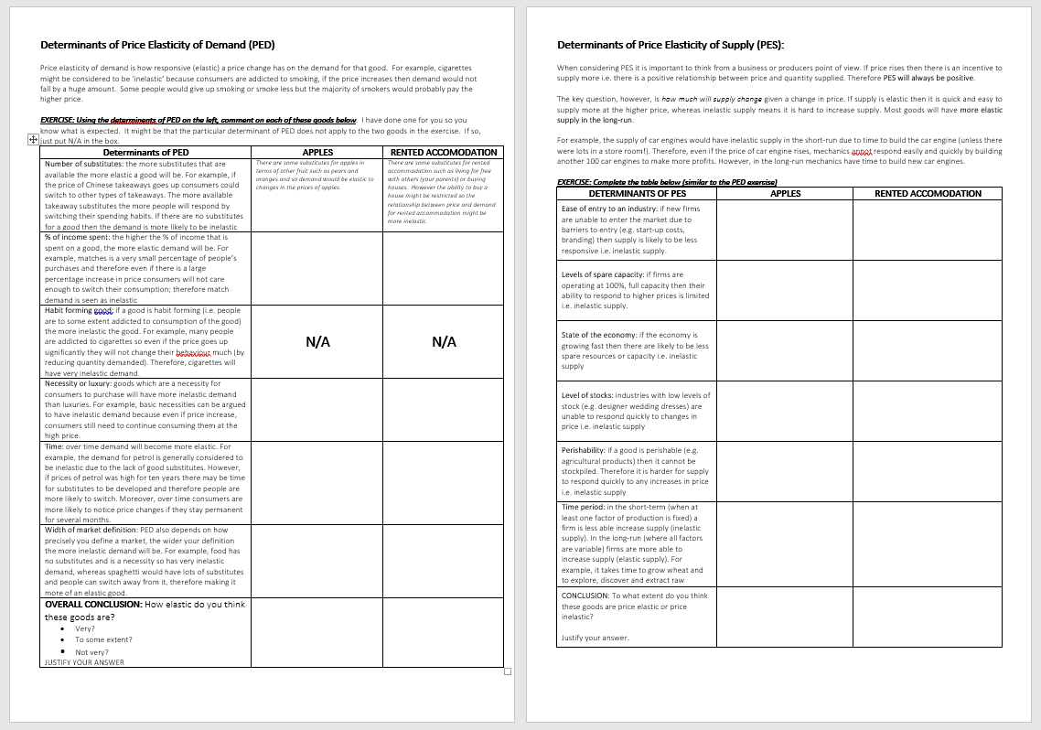
Determinants of PED and PES
Introduction
Complete the worksheet

Slide 38
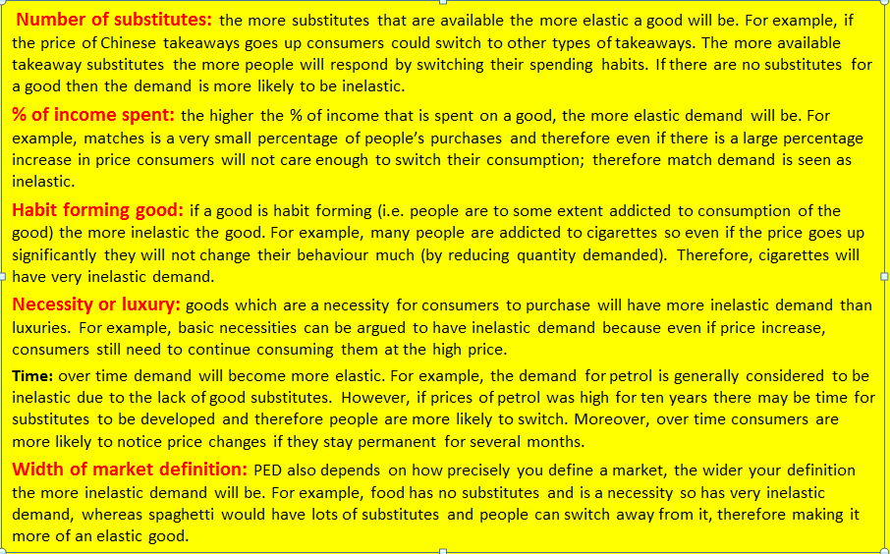
Determinants of PED Substitutes?
Determinants of PES
Time?

Slide 39
WEEK 3

Slide 40
RWS HWK

Slide 41
Economics in the News
What do you know?

Slide 43
30

Slide 44
Applications of Elasticity

Slide 45
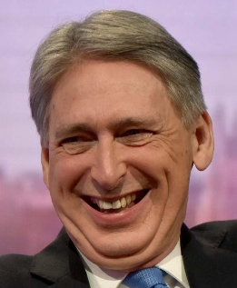
TODAYs LESSON
TODAY
Economics in the News
Admin – RWS3 for Micro and Macro (Total of 4.5 to 6 hours for both)
30: Applications of Elasticity
30: Exchange Rates
STARTER: Discuss the following questions in pairs or threes and make sure your homework is out for inspection
RECAP OF ELASTICITY (no notes! Use each other and no writing down answers…try to remember)
What does ‘elasticity’ measure?
What are the 4 types of elasticity that you need to know?
Name one determinant of PED and one of PES
Goods are normally split into ‘normal’ and ‘inferior’ goods but there are two types of ‘normal’ good….what are they?
ECONOMICS IN THE NEWS: What is your opinion???
“The recent economic growth figures released over the weekend show that in third quarter (July to September) GDP growth was 0.6%. It is the highest quarterly growth figure since the fourth quarter (Oct-Dec) of 2016 when the economy grew by 0.6%.”
Philip Hammond said: “Today’s positive growth of 0.6% is proof of the underlying strength in our economy….thanks to the Conservatives”. Do you agree with his statement?
Notes:
YES – highest growth since 2016; signs that the economy increase in output shows our strength especially with the looming prospect of BREXIT. Conservatives in power since 2015 and before that part of coalition Government since 2010
NO – growth only because of warm weather and World cup….
- business investment down by 1.2% on this time last year
- Growth should be higher if it wasn’t for Austerity

Slide 46
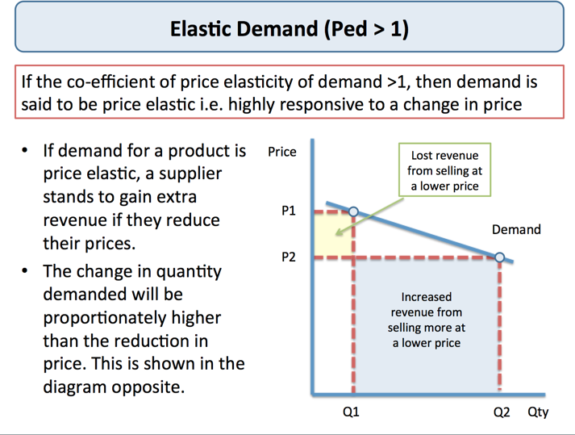
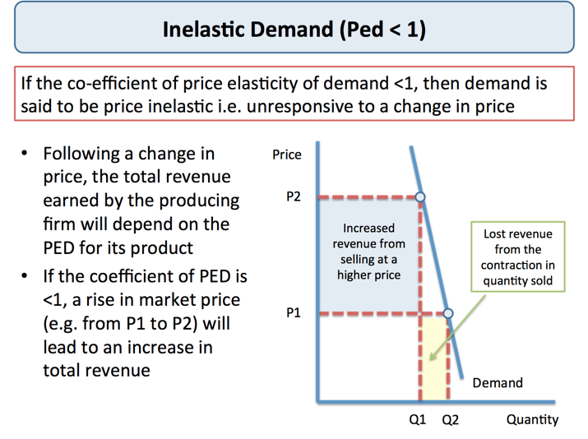
Application of Elasticity: PED and Firms
Note Taking Exercise
Introduction to Firms: What are Revenue, Costs and Profit?
How would you show total revenue on a unitary demand curve?
GROUP TASK 1: Answer one of the two questions below (both questions are to do with maximizing revenue as this will increase profits if we assume that costs stay the same).
If a firm faced an elastic demand curve, would it raise or lower it’s price? Use a diagram to explain why.
If a firm faced an inelastic demand curve, would it raise or lower it’s price? Use a diagram to explain why. HINT: It’s to do with maximizing revenue (because if we assume costs stay the same, this will increase profits).

Slide 47
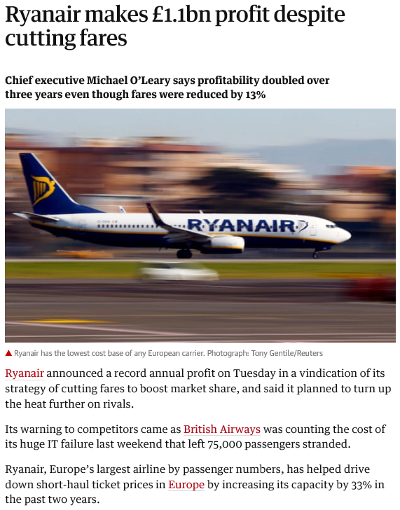
Ryanair and Price Elasticity of Demand
Multiple Choice Question
Ryanair have managed to make £1.1bn profit despite cutting fares because:
The price elasticity of demand for their product is very elastic and therefore a fall in price leads to a greater increase in revenue
The price elasticity of demand for their product is very elastic and therefore a fall in price leads to a greater increase in costs
The price elasticity of demand for their product is very inelastic and therefore a fall in price leads to a greater increase in costs
The price elasticity of demand for their product is very inelastic and therefore a fall in price leads to a greater increase in revenue

Slide 48
Ryanair and Price Elasticity of Demand
Basics of the News Story:
Ryanair have a history of ‘cheap airfares’ but with ‘stupid’ add-ons
Latest – November Ryanair will only allow cases in the cabin if you pay £8 extra.
TASK: Use the concept of price elasticity of demand to explain why Ryanair might have taken this decision?
Notes:
https://www.theguardian.com/business/2018/aug/24/wheelies-and-turnarounds-the-economics-of-ryanair-baggage-rules

Slide 49
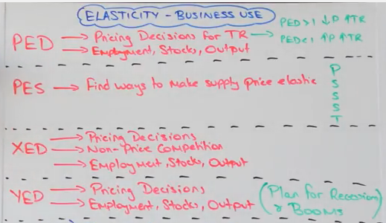
Other Applications of Elasticity with Firms
TASK: Think Pair Share
CLASS TASK: Watch this 8 minute video (https://www.youtube.com/watch?v=pyuOcDjul8s&index=18&list=PLWeicFreBUYCOFC2A0SlKrpEYgwaSF63t&t=0s). Then for the other elasticities (PES, XED and YED), explain why firms would be interested in knowing the values of data for these elasticities below.
It is desirable for a firm to be highly responsive to changes in price and other market conditions. This is because a high PES makes the firm more competitive than its rivals and it allows the firm to generate more revenue and profits.
Knowledge of income elasticity of demand helps firms predict the effect of the economic cycle on sale. Luxury products with high income elasticity see greater sales volatility over the economic cycle. Necessities are less sensitive to changes in the economic cycle)
Notes:
(2) INCOME ELASTICITY OF DEMAND
(3) CROSS PRICE ELASTICITY OF DEMAND
Knowing how complementary and substitute goods react to each other? Helps with supply of that product

Slide 50
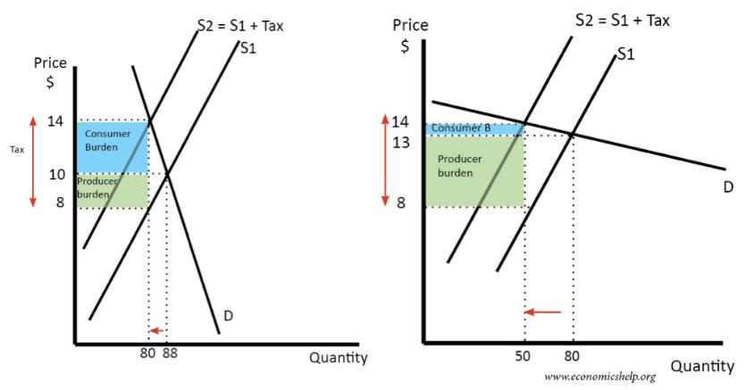
Applications of Elasticity: Government and PED ‘Incidence’ of Taxation and Subsidies Worksheet
POINTS
What is a tax? Indirect .v. Direct?
What is a subsidy?
What effect do taxes and subsidies have on the market
What makes effective taxes and subsidies?
Who shoulders the burden of the tax? The producer or consumer?

Slide 51
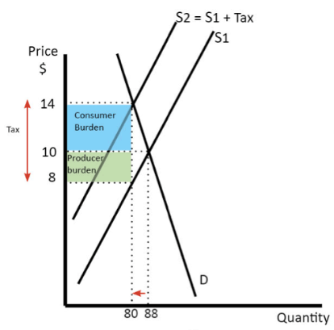
Taxation Considerations: How effective is the tax?
TAX (Inelastic Demand): Cigarettes
SCENARIO: Cigarettes cause early death and have a huge burden on the health service in the UK. The Government want to reduce the amount of cigarettes consumed.
OUTCOME OF A TAX:
Revenue for Government?
Lots of Government revenue - why?
Stopping people smoking?
Not much cut back in quantity - why?
Who pays the burden?
Consumer pays the burden? - Good thing?
Is this tax appropriate?

Slide 52
90

Slide 53
Calculations of Elasticity

Slide 54
RWS3 - Elasticity Starter Activity
RWS3 – Route through
Concept = PED, XED, YED and PES
Diagram = PED and PES
Application = PED - Firms (Total Revenue) and Government’s (Taxation and Subsidies)
Data = Interpreting and Calculating
GROUP EXERCISE (PAIRS):
Complete these exercises in the first 10 minutes - I will be speaking to you all briefly.
Check your answers from the worksheet with your pair and assess each others answers? Do you think you are right? If there is a discrepancy, decide on who is right and make amendments to your notes.
Provide elasticity scores for the following (be able to justify your point verbally):
XED of Plums and Pears (so the impact change in price of pears on the demand for plums)
YED of wholemeal bread
PED of diamonds
PES of new build houses
A report shows that the YED of fast food is +0.2. How would you classify this good?

Slide 55
The Elasticity Spectrum Checking the answers to the first page of your worksheet
INFINITY
-1
INELASTIC
0
1
INFINITY
ELASTIC
INELASTIC
ELASTIC
PERFECTLY ELASTIC
UNITARY
PERFECTLY INELASTIC
UNITARY
PERFECTLY ELASTIC
PRICE ELASTICITY OF DEMAND
PED & PES
PRICE ELASTICITY OF SUPPLY
NORMAL GOODS
INFERIOR GOODS
YED
NECESSITY GOODS
1
LUXURY GOODS
COMPLEMENTS
XED
SUBSTITUTES

Slide 56
How do Economist’s calculate elasticity? Checking the answers to the second page of your worksheet
-
% change in Qd
PED = --------------------
% change in P
OUTPUT FROM CALCULATION
<-1=Elastic
-1 = Unitary
0 = Inelastic
1 = Unitary
>1 = Elastic
+
% change in Qs
PES = --------------------
% change in P
-
+
% change in Qd
YED = --------------------
% change in Y
-
+
% change in Qd (Good B)
XED = -------------------------------------
% change in P (Good A)
What will the ‘sign’ be for PED, PES, YED and XED?

Slide 57
Calculating Elasticity: Basic Maths
Positive and Negative Numbers
-3 x 5 =
-6 x -3=
7 x -6 =
8 x 8 =
-6/3 =
Calculating percentages
Production increases from 40 to 80, what is the % increase?
Demand falls from 9000 to 3000, what is the % decrease

Slide 58
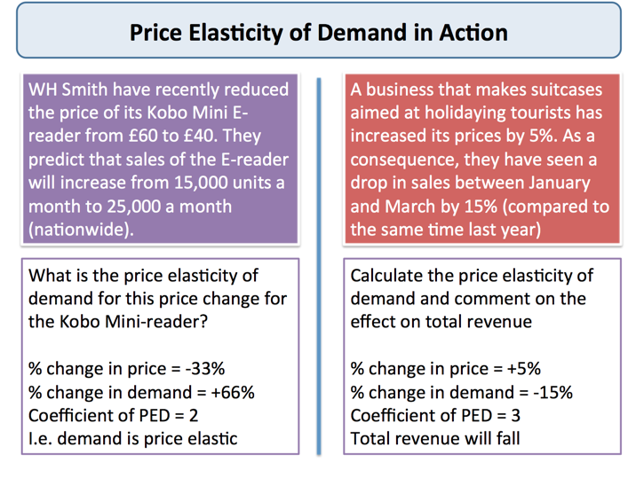

Slide 60
ACTUAL UK DATA Household Survey 2001 to 2009 by the ONS
TASKS:
Class: Which two elasticities would we be able to calculate from this data?
Groups: What is the PED and XED for these goods.
Groups: Explain why this might be the case?
 | CHANGE IN QUANTITY DEMANDED
CHANGE IN PRICE | CIGARETTES | LIGHTERS
CIGARETTES | -(0.76) | -(0.03)
LIGHTERS | -(1.25) | -(1.54)
 | CHANGE IN QUANTITY DEMANDED
CHANGE IN PRICE | Tea | Instant Coffee
Tea | -(0.33) | -(0.01)
Instant Coffee | -(0.01) | -(0.14)

Slide 61
Applications of Elasticity for Firms Interpreting PES and YED Calculations (answers in PP notes)
Explain what the PES of these particular goods is telling you? Why might a firm producing these goods be interested in this and how would it influence their behaviour?
Cigarettes 0.3
Easter Eggs 2.3
Explain what the YED of these particular goods is telling you? Why might a firm producing these goods be interested and how would it influence their behaviour?
Champagne 3.4
Waitrose essential baked beans -0.2
Notes:
Cigarettes (inelastic) telling firms that perhaps their stock is low and therefore they might need to increase their stocks to be able to be more flexible to market changes?
Easter Eggs (elastic) telling firms that their stocks are OK or it is easy to quickly manufacture Easter eggs given the time frame when eggs have to be made (i.e. by Easter). Might therefore plan to ensure Easter has lots of eggs available for Easter time
Champagne (elastic and luxury – normal good) – good to stock this in booms to allow for increased stocks
Waitrose essential baked beans (inferior good – very inelastic)…probably just need to ensure that there is a steady stock supply throughout the year and not worry about the economic cycle!

Slide 62
PRICE AND CROSS-PRICE ELASTICITY OF DEMAND
 | CHANGE IN QUANTITY DEMANDED
CHANGE IN PRICE | Oranges | Apples
Oranges | -(1.44) | -(0.22)
Apples | -(0.09) | -(0.19)
 | CHANGE IN QUANTITY DEMANDED
CHANGE IN PRICE | Cigarettes | Lighters
Cigarettes | -(0.76) | -(1.25)
Lighters | -(0.03) | -(1.54)
SOURCE: Data collected from Household surveys by the ONS 1981-1988

Slide 63
The Price Toolkit How do I remember all of this??!
Calculating Elasticity
% change in Qd
PED = --------------------
% change in P
Q before you P
Factors affecting Supply Curves
P = Price
COP = Costs of Production
OF = Other Factors
POG = Price of Other Goods (Joint Supply and Composite Demand)
% change in Qs
PES = --------------------
% change in P
% change in Qd
YED = --------------------
% change in Y
Factors affecting Demand
P = Price
I = Income
T = Tastes
OF = Other Factors
POG = Price of Other Goods (Joint Demand and Competitive Demand)
% change in Qd (Good B)
XED = ---------------------------------
% change in P (Good A)

Slide 64
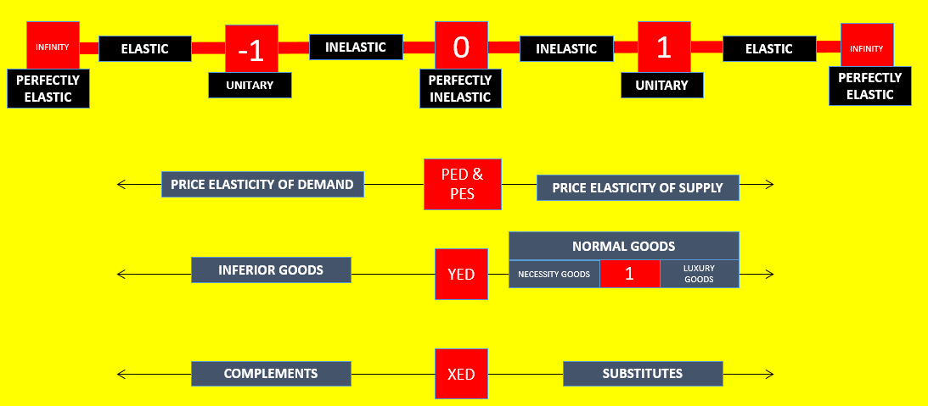
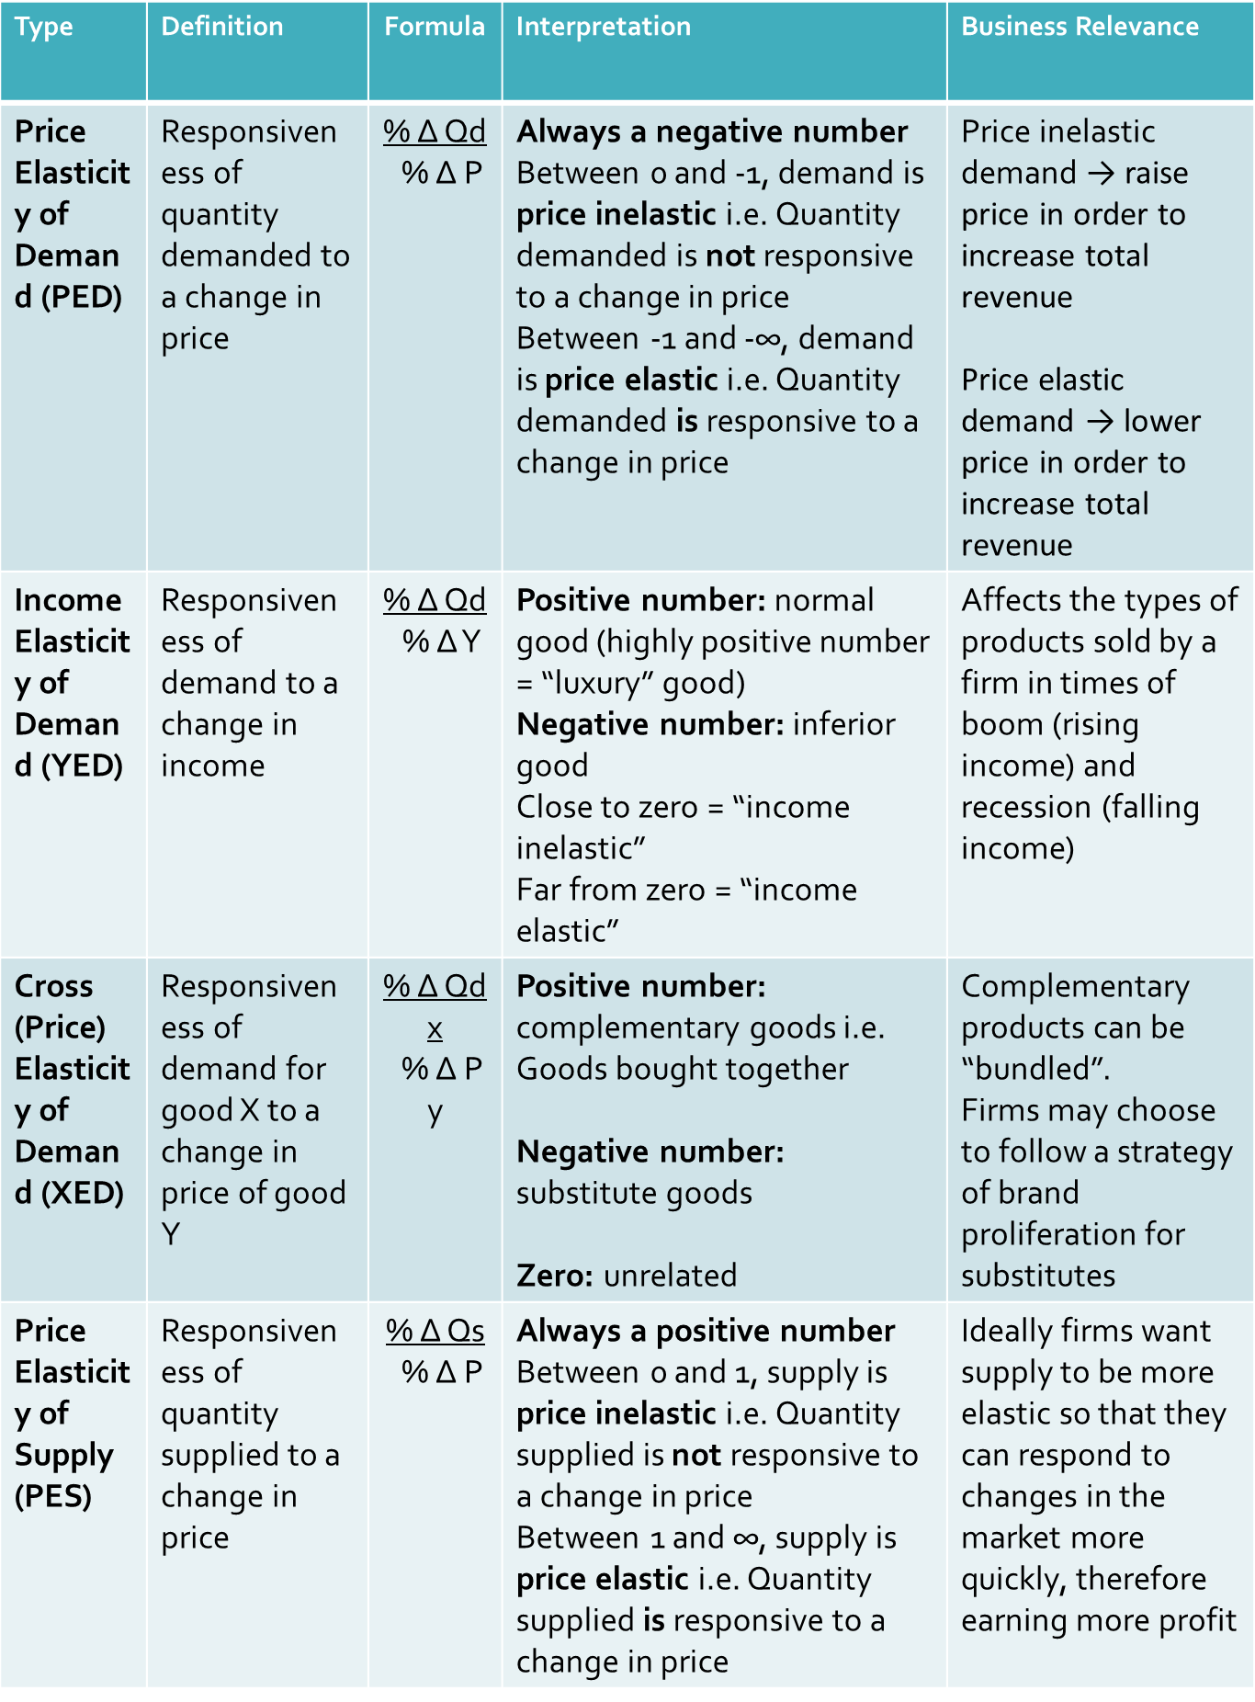
Interpreting Elasticity Data….

Slide 65
END

Slide 66
STARTER: RECAP OF INFORMATION SO FAR - complete in first 8 minutes using the white boards for Q.2 and 3.
How elastic are the following scenario’s? Give a rough data score in your head
Price Elasticity of demand: Cigarettes
Price Elasticity of supply: New Houses
Income elasticity of demand: Holidays abroad
Cross price elasticity of demand: Price of lighters influencing the demand for cigarettes
JUSTIFY YOUR THINKING FOR EACH ONE
Using the white board: Considering elasticity, draw a supply and demand diagram for ‘FA Cup Final Tickets’ showing an equilibrium price.
Using the white board: Analyse what might happen if incomes rose in this market by drawing a separate demand and supply diagram?

Slide 67
% change in Qd
% change in P
% change in Qs
% change in P
% change in Qd
% change in Y
% change in Qd of good 2
% change in P of good 1

Slide 68
RECAP Applications of Elasticity using Calculations
FIRM: Revenue Information
GOVT: Taxation and Subsidy Information

