Slide 1
WEEK 4

Slide 2
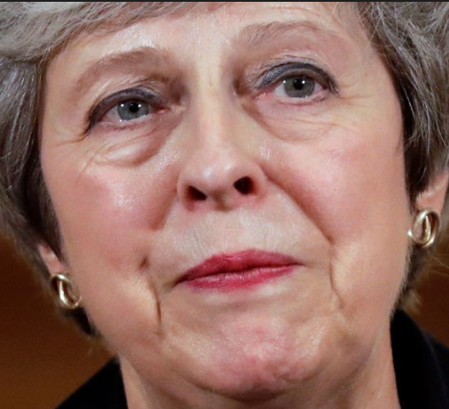
STARTER (Cover Work) First 10 Minutes – try to recall the answers without using your notes
TODAY: MICROECONOMICS
Recap Mondays Lesson
Intro to RWS 4 and PREP HWK
Measuring the effectiveness of ‘Free Markets’
THURSDAY: MACROECONOMICS
What are the two revision worksheets (RWS 4) about for Micro and Macro?
What are some of the assumptions of the ‘free market’ (there were 4).
How realistic are these assumptions in your view?
What is competition and why is it considered to be good for society?
How competitive are markets in reality do you think?
What is the alternative to the ‘free market’?
What are the two ways that economists measure the effectiveness of ‘free markets’
EFFICIENCY ECONOMICS: Allocative and productive efficiency – what are they?
WELFARE ECONOMICS: What is the similarity and difference between consumer surplus and producer surplus?
If Theresa May gets the sack this week, what do you think the implications for the UK economy will be?

Slide 3
RWS 4 - Weeks 4 and 5
MICRO – The Role of the Market
The role of the market and efficiency (allocative and productive)
Welfare economics – consumer and producer surplus
The role of prices in the market (disequilibrium analysis)
Introduction to “Behavioral Economics’ - challenging the assumption of ‘rationality’ of consumers and firms
MACRO – Price Levels and Economic Data
The concept of money
Importance of Stable Prices: The effects of Volatile Price Levels - Hyper Inflation (Zimbabwe, Germany, Hungary) and Deflationary Traps (Japan)
Causes of changes in price levels
Measuring price levels (CPI and RPI) and UK economic history
Economic data of macroeconomic indicators - price indices etc.

Slide 4
RWS4 – PREP HOMEWORK Due for inspection on Monday 26th Nov 2018
MICRO (2.25-3 hours): PREP (prepare for inspection)
1-1.5 hour: Complete the reading and questions on the ‘role of prices’
1-1.5 hour: Complete reading and worksheet on ‘Behavioral Economics’.
MACRO (2.25-3 hours): PREP (prepare for inspection)
1.25 to 2 hours: Complete the reading and worksheet on ‘Deflation in Japan’.
45 minutes max: Complete reading and questions on the concept of INDEX numbers; this was part of the GCSE Maths syllabus so you should of encountered it before.
ALL AVAILABLE ON GOL UNDER RWS4 FOLDERS IN MICRO AND MACRO SECTION

Slide 5
30+90

Slide 6
INTRODUCTION

Slide 7
RWS 4 Introduction: The Role of Markets
How do we solve the economic problem? Two options:
Free Markets (capitalism, market economy etc.) = RWS 4: Governments establish ‘property rights’ but then leave ‘Firms’ and ‘Consumers’ (from households) to negotiate a ‘market-clearing equilibrium’ price for goods and services. This price then determines the allocation and subsequent production of certain goods and services to meet the needs/wants of consumers.
Government Intervention (socialism, planned economy etc.) = RWS 5: Government’s not only establish ‘property rights’ but also produce and allocate scarce resources to meet the needs/wants of consumers. Or they are heavily involved in regulating the market to ensure that consumers needs/wants are maximised with minimal waste of scarce resources.
How do we measure which method is best? Two options:
Efficiency Economics: Allocative and Productive Efficiency (Minimising waste of scarce resources)
Welfare Economics: Consumer and producer surplus (Maximising the wants of consumers to improve utility or living standards)

Slide 8
MICROECONOMICS OVERVIEW
THE BASIC ECONOMIC PROBLEM
Scarcity (resources), unlimited wants forces a choice (PPF MODELS) which involves an opportunity cost. There is not enough for everyone so how best to distribute our scarce resources to meet everyones wants.
Theory of the Firm
Basics of the firm:
Types of firm (Sole Trader, Ltd and PLC)
Objectives of firm (short term and long term profit, sales maximization, ethical, behavioural and managerial)
Market structure and concentration ratio’s
Production theory –
Revenue, costs (fixed and variable) and profit (abnormal and normal): marginal, average and total - curves and calculations – difference between SR and LR (diminishing marginal returns .v. economies of scale)
Specialisation, division of labour and economies of scale
Technological change – innovation and invention and contribution to competition
Competition Models:
Perfect competition
Competitive Oligopoly (kinked demand curve for non-price competition, price wars, price stability, predatory and limit pricing)
Contestable markets
Monopolistic Competition
Benefits of Monopoly
Natural monopoly and Economies of Scale
Dynamic efficiency from abnormal profits
Concepts of ‘Creative Destruction’ (i.e. monopolies will not last forever)
Efficiency
static (productive and allocative)
dynamic
Labour Markets
Redistribute income and wealth
Taxation (direct - income, corporation, inheritance, National Insurance and indirect - VAT and excise duties).
Benefits (JSA, WTC, Pensions, Universal Credit debate, in kind)
Government Legislation
Trade Union power change
Minimum Wage (and the Living Wage)
Maximum wage cap?
Prevent Discrimination (Equality Act 2010)
Government Job Scheme: Macroeconomic policy and job creation through demand and supply side policies
Poverty Targeting: 1997 New Labour target and the Child Poverty Act 2010
SOCIALISM
CAPITALISM
Welfare Economics
Price Mechanism
Indirect taxation
Subsidies
Tradable pollution permits
Direct Controls
Legislation and regulation (incl. pollution permits)
Price controls - max and min prices and buffer stocks
Government provision
Identifying property rights through patents and legislation
Persuasion
Govt. Guidance
Nudge Theory
Choice architecture: default, restricted and mandated
Welfare Economics
Demand & Supply Curves
Factors affecting demand curve (P IT OF POG). Also utility for consumers, rationality and diminishing marginal utility
Factors affecting supply curve (P COP OF POG)
Inter-relationships between markets: joint demand, competitive demand, composite demand, derived demand and joint supply
Elasticity - calculating PED, PES, XED and YED plus drawing graphs for PED and PESI
Equilibrium
The role of prices (signals, incentives, ration)
Equilibrium .v. Disequilibrium
Efficiency and Welfare (consumer and producer surplus)
Coase’s Theorem
GOVERNMENT INTERVENTION
FREE MARKET SUCCESS
Theory of the Firm (Industrial Policy)
Competition Policy
Regulation
Bodies: CMA plus specific industry watchdogs (OFGEM, OFWAT, ORR) and European Commission
Types: Price capping (RPI-X, fines/ prosecution, legislation, break up, windfall taxes etc.)
Deregulation - removing barriers via legislation and subsidies
Nationalisation and Privatisation
Labour Markets
Wage determination
MRP theory and Labour Demand
Labour Supply
Elasticity of Ld and Ls
Perfectly competitive labour markets
Flexible Labour Markets and Impact of Globalisation
‘Trickle Down Effect’ and other reasons why inequality is ‘good’!
Welfare Economics
Externalities (positive & negative) including diagrams (4 in total)
Consumption (split in MSB - merit and demerit goods) - under and over consumption
Production Externalities (split in MSC) - under and over production
Public Goods (missing markets)
Pure (no production) and ‘free rider’ issue
Quasi (under production)
Absence of property rights
Behavioural Economics
Imperfect information (asymmetric info)
Bounded rationality
Biases in decision making
Paradox of altruism and fairness
Theory of the Firm
Regulatory capture
Crowding Out through Nationalisation
Cost to Government (including opportunity cost)
Moral hazard
Welfare Economics
Unintended effects: Shortages/surpluses
Political conflicts: Public choice theory and corruption
Admin Errors/Costs: Bureaucractic costs
Imperfect info: unable to put a value on externalities
Theory of the Firm
Monopoly:
Natural, Monopoly Power and Monopoly.
Price discrimination (1st, 2nd and 3rd degree
Inefficiency – static (x-inefficiency and underproduction)
Loss of consumer surplus (and gain of producer surplus)
Collusive Oligopoly Tacit (price leadership) and overt collusion (cartels)
GOVERNMENT FAILURE
FREE MARKET FAILURE
Labour Markets
Moral Hazard (or Dependency)
Disincentive effects (unemployment trap & poverty trap? PLUS ‘brain drain’ and less risk taking?)
Burden of taxation (progressive .v. regressive)
Cost to Government (incl. opportunity cost)
Labour Markets
Absolute and Relative Poverty: Low wages and unemployment
Inequality and equity issues: GINI coefficient and history since 1979
Discrimination (gender, ethnicity etc.)
Imperfect competition in the market: e.g. trade union (or monopoly power), monoposony (buyers) power and bi-lateral monopoly
Labour immobility: Occupational and geographical

Slide 9
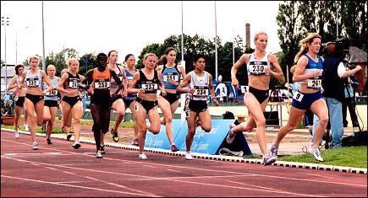
What is a Market The Key Assumptions
TASK 1: Are you happy with these assumptions? Are they realistic?
TASK 2: The importance of competition to the functioning of the free market…
What is competition
Why is competition considered to be good for society (the consumer say?)?
What happens if there is no competition in a market?
How competitive are markets in reality?
Economic agents are ‘rational’ (i.e. consumers will ALWAYS want to maximise their standards of living or ‘utility’ and firms will want to maximise their profits)
Economic agents are ‘selfish’ (i.e. they will only do what is best for themselves without worrying about others…this ultimately leads to a good outcome for all).
Free markets have very little Government intervention apart from establishing property rights
Free markets will thrive because competition will be present amongst supplying firms

Slide 10
EFFICIENCY MEASURES IN ECONOMICS

Slide 11
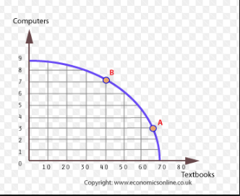
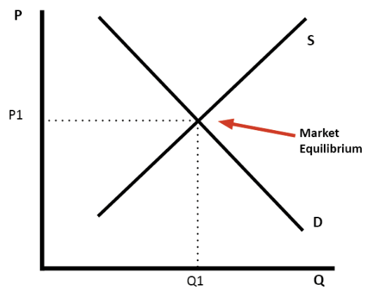
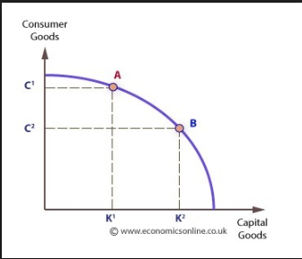
Efficiency Economics and the Market Allocative and Productive Efficiency
STARTER:
Can you remember what allocative and productive efficiency are from your PPF modelling, earlier in the year?
How can we/can’t we use a PPF’s to measure productive and allocative efficiency?

Slide 12
Efficiency Economics and the Free Market Allocative and Productive Efficiency
Efficiency Economics: The study of how an economy can best allocate resources to maximise the utility or economic welfare (or surplus) of its citizens.
Allocatively Efficient: When resources are distributed in the most efficient way so that the exact amount of a good/service are produced that is needed and there is no waste of scarce resources. Therefore markets are efficient in distribution. The price mechanism determines WHAT goods and services we should produce and for WHOM.
Productively Efficient: When resources are used in the best possible way in the production of a good or service. All inputs are used to maximise outputs. Therefore markets are efficient in production. The price mechanism determines HOW we should produce the goods and services
The equilibrium is allocatively efficient because this price is the ‘market clearing price’. In other words, all the goods/services that have been brought to market, have been sold/consumed. Therefore there is no waste of our scarce resources in producing goods/services that are not needed.
Figure 1: Supply and Demand Curve for the Textbook Market
Productive efficiency can be measured on the PPF line at A and B because this is where all the inputs (scarce resources) are used by the firm…there are no resources lying idle and so we are producing at maximum efficiency.
The other side of productive efficiency is that because of competition, firms will fight each other to cut costs in order to lower their prices. Therefore they are not only maximising their inputs, they are producing in the best way (i.e. at lowest possible cost)
Figure 2: PPF showing a firm that can produce either computers or textbooks

Slide 13
Why does competition lead to Productive Efficiency?
Analytical Chains of Logic for a Paragraph
e.g TOYOTA
Toyota invent robotic welders
What are the advantages of robotic welders?
No tea breaks
100% work rate
Japanese so don’t go wrong
What happens to Toyota’s costs?
What happens to Toyota’s profits?
Cuts costs
Increase!
What will Toyota’s competitors do?
What might these greater
profits do to potential
competitors outside the market?
Attract them into the
market.
Invent robotic welders!
What happens to output in the industry?
What happens to the supply curve for cars in the market?
What happens to the price of cars in the market?
Increases!
Increases!
Falls!

Slide 14
Productive Efficiency and ‘the free market’ Why does competition lead to productive efficiency and why is this good for our economy? The Case of ‘Big Tech’ Companies….
TASK: Take notes by answering the following questions for each FIRM:
Who are these companies competing against? (Can you name specific firms?)
How have these companies changed the markets they have entered?
ANSWER THIS QUESTION FOR THESE TWO FIRMS
Using these examples, explain what the internet has done for competition (and therefore productive efficiency) in your view?
2
1
Founded in 2009 - a web based taxi service
Founded in 1994 and primarily sold books over the internet. Now selling everything and most recent development is ONLINE grocery shopping….

Slide 15
Allocative Efficiency and the ‘Free Market’ Why are ‘free markets’ the best way to allocate scarce resources efficiently according to some economists?
Evaluation – need a ‘yes, a good example’ and a ‘no, not a good example’
Dragons Den (the ‘epitome of the free market’) and Allocative Efficiency
EXERCISE:
To what extent does the example of ‘The Shuc’ demonstrate the ‘free markets’ are an excellent way to achieve ‘allocative efficiency’?
YES - A GOOD EXAMPLE
The SHUC did not attract any investment and was not produced in large quantities. The Dragons (market) said no - do not waste scarce resources in producing this product!
NO - A BAD EXAMPLE
Resources were still spent in producing this product (£200,000) which very few will buy. Therefore a waste of resources – the money could have been spent on producing goods/services that consumers ACTUALLY want.
“The SHUC”

Slide 16
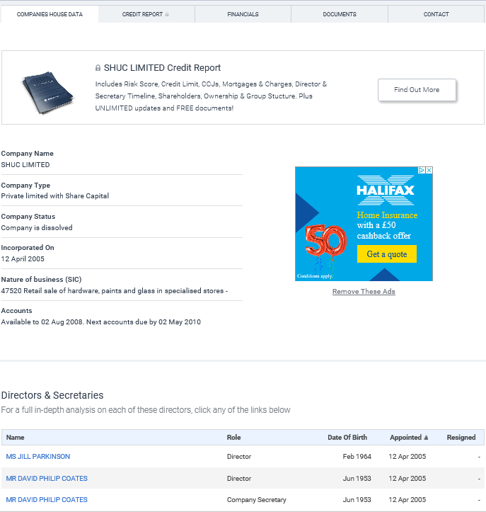

Slide 17
The Importance of “Value” to Economics Measured by the ‘Price’ consumers are willing to pay in the market
Price is….
…vital to Economic theory on the ‘free market’
….what signals to firms what consumers want
In the ‘free market’, goods and services are only produced if the consumer is willing to pay a price. In other words, the consumer values the good/service at a particular price as it will provide the consumer with ‘utility’.
Firms then respond by producing that good/service as they can earn profit (if their costs are low enough).
CONCLUSION: The consumer is KING in the ‘free market’, helping to achieve allocative efficiency.

Slide 18
The Role of Markets
Achieving ECONOMIC EFFICIENCY: A CONCLUSION
ALLOCATIVE EFFICIENCY (WHAT and for WHOM?):
WHAT IS IT? Deciding what is needed and distributing those scarce resources in the best way to those members of society who are willing to pay the price – there is no waste.
HOW DOES THE MARKET ACHIEVE IT? The “price” of a good means something has value which means a consumer wants it to maximise their utility. This means a firm will want to provide it to make profit.
PRODUCTIVE EFFICIENCY (HOW?):
WHAT IS IT? Producing scarce resources in the best way so there is no waste. So minimal cost and all inputs are used to achieve the maximum output.
HOW DOES THE MARKET ACHIEVE IT? Firms have an incentive to be more efficient because they face competition in the market.

Slide 19
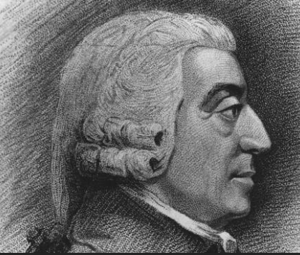
ADAM SMITH: The Founding Father of Economics in 1776
KEY ASSUMPTION: Adam Smith said that the best outcome (most efficient) would be achieved through natural selfishness (everyone looking out for themselves). Everyone is ‘egotistical’ as opposed to ‘altruistic’.
ROLE OF FREE MARKETS: Free markets of firms and consumers were key to this success. Any attempt by Government to distort the workings of “the invisible hand” would lead to an inefficient allocation and production of resources.

Slide 20
WELFARE MEASURES IN ECONOMICS

Slide 21
Welfare Economics and the Free Market Consumer and Producer Surplus
Welfare Economics: The study of how a market can best allocate resources to maximise the utility or economic welfare (or surplus) of its citizens.
Consumer surplus: The difference between the market price which consumers pay and that which they are prepared to pay.
Producer surplus: The difference between the market price which firms receive and the price at which they would be prepared to supply.
Equilibrium Price: Welfare (surplus for producers and consumers) is maximised here. Indeed no one in the market can be made better off without making someone worse off and so welfare is maximised. If the equilibrium changes then the welfare will still be maximised but at a different equilibrium price (although the producer and consumer surplus might be more or less).

Slide 22
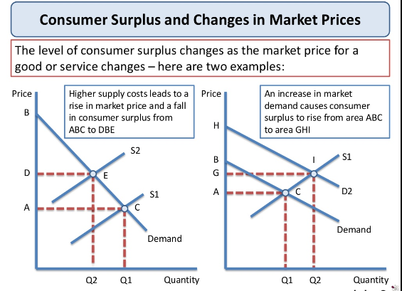
Surplus and Changes to Equilibrium
(1) What is the original consumer surplus and what will the new surplus be?
(2) What is the original consumer surplus and what will the new surplus be?
(3) What is the original producer surplus and what will the new surplus be?
(4) What is the original producer surplus and what will the new surplus be?

Slide 23
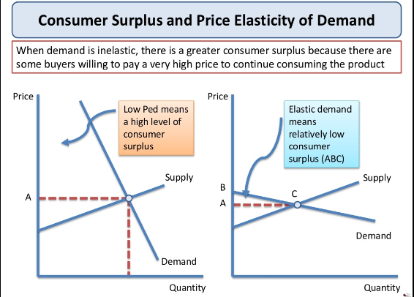
Surplus and Elasticity Exercise
A firm faces quite an inelastic demand curve.
How would the consumer surplus and producer surplus differ from a firm which faced a unitary or elastic demand curve?
Draw a demand curve in your notes to help you answer the question

Slide 24
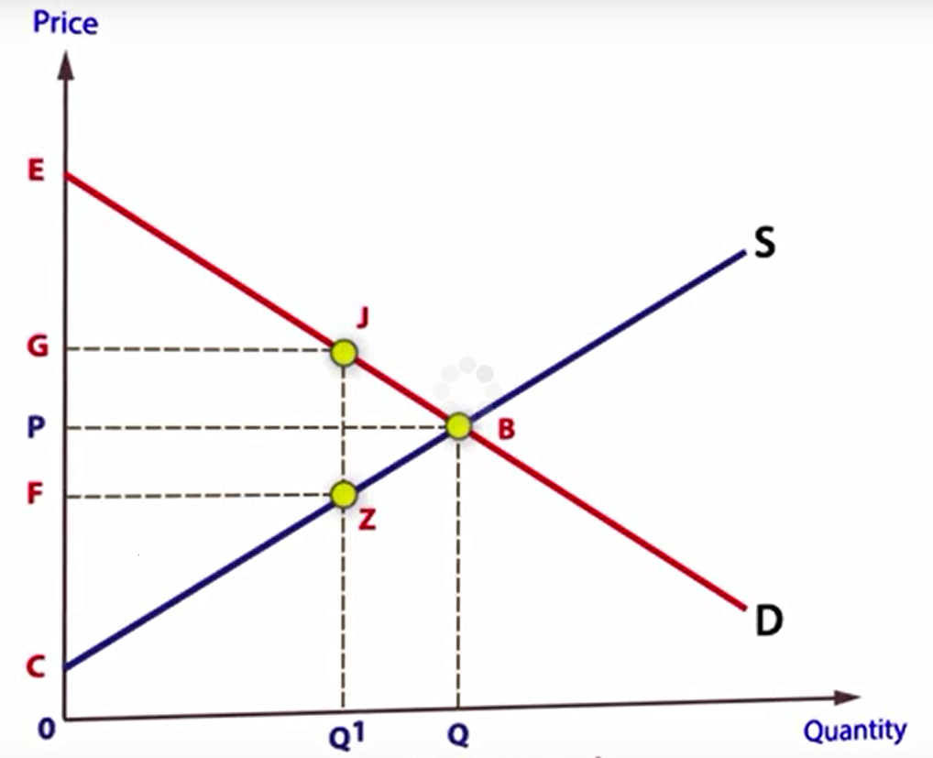
Final Thought: Distortions and interferences to the Market The concept of ‘deadweight loss’ (loss of consumer and producer surplus)
How could the price move to G (but the equilibrium stayed at B)?
If a Government imposed a regulation to keep price at G, what would be the welfare loss to society?
If a monopoly (i.e. a market with no competition) raised it’s price to exploit the market, the same thing could happen.
Why might the higher price lead to a loss of welfare?
What must happen in the market to maximise welfare to eradicate this ‘deadweight loss’?
N.B. this is different to a situation where the equilibrium changes to push up the price (from say a supply fall – S shifts to the right). If that were to happen, then welfare would be maximised at the new price (even though consumer surplus reduces) as this is market ‘adjustment’ NOT ‘distortion.
Deadweight loss?
Notes:
Subsidy also leads to deadweight loss: https://www.youtube.com/watch?v=4tYVsnSsoBo

Slide 25
WEEK 4

Slide 26
RWS HWK

Slide 27
30

Slide 28
RWS 4: The Role of Markets

Slide 29
Starter Activity - first 5 minutes
It is Black Friday!!! Prices of your favourite purchases have been cut in half.
What signals does this send to you as a consumer using traditional economic theory?
What alternative signals might this send to you as a consumer if you took into account a ‘behavioural’ theory?
From a traditional (or classical) economist’s point of view, how have the consumers incentives to buy changed?
From a behavioural economist’s point of view, how have the consumers incentives to buy changed?

Slide 30
RESTORING EQUILIBRIUM:
The Functions of Prices and Profits: An explanation…..
THREE FUNCTIONS OF PRICE
SIGNALS: (A BEACON!)
Prices send signals to both consumers and firms, revealing insights about the market.
(2) INCENTIVES: (AN ACTION)
Prices influence the behaviour of consumers and firms. For example, a firm may decide to produce more of a certain good due to a higher price resulting in higher profits.
(3) RATIONING:
Prices help to ration goods. A high price will discourage certain consumers from buying a good and this will reduce demand for that good.
£

Slide 31
The Role of Prices in the Market Mechanism: Disequilibrium Analysis:
e.g. Shifts in the Demand Curves
STAGE 1: INITIAL EQUILIBRIUM
The market is in equilibrium – demand equals supply at a suitable price.
STAGE 2: THE CHANGE IN DEMAND OR SUPPLY CURVE = A SHIFT
As incomes of individuals have risen, so has demand for apples. The demand curve shifts to the right from D1 to D2.
D1 could now be taken out as it has been replaced by D2.
STAGE 3: THE DISEQUILIBRIUM EFFECT OF A DEMAND OR SUPPLY CHANGE
At P1, we now have a situation where there is excess demand at A to C (Q1 to Q3). If the price stayed at P1 with the new demand curve D2, although demand has changed, supply has stayed the same creating disequilibrium at first.
STAGE 4: RESTORING EQUILIBRIUM AUTOMATICALLY VIA THE PRICE
As there is excess demand, suppliers realise they can increase their prices from P1 to P2. The increase in prices will send a signal to other suppliers of the potential of more profit in this market and existing firms will also see this as a reason to increase supply. As new suppliers enter the market and existing firms increase production, supply extends ALONG the supply curve as suppliers have an incentive to produce more from A to B (because of the profit motive). At the same time, higher prices may force some consumers to cut back (ration) some of their expenditure and demand contracts ALONG the demand curve from C to B.
STAGE 5: THE NEW EQUILIBRIUM ESTABLISHED AT B
When price has risen sufficiently to P2, enough extra supply has dealt with the shortage and enough consumers have rationed expenditure of the good to create a new AND stable equilibrium at B. As a result, price moves from P1 to P2 and quantity increases from Q1 to Q2.
The Market for Apples
Price
S
B
P2
P1
C
A
D2
D1
Q1
Q2
Q3
Quantity
A
B
ULTIMATELY: A shift in demand to the right has caused the price to rise and the quantity supplied of the product to increase from A to B
EXCESS DEMAND

Slide 32
CHANGES IN EQUILIBRIUM:
Shifts in the Demand and Supply Curves (A4 sheet landscape, DIVIDED INTO 4)
EXERCISE: Using the 5 stage technique from the previous explanation, complete the following shifts in the demand and supply curves and state what happens to price and quantity as a result:
(1) The demand curve for beef shifts to the left due to the Foot and Mouth crisis
(2) A weaker pound means that Unilever face higher import costs for their inputs. The costs of production therefore increase and the supply curve shifts to the left.
(3) An import tax on coffee from Rwanda is reduced by the EU Government. As a result the supply curve of Coffee in the UK shifts to the right due to the lower costs of production.
(4) A demand curve shifts to the right for Mercedes cars as consumers tastes change away from VW
TOP TIPS:
(i) Before you draw your diagrams, what is your gut feeling? Write down your answer and check it once you have completed the diagram.
(ii) Remember to correctly label your diagram and make it big.

Slide 33
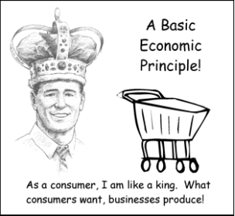
Why do prices mean resources are allocated efficiently?
WHAT DO PRICES DO?
Prices act as signals to existing economic agents (individuals) in the market and those outside the market
Prices create incentives that affect decisions that individuals make
Prices can ration goods if there is a shortage
WHY DOES THIS LEAD TO EFFICIENCY?
All of this means that scarce resources are distributed in the best way for society. Nothing is produced that is not needed.
The consumer drives this process by placing values on everything. The consumer is king!
CHALLENGE THIS?
Does this mean that we can put a price on everything?
Does this mean that consumers and firms will always behave consistently in the same way?

Slide 34
90

Slide 35
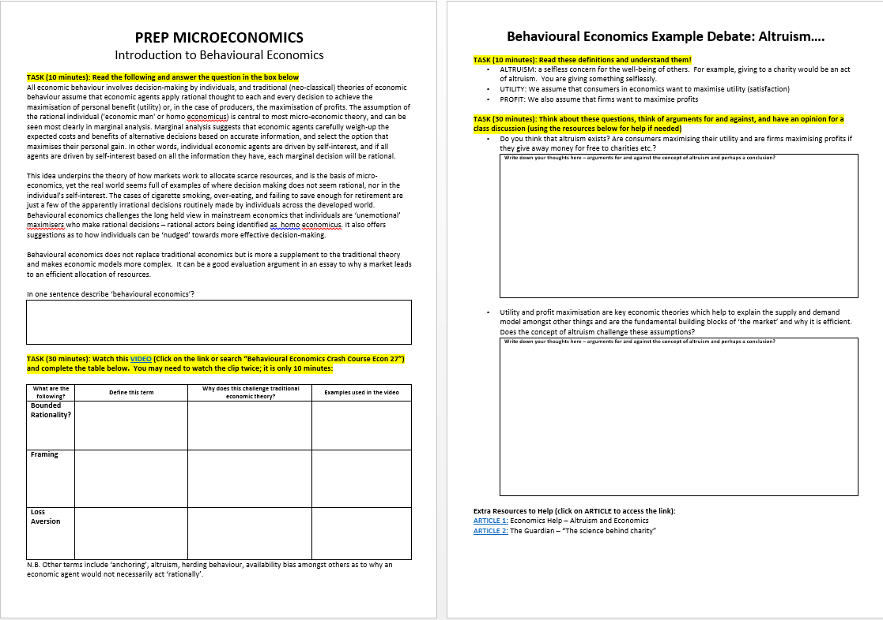
RWS4 (MICRO) - The Role of the Market
PART 1: Discussion of the first side of the worksheet - KEY QUESTIONS
What is behavioural economics?
Does behavioural economics mean traditional economic theory is pointless?
Bounded rationality?
Framing?
Loss Aversion?
PART 2: Behavioural Economics Debate: Does altruism exist?
Conclusions?

Slide 36
Behavioural Economics Challenging ‘Classical Economics’
How?
Classical economists believe economic agents/individuals (consumers, firms etc.) are rational. They follow a set of rules consistently when making decisions. E.g. the Law of Demand and Supply and being ‘egotistical’ or selfish
Behavioural economists think it might be more complex than that. Do we make decisions purely for our self-interest and can we accurately predict how we might respond to price changes?
Why do Behavioural Economists think we may not have consistent, rational behaviour?
Bounded rationality (and self-control)
Biases in decision making
Altruism and fairness
Framing (and choice architecture)

Slide 37
Altruism Debate
Classical economists assume we are all selfish (consumers and firms) and all out for our own advantage? Are they right?

Slide 38
TODAYS LESSON:
Recap ‘Classical’ .v. Behavioural Economics in terms of the roles of prices in the market
Concept of Welfare Economics: Consumer and Producer Surplus
How to write a point in an essay where you are explaining why the market is a good tool to solve the economic problem.

Slide 39
How to write a point in an essay where you are explaining why the market is a good tool to solve the economic problem.
To what extent should the Government intervene in the market to reduce the consumption of cigarettes?
Point: Government’s shouldn’t intervene as markets work best if there is no Government intervention
ARGUMENTS TO SUPPORT this POINT
As#1: Efficiency Argument - maximising both allocative efficiency through the price mechanism and productive efficiency through competition
As#2: Welfare Argument - maximising economic welfare to society and there is no ‘deadweight loss’
ARGUMENT TO EVALUATE this POINT
Ae: Behavioural economics argument - should we assume that people are rational and make decisions based upon prices….are they consistent? Are they selfish?

Slide 40
ARCHIVE

