Slide 1
WEEK 7

Slide 2
HWK

Slide 3
Spring Half-Term Year 1: First 6 Weeks
Weeks 1 and 2
MICRO RWS#5: The Role of Government
Why might the market fail? The Morality of Capitalism?
What is the role of the Government in the market to correct the failure?
Why might the Government fail?
Weeks 3 and 4
MICRO RWS#6: Monopoly as a Market Failure
What is a firm and what are its objectives?
The concept of Economies of Scale
Monopoly and Monopoly Power in the Market
Government Intervention and Failure: Supermarkets Case Study
Weeks 5 and 6
Review Week and Benchmark
10 Multiple Choice and 25 Mark Essay
Weeks 1 and 2
MACRO RWS#5: Aggregate Demand and Supply in the Economy
Components of Aggregate Demand AD
Components of Aggregate Supply AS
Aggregate Demand and Supply Curves
Weeks 3 and 4
MACRO RWS#6: Macroeconomic Equilibrium Theory
Macroeconomic Equilibrium
Changes to Equilibrium from AD and AS
Policy Conflicts
Weeks 5 and 6
Review Week and Benchmark
10 Multiple Choice and 25 Mark Essay

Slide 4
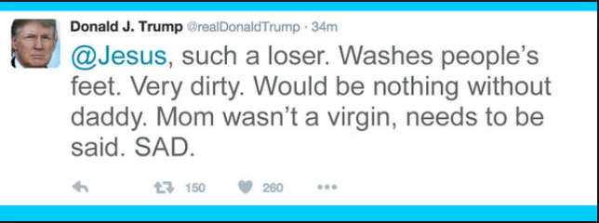
Economics Homework For the 7th January 2019 (3.5 weeks away) Can be completed in class Monday and Tuesday = 2 possible hours
IMPORTANT IT NOTICE
Change your password before you break up to get access to GOL in case it expires over the Christmas break
MICROECONOMICS PREP (2.25 to 3hrs=3 to 4 45m):
1x30m Worksheet: ‘Morality of Capitalism’ (in class)
1-2 x45m - Worksheet: ‘Intro to Markets .v. Government’ (some completed in class)
2-3x45m - PREP WORK: Complete A3 mind map on agriculture and housing market context
MACROECONOMICS PREP (2.25 to 3hrs=3 to 4 45m):
4-5x45m Worksheet: Introduction to Aggregate Demand (some completed in class)
CURRENT AFFAIRS (ongoing):
Finish reading the Macroeconomics book by Tim Harford, read for a test in the first lesson back
Stay up to date over the Christmas break….Trump, Brexit etc.

Slide 5
30

Slide 7
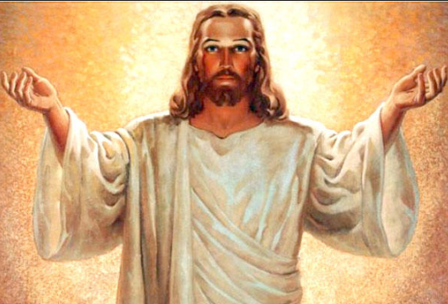
RWS5 (MICRO): The Role of Government RWS5 (MACRO): AD and AS Macro Theory
Microeconomics: The Morality of Capitalism
(8 minutes): Discuss TASK 1 in groups, ready for a class discussion
(7 minutes): Class discussion on TASK 1
TASK 2 – Think (2), Pair 2 and Share 5
TODAY
Admin – setting PREP homework and explaining benchmarks etc.
Intro to MICRO RWS5: The Role of Governments
Intro to MACRO RWS5: Aggregate Demand and Aggregate Supply in the Economy (Macro Theory)

Slide 8
Morality of Markets…. Can Prices tell us everything?
ULTIMATE QUESTION FOR DISCUSSION:
Can the price mechanism be used in ALL areas of life?
YES or NO
Come to a conclusion in your group and provide explanation as to why you are saying YES or NO
Notes:
Love
Doctors
Extending the use of the price mechanism into new areas of activity
Is the price mechanism an impersonal method of allocating resources in some cases?
Students should be able to
assess the view that the price
mechanism is an impersonal
method of allocating
resources.
They should also be able
to assess the view that
introducing the price
mechanism and markets into
some fields of human activity
may be undesirable and is
likely to affect the nature of
the activity, eg introducing a
market for blood changes the
nature of the transaction and
the incentives involved.

Slide 9
WEEK 1

Slide 10
HWK

Slide 11
PREP HOMEWORK 2 (4.5 to 6 Hours) Due for Monday 14th January 2018
MICROECONOMICS
(45m-1.5hrs) Complete the worksheet on ‘The Morality of Government’
(1-1.5hrs) Complete the mindmap of these four types of market failure using the resources on GOL
Legislation/Regulation
Government Ownership
Education
Nudge Theory
MACROECONOMICS
(1) (2.25 to 3 hours) Complete the worksheet on Aggregate Supply

Slide 12
30

Slide 13
STARTER ACTIVITY What is Market Failure?
RWS5 The Role of Government (MICROECONOMICS) Key Terms: Market Failure, Government Intervention, Government Failure
TODAYS LESSON:
RWS 5 – The Role of Government (MICRO)
What is Market Failure?
How do we classify Government Intervention and Failure?
Recap Subsidies and Taxation
Introduce ‘Price Controls’ to the Housing and Agricultural Markets
TOMORROW’s LESSON:
RWS5: Aggregate Demand and Aggregate Supply (MACRO)
Test on Tim Harford Book
THURSDAYS LESSON:
Olly not here – Micro and Macro work (1.5 hours) to complete 1045-1215
IN PAIRS: Complete the following tasks in the first 10 minutes – you will need your red pen.
TASK 1: Using your PREP homework on the NHS in the UK and Prohibition in the US.
Compare your tables (‘TASK 1: Application Exercise’) looking at the Heathcare in the UK and Alcohol in the US. Write down additions to your table in red pen.
Write a definition of market failure in one sentence without using the words ‘failure’.
TASK 2: Using your A3 mind map on Agricultural and Housing Markets, apply the concepts of Market Failure, Government Intervention and Failure to the following questions. Scribble your answers on the A3 mind map somewhere…
What is the key type of market failure in the Housing and Agricultural Market
How has (or might) the Government intervene to correct it?
Government Failure? How might you comment on this?

Slide 14
90

Slide 15
Government Intervention and Failure Classifications
RWS5 The Role of Government (MICROECONOMICS) Key Terms: Market Failure, Government Intervention, Government Failure
TASK 1: Write down the title and the three categories to the left in your notes.
Take the following specific interventions and place them into the different categories:
Government Provision
Taxation (indirect)
Education
Subsidies
Price Controls
Legislation/Regulation
Nudge Theory
TASK 2: Using the whiteboards, draw a diagram to show the effect of an indirect tax on a good (what has the tax done?)
TASK 3: Using the whiteboards, draw a diagram to show the effect of a subsidy on a good (what has the subsidy done?)
Direct Controls
Legislation/Regulation
Government Provision
Price Controls
Price Equilibrium (Mechanism) Changes
Taxation (Indirect)
Subsidies
Persuasion
Education
Nudge Theory
Notes:
Why are these in red?

Slide 16
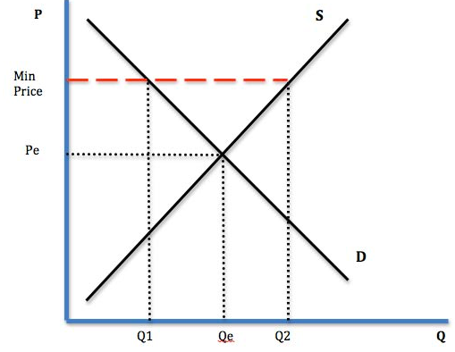
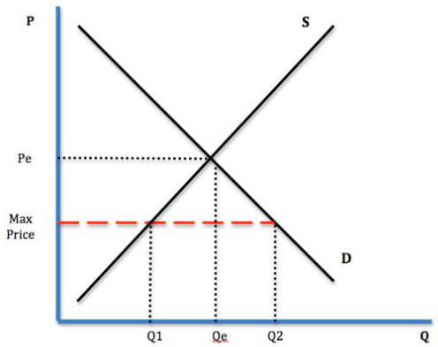
Agricultural and Housing Markets
RWS5 The Role of Government (MICROECONOMICS) Key Terms: Market Failure, Government Intervention, Government Failure
Possible Market Failures?
Inequality and poverty - the homeless in London?
Inequality and poverty - a lack of food production by farmers
How do you solve it as a Government?
Price Controls
Maximum Prices – prices cannot exceed a certain level
Minimum Prices – prices cannot fall below a certain level
Price controls are designed to distort the price equilibrium and forcibly control the price by regulating a ‘MAXIMUM’ or ‘MINIMUM’ price in the market if the Government feel the price equilibrium is ‘WRONG’.
BRAINSTORM EXERCISE on whiteboards:
Draw a diagram to show the Government implementing a ‘minimum price’ in a market where they consider the price equilibrium to be too low.
Draw a diagram to show the Government implementing a ‘maximum price’ in a market where they consider the price equilibrium to be too high.
Compare ‘price controls’ and ‘taxation and subsidies’ (in other words why are they different and similar Government Interventions?)
Max or min

Slide 17
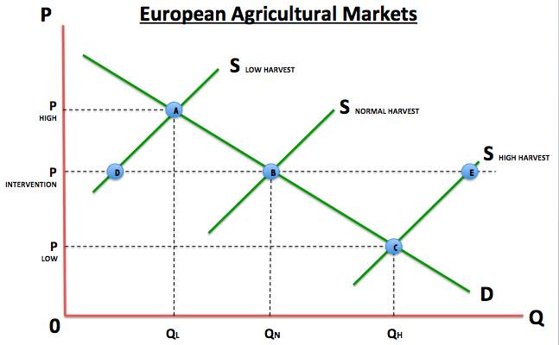
EXTENSION Agricultural Markets and Buffer Stocks
RWS5 The Role of Government (MICROECONOMICS) Key Terms: Market Failure, Government Intervention, Government Failure
Possible Market Failures?
Inequality and poverty - a lack of food production by farmers equals loss of livelihood and lack of food
How do you solve it as a Government?
Buffer Stocks (a combination of maximum and minimum prices by setting an ‘intervention price’)
QVH

Slide 18
Thursday 8th January Cover Work 1 to 1.25 hours worth
MICROECONOMICS (30 Minutes)
RECAPPING the content from the first week by completing the worksheet ‘Government Intervention Analysis’ on
Taxation
Subsidies
Minimum Prices
Maximum Prices
MACROECONOMICS (30-45 Minutes)
Complete the ‘AD Activity Worksheet’

Slide 19
WEEK 2

Slide 20
HWK

Slide 21
RWS 5 HWK (4.5 to 6 hrs) Due for Monday 21st January 2018
RWS5 The Role of Government (MICROECONOMICS) Key Terms: Market Failure, Government Intervention, Government Failure
MICROECONOMICS (2.25 to 3 hrs)
The Role of Government
MACROECONOMICS (2.25 to 3 Hrs)
Aggregate Demand and Aggregate Supply
All resources, instructions and powerpoint on GOL!

Slide 22
30

Slide 23
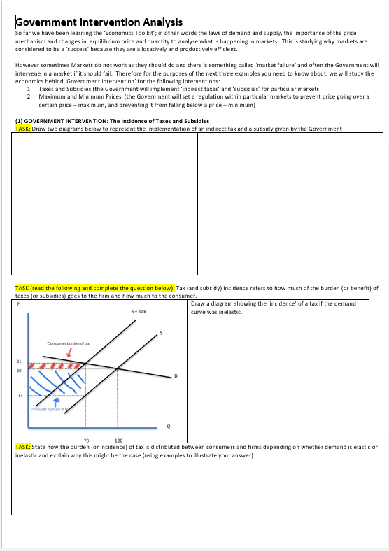
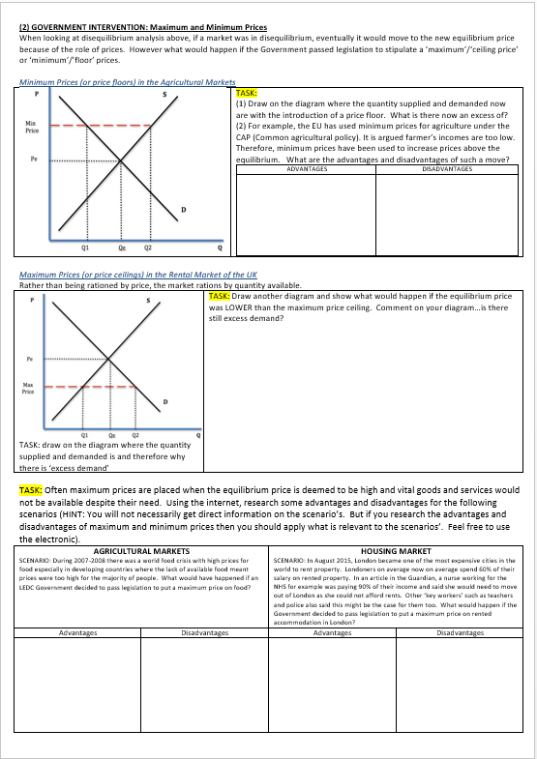
Cover Work Assessment - Thursday “Government Intervention Analysis” Worksheet
RWS5 The Role of Government (MICROECONOMICS) Key Terms: Market Failure, Government Intervention, Government Failure
EXERCISE
Swap with the person next to you and get out your red pen.
We will go through and mark this together

Slide 24
WRITING EXERCISE Why are Price Controls effective Government Intervention?
RWS5 The Role of Government (MICROECONOMICS) Key Terms: Market Failure, Government Intervention, Government Failure
Explain using examples why maximum and minimum prices are effective forms of Government Intervention in a market (9 marks)
Write an answer to this individually in the first 10 minutes using the paper
Go through a moderation exercise using the visualiser
Swap with the person next to you for marking

Slide 25
MODERATION EXAMPLE Why are Price Controls effective Government Intervention?
RWS5 The Role of Government (MICROECONOMICS) Key Terms: Market Failure, Government Intervention, Government Failure
Explain using examples why maximum and minimum prices are effective forms of Government Intervention in a market (9 marks)
Price controls (maximum and minimum prices) are examples of how the Government can intervene in a market to enforce a price ceiling and floor in a market to correct a possible market failure.
Minimum prices are price floors by which prices are forbidden from falling below. The Common Agricultural Policy from the EU had such a policy with their ‘guaranteed intervention price’ after World War 2 to ensure that farmers received a regular income and ensured there was plenty of food for everyone to eat. In figure 1, the equilibrium price (Pe) is the current market price which is deemed too low by the Government; perhaps farmers are falling into poverty and to ensure a domestic food production, the Government intervene by implementing a minimum price at ‘Min Price’. This is effective as it solves the market failure by providing higher revenues to farmers per unit sold (especially if the Government buy up the surplus Q1 to Q2).
Maximum prices are price ceilings by which prices are forbidden from rising above a certain level. An example might be with rental properties in London with rent being very high especially for key professions such as nurses and teachers. This leads to a level of inequality (and possibly poverty) where these key workers struggle to find accommodation or face lengthy commutes. The maximum rent forces landlords to lower their prices below the market equilibrium and is therefore effective at solving the market failure as it leads to these workers being able to afford accommodation.
Figure 1: Agricultural Markets

Slide 26
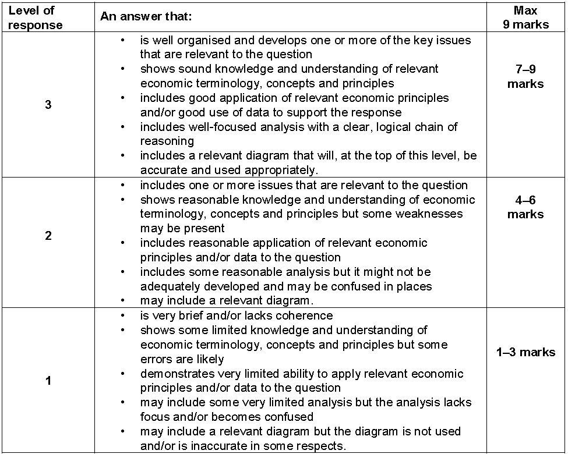
To get to level 3…
2 Points?
Analysis (graphs, key terms)
Examples (rental market, food market)

Slide 27
Explain using examples why maximum and minimum prices are effective forms of Government Intervention in a market (9 marks)
Price controls (maximum and minimum prices) are examples of how the Government can intervene in a market to enforce a price ceiling and floor in a market to correct a possible market failure.
Minimum prices are price floors by which prices are forbidden from falling below. The Common Agricultural Policy from the EU had such a policy with their ‘guaranteed intervention price’ after World War 2 to ensure that farmers received a regular income and ensured there was plenty of food for everyone to eat. In figure 1, the equilibrium price (Pe) is the current market price which is deemed too low by the Government; perhaps farmers are falling into poverty and to ensure a domestic food production, the Government intervene by implementing a minimum price at ‘Min Price’. This is effective as it solves the market failure by providing higher revenues to farmers per unit sold (especially if the Government buy up the surplus Q1 to Q2).
Maximum prices are price ceilings by which prices are forbidden from rising above a certain level. An example might be with rental properties in London with rent being very high especially for key professions such as nurses and teachers. This leads to a level of inequality (and possibly poverty) where these key workers struggle to find accommodation or face lengthy commutes. The maximum rent forces landlords to lower their prices below the market equilibrium and is therefore effective at solving the market failure as it leads to these workers being able to afford accommodation.
Figure 1: Agricultural Markets

Slide 28
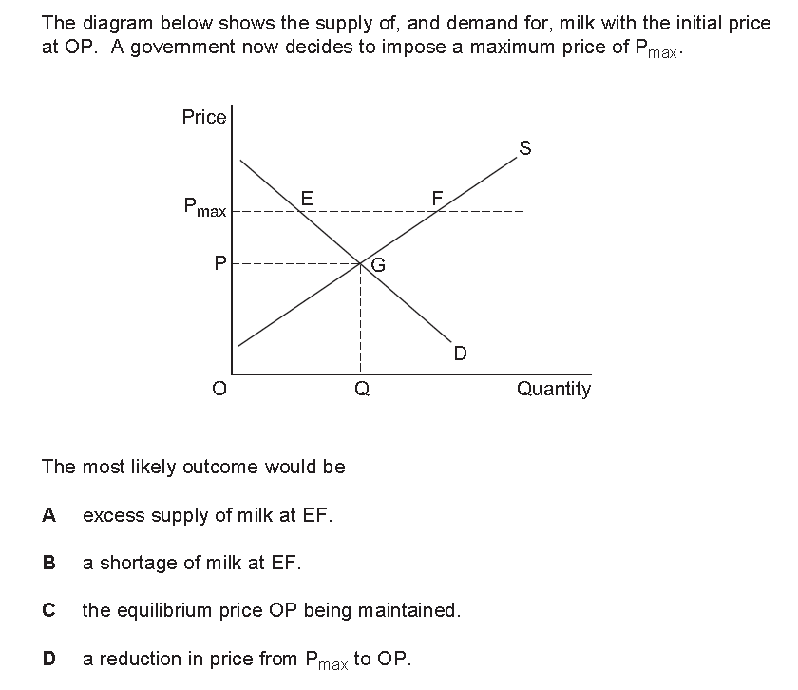

Slide 30
90

Slide 31
Other Forms of Government Intervention (and Failure) Get out your PREP mind map
RWS5 The Role of Government (MICROECONOMICS) Key Terms: Market Failure, Government Intervention, Government Failure
Direct Controls
Legislation/Regulation
Government Provision
Price Controls
Price Equilibrium (Mechanism) Changes
Taxation (Indirect)
Subsidies
Persuasion
Education
Nudge Theory
EXERCISE:
Compare your answers within your groups, adding additions with a red pen.
Four people to present each of their answers to the class with directed questioning for the rest of you!

Slide 32
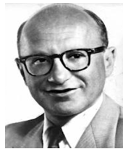
The Morality of Government? Milton Freidman and Drugs: Should Government’s Intervene?
TASK 1 (first 5 minutes): In groups:
Compare your answers on the ‘drugs worksheet’ and make sure you have answered the boxes correctly
TASK 2 (5 minutes): Class discussion
Clarification of the boxes on the worksheet
TASK 3 (10 minutes): In groups, complete the following-
Compare your arguments for and against the legalisation of drugs
Reach a conclusion about whether drugs should be legalised or not.
What role should the Government have in markets in your view?
YOU MAY BE CALLED UPON TO ANSWER ANY DIRECTED QUESTIONS FROM ME OR SHARE YOUR GROUPS CONCLUSION SO MAKE SURE YOU KNOW WHAT THE ARGUMENTS ARE

Slide 33
ARCHIVE

Slide 34
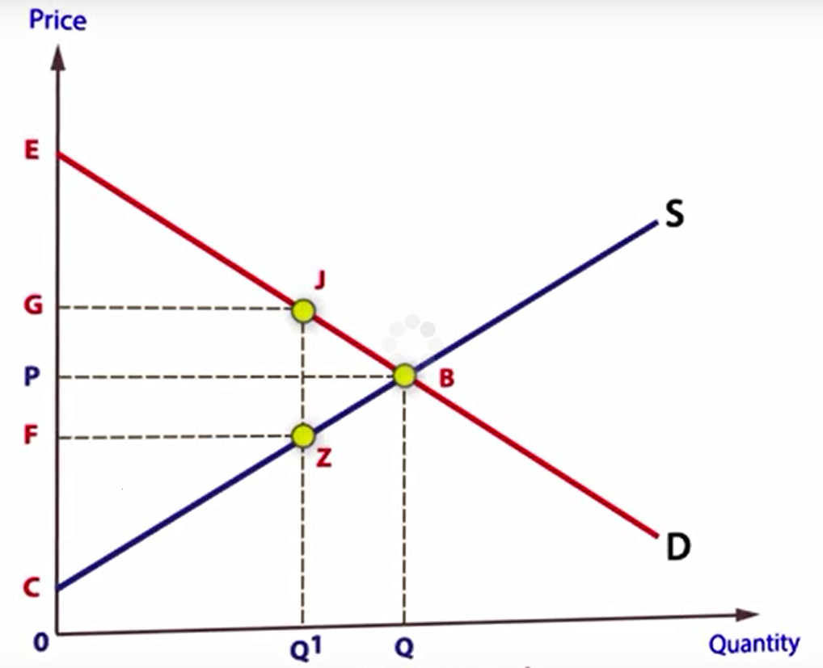
Final Thought: Distortions and interferences to the Market The concept of ‘deadweight loss’ (loss of consumer and producer surplus)
How could the price move to G (but the equilibrium stayed at B)?
If a Government imposed a regulation to keep price at G, what would be the welfare loss to society?
If a monopoly (i.e. a market with no competition) raised it’s price to exploit the market, the same thing could happen.
Why might the higher price lead to a loss of welfare?
What must happen in the market to maximise welfare to eradicate this ‘deadweight loss’?
N.B. this is different to a situation where the equilibrium changes to push up the price (from say a supply fall – S shifts to the right). If that were to happen, then welfare would be maximised at the new price (even though consumer surplus reduces) as this is market ‘adjustment’ NOT ‘distortion.
Deadweight loss?
Notes:
Subsidy also leads to deadweight loss: https://www.youtube.com/watch?v=4tYVsnSsoBo

Slide 35
QUESTION 3

