Slide 1
WEEK 1

Slide 2
90

Slide 3
45

Slide 4

RWS6 (MICRO): Market Failure #1 – Monopoly Power
Concepts of ‘Total’, Average and Marginal looking at Costs, Revenue and Profit for a Firm
STARTER: 10 Minutes in PAIRS
Get Homework (RWS5’s) out for collection
Complete the first two tasks fully on the Worksheet.
If time, have a go at the extension task (A*-B students should be attempting this)
Pedro’s PaperBox Ltd.

Slide 5
MICROECONOMICS OVERVIEW
THE BASIC ECONOMIC PROBLEM
Scarcity (resources), unlimited wants forces a choice (PPF MODELS) which involves an opportunity cost. There is not enough for everyone so how best to distribute our scarce resources to meet everyones wants.
Theory of the Firm
Basics of the firm:
Types of firm (Sole Trader, Ltd and PLC)
Objectives of firm (short term and long term profit, sales maximization, ethical, behavioural and managerial)
Market structure and concentration ratio’s
Production theory –
  Revenue, costs (fixed and variable) and profit (abnormal and normal): marginal, average and total - curves and calculations – difference between SR and LR (diminishing marginal returns .v. economies of scale)
  Specialisation, division of labour and economies of scale
  Technological change – innovation and invention and contribution to competition
Competition Models:
  Perfect competition
  Competitive Oligopoly (kinked demand curve for non-price competition, price wars, price stability, predatory and limit pricing)
  Contestable markets
  Monopolistic Competition
Benefits of Monopoly
Natural monopoly and Economies of Scale
Dynamic efficiency from abnormal profits
Concepts of ‘Creative Destruction’ (i.e. monopolies will not last forever)
Efficiency
  static (productive and allocative)
  dynamic
Labour Markets
Redistribute income and wealth
  Taxation (direct - income, corporation, inheritance, National Insurance and indirect - VAT and excise duties).
  Benefits (JSA, WTC, Pensions, Universal Credit debate, in kind)
Government Legislation
  Trade Union power change
  Minimum Wage (and the Living Wage)
  Maximum wage cap?
  Prevent Discrimination (Equality Act 2010)
Government Job Scheme: Macroeconomic policy and job creation through demand and supply side policies
Poverty Targeting: 1997 New Labour target and the Child Poverty Act 2010
SOCIALISM
CAPITALISM
Welfare Economics
Price Mechanism
  Indirect taxation
  Subsidies
  Tradable pollution permits
Direct Controls
  Legislation and regulation (incl. pollution permits)
  Price controls - max and min prices and buffer stocks
  Government provision
  Identifying property rights through patents and legislation
Persuasion
  Govt. Guidance
  Nudge Theory
  Choice architecture: default, restricted and mandated
Welfare Economics
Demand & Supply Curves
  Factors affecting demand curve (P IT OF POG). Also utility for consumers, rationality and diminishing marginal utility
  Factors affecting supply curve (P COP OF POG)
  Inter-relationships between markets: joint demand, competitive demand, composite demand, derived demand and joint supply
  Elasticity - calculating PED, PES, XED and YED plus drawing graphs for PED and PESI
Equilibrium
  The role of prices (signals, incentives, ration)
  Equilibrium .v. Disequilibrium
  Efficiency and Welfare (consumer and producer surplus)
Coase’s Theorem
GOVERNMENT INTERVENTION
MARKET SUCCESS
Theory of the Firm (Industrial Policy)
Competition Policy
  Regulation
      Bodies: CMA plus specific industry watchdogs (OFGEM, OFWAT, ORR) and European Commission
      Types: Price capping (RPI-X, fines/ prosecution, legislation, break up, windfall taxes etc.)
  Deregulation - removing barriers via legislation and subsidies
Nationalisation and Privatisation
Labour Markets
Wage determination
MRP theory and Labour Demand
Labour Supply
Elasticity of Ld and Ls
Perfectly competitive labour markets
Flexible Labour Markets and Impact of Globalisation
‘Trickle Down Effect’ and other reasons why inequality is ‘good’!
Welfare Economics
Externalities (positive & negative) including diagrams (4 in total)
  Consumption (split in MSB - merit and demerit goods) - under and over consumption
  Production Externalities (split in MSC) - under and over production
Public Goods (missing markets)
  Pure (no production) and ‘free rider’ issue
  Quasi (under production)
Absence of property rights
Behavioural Economics
  Imperfect information (asymmetric info)
  Bounded rationality
  Biases in decision making
  Paradox of altruism and fairness
Theory of the Firm
Regulatory capture
Crowding Out through Nationalisation
Cost to Government (including opportunity cost)
Moral hazard
Welfare Economics
Unintended effects: Shortages/surpluses
Political conflicts: Public choice theory and corruption
Admin Errors/Costs: Bureaucractic costs
Imperfect info: unable to put a value on externalities
Theory of the Firm
Monopoly:
Natural, Monopoly Power and Monopoly.
Price discrimination (1st, 2nd and 3rd degree
Inefficiency – static (x-inefficiency and underproduction)
Loss of consumer surplus (and gain of producer surplus)
Collusive Oligopoly Tacit (price leadership) and overt collusion (cartels)
GOVERNMENT FAILURE
MARKET FAILURE
Labour Markets
Moral Hazard (or Dependency)
Disincentive effects (unemployment trap & poverty trap? PLUS ‘brain drain’ and less risk taking?)
Burden of taxation (progressive .v. regressive)
Cost to Government (incl. opportunity cost)
Labour Markets
Absolute and Relative Poverty: Low wages and unemployment
Inequality and equity issues: GINI coefficient and history since 1979
Discrimination (gender, ethnicity etc.)
Imperfect competition in the market: e.g. trade union (or monopoly power), monoposony (buyers) power and bi-lateral monopoly
Labour immobility: Occupational and geographical

Slide 6
ECONOMIC AGENTS IN THE ECONOMY
The main players in the economy through the Circular Flow of Income (Income = Output = Expenditure)
MACROECONOMICS OVERVIEW
MACROECONOMIC INDICATORS (Objectives in Brackets)
Judging the performance of an economy
ECONOMIC THEORY
2 main theories showing policy conflicts
Supply Side Policies
Free Market (neo-liberalism?): Privatisation, deregulation, tax cuts, labour market reforms (TU’s etc.)
Interventionist (socialism?): education and health spending, infrastructure, research and development
ECONOMIC GROWTH and DEVELOPMENT (Sustainable)
Similarities and differences between growth, development and standards of living
Economic cycles and demand/supply causes of growth (also short run and long run).
Measurement through GDP (and index numbers) plus HDI as alternative for standards of living. PPP considerations.
Costs and benefits of economic growth; impact on individuals, the economy and environment
Opportunities and barriers to growth for developing countries. The role of trade .v. aid.
GOVERNMENT
Fiscal position – deficits and surplus (structural and current deficit) and national debt (as % of GDP)
Short Run Aggregate Supply (SRAS)
(short run changes in costs of production – e.g. higher import prices etc.)
Long Run Aggregate Supply (LRAS)
(quality and quantity of
labour and capital)
Demand Side Policies
Monetary (interest rates and the transmission mechanism PLUS QE forms (original, funding for lending & forward guidance) and exchange rate manipulation
Fiscal: Taxation (why, types – direct, indirect, proportional, regressive, progressive, principles, roles, merits), Spending (types, areas) and Budgets (structural, cyclical deficits and surpluses)
Aggregate Supply AS
The total amount of resources in the economy - Classical Curve (SRAS and LRAS) and Keynesian Curve (AS)
MACROECONOMIC EQUILIBRIUM
(Policy Conflict of Inflation and Growth)
UNEMPLOYMENT (Minimising)
Measuring unemployment – LFS and claimant count
Natural rate of unemployment (voluntary unemployment - structural and frictional)
DISEQUILBRIUM: Cyclical unemployment and involuntary unemployment (negative output gaps) – Keynesian view. Real wage unemployment – classical view.
Consequences of unemployment
HOUSEHOLDS and FIRMS
Confidence (‘animal spirits’)
Debt issues
Multiplier Effect (and the Marginal Propensity to Consumer)
Aggregate Demand AD
The total amount of demand for resources in the economy
PRICE LEVELS (Stable)
Inflation and hyperinflation (Positive Output Gaps)
Deflation and deflationary spirals
Measurement - CPI and RPI (also index numbers)
Causes of inflation – expectations theory, keynesian theory (cost push/demand pull), quantity theory of money (monetarist) theory.
FINANCIAL MARKETS
Role of money, definitions of money (broad and narrow) and ‘credit money’ (how banks create private money)
Role of financial markets in wider economy: Money Markets – short term loans, treasury bills (less than a year), Capital Markets – Bonds and Equity, FOREX Markets – determination of exchange rates (using supply and demand). How do
Government bonds - Bond prices and yields are inverted. Coupon and maturity rates.
The role of commercial and investment banks – wider economy, balance sheets (assets and liabilities), objectives of banks (conflicts between liquidity, profitability and security).
Market failure – moral hazard, systemic risk (externalities) and imperfect information
The role of central banks, the MPC and financial regulation (PRA, FPC and FCA). Liquidity and capital ratios.
Consumption (C)
Spending by households in the economy. The opposite of Saving (Saving is not investment!).
Investment (I)
Spending by firms in the economy on capital items.
Govt Spending (G)
Spending by the Government in the economy
Trade Balance (X-M)
Exports (foreigners buying our products) and Imports (buying foreigners
Accelerator Effect (greater output leads to domestic firms ‘accelerating’ investment)
OTHER INDICATORS TO CONSIDER
FISCAL POSITION: Austerity economics, Effects of budget deficit (structural and cyclical) and surplus etc. National debt and the role of the OBR.
INEQUALITY: Gini co-efficient derived from lorenz curve suggesting diffrence in income and wealth.
LABOUR PRODUCTIVITY: Affected by technology, wage levels, morale of workforce
EXCHANGE RATE STABILITY: How volatile is the currency? May depend on political stability as well as exchange rates etc.
GLOBAL ECONOMY
Globalisation – causes, characteristics, and consequences
Free Trade (absolute and comparative advantage theory and global specialisation, exploiting economies of scale and competition, forced specialisation, dutch disease, export orientated industrialisation). Role of WTO
Role of protectionism (tariff escalation, tariff diagram, import substitution industrialisation, types of – tariffs, quotas and embargos). EU Customs Union and Single Market.
Role of MNC’s on host and foreign countries macro indicators
Global Economic Growth and impact on macroeconomic indicators
Role of exchange rates – determinants (demand and supply), PPP v market, fixed or floating?
Short Run Phillips Curve (SRPC)
Short run trade off between unemployment and inflation. Unemployment reduced by demand side polices means higher unemployment.
PHILLIPS CURVE ANALYSIS
(Policy Conflict of Inflation and Unemployment)
Long Run Phillips Curve (LRPC)
No trade off between unemployment and inflation. Reducing unemployment using demand side policies leads to inflation (wage spiral)
BALANCE OF PAYMENTS (Balanced)
Current account (Exports, Imports, Investment Income and Transfers)
Financial and Capital Account (FDI, Hot Money Flows, Portfolio Investment)
Deficits and surplus on the balance of payments (current account). Balance of payments crisis (excessive current account deficit leading to a sharp depreciation in the exchange rate)
Expenditure switching and reduction policies
Currency zones (Eurozone etc) – Advantages and Disadvantages

Slide 7
RWS 6: Next Two Weeks
Leading up to Benchmark 3 (20 MC’s and a 25 Mark Essay)
MICRO: Market Failure 1 - Monopoly
Theory of the Firm Basics
Why is Monopoly considered a market failure?
How can the Government intervene and will they succeed? (Regulation)
CASE STUDIES: ‘Grocery’ Market in the UK (Supermarkets)
MACRO: Macroeconomic Equilibrium
Equilibrium in the long run and short run using AD, SRAS and LRAS Curves
Economics of ‘Trade offs’: Modelling Economic Growth, Unemployment and Price Levels
Classical .v. Keynesian School of Economics
Government Policy Conflicts Introduction
PREP HOMEWORK (due for Monday 27th January 2020)
MICRO (2.25 to 3 Hours): Check GOL
MACRO (2.25 to 3 Hours): Check GOL

Slide 8
PREP HOMEWORK
Due for Monday 27th January 2020
MICRO (2-3 hours)
45: Finish off class booklet on Theory of the Firm, Profit Maximisation and Market Structure Introduction
90: Research about one of the monopoly case studies
  Watch videos
  Internet research
  Complete A4 Mind Map of Notes
MACRO (2-3 hours)
45: Complete the AD/AS Mechanics Worksheet
90: Complete the Worksheet on Classical and Keynesian schools of Economics
  Internet research on the 1929 Great Depression and the 2008 Financial Crisis
  Read about the two schools and their conflicts

Slide 9
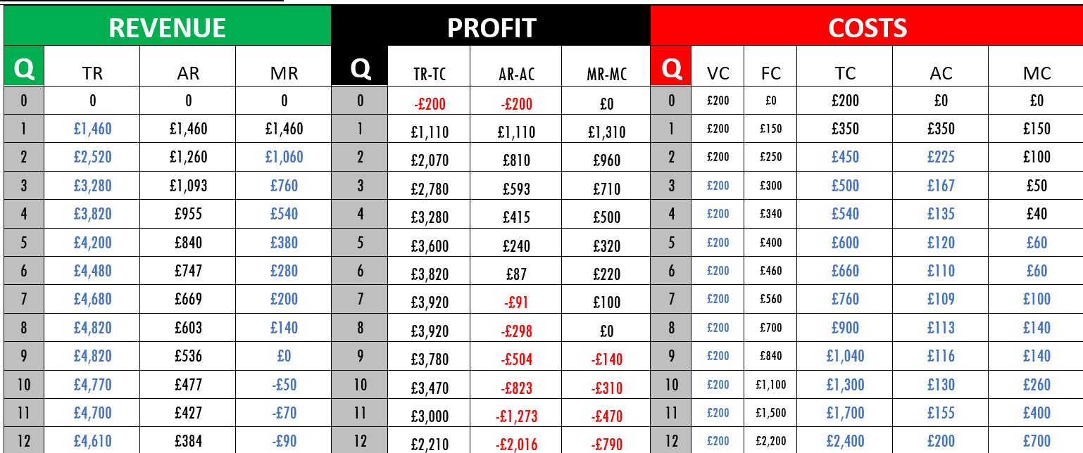
Profit/Loss Accounts for ‘Pedro’s PaperBox Ltd’
RWS6 (MICRO): Market Failure #1 – Monopoly Power
Concepts of ‘Total’, Average and Marginal looking at Costs, Revenue and Profit for a Firm

Slide 10
45

Slide 11
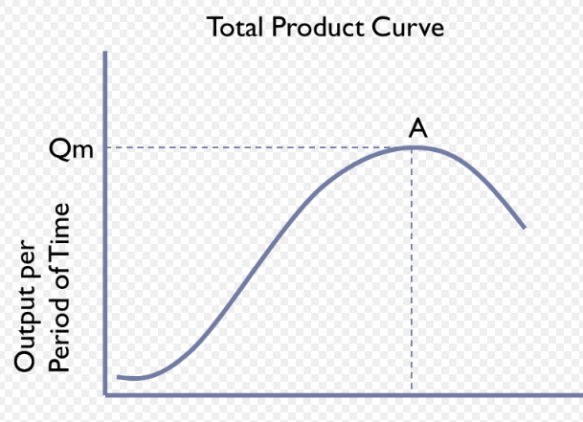
RWS6 (MICRO): Market Failure #1 – Monopoly Power
Profit: Costs and Revenue Curves in the Short Run and Long Run
Short Run .v. Long Run Production:
  Production Process – Fixed and Variable Inputs: Pedro’s Paperbox Ltd. Demonstration
Short Run Average Cost
  Specialisation and The Law of Diminishing Returns)
Revenue and Profit
  Average Revenue, Price and Demand Curve
  Normal and Abnormal Profit
Long Run Average Cost (‘Economies of Scale’)
  Watch the video and then in pairs describe what this term means
  Worksheet – talk through…
  What are external economies of scale?
SHORT RUN PRODUCTION
Labour is Variable but Capital is Fixed
1
2
3
4
5
6
1
8
Labour Input to Fixed Capital
Notes:
Lecture and Note Taking
Worksheet 1: Comparing my notes with yours? What did you miss?
Worksheet 2: Multiple Choice Question Check
Worksheet 3: Economies of Scale Worksheet
Worksheet 4: Competition and Types of Markets

Slide 12
45

Slide 13
RWS6 (MICRO): Market Failure #1 – Monopoly Power
Profit: Costs and Revenue Curves in the Short Run and Long Run
Short Run .v. Long Run Production:
  Production Process – Fixed and Variable Inputs: Pedro’s Paperbox Ltd. Demonstration
Short Run Average Cost
  Specialisation and The Law of Diminishing Returns)
Revenue and Profit
  Average Revenue, Price and Demand Curve
  Normal and Abnormal Profit
Long Run Average Cost (‘Economies of Scale’)
  Watch the video and then in pairs describe what this term means
  Worksheet – talk through…
  What are external economies of scale?
SHORT RUN PRODUCTION
Labour is Variable but Capital is Fixed
1
2
3
4
5
6
1
8
Labour Input to Fixed Capital
Notes:
Lecture and Note Taking
Worksheet 1: Comparing my notes with yours? What did you miss?
Worksheet 2: Multiple Choice Question Check
Worksheet 3: Economies of Scale Worksheet
Worksheet 4: Competition and Types of Markets

Slide 14
STARTER QUESTION: Where is the firm below making profit?
ABNORMAL PROFIT for R+D etc.
GREATER ECONOMIES OF SCALE…..Lower prices in the long run?
Price/Cost
Price/Cost
Firm’s Average Revenue and Cost Curve in a Market for a Good/Service
Market for a Good/Service
P=ARM
B
SRAC
LRAC
ACM
PPC
B
P=AR=ACPC
A
PM
A
D=AR
QM
QPC
Quantity
QPC
QM
Quantity

Slide 15
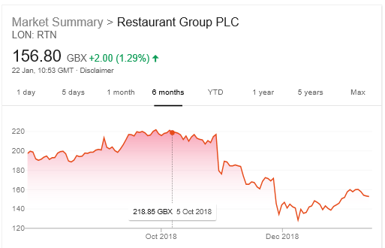
Economies of Scale TEST
TASK 1: “October 2018: ‘The Restaurant Group’, the owners of the Frankie and Benny and Garfunkels restaurant chains has bought ‘Wagamamas’.”
Why might ‘The Restaurant Group’ benefit from internal economies of scale on this takeover deal?
Demonstrate on an LRAC curve for ‘The Restaurant Group’ what would happen if we assume they would benefit from internal ‘economies of scale’?
Why might ‘The Restaurant Group’s takeover, arguably lead to ‘diseconomies of scale’?
Demonstrate on a separate LRAC curve, how this would look
TASK 2: Figure 1 shows the share price for the last 6 months of ‘The Restaurant Group’ on the London Stock Exchange….
What might the graph imply as to whether ‘The Restaurant Group’ have benefitted from Economies of Scale or not?
Evaluate your point

Slide 16
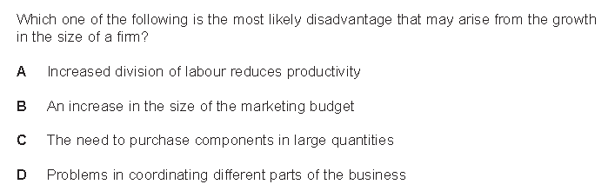

Slide 17
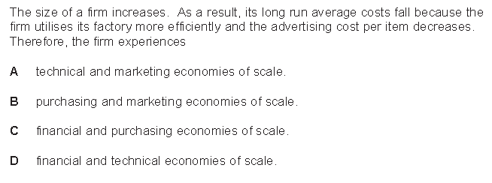

Slide 18
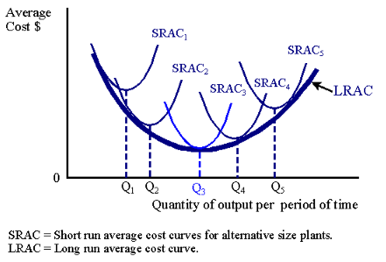
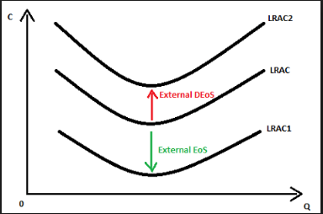
Short Run Cost Relationships
Specialisation and Diminishing Returns
Long Run Cost Relationships
Economies and Diseconomies of Scale
SRAC
Average Cost (Short Run)
Total Output (Quantity) in Short Run
INTERNAL ECONOMIES AND DISECONOMIES OF SCALE
Total Product
0
1
2
3
4
5
6
7
0
Labour
Labour (# of workers) | 0 | 1 | 2 | 3 | 4 | 5 | 6 | 7 | 8
Total Product (Quantity) | 0 | 5 | 11 | 20 | 40 | 60 | 50 | 20 | 5
Total Cost (£) | £0 | £100 | £200 | £300 | £400 | £500 | £600 | £700 | £800
SRAC Average Cost (£) | £0 | £20 | £18 | £15 | £10 | £8 | £12 | £35 | £160
EXTERNAL ECONOMIES AND DISECONOMIES OF SCALE

Slide 19
WEEK 2

Slide 20
90

Slide 21
RWS 6: Market Failure#1 – Monopoly
Introduction to Market Structure
STARTER ACTIVITY:
In a market, what does ‘competition’ mean?
Why is it good for society?
Why might it be bad for society?
If you were to design a perfectly competitive market, what features or conditions would there need to be to achieve this?
Notes:
15: Multiple Choice 10 Question Test on Theory of the Firm
30: Market Structure and Concentration Ratios RECAP, Perfect Competition and Pure Monopoly
30: Monopoly Theory
15: Case Study of Supermarkets

Slide 22
What’s the point of perfect competition and pure monopoly as concepts?
more competitive
less competitive
PERFECT
CONTESTABLE
MONOPOLISTIC
OLIGOPOLY & DUOPOLY
PURE MONOPOLY
COMPETITION
MARKETS
COMPETITION
Less concentration
More concentration
MANY sellers
ONE seller

Slide 23
What’s the point of perfect competition and pure monopoly as concepts?
Less Concentration
More Concentration
PERFECT
CONTESTABLE
MONOPOLISTIC
OLIGOPOLY & DUOPOLY
PURE MONOPOLY
COMPETITION
MARKETS
COMPETITION
More competition
Less competition
MANY sellers
ONE seller

Slide 24
15

Slide 25
What’s the point of perfect competition and pure monopoly as concepts?
Less Concentration
More Concentration
PERFECT
CONTESTABLE
MONOPOLISTIC
OLIGOPOLY & DUOPOLY
PURE MONOPOLY
COMPETITION
MARKETS
COMPETITION
More competition
Less competition
MANY sellers
ONE seller

Slide 26
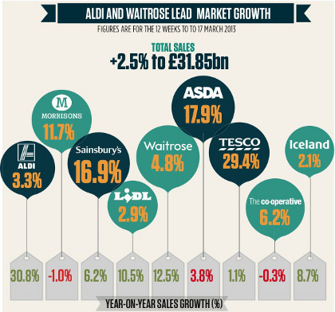
Concentration Ratios…

Slide 27
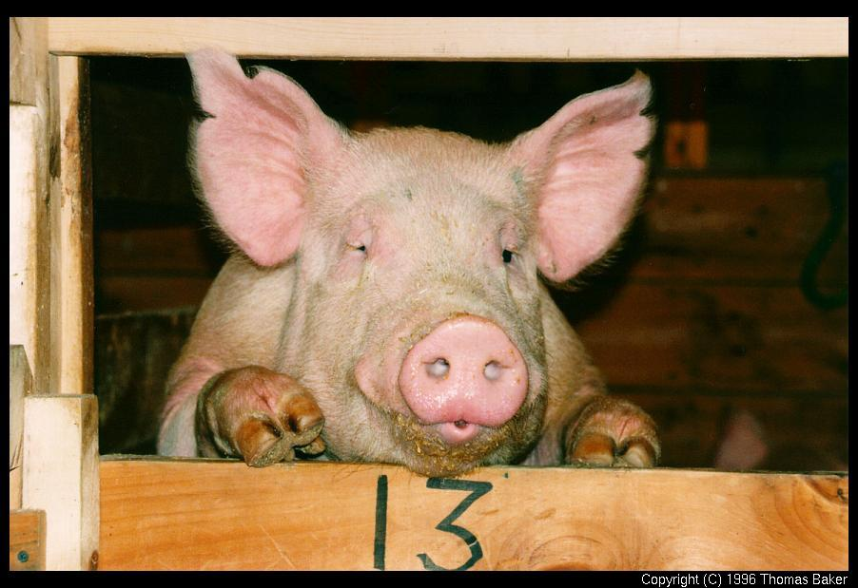
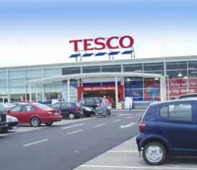

Market Structure EXTREMES
Perfect Competition .v. Pure Monopoly: Does it really matter?
PERFECT COMPETITION
Lots of firms each with very small concentration ratio
No market influence – has to accept market price (price taker)
No barriers to entry and exit – anyone firm can enter the market or leave at very short notice
Price is as low as possible = allocatively and productively efficient and no deadweight loss (welfare maximisation)
PURE MONOPOLY
One firm with 100% concentration ratio
Significant market power; can determine the price (price maker)
High barriers to entry (and exit)
Price can be placed higher = allocative inefficiency (underproduction) and productive inefficiency (higher SRAC). Deadweight loss.

Slide 28
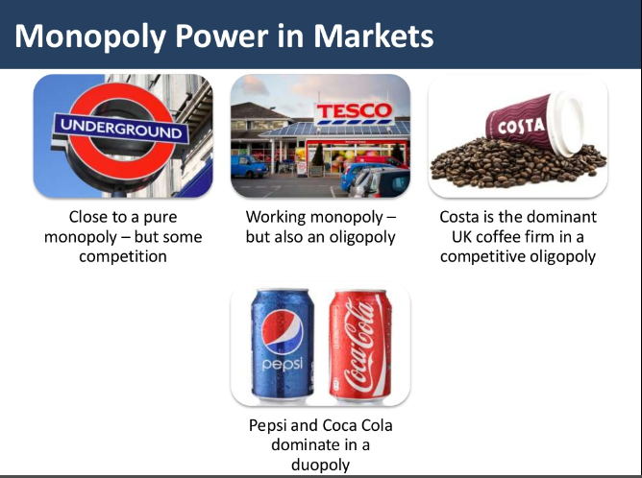

Slide 29
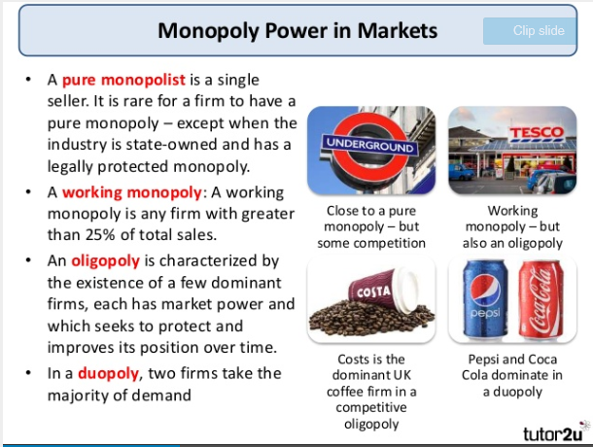
Slide 3
legal
Legal

Slide 30

Notes:
App development
Cinemas
Supermarkets
Structural
Strategic
Legal

Slide 31
Cover Work: Tuesday 29th January 2019
The following needs to be with you in Thursday 31st January’s lesson and should take you no longer than 1.5 hours
Complete the ‘Theory of the Firm Basics’ Booklet. This should include:
  Market Structure: The Competition Spectrum and the exercises on concentration ratios
  Market Structure: Perfect Competition
  Market Structure: Monopoly
Complete the grid to the right using your PREP homework on the case study of Supermarkets ready for discussions in class on Thursday
“Market Failure” (why might the grocery market in the UK have failed? Talk about the power of supermarkets and how they have distorted the market.) | Government Intervention 1: Name one way that the Government has intervened so far to prevent market failure in the grocery market. Think about your research on the CMA regulator. Why has this arguably been successful at stopping the market failure. | Government Intervention 2: Name another way that the Government has intervened so far to prevent market failure in the grocery market. Think about your research on the CMA regulator. Why has this arguably been successful at stopping the market failure.
“Market Success” (why might the development of monopoly power through the free market, not be a bad thing?): Evaluate your argument above – why might the supermarket market not be a significant monopoly? Why might there actually be competition? Even if there is monopoly power in some areas, why might this not be a bad thing? | Government Failure 1: Why has the intervention you named above arguably NOT been successful in solving the market failure? Has it even made the situation worse? | Government Failure 2: Why has the intervention you named above arguably NOT been successful in solving the market failure? Has it even made the situation worse?

Slide 32
90

Slide 33
STARTER ACTIVITY: 5 Minutes in PAIRS
TODAY: RWS 6(Micro) – Monopoly as a Market Failure
Writing ‘rough note’ answers on your whiteboard and using your ‘Theory of the Firm Basics’ Booklet (and each other), answer the following questions:
What is the difference between a 3 and 5 firm concentration ratio?
What is the concentration ratio of the ‘big 4’ supermarkets in the UK?
Is Tesco’s a monopoly? Yes or No? (Pick one and justify)
What 4 assumptions must hold if markets are considered to be perfectly competitive
Why are firms in competitive markets ‘price takers’ and firms in monopoly markets ‘price makers’?

Slide 34
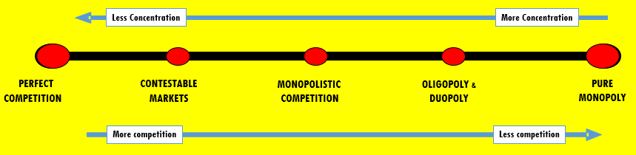



Theory of the Firm Basics: Market Structures Introduction
PERFECT COMPETITION
CONCENTRATION RATIO: Lots of firms each with very small concentration ratio
PRICE INFLUENCE: No market influence – has to accept market price (price taker)
BARRIERS: No barriers to entry and exit – anyone firm can enter the market or leave at very short notice
PRICES: Price is as low as possible = allocatively and productively efficient and no deadweight loss (welfare maximisation)
PED: Demand curve perfectly elastic
PURE MONOPOLY
CONCENTRATION RATIO: One firm with 100% concentration ratio
PRICE INFLUENCE: Significant market power; can determine the price (price maker)
BARRIERS: High barriers to entry (and exit)
PRICES: Price can be placed higher = allocative inefficiency (underproduction) and productive inefficiency (higher SRAC). Deadweight loss.
PED: Demand curve more inelastic (BUT NOT perfectly inelastic….why)

Slide 35
Theory of the Firm Basics: Costs Curve Overview
Short Run Cost Relationships
Specialisation and Diminishing Returns
Long Run Cost Relationships
Economies and Diseconomies of Scale
SRAC
Average Cost (Short Run)
INTERNAL ECONOMIES AND DISECONOMIES OF SCALE
Total Output (Quantity) in Short Run
Total Product
0
1
2
3
4
5
6
7
0
Labour
Labour (# of workers) | 0 | 1 | 2 | 3 | 4 | 5 | 6 | 7 | 8
Total Product (Quantity) | 0 | 5 | 11 | 20 | 40 | 60 | 50 | 20 | 5
Total Cost (£) | £0 | £100 | £200 | £300 | £400 | £500 | £600 | £700 | £800
SRAC Average Cost (£) | £0 | £20 | £18 | £15 | £10 | £8 | £12 | £35 | £160
EXTERNAL ECONOMIES AND DISECONOMIES OF SCALE

Slide 36
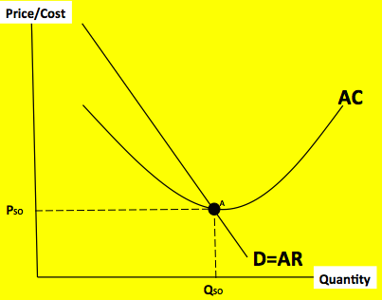
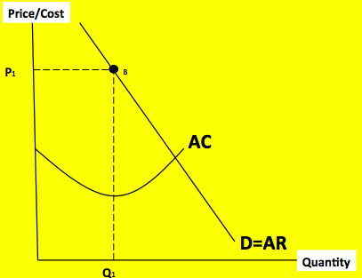
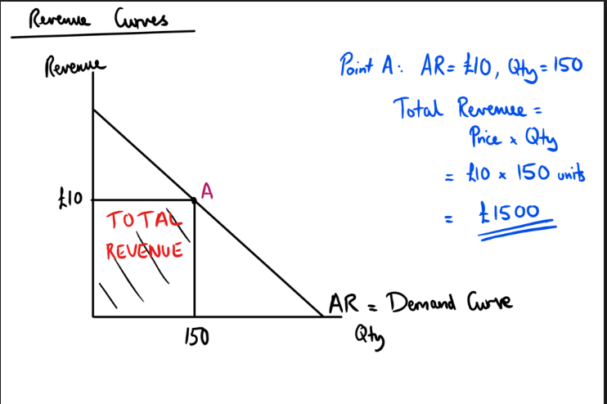
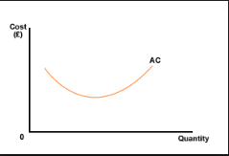
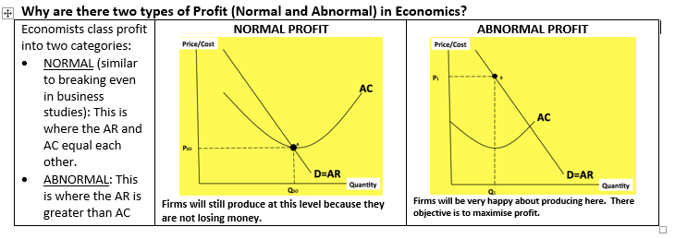
Theory of the Firm Basics: Costs, Revenues and Profits
The AR is just the demand curve because for a firm to sell more goods, it needs to lower it’s prices for all goods to encourage consumers to buy more. If the firm lowers it’s price then the revenue it gets per item (average revenue) will fall so the two curves are exactly the same.

Slide 37
Monopoly Power….
THEORY: Why are monopolies a market failure?
APPLICATION: What does “Monopoly” mean in the grocery market?
MONOPOLY AS A MARKET FAILURE
Why is a firm with a pure monopoly or significant monopoly power considered a market failure and therefore detrimental to society?
  Allocative Inefficiency
  Deadweight loss
  Productive Inefficiency
How can we evaluate this? In other words, why might monopolies be a good thing for society?
  Economies of Scale
  Innovation
How can the Government Intervene to reduce the problems of monopoly?
  Regulation
Why might the Government fail in reducing the power of monopolies?
POINT 1
POINT 2
POINT 3
“Market Failure” (why might the grocery market in the UK have failed? Talk about the power of supermarkets and how they have distorted the market.) | Government Intervention 1: Name one way that the Government has intervened so far to prevent market failure in the grocery market. Think about your research on the CMA regulator. Why has this arguably been successful at stopping the market failure. | Government Intervention 2: Name another way that the Government has intervened so far to prevent market failure in the grocery market. Think about your research on the CMA regulator. Why has this arguably been successful at stopping the market failure.
“Market Success” (why might the development of monopoly power through the free market, not be a bad thing?): Evaluate your argument above – why might the supermarket market not be a significant monopoly? Why might there actually be competition? Even if there is monopoly power in some areas, why might this not be a bad thing? | Government Failure 1: Why has the intervention you named above arguably NOT been successful in solving the market failure? Has it even made the situation worse? | Government Failure 2: Why has the intervention you named above arguably NOT been successful in solving the market failure? Has it even made the situation worse?
Argument to Support Point (As)
Argument to Evaluate Point (Ae)
Notes:
EDIT YOUR COVER WORK SHEET (by using the back etc.)

Slide 38
Monopoly Theory
THEORY: Why are monopolies a market failure?
APPLICATION: What does “Monopoly” mean in the grocery market?
MONOPOLY AS A MARKET FAILURE
Why is a firm with a pure monopoly or significant monopoly power considered a market failure and therefore detrimental to society?
  Allocative Inefficiency
  Deadweight loss
  Productive Inefficiency
How can we evaluate this? In other words, why might monopolies be a good thing for society?
  Economies of Scale
  Innovation
How can the Government Intervene to reduce the problems of monopoly?
  Regulation
Why might the Government fail in reducing the power of monopolies?
Allocatively inefficient – firms may have an incentive to artificially raise their prices. The consumer is no longer king (monopoly firms are price makers) and some consumers in society cannot consume the good = a lack of choice
Productive Inefficiency – firms or institutions who have no competition, may not have an incentive to cut costs and produce as efficiently as they could
Deadweight Loss – Due to underproduction, not all the consumers will be able to receive the good and there will be a loss of welfare. Welfare could be maximised by increasing production.

Slide 39
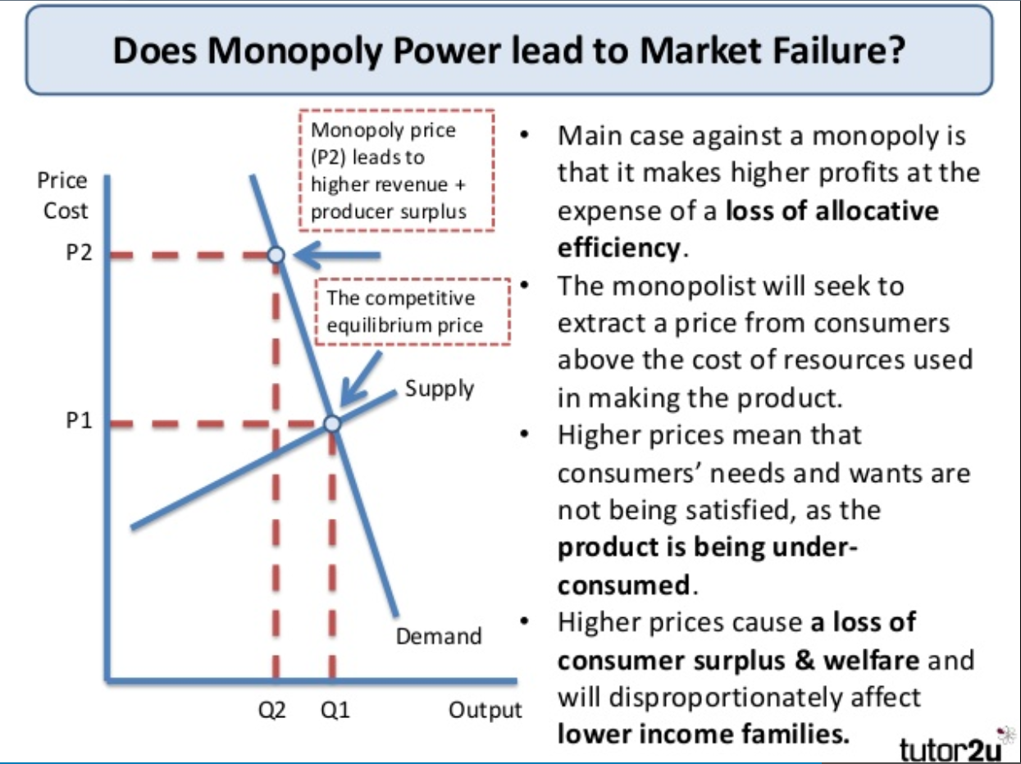
(1) Allocative Inefficiency….
Figure 1: The D+S facing a monopoly firm and the whole market

Slide 40
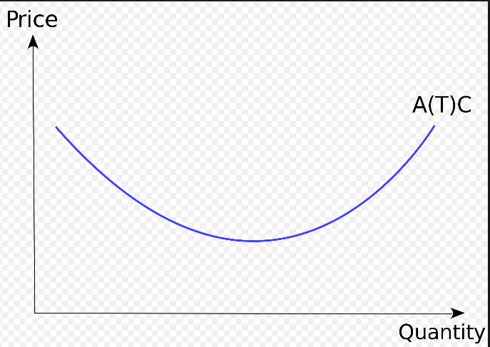
(2) Productive Inefficiency….
Figure 2: Average Cost for an Individual Firm
KEY QUESTIONS:
Where do you think on the graph the productively efficient point is for this firm?
Therefore, what will a monopoly do that will make it productively inefficient?
Can you explain WHY a pure monopoly might not be bothered about producing at the bottom of it’s AC curve?
AC

Slide 41
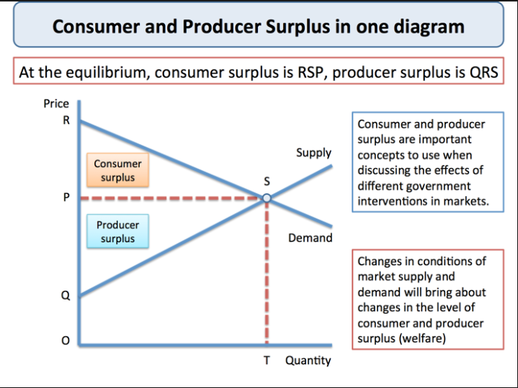
(3) Deadweight Loss
Welfare Economics and the Market RECAP
Consumer and Producer Surplus
Welfare Economics: The study of how an economy can best allocate resources to maximise the utility or economic welfare of its citizens.
Welfare analysis considers whether economic decisions by individuals, organisations, and the government increase or decrease economic welfare.
Consumer surplus: The difference between the market price which consumers pay and that which they are prepared to pay.
Producer surplus: The difference between the market price which firms receive and the price at which they would be prepared to supply.
Figure 3: D+S Diagram for a Market

Slide 42
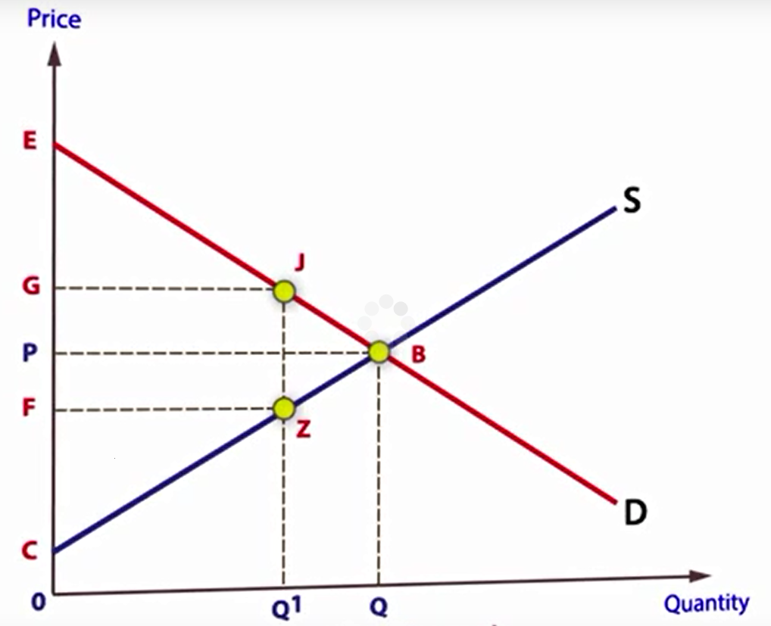
(3) Deadweight Loss Continued….
KEY QUESTIONS
How could the price move to G (but the equilibrium stayed at B)?
  If a Government imposed a regulation to keep price at G, what would be the welfare loss to society?
  If a monopoly (i.e. a market with no competition) raised it’s price to exploit the market, the same thing could happen.
Why might the higher price lead to a loss of welfare? Who loses and who gains?
Figure 4: D+S for a Whole Market
Deadweight loss?
Notes:
Subsidy also leads to deadweight loss: https://www.youtube.com/watch?v=4tYVsnSsoBo

Slide 43
Perfect Competition .v. Pure Monopoly
Price/Cost
QUESTIONS:
Where would a perfectly competitive market operate (and why)?
Using the diagram, explain why pure monopoly is considered to be a market failure?
Market for a Good/Service
PM
B
SRAC
PSO
A
D=AR
Quantity
QM
QSO

Slide 44
Price/Cost
REALISTIC EXAMPLE?
Example where there might not be perfect competition but just ‘competition’.
Monopoly equilibrium
PM
B
Competitive equilibrium
SRAC
PSO
A
ACM
ACSO
Productive Efficiency in competition = (bottom of the AC curve)
D=AR
QM
QSO
Quantity
Allocative Efficiency in competition
(the right amount produced by society)
Productive Inefficiency in a firm dominated by a monopoly = (NOT at the bottom of the AC curve)
Allocative Inefficiency in a firm dominated by a monopoly = (underproduction)

Slide 45
Price/Cost
E
Market for a Good/Service
AR=PM
B
SRAC
ACM
C
ARPC=ACPC=PPC
F
D
A
D=AR
Quantity
QM
QPC

Slide 46
Price/Cost
E
Figure 1: UK Grocery Market
AR=PM
B
SRAC
ACM
C
ARPC=ACPC=PPC
F
D
A
D=AR
Quantity
QM
QPC

Slide 47
Monopoly Theory
THEORY: Why might monopolies work or NOT be as bad as originally made out? (Market Success!)
APPLICATION: Why might “monopoly power” in the grocery market lead to market success?
MONOPOLY AS A MARKET FAILURE
Why is a firm with a pure monopoly or significant monopoly power considered a market failure and therefore detrimental to society?
  Allocative Inefficiency
  Deadweight loss
  Productive Inefficiency
How can we evaluate this? In other words, why might monopolies be a good thing for society?
  Economies of Scale
  Innovation
How can the Government Intervene to reduce the problems of monopoly?
  Regulation
Why might the Government fail in reducing the power of monopolies?
EVALUATION 1: Monopolies can have benefits
Research and Development
Profits can be used to fund innovation with important spillover benefits. This can lead to efficiency in the long run.
Economies of Scale
Monopoly producers may achieve economies of scale due to their greater size. This could lead to lower long run average costs.
EVALUATION 2: Monopolies are not as bad as people think
International Competition
A firm may enjoy domestic monopoly power but still face competition from overseas
Regulation (Government Intervention so not Market Success)
Often, Governments have regulatory bodies who monitor markets or directly intervene to prevent abuse of power.

Slide 48
Benefits of Monopoly
ABNORMAL PROFIT for R+D etc.
GREATER ECONOMIES OF SCALE…..Lower prices in the long run?
Price/Cost
Price/Cost
Market for a Good/Service
Market for a Good/Service
P=ARM
B
SRAC
LRAC
ACM
PPC
B
P=AR=ACPC
A
PM
A
D=AR
QM
QPC
Quantity
QPC
QM
Quantity

Slide 49
Benefits of Monopoly
ABNORMAL PROFIT for R+D etc.
GREATER ECONOMIES OF SCALE…..Lower prices in the long run?
Price/Cost
Market for a Good/Service
Price/Cost
Figure 2: Grocery Market in the UK
P=ARM
B
SRAC
LRAC
ACM
PPC
B
P=AR=ACPC
A
PM
A
D=AR
QM
QPC
Quantity
QPC
QM
Quantity

Slide 50
Monopoly Theory
THEORY: Regulation as a Government Intervention
MONOPOLY AS A MARKET FAILURE
Why is a firm with a pure monopoly or significant monopoly power considereda market failure and therefore detrimental to society?
  Allocative Inefficiency
  Deadweight loss
  Productive Inefficiency
How can we evaluate this? In other words, why might monopolies be a good thing for society?
  Economies of Scale
  Innovation
How can the Government Intervene to reduce the problems of monopoly?
  Regulation
Why might the Government fail in reducing the power of monopolies?
Types of Regulation
PRE-EMPTIVE (trying to prevent behaviour before it happens)
Legislation
Price controls (RPI-X) or Rate of return control
Quality control
Merger policy
REACTIVE (dealing with bad behaviour once it has happened)
Fines for abuse of monopoly power
Breaking up monopolies
General Advantages and Disadvantages of regulation
Advantage
Prevent poor behaviour (monopoly power?) as legally binding.
Regulation can lead to fast effects as the threat of punishment can be a deterrent.
Revenue from fines etc. can be used to redress the market failure
Disadvantage
Regulatory Capture – the people who run the regulator might be sympathetic to the industry it is trying to control. The regulators might have once been part of the industry and therefore are sympathetic
Hard to find evidence of wrong-doing due to imperfect information; can cause delays.
Creates ‘Red Tape’ – damages the competitiveness of business as they have to conform to legislation. Might push up their costs (and therefore prices?).
Regulatory tools are weak and therefore do not act as much of a deterrent
Cost of regulator to the Government

Slide 51
Monopoly Theory
Government Intervention (Regulation through the CMA) or Failure?
QUESTIONS:
To what extent do you think the regulator (CMA) to monitor supermarket is doing a good job?
HINT: Arguments for and against based upon the pro’s and con’s.
TIMELINE: Abuse of Monopoly Power in the Grocery Market? Has the regulator done enough?
2002 – Milk price fixing
MARKET FAILURE: Tesco, Sainsbury's, Asda and Safeway, which is now part of Morrisons, were all implicated in the collusion of price rigging on milk and cheese that cost families £270million.
GOVERNMENT INTERVENTION: In 2012, Supermarkets and dairy firms have been fined almost £50million over The abuses were passed to the regulators in 2007.
2005 – Predatory Prices
MARKET FAILURE: The Association of Convenience Stores launched the appeal after the OFT ruled the grocery market was not restricted.
The ACS says supermarket competition led to the closure of almost 2,000 independent stores last year. Supermarkets were deliberately lowering their prices to drive out smaller independent shops.
GOVERNMENT INTERVENTION: Promised to look into the issue. Published a report in 2007 expressing concern about the practice.
2007 – Land GRABS and creation of Local Monopolies
MARKET FAILURE: Accusations that Tesco’s have bought up lots of land to prevent other supermarkets from building stores…leads to local monopoly (Tesco Town). Also launch of Tesco’s Express etc. to drive out local shops.
GOVERNMENT INTERVENTION: 2007, the regulator published a document expressing concern about the practice.
2010 and 2016 – ‘Monopsony Power’: Exploiting Farmers
MARKET FAILURE: More than 3,000 farmers and other suppliers have been driven out of business by bulling and unfair buying policies in recent years. Supermarkets were driving down the cost of milk to less than half the cost of bottled water. Farmers claimed that competition was so fierce that the price of wholesale milk has only written by 1p per pint over the last 15 years. Pig farmers have also been forced to sell animals at a loss of £10 to £30 since August 2010.
GOVERNMENT INTERVENTION: No action taken so far; regulator cites lack of evidence.
2015 – Misleading price information
MARKET FAILURE: Which? had previously submitted a dossier with details of “dodgy multi-buys and baffling sales offers” to the CMA, claiming big four supermarkets such as Tesco, Sainsbury’s and Asda were creating the illusion of savings.
GOVERNMENT INTERVENTION: A report was released by the regulator criticising supermarkets in July 2015. It published a list of recommendations for supermarkets and stopped short of a market wide enquiry. In April 2016, Asda was singled out by the regulator with criticism. Asada has to provide a written commitment to adhere to the CMA’s recommendations. No other supermarket does.
2017-18 – Mega Mergers to garner Economies of Scale?
MARKET FAILURE: Tesco’s have taken over ‘Booker’ the wholesalers to develop their supply chains but Tesco’s have become more powerful as a result. Sainsbury’s took over Argos, moving into the homeware industries. Sainsbury’s also were thinking of taking over ‘Nisa’ (Kendrews in Godalming!) but 2018 - Sainsbury’s in talks for a ‘mega merger with Asda to overtake Tesco as the leading supermarket (in terms of market share).
GOVERNMENT INTERVENTION: The CMA have allowed the Tesco’s and Booker merger despite controversy. CMA helped to delay Sainsbury’s takeover of Nisa which meant the ‘Co-Op’ swooped in (a smaller competitor). The Sainsbury’s-Asda merger is to be reported on in February 2019 but the CMA are investigating.

Slide 52
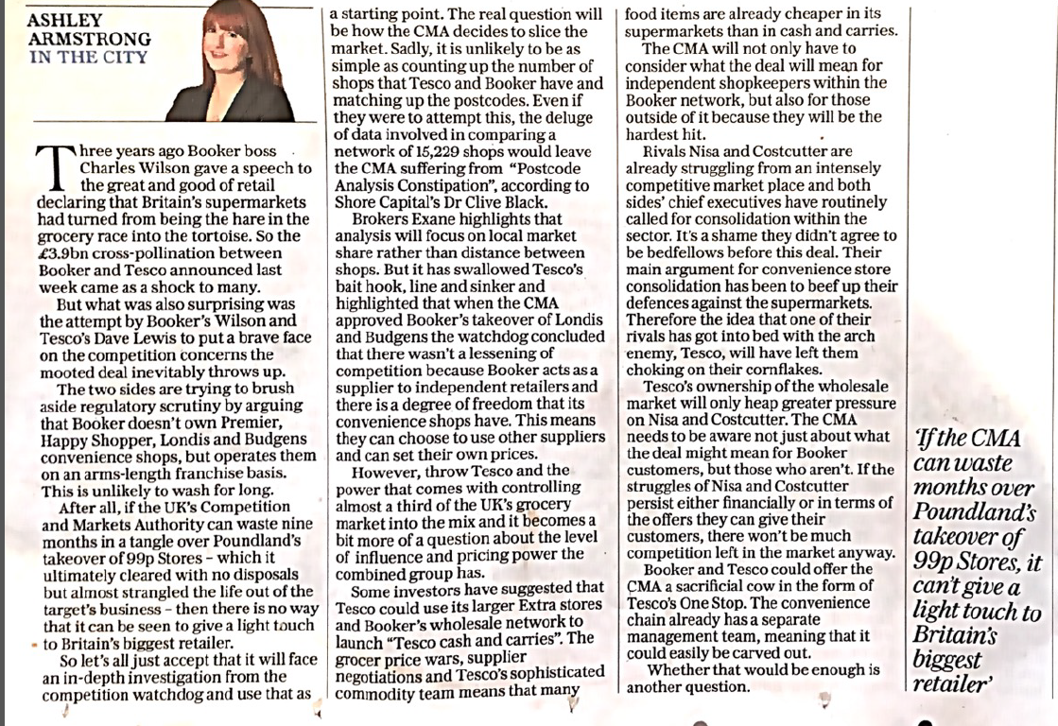
February 2017 in the Daily Telegraph

Slide 53
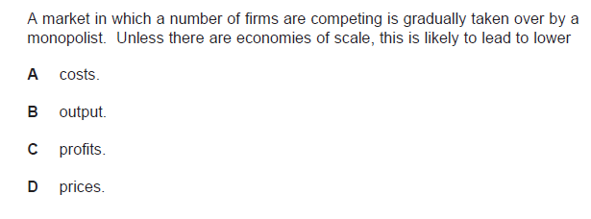
MCQ1
Notes:
B

Slide 54
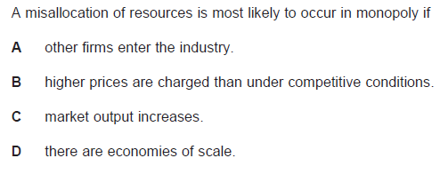
MCQ2
Notes:
B

Slide 55
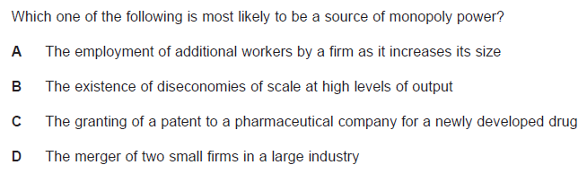
MCQ3

Slide 56
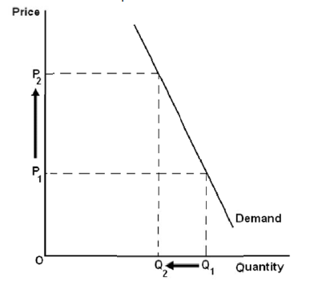
Monopoly Diagram
Using a diagram, show how China can increase the prices of rare-earth metals by using monopoly power

Slide 57
END

Slide 58
MCQ1
Notes:
B

Slide 59
MCQ2
Notes:
B

Slide 60
MCQ3

Slide 61
Monopoly Diagram
Using a diagram, show how China can increase the prices of rare-earth metals by using monopoly power

Slide 62
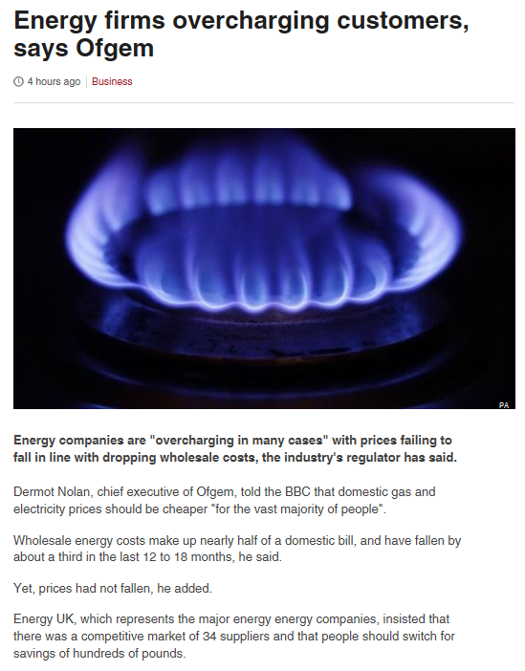

Government intervention and Failure
http://www.bbc.co.uk/news/business-35321697
Task:
What is the Government Intervention to prevent monopoly? (Think, Pair Share)
Has the Government failed in your view? Why? Or Why not? (Groups of 3…reach a conclusion and justification)
GOVERNMENT INTERVENTION = REGULATION
Encourage growth of small firms
Lower barriers to entry (change the law, remove import tariffs)
Make anti-competitive practices illegal
Notes:
CMA investigates and addresses issues of concern in the following:
In mergers (when over 25% market share)
In markets (when competition is being restricted) – Pfizer merged with other firm’
In regulated sectors where the regulatory system is not working effectively

